Slide 1
Capturing Instagram handles from phone numbers
A WhatsApp link opens an Instagram chat, and the person's @handle is saved against their number, with no typing. Now with contact-list import and tracking.
Project update · November 2026
Notes:
What we set out to do, how it works, what blocked us, the approach we chose, the new contact-list import, and what stands between this and real users.

Slide 2
The goal, and where we are
Goal
5
real Instagram accounts linked in testing
We know a person's phone number
We want their Instagram ID and @username, linked to that number
They must not type their handle; at most 3 taps
0
keystrokes needed from the person
Status
Working end to end, live at ig-handle-capture.vercel.app
Admin login, MongoDB storage, Meta-signed webhooks only, 24-hour link expiry
New: import a CSV or Excel list and track each person to connected
12 s
from “Start chat” to connected (new account)

Slide 3
How it works
1
2
3
4
5
Add the number
Send on WhatsApp
Step 1: Start chat
Step 2: reopen
Match and save
Import a CSV / Excel list, or type one number. Invite makes a one-time code.
One message with two links, sent by the admin. The code is in Step 2.
Opens a chat with our business account. “Start chat” creates the conversation.
Opens the same chat again. Instagram now sends us their user ID plus the code.
Code → phone number. We fetch the @username and reply “All set ✅”.
Why this proves the number: only the owner of the phone receives the WhatsApp message, so whoever opens Step 2 with that code is the owner.
Notes:
Steps 1 and 2 are done by the admin; steps 3 and 4 by the person on their phone; step 5 by the server automatically.

Slide 4
Approaches we considered
Approach | Verdict | Why
Ask the person to type their handle | Rejected | Breaks the no-typing rule; typos; nothing proves it's really their account
Look up the handle from the phone number | Rejected | Instagram has no API for this; scraping breaks Meta's terms
“Log in with Instagram” on a web page | Rejected | Only offered for business/creator accounts, not regular users
Track link clicks and match by timing | Partial | No typing, but it's a guess: at busy moments it can link the wrong person
ig.me link with a one-time code + Instagram webhook | Chosen | Instagram itself tells us who opened which link: exact, official, no typing
Safeguards built in: single-use links (a forwarded link is rejected) · links expire after 24 hours · only Meta-signed webhooks accepted · dashboard behind an admin login

Slide 5
Instagram drops the code on first contact
Meta's docs say the code arrives on the first tap in a new chat
In our tests it never did: 0 of 4 first-time taps carried it
Once the chat exists, reopening the link carries it every time
Not our setup: another company reports the same
Workarounds we tested
Auto-reply: “tap the link again”
Works
Works, but people only learn about it after getting stuck.
A second button inside the chat
Failed
Button taps inside a chat never carry the code.
Type “hi” instead of the button
Untested
Meta developer forum report · unresolved
The same first-contact rule likely applies.
0 of 8
23 of 23
Two links in one message
Chosen
first-contact taps delivered the code
returning-user opens delivered it
Step 1 creates the chat, Step 2 brings the code.
Source: Meta Developer Community, “ig.me ‘ref’ parameter missing from messaging_postbacks on a user's FIRST conversation”, Sep 2026, developers.facebook.com/community/threads/1552269896122738.
Notes:
This is why the message has two links. Meta's own documentation says the code arrives on the first tap; in practice it doesn't, and another company has reported the same.

Slide 6
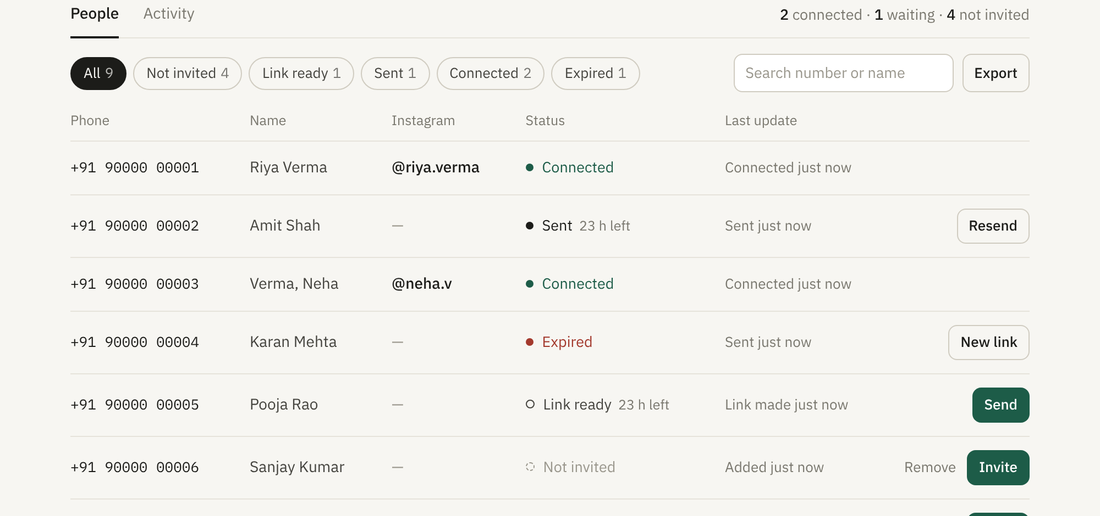
New: import a contact list and track everyone
Upload a .csv or .xlsx file; phone and name columns are picked from the titles
Preview before saving: repeats and unreadable rows (like 9.19E+11) are flagged
Local numbers get +91 automatically
The link is created when you press Invite, so it's never stale
Opening WhatsApp marks the person Sent; Next → moves down the list
Not invited → Link ready → Sent → Connected or Expired
One row per phone number, with status, filters, search and CSV export
Sending is still one message at a time.
Notes:
Importing doesn't message anyone. The admin still sends each WhatsApp message by hand, but the dashboard lines people up and remembers where each one is.

Slide 7
Challenges once real people use it
People drop off between steps
Invites can look like spam
Consent for imported lists
3 taps across two apps. Some stop after Step 1, open the link on a laptop, or let the 24-hour link expire.
An unexpected WhatsApp message with two links looks like phishing, so many people won't tap.
Imported numbers need consent to be messaged (DPDP Act), and deletions must be honoured.
Fix: Pilot to measure it; remind people still at “Sent” after a few hours
Fix: Send from a recognised, branded business number
Fix: Record where each list came from; add a full “delete this person”
Built on Meta's behaviour
The business inbox fills up
Failures are silent
The two links work around a Meta bug. If Meta changes it or retires the API version, the flow must change.
Every invite opens a chat with @ig_280702. At thousands of invites, real customer messages get buried.
Errors only appear in Vercel logs. One shared admin password; free hosting and database tiers.
Fix: Watch Meta's changelog; keep a one-link fallback ready
Fix: Use a separate account for linking, or auto-archive these chats
Fix: Health check with alerts; personal logins; paid tiers at volume
Notes:
Unlike the launch blockers on the next slide, these don't stop us going live. They decide how well it works once we do. The pilot is designed to measure the first two.

Slide 8
What must happen before launch
# | Blocker | What it means
1 | Meta app in Development mode | Only accounts with a role on the app are guaranteed to work. Needs App Review, then Live mode.
2 | Business verification | Company documents to Meta. Required for App Review and official WhatsApp sending. Slowest step.
3 | Privacy policy + data deletion | Required by Meta before Live mode, and by India's DPDP Act. Needs a way to fully delete a person (today only un-invited rows).
4 | WhatsApp at scale | Lists import now, but each message is sent by hand. Bulk needs the Business Platform: templates, opt-in, cost per message, daily caps.
5 | Permissions clean-up | The access token is a system-user token that never expires (good), but it carries 2 unused permissions. Request only messaging in App Review.
Notes:
These are gates: real users can't complete the flow until 1 to 3 are done, and they depend on each other in that order (verification first).

Slide 9
Next steps
Deploy the import and check it on the live site (data lands in MongoDB)
Start Meta business verification
Publish privacy and data-deletion pages; add a full delete for any person
Submit App Review with messaging permissions only, then switch to Live
Pilot 20–50 real people from an imported list; measure drop-off at each status
Use the pilot to decide on a WhatsApp Business provider; add a health alert

