Slide 1
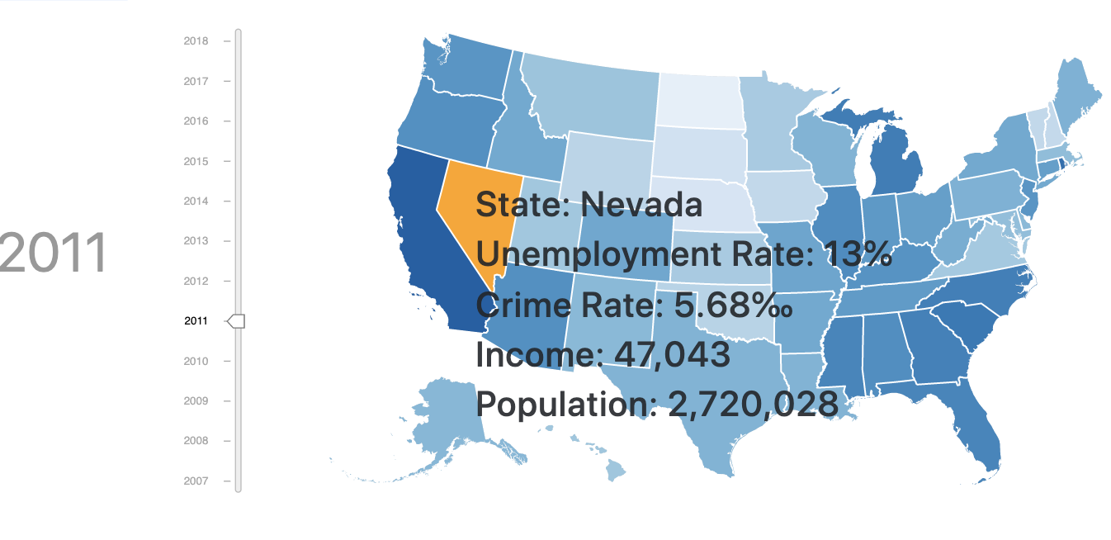
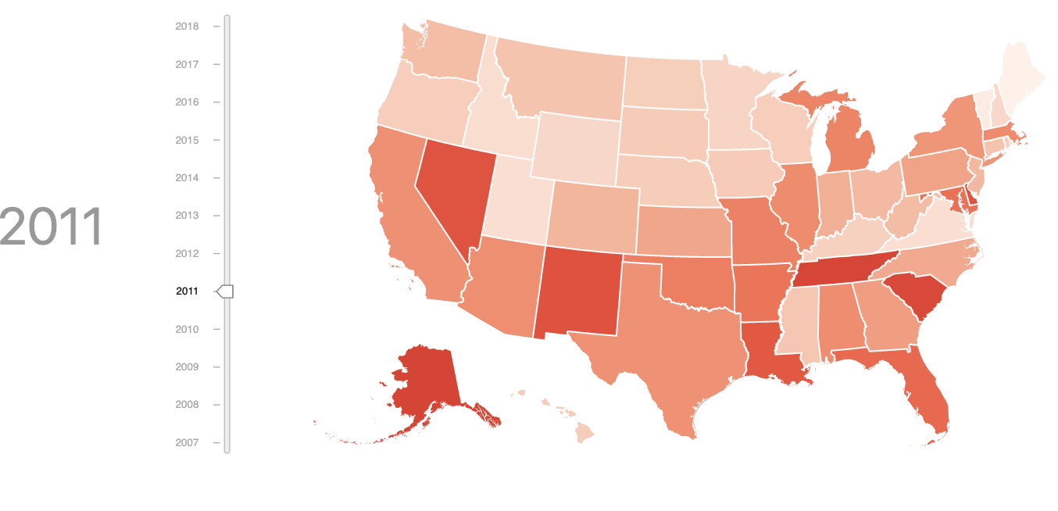
A. under unemployment rate view
B. under crime rate view

Slide 2


A. under unemployment rate view
B. under crime rate view

