Slide 1
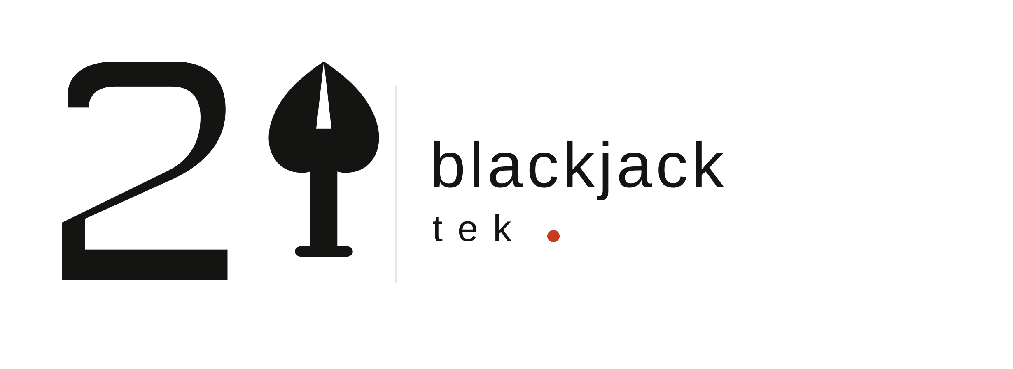
MEDIA KIT
2025
blackjacktek@gmail.com · @blackjacktek · blackjacktek.com

Slide 2
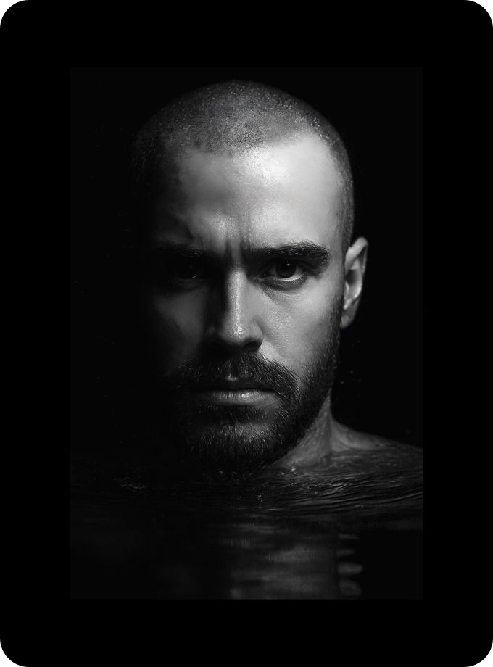
CONTENT CREATOR IN TECH & LIFESTYLE
I turn products into cinematic stories
that sell.
I’m Blackjacktek — filmmaker, brand photographer, and creative partner to global brands. I make products look like they belong on a big screen — and perform like they belong in your feed.
4+
150+
100%
Years of
Experience
Brands
Worked With
Client
Satisfaction

Slide 3
MEDIA STATISTICS
The numbers.
51K+
Instagram Followers
5.7M+
Total Impressions (last 30 days)
660K+
Accounts Reached (last 30 days)
5%
Engagement Rate (last 30 days)
550K
Weekly Reach
80% Male
Based in Italy
Available Worldwide

Slide 4
WHAT I DO
Creating content that brands actually want to share.
01
Cinematic Brand Video
Story-driven video for tech brands. Your product in its natural habitat — real life, real people, real moments.
02
Brand Photography
High-quality product photography in real-world environments. No white backgrounds — just life, beautifully composed.
03
Creator Consulting
Private sessions for creators ready to level up — content strategy, workflow systems, brand deal outreach.
04
Digital Products
Tools built for the creator community — Notion templates, Lightroom presets, and curated wallpapers.

Slide 5
PRICING
Flexible packages for every brand stage.
MOST POPULAR
STARTER
BRAND PARTNER
CUSTOM
€800/project
€1,499/project
Let’s talk
For brands ready to explore cinematic content for their social channels.
For brands serious about content that’s not just seen — it converts.
A campaign, a product launch, a multi-day production — let’s build something big.
✓ 1 short-form video (60–90s)
✓ 2 short-form videos
✓ Fully tailored scope
✓ 1 revision round
✓ 10 edited photos
✓ Multi-day productions
✓ Social-ready formats
✓ 3 revision rounds
✓ Campaign packages
✓ 7-day turnaround
✓ All formats & ratios
✓ Travel included
— Photo shooting
✓ 14-day turnaround
✓ Full creative direction
— Full licensing
— Full licensing
— Strategy session
Get Started
Get Started
Get a Quote

Slide 6
LET’S WORK TOGETHER
Have a brand project
or something in mind?
For brand video, photography, consulting, and
partnerships — reach out directly.
Let’s Talk →
YouTube
Instagram
Threads
TikTok
X / Twitter
Blackjacktek · blackjacktek@gmail.com · © 2025

