Slide 1
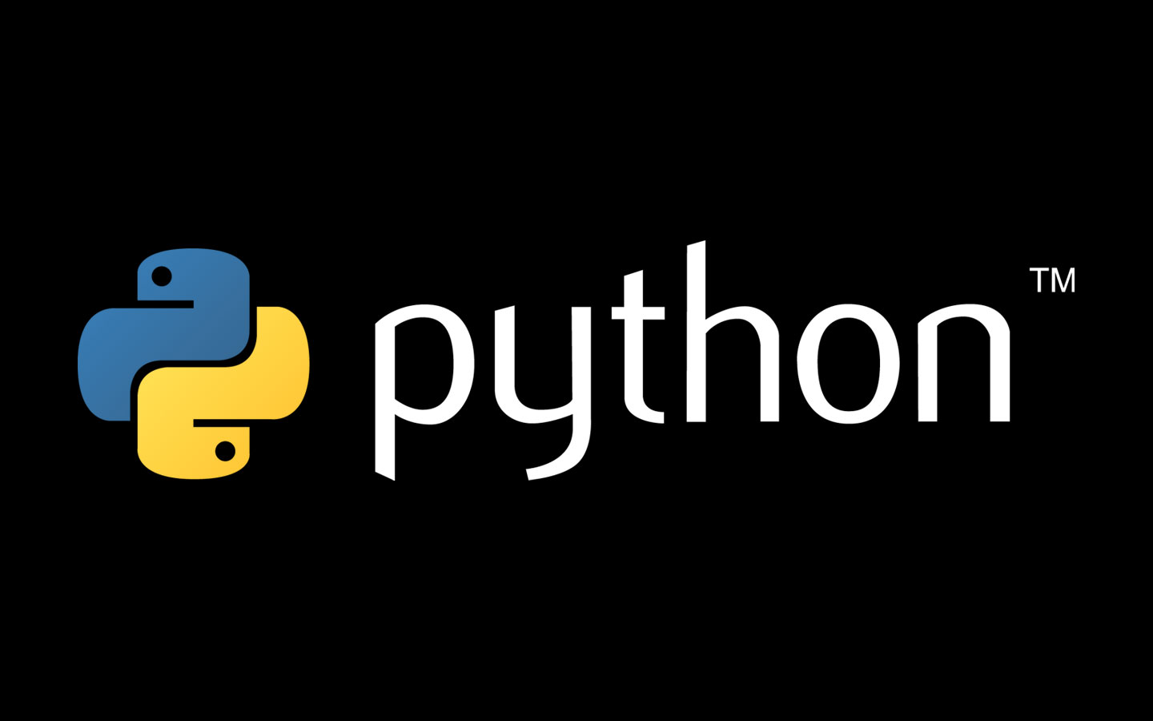
introduction to
Felix Matathias
Bloomberg LP

Slide 2
this presentation…
assumes you know nothing about programming
contains everything I consider essential to get you going as a beginner in python…
lots of slides with
the goal: to make you self sufficient and prepare you for the next level!
teach you a little bit about the culture of python!
real python code

Slide 3
why python?
python is fun!!!!
general purpose, high Level
rapid development
weakly typed language
interpreted vs. compiled:
work interactively with the python interpreter (let’s start one!)
tremendous wealth of reusable libraries
“python comes with batteries”
clean syntax,
lots and lots of books and documentation

Slide 4
what can you do with python?
anything you can imagine…
read and analyze tweets
get data in and out of facebook
interact with amazon web services
cryptography, web security
data analysis
machine learning
deep learning algorithms
bioinformatics
websites
…your future killer app!

Slide 5
import this
the cultural aspects of python…
The Zen of Python, by Tim Peters
Beautiful is better than ugly.
Explicit is better than implicit.
Simple is better than complex.
Complex is better than complicated.
Flat is better than nested.
Sparse is better than dense.
Readability counts.
Special cases aren't special enough to break the rules.
Although practicality beats purity.
Errors should never pass silently.
Unless explicitly silenced.
In the face of ambiguity, refuse the temptation to guess.
There should be one-- and preferably only one --obvious way to do it.
Although that way may not be obvious at first unless you're Dutch.
Now is better than never.
Although never is often better than *right* now.
If the implementation is hard to explain, it's a bad idea.
If the implementation is easy to explain, it may be a good idea.
Namespaces are one honking great idea -- let's do more of those!

Slide 6
the short history of python
https://en.wikipedia.org/wiki/History_of_Python
“Python was conceived in the late 1980s^{[1]} and its implementation was started in
December 1989^{[2]} by Guido van Rossum at CWI in the Netherlands as a successor to the
ABC programming language capable of exception handling and interfacing with the
Amoeba operating system.^{[3]} Van Rossum is Python's principal author, and his continuing
central role in deciding the direction of Python is reflected in the title given to him by the
Python community, Benevolent Dictator for Life (BDFL).”

Slide 7
there are 2 pythons!
python 2
current version 2.7.10
python 3 (2008)
current version 3.4.3
not important differences for beginners except:
print is a function in python 3, a statement in python 2
not backwards compatible
“python 2.x is legacy, python 3.x is the present and future of the language” https://wiki.python.org/moin/Python2orPython3
>python --version

Slide 8
weakly typed languages
require discipline in coding standards
or the code can get out of control and difficult to maintain
“spaghetti code”
“technological deficit”
require good documentation
python provides excellent documentation tools
exhaustive testing of all code paths
no surprises when the code runs in production
compiled languages catch most errors during compilation
you pay a speed penalty because you do not declare types

Slide 9
start your engines! (…interpreters)
the easiest way to learn Python is to write code directly in the python interpreter!
>which python
>python
print(“Hello World”)
Use exit() or Ctrl-D to exit

Slide 10
how to best follow the class
editing and running
one screen with the python interpreter
one screen with your favorite editor, editing your script
one screen with the command line to run your script

Slide 11
python scripts
the interpreter command line is used for testing
for real programs we create a separate file containing our code, e.g., hello.py
first line of the file is called the ‘shebang’
lets the operating system know how to run it
#!/usr/bin/env python
to run it: >python hello.py
to make the script an executable program:
>chmod +x hello.py:
>./hello.py

Slide 12
hello.py
#!/usr/bin/env python
import sys
# Define a main function
def main():
print sys.argv
name = sys.argv[1]
print 'Hello ' + name
if name.lower() == 'felix':
print ’you must be the instructor!'
else:
print ‘enjoy the class!'
# This calls the main function
if __name__ == '__main__':
main()

Slide 13
keywords, built-ins, libraries

Slide 14
every language has its keywords…
import keyword
keyword.kwlist
['and', 'as', 'assert', 'break', 'class', 'continue', 'def', 'del', 'elif', 'else', 'except', 'exec', 'finally', 'for', 'from', 'global', 'if', 'import', 'in', 'is', 'lambda', 'not', 'or', 'pass', 'print', 'raise', 'return', 'try', 'while', 'with', 'yield']

Slide 15
['and', 'as', 'assert', 'break', 'class', 'continue', 'def', 'del', 'elif', 'else', 'except', 'exec', 'finally', 'for', 'from', 'global', 'if', 'import', 'in', 'is', 'lambda', 'not', 'or', 'pass', 'print', 'raise', 'return', 'try', 'while', 'with', 'yield']

Slide 16
THIS PRESENTATION
['and', 'as', 'assert', 'break', 'class', 'continue', 'def', 'del', 'elif', 'else', 'except', 'exec', 'finally', 'for', 'from', 'global', 'if', 'import', 'in', 'is', 'lambda', 'not', 'or', 'pass', 'print', 'raise', 'return', 'try', 'while', 'with', 'yield']

Slide 17
and its built-in functions…
abs(), divmod(), input(), open(), staticmethod(), all(), enumerate(), int(), ord(), str(), any(), eval(), isinstance(), pow(), sum(), basestring(), execfile(), issubclass(), print(), super(), bin(), file(), iter(), property(), tuple(), bool(), filter(), len(), range(), type(), bytearray(), float(), list(), raw_input(), unichr(), callable(), format(), locals(), reduce(), unicode(), chr(), frozenset(), long(), reload(), vars(), classmethod(), getattr(), map(), repr(), xrange(), cmp(), globals(), max(), reversed(), zip(), compile(), hasattr(), memoryview(), round(), __import__(), complex(), hash(), min(), set() , delattr(), help(), next(), setattr(), dict(), hex(), object(), slice() , dir(), id(), oct(), sorted()
https://docs.python.org/2/library/functions.html

Slide 18
and of course its libraries…
“python comes with batteries”
standard Library:
https://docs.python.org/2/library/
“keep this under your pillow”
let’s have a tab with this link open at all times!
open source licensed packages:
https://pypi.python.org/pypi
63,000 packages!

Slide 19
variables

Slide 20
contain all the information of your program
variable types
numerical: int, float, long, complex
boolean: True, False
None
strings
Compound types (we will discuss later)
type conversions
let’s create our first variables!

Slide 21
fun with variables
#The variable type is inferred from the assignment
a = 14 (a is a reference to an integer)
a = “gluon” (a becomes a reference to a str)
b = 13.14159
c = True
e = “1.345”
f = float(e) #converting types
g = None type(g)

Slide 22
deep thoughts on variables
where are variables stored?
concept of mutable and immutable objects
a = “quark”
id(a)
4299832424
b = “quark”
id(b)
4299832424
a is b # True
a == b # True

Slide 23
the simplest things can get tricky for beginners… we will address this later
a = [1,2,3]
b = a # b is another reference
# to the object [1,2,3]
a is b # True
a == b # True
b = a[:] # b is a reference to a copy
a is b # False
a == b # True

Slide 24
help and documentation

Slide 25

your best friend
in the previous slide someone might ask:
is there a difference between == and ‘is’ in python?
http://stackoverflow.com/questions/132988/is-there-a-difference-between-and-is-in-python
invaluable resource for developers

Slide 26
help()
Welcome to Python 2.7! This is the online help utility.
If this is your first time using Python, you should definitely check out
the tutorial on the Internet at http://docs.python.org/2.7/tutorial/.
Enter the name of any module, keyword, or topic to get help on writing
Python programs and using Python modules. To quit this help utility and
return to the interpreter, just type "quit".
To get a list of available modules, keywords, or topics, type "modules",
"keywords", or "topics". Each module also comes with a one-line summary
of what it does; to list the modules whose summaries contain a given word
such as "spam", type "modules spam".

Slide 27
dir()
Without arguments, return the list of names in the current local scope. With an argument, attempt to return a list of valid attributes for that object.
Returns information about the type of the object
el = “electron”
type(el)
dir(el)
type(el)

Slide 28
strings and their functions
str.capitalize()
str.find()
str.format() (very important)
str.isalpha()
str.isalnum()
str.isdigit()
str.isspact()
str.isupper()
str.join()
str.lower()
str.lstrip()
str.replace()
str.split()
str.strip()
str.title()
str.upper()
str.isnumeric()
str.isdecimal()
documentation: https://docs.python.org/2/library/stdtypes.html
help(‘string’)
Reuse existing code! Do not reinvent the wheel!

Slide 29
string functions
help(‘’.lower) # why does this work?
a = "the weather is nice”
b = a.title()
print b
'The Weather Is Nice’
# don’t reinvent the wheel,

Slide 30
important string functions
str1 = "this is a string example....wow!!!";
str2 = "exam";
print str1.find(str2); #17
print str1.find(str2, 10); #17
print str1.find(str2, 40); #-1
str = "0000000this is a string example....wow!!!00000";
print str.strip('0’);
s = "topeka, kansas city, wichita, olathe”
cities = s.split(‘,’)
[topeka, kansas city, wichita, olathe]
str1 = "-";
seq = ("a", "b", "c"); # This is sequence of strings.
print str1.join( seq );
a-b-c
str1 = “my name is george”
str1.replace(“george”, “jim”)

Slide 31
string formatting
name = “Felix”
a = "My name is {0}".format(name)
print(a)
'My name is Felix’
"My name is {0} {1}".format("Felix", "Matathias")
'My name is Felix Matathias’
we are invoking the attribute format() in a str object
https://docs.python.org/2/library/string.html#format-examples

Slide 32
lets get two important things out of the way…

Slide 33
a) indentation
in python source code, white space is significant
the indentation at the left of your statements
religious debate
for x in range(0,3):
print("x has value: ", x)
CTRL-D
→ TAB

Slide 34
b) everything in python is an object…
repeat 20 times every day
…and almost everything has attributes
““This is so important that I'm going to repeat it in case you missed it the first few times: everything in Python is an object. Strings are objects. Lists are objects. Functions are objects. Even modules are objects.” –Dive into Python
http://www.diveintopython.net/getting_to_know_python/everything_is_an_object.html

Slide 35
what is an object?
a data abstraction, the axiom in our system, the entity
a grouping of attributes that define an abstraction, like an Animal, a Vehicle, a Particle
think of them as the “nouns” in your program
object Vehicle
Attributes:
length
weight
number_of_wheels
Methods (also attributes), the “verbs”:
drive()
stop()
turn_lights_on()
they define the interface of an object,
what it can do

Slide 36
s = "Felix” #s is a string. A string is an object
dir(s)
['__add__', '__class__', '__contains__', '__delattr__', '__doc__', '__eq__', '__format__', '__ge__', '__getattribute__', …, '__hash__', '__init__', '__le__', '__len__', '__lt__', '__mod__', '__mul__', '__ne__', '__new__', '__reduce__', '__reduce_ex__', '__repr__', '__rmod__', '__rmul__', '__setattr__', '__sizeof__', '__str__', '__subclasshook__', '_formatter_field_name_split', '_formatter_parser', 'capitalize', 'center', 'count', 'decode', 'encode', 'endswith', 'expandtabs', 'find', 'format', 'index', 'isalnum', 'isalpha', 'isdigit', 'islower', 'isspace', 'istitle', 'isupper', 'join', 'ljust', 'lower', 'lstrip', 'partition', 'replace', 'rfind', 'rindex', 'rjust', 'rpartition', 'rsplit', 'rstrip', 'split', 'splitlines', 'startswith', 'strip', 'swapcase', 'title', 'translate', 'upper', 'zfill']

Slide 37
what was that all about?
these are the attributes of the string object!
data and function attributes
everything that has a double underscore (__dunder__ , short for double underscore) is not intended for general use, it is an implementation detail that could change any time
every object has its “signature”, the collection of all the things it can do
these are the “attributes” or “methods” of the object

Slide 38
conditionals

Slide 39
conditional statements
boolean operations
x or y if x is false, then y, else x
x and y if x is false, then x, else y
not x if x is false, then True, else False
comparisons:
>, >= (less, less or equal)
<, <= (greater, greater of equal)
== (equal, caution!, 2 equal signs)
!= (not equal)
if a > b:
print(“a is greater than b”)
else:
print(“a not greater than b”)

Slide 40
what is False in python
None
False
Zero of any numeric type, for example, 0, 0L, 0.0, 0j
Any empty sequence, for example, '', (), []
Any empty mapping, for example, {}
Instances of user-defined classes, if the class defines a __nonzero__() or __len__() method, when that method returns the integer zero or bool value False
Anything else evaluates to True

Slide 41
fun with conditional statements
x = int(raw_input("Please enter an integer: "))
Please enter an integer: 42
if x < 0:
x = 0
print 'Negative changed to zero’
elif x == 0:
print 'Zero’
elif x == 1:
print 'Single’
else:
print 'More'
...
More

Slide 42
functions

Slide 43
functions
the workhorse of the python language
“A function is a block of organized, reusable code that is used to perform a single, related action. Functions provide better modularity for your application and a high degree of code reusing” –tutorialpoints.com
def function_name( parameters ):
"function_docstring"
function_suite
return [expression]

Slide 44
let’s code some functions
important concept: variable scope
def sum( arg1, arg2 ):
“””Add both the parameters and return them.”””
total = arg1 + arg2
print "Inside the function : ", total
return total;
# Now you can call sum function
total = sum( 10, 20 );
print "Outside the function : ", total

Slide 45
a subtle topic in python…
what happens to the value of a variable that you pass to a function?
def add_one(a):
a = a + 1
return a
b = 5
add_one(b)
print b #prints 5, didn’t change

Slide 46
but, if you pass a list…
def add_one_element(a):
a.append("one more")
myl = [4]
add_one_element(myl)
print myl #prints [4, ‘one more’]
huh? keep this in mind, will revisit later

Slide 47
two important built-in functions
range() and xrange()
xrange() is very similar to range() but outside of the scope of this presentation
range(5)
[0, 1, 2, 3, 4]
range(5, 10)
[5, 6, 7, 8, 9]
range(0, 10, 3)
[0, 3, 6, 9]

Slide 48
loops

Slide 49
loops
an essential part of programming
for loop through a sequence of values
while loop as long as condition is True
break
continue

Slide 50
for loop
#!/usr/bin/env python
for i in range(0,10):
if i > 7 :
print "break at i={0}".format(i)
break
if i > 4 :
print "continue at i={0}".format(i)
continue
print i

Slide 51
while loop
i = 0
while i < 10:
if i > 7:
print "break at i={0}".format(i)
break
if i > 4 :
print "continue at i={0}".format(i)
i = i + 1
continue
print i
i += 1 #shorthand for i = i + 1
careful with infinite loops!

Slide 52
lab 1

Slide 53
data structures

Slide 54
data structures
programming is all about algorithms and data structures
compound data types
ways to organize information efficiently
which one to choose?
fast retrieval of what was stored
fast updates
time complexity (advanced notion)
best memory footprint
we will cover:
list
dictionary

Slide 55
lists
mylist = [44, 23, 99, 7, ‘bear’]
dir(mylist) #to see the list interface
['__add__', '__class__’,…., 'append', 'count', 'extend', 'index', 'insert', 'pop', 'remove', 'reverse', 'sort']
help(mylist.pop)
mylist = [] #empty list
mylist.append(‘Felix’)
mylist.append(‘GA’)
mylist.append(‘14’)
print mylist
[‘Felix’, ‘GA’, 14]

Slide 56
list interface
append(x) #insert at the end of the list
count(x) #return number of occurrences of x
extend(x) #extend list by appending items from x
index(x) #return first index of value x
insert(i,x) #insert object x before index i
pop() #remove and return last item
remove(x) #remove first occurrence of value x
reverse() #reverse in place
sort() #sort in place, or use sorted() function

Slide 57
list indexing and slicing
myl = [0, 1, 2, 3, 4, 5]
myl[0]
0
myl[6]
Traceback (most recent call last):
File "<stdin>", line 1, in <module>
IndexError: list index out of range
myl[3:] #slicing!
[3,4,5]
myl[:4]
[0,1,2,3]
myl[2:4]
[2,3]
myl2 = myl[:] #this makes a copy

Slide 58
strings are sequences
s = "felix”
type(s)
<type 'str'>
s[0]
'f’
s[-1] #negative index! what does it mean?
'x’
s[2:]
'lix’
s[::2] #skip every other
’flx’
s[0]=‘g’ #does it work?
len(s)
5
h=‘python’
s+h #adding strings?

Slide 59
dictionaries
aka associative arrays or maps
indexed by immutable keys not by range of numbers
ints and strings can always be used as keys
lists can not, they are mutable
{}

Slide 60
dictionaries
tel = {'jack': 4098, 'sape': 4139}
tel['guido'] = 4127
tel
{'sape': 4139, 'guido': 4127, 'jack': 4098}
tel['jack']
4098
del tel['sape']
tel['irv'] = 4127
tel
{'guido': 4127, 'irv': 4127, 'jack': 4098}
tel.keys()
['guido', 'irv', 'jack']
'guido' in tel
True

Slide 61
loops revisited
animals = [“cat”, “dog”, “bird”]
for animal in animals:
print animal
for index, value in enumerate(animals):
print index, value
my_dict = {‘e’:1, ‘p’:32, ‘q’:2}
for key in my_dict.keys():
print key
for value in my_dict.values():
print value
for k, v in my_dict.items():
print(k,v)

Slide 62
the “pythonic” way
“a term used by the Python community to describe code that follows a particular style. The idioms of Python have emerged over time through experience using the language and working with others” –Effective Python
i = 0 while i < mylist_length: do_something(mylist[i]) i += 1
for i in range(mylist_length): do_something(mylist[i])
for element in mylist:
do_something(element)
pythonic

Slide 63
lab 2

Slide 64
the standard library

Slide 65
working with the standard library
import module
from module import object
can not stress enough the depth of the libs
import calendar
dir(calendar)
help(calendar)
birthday = calendar.weekday(1987, 06, 14)
print calendar.day_name[birthday]
Sunday

Slide 66
file input / output
f = open(’workfile', 'w’)
print f
<open file'workfile', mode 'w' at 80a0960>
f.readline()
“This is the first line of the file.\n”
for line in f:
print line
f.write(“output string”)
f.close() # don’t forget this!

Slide 67
pythonic i/o
it is good practice to use the with keyword when dealing with file objects. This has the advantage that the file is properly closed after its suite finishes, even if an exception is raised on the way. It is also much shorter than writing equivalent try-finally blocks:
with open('workfile', 'r') as f:
read_data = f.read()
f.closed
True

Slide 68
the comma separated values format and the csv format
import csv
with open('eggs.csv', 'rb') as csvfile:
spamreader = csv.reader(csvfile, delimiter=‘,’)
for row in spamreader:
print ', '.join(row)
Spam, Spam, Spam, Spam, Spam, Baked Beans
Spam, Lovely Spam, Wonderful Spam
Each row read from the csv file is returned as a list of strings.

Slide 69
objects

Slide 70
python object model
x = [] # lists are mutable
y = x # creates a new var referring to the same mutable obj
y.append(10)
print y
[10]
print x
[10]
x
[3,4,6]
y
x = 5 # ints are immutable
y = x
x = x + 1 # 5 can't be mutated,
# we are creating a new object here (6)
print x
6
print y
5
x
6
y
5
http://jeffknupp.com/blog/2013/02/14/drastically-improve-your-python-understanding-pythons-execution-model/

Slide 71
pass by value, pass by reference, pass by assignment
def func2(a, b):
a = 'new-value' # a and b are local names
b = b + 1 # assigned to new objects
return a, b # return new values
x, y = 'old-value', 99
x, y = func2(x, y)
print(x, y) # output: new-value 100
mutable objects( list, dict, set, etc) are changed within a function call
immutable objects ( int, str, tuple, etc) are not changed
https://docs.python.org/2.7/faq/programming.html#why-did-changing-list-y-also-change-list-x

Slide 72
object identity, type, value
Every object has an identity, a type and a value.
An object’s identity never changes once it has been created; you may think of it as the object’s address in memory. The ‘is‘ operator compares the identity of two objects; the id() function returns an integer representing its identity.
An object’s type is also unchangeable. An object’s type determines the operations that the object supports (e.g., “does it have a length?”) and also defines the possible values for objects of that type. The type() function returns an object’s type (which is an object itself).
The value of some objects can change. Objects whose value can change are said to be mutable; objects whose value is unchangeable once they are created are called immutable. An object’s mutability is determined by its type; for instance, numbers, strings and tuples are immutable, while dictionaries and lists are mutable.
https://docs.python.org/2.7/reference/datamodel.html

Slide 73
object oriented paradigm
Why objects?
Encapsulation of data:
class ElementaryParticle
name
mass
spin
Inheritance:
class ChargedElementaryParticls
Charge
Let’s write our first Python class!

Slide 74
class Animal
class Animal(object):
def __init__(self, name): #self is always first parameter
self.name = name
def talk(self):
print "Generic Animal Sound”
animal = Animal("thing")
animal.talk()

Slide 75
inheritance
class Dog(Animal):
def talk(self):
print ’{0} says, wow!’.format(self.name)
dog = Dog(”Felix")
dog.talk() # invoke method dog.talk()

Slide 76
strive for elegant style!
the PEP08 Style Guide for Python Code:
https://www.python.org/dev/peps/pep-0008/
google Python Style Guide
https://google-styleguide.googlecode.com/svn/trunk/pyguide.html
function names:
calculate_speed()
variables:
number_of_particles
constants:
SPEED_OF_LIGHT
classes:
ChargedParticle
white spaces, etc:
Read the links above
PEP = Python Enhancement Proposal

Slide 77
pearls of wisdom
write short functions
rule of thumb: if function is more than a screen full it needs to be broken down
will help you think in a modular way
helps you write reusable code
write short lines
don’t pack too much in a single line of code
very difficult to read
if you write complex one-liners it doesn’t make you smarter
next person to read your code will hate you!
avoid global variables

Slide 78
lab 3

Slide 79
q&a

Slide 80
Important Resources
The Zen of python: https://www.python.org/dev/peps/pep-0020/
Keywords: http://www.programiz.com/python-programming/keyword-list
Standard library: https://docs.python.org/2/library/
Language reference: https://docs.python.org/2/reference/index.html
Programming FAQ: https://docs.python.org/2.7/faq/programming.html
Major python website: https://www.python.org/
The python package index: https://pypi.python.org/pypi
Fast access to official documentation: https://docs.python.org/2/
Dive into python: http://www.diveintopython.net/index.html
Google’s python class: https://developers.google.com/edu/python/
Google’s exercises: https://developers.google.com/edu/python/exercises/basic

Slide 81
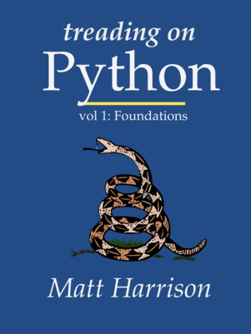
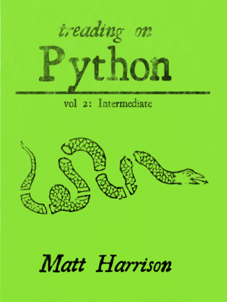
My favorite two little books https://leanpub.com/u/mharrison

Slide 82
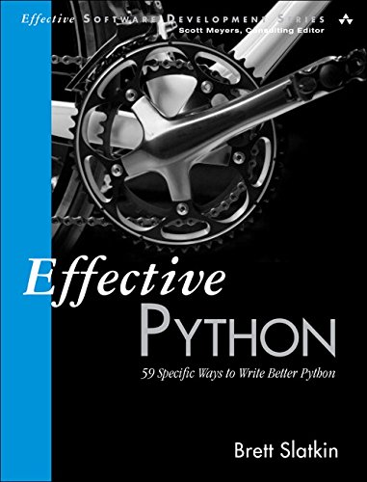
My favorite advanced book (series) http://www.effectivepython.com

