Slide 1
Parameter dependency check of couple mode theory in time
陳居文 2025.07.15

Slide 2
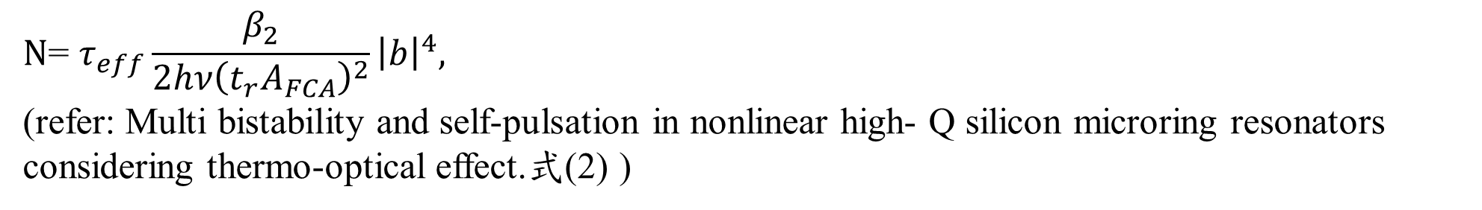
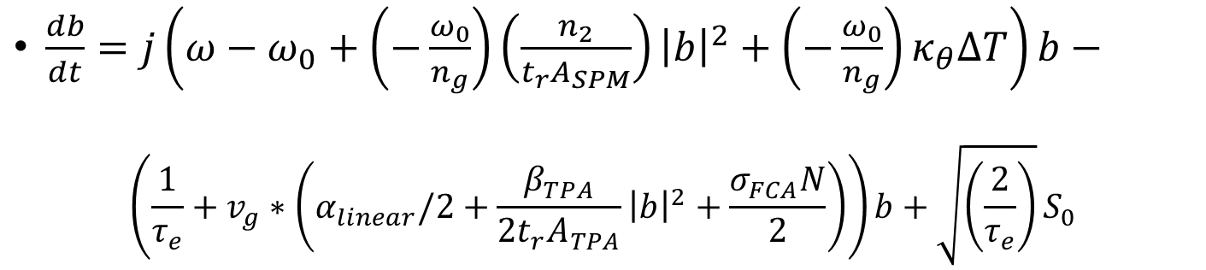
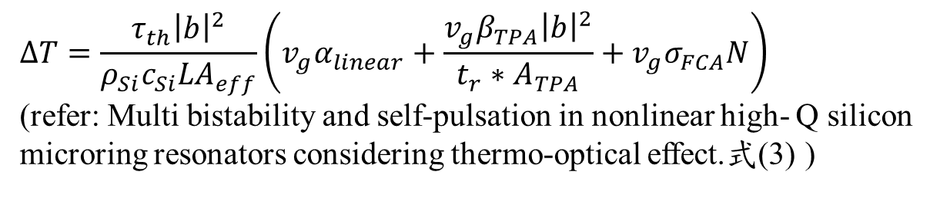
Couple mode theory in time
$\frac{db}{dt}=j\left(ω−ω_{0}+\left(−\frac{ω_{0}}{n_{g}}\right)\left(\frac{n_{2}}{t_{r}A_{SPM}}\right){\left|b\right|}^{2}+\left(−\frac{ω_{0}}{n_{g}}\right)κ_{θ}ΔT\right)b−$
$$\left(\frac{1}{τ_{e}}+v_{g}∗\left(α_{linear}/2+\frac{β_{TPA}}{2{t_{r}A}_{TPA}}{\left|b\right|}^{2}+\frac{σ_{FCA}N}{2}\right)\right)b+\sqrt{\left(\frac{2}{τ_{e}}\right)}S_{0}$$
$$ΔT=\frac{τ_{th}{\left|b\right|}^{2}}{ρ_{Si}c_{Si}LA_{eff}}\left(v_{g}α_{linear}+\frac{v_{g}β_{TPA}{\left|b\right|}^{2}}{t_{r}∗A_{TPA}}+v_{g}σ_{FCA}N\right)$$
(refer: Multi bistability and self-pulsation in nonlinear high- Q silicon microring resonators considering thermo-optical effect.式(3) )
$$N\text{= }τ_{eff}\frac{β_{2}}{2hν{\left(t_{r}A_{FCA}\right)}^{2}}{\left|b\right|}^{4},$$
(refer: Multi bistability and self-pulsation in nonlinear high- Q silicon microring resonators considering thermo-optical effect.式(2) )

Slide 3
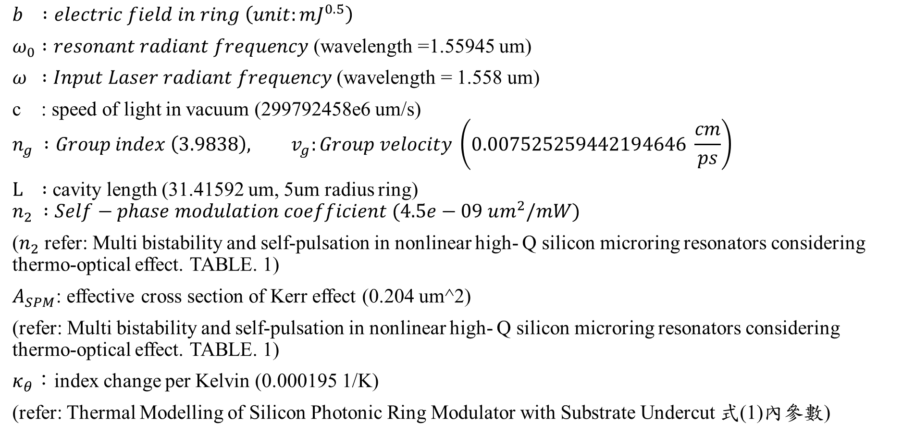
參數
$$b :electric field in ring \left(unit:mJ^{0.5}\right)$$
$ω_{0} :resonant radiant frequency$ (wavelength =1.55945 um)
$ω :Input Laser radiant frequency$ (wavelength = 1.558 um)
c : speed of light in vacuum (299792458e6 um/s)
$$n_{g} :Group index \left(3.9838\right), v_{g}:Group velocity \left(0.007525259442194646 \frac{cm}{ps}\right)$$
$L :$ cavity length (31.41592 um, 5um radius ring)
$$n_{2} :Self−phase modulation coefficient (4.5e−09 um^{2}/mW)$$
($n_{2}$refer: Multi bistability and self-pulsation in nonlinear high- Q silicon microring resonators considering thermo-optical effect. TABLE. 1)
$A_{SPM}$: effective cross section of Kerr effect (0.204 um^2)
(refer: Multi bistability and self-pulsation in nonlinear high- Q silicon microring resonators considering thermo-optical effect. TABLE. 1)
$κ_{θ}$：index change per Kelvin (0.000195 1/K)
(refer: Thermal Modelling of Silicon Photonic Ring Modulator with Substrate Undercut 式(1)內參數)

Slide 4
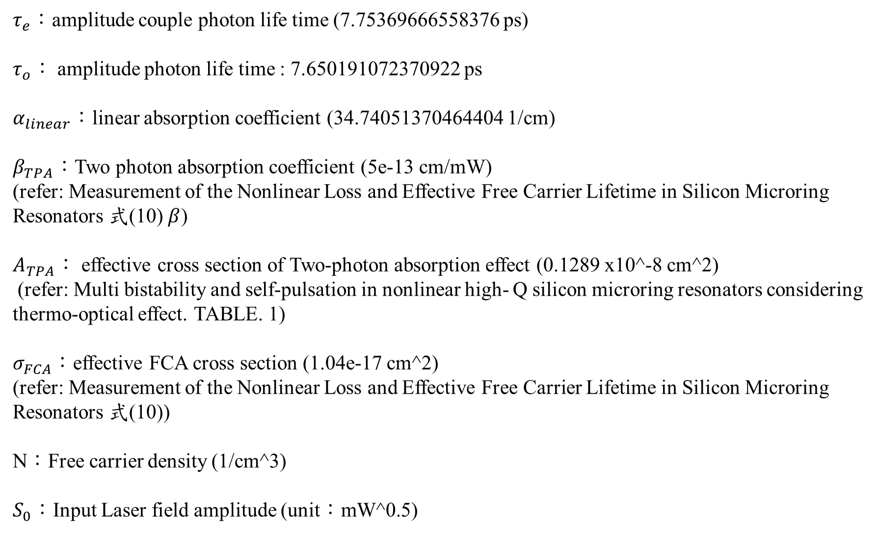
$τ_{e}$：amplitude couple photon life time (7.75369666558376 ps)
$τ_{o}：$ amplitude photon life time : 7.650191072370922 ps
$α_{linear}$：linear absorption coefficient (34.74051370464404 1/cm)
$β_{TPA}：$Two photon absorption coefficient (5e-13 cm/mW)
(refer: Measurement of the Nonlinear Loss and Effective Free Carrier Lifetime in Silicon Microring Resonators 式(10)$β$)
$A_{TPA}：$ effective cross section of Two-photon absorption effect (0.1289 x10^-8 cm^2)
(refer: Multi bistability and self-pulsation in nonlinear high- Q silicon microring resonators considering thermo-optical effect. TABLE. 1)
$σ_{FCA}：$effective FCA cross section (1.04e-17 cm^2)
(refer: Measurement of the Nonlinear Loss and Effective Free Carrier Lifetime in Silicon Microring Resonators 式(10))
N：Free carrier density (1/cm^3)
$S_{0}$：Input Laser field amplitude (unit：mW^0.5)

Slide 5
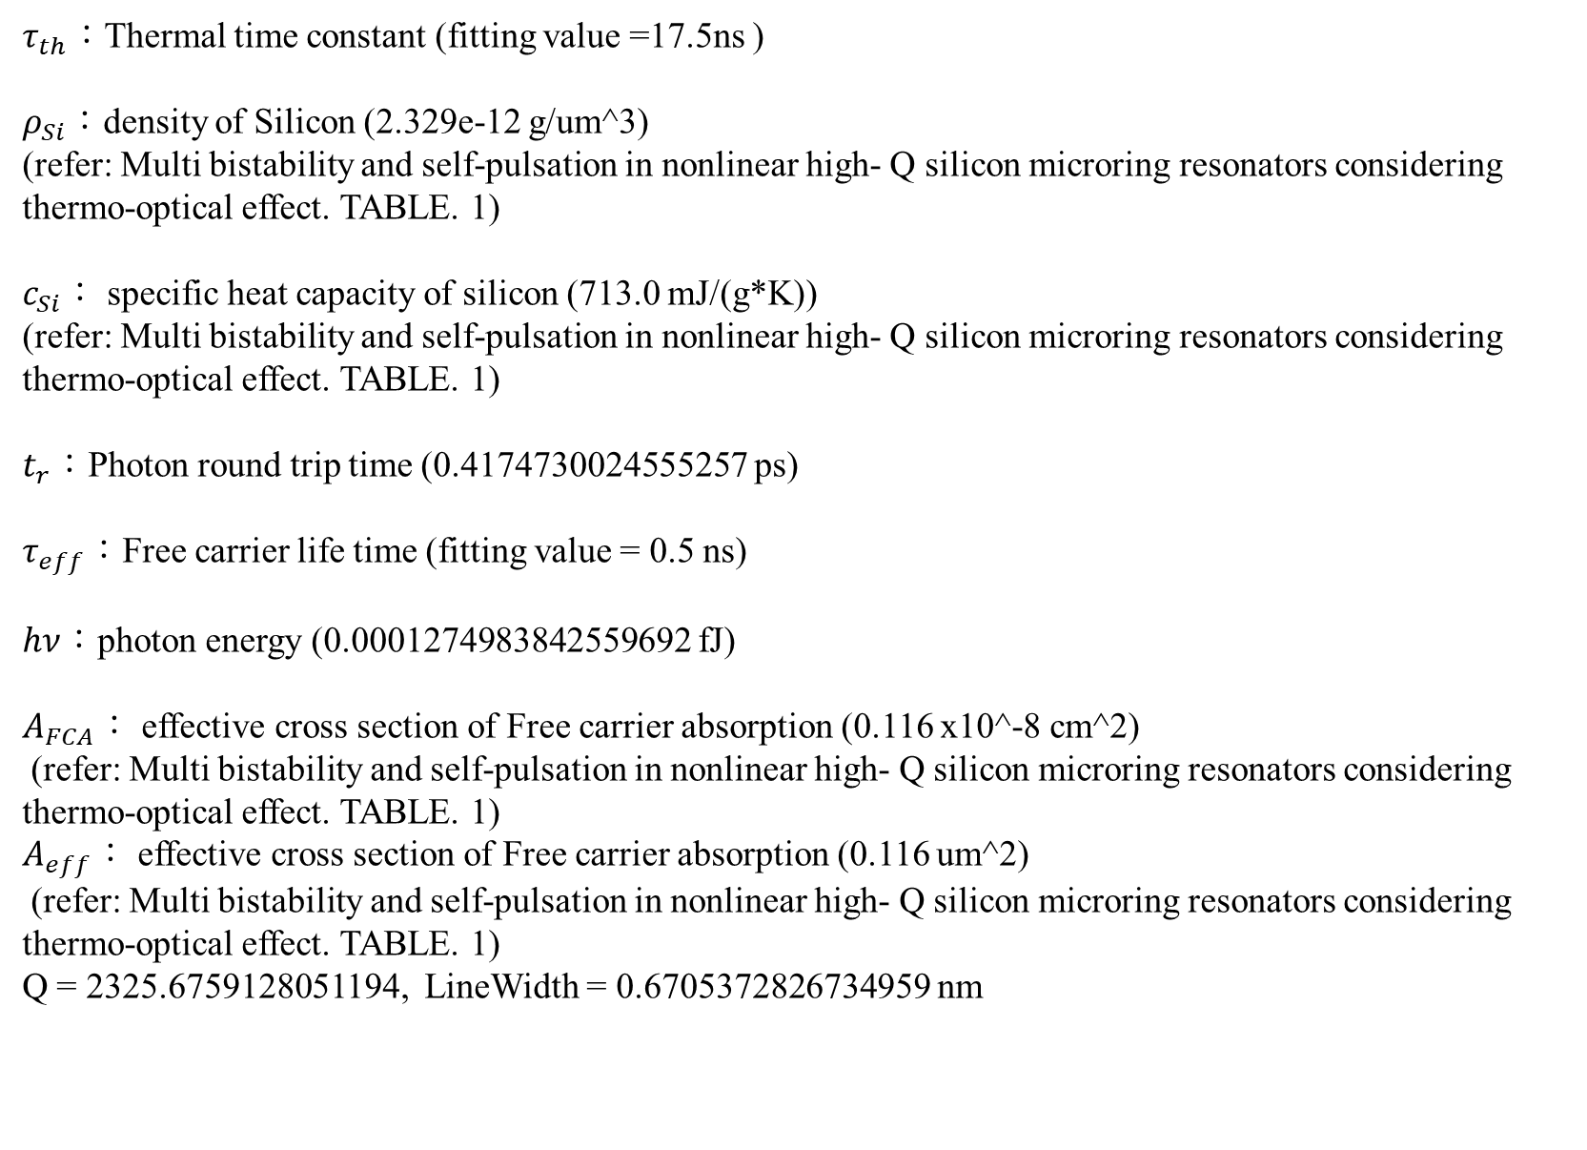
$τ_{th}：$Thermal time constant (fitting value =17.5ns )
$ρ_{Si}$：density of Silicon (2.329e-12 g/um^3)
(refer: Multi bistability and self-pulsation in nonlinear high- Q silicon microring resonators considering thermo-optical effect. TABLE. 1)
$c_{Si}$： specific heat capacity of silicon (713.0 mJ/(g*K))
(refer: Multi bistability and self-pulsation in nonlinear high- Q silicon microring resonators considering thermo-optical effect. TABLE. 1)
$t_{r}$：Photon round trip time (0.4174730024555257 ps)
$τ_{eff}$：Free carrier life time (fitting value = 0.5 ns)
$hν$：photon energy (0.0001274983842559692 fJ)
$A_{FCA}$： effective cross section of Free carrier absorption (0.116 x10^-8 cm^2)
(refer: Multi bistability and self-pulsation in nonlinear high- Q silicon microring resonators considering thermo-optical effect. TABLE. 1)
$A_{eff}$： effective cross section of Free carrier absorption (0.116 um^2)
(refer: Multi bistability and self-pulsation in nonlinear high- Q silicon microring resonators considering thermo-optical effect. TABLE. 1)
Q = 2325.6759128051194, LineWidth = 0.6705372826734959 nm

Slide 6
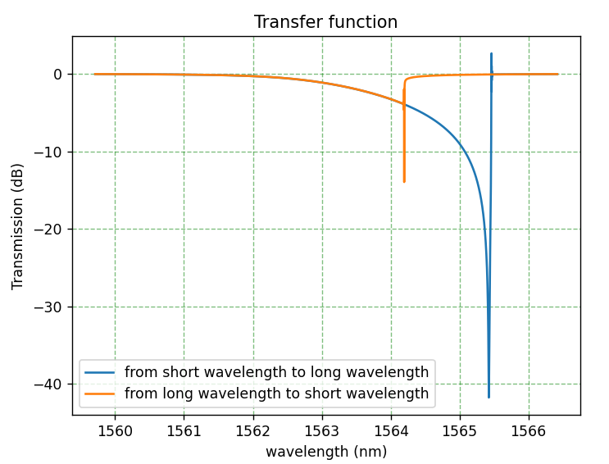
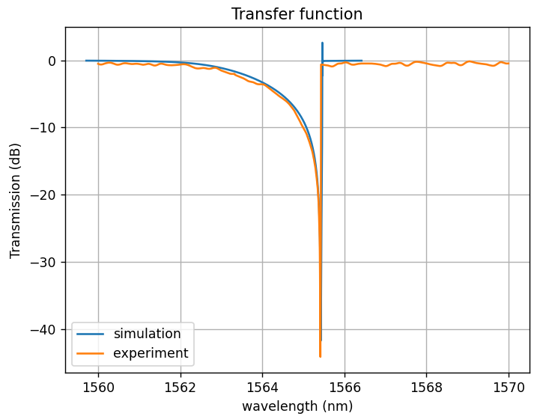
Transmission when S0 = 10^0.5 (Input Laser power = 10 mW)

Slide 7
Absorption in resonance
Peak two photon absorption = 0.03543669954254454 1/cm
Peak Free carrier absorption = 0.0632404645402325 1/cm
Field Linear round-trip loss = 0.9468919671731187
Field couple through coefficient = 0.947582
Photon Round Trip time : 0.41747300245552565 ps
Input Laser photon energy : 0.0001274983842559692 fJ
(Input Laser wavelength = 1.558 um)

