Slide 1
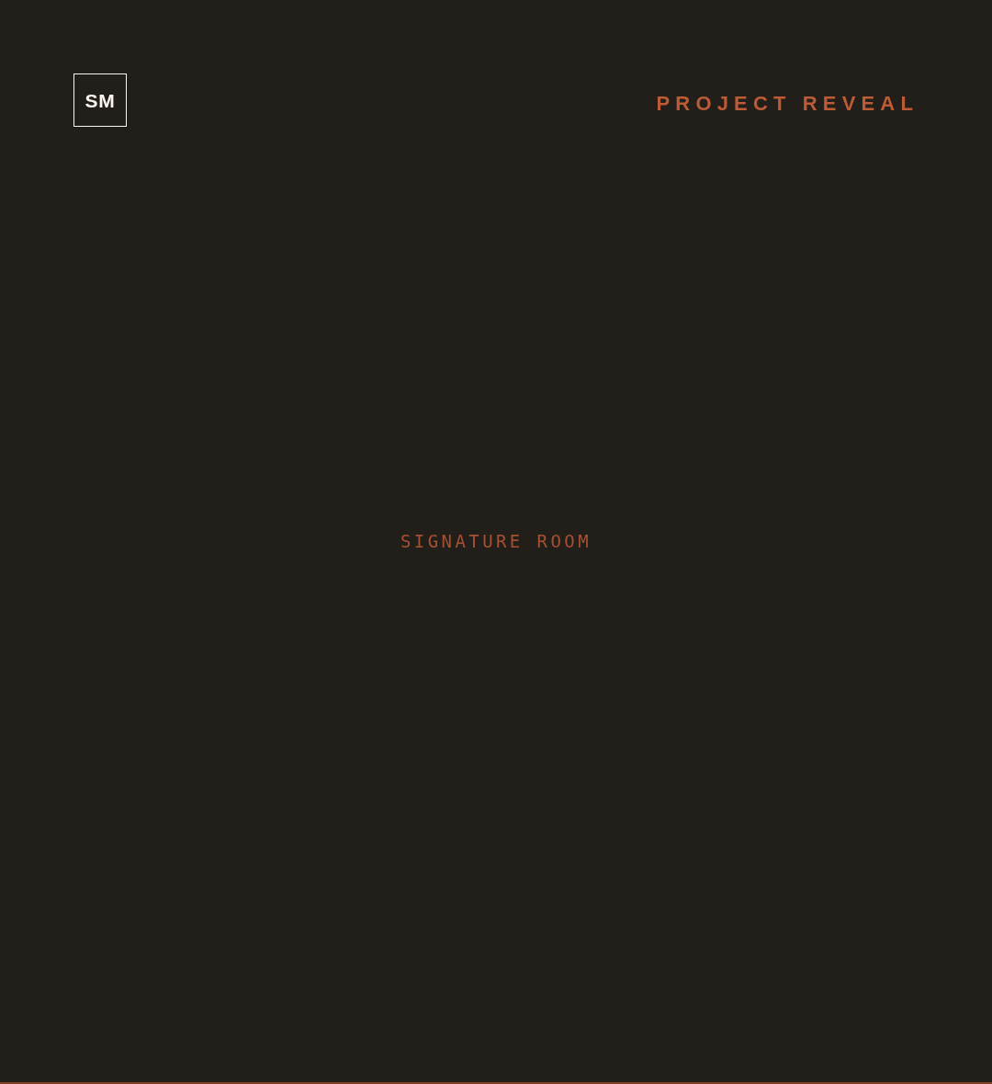
JUST COMPLETED
The Hawthorne Project
PORTLAND · 5 ROOMS · 2,400 SF
FULL-HOME DESIGN
SEE THE FULL REVEAL
↗
@STUDIOMAEVE ◆ STUDIOMAEVE.COM

