Slide 1
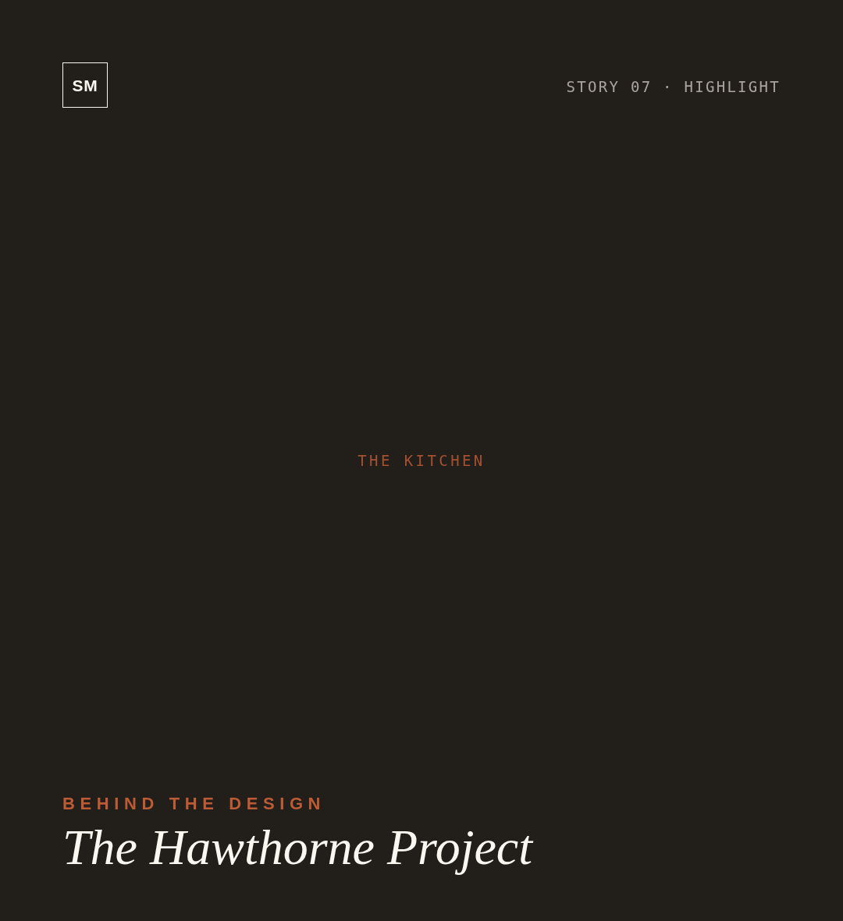
01
Custom millwork in white oak and brass
02
Limewashed walls, original 1910 trim
03
A reading nook in bouclé and vintage kilim
SEE ALL PHOTOS
↗
@STUDIOMAEVE ◆ STUDIOMAEVE.COM

