Slide 1
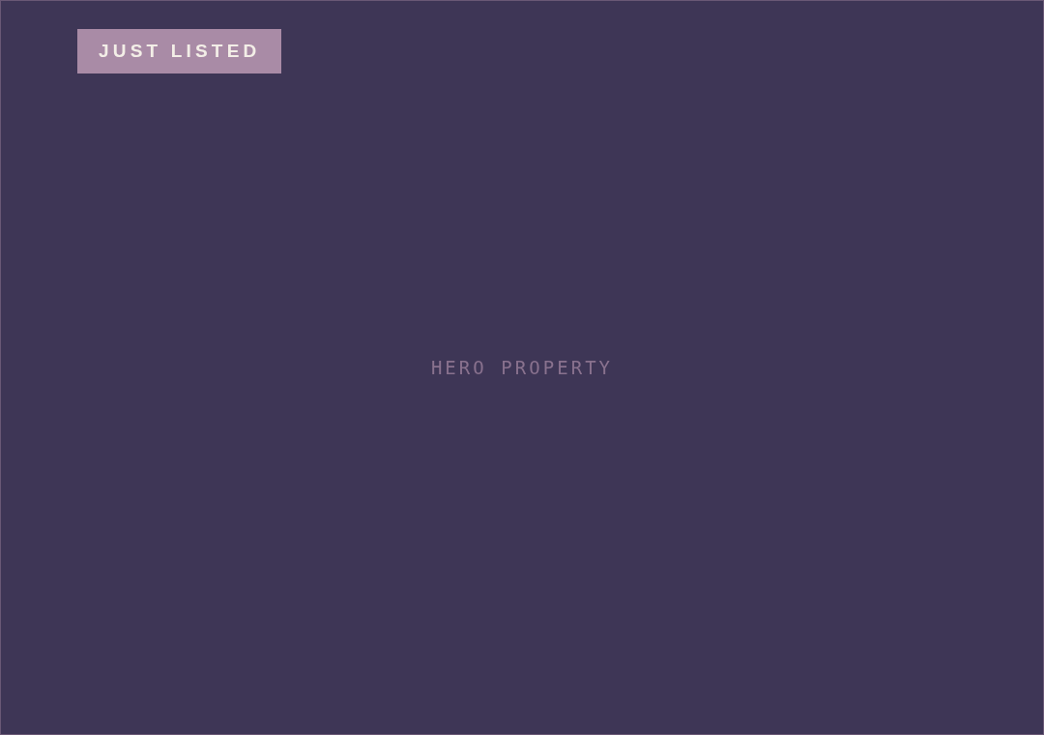
MV
STORY 13 · JUST LISTED
JUST LISTED
NEW ON THE MARKET
17 Tidewater Lane
SANTA LUCIA, CALIFORNIA · 4 BD · 3 BA · 3,140 SF
$3,250,000
↗
SEE THE FULL TOUR
@MARISOLVANCE ◆ MARISOLVANCE.COM

