Slide 1
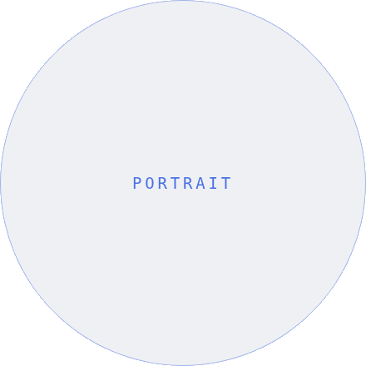
NO
STORY 06 · ABOUT
MEET YOUR AGENT
Julian Reyes
CONDO & LOFT SPECIALIST
01
Eight years
selling condos across downtown.
02
Top 2%
of agents in the city by volume.
03
Lifelong local
who actually knows the buildings.
Follow for more
↗
@NORTHANDOAK ◆ NORTHANDOAK.CO

