Slide 1
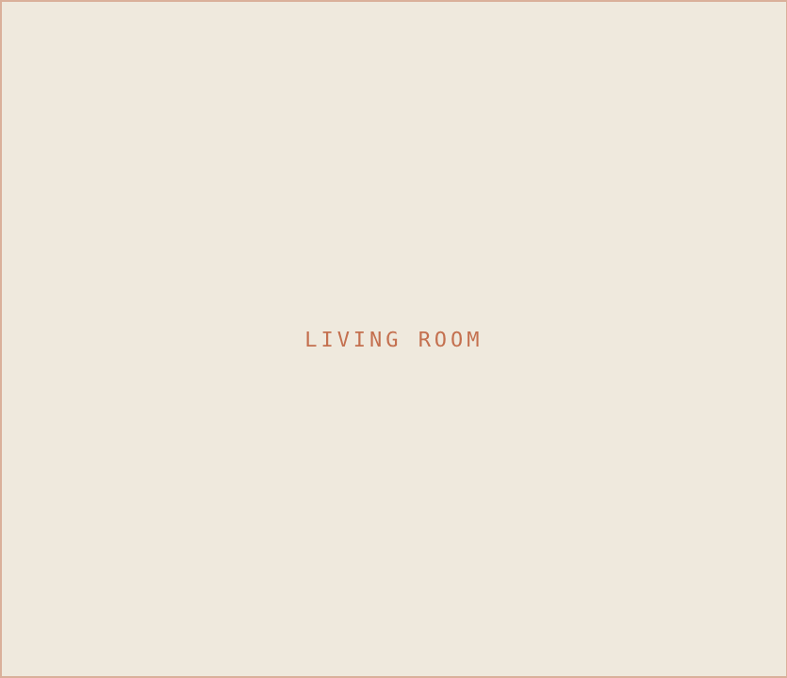


SM
STUDIO MAEVE
VOL. 01 — THE COVER
INTERIOR DESIGN & STYLING — PORTLAND, OR
THE
ATELIER
Edit.
Forty templates. One considered system. Everything an interior studio needs to look as composed online as the rooms it makes — social, print, and inbox, done for you.
40 TEMPLATES
5 SECTIONS
VOL. 01
BRAND & MARKETING KIT · VOL. 01
STUDIOMAEVE.COM

