Slide 1
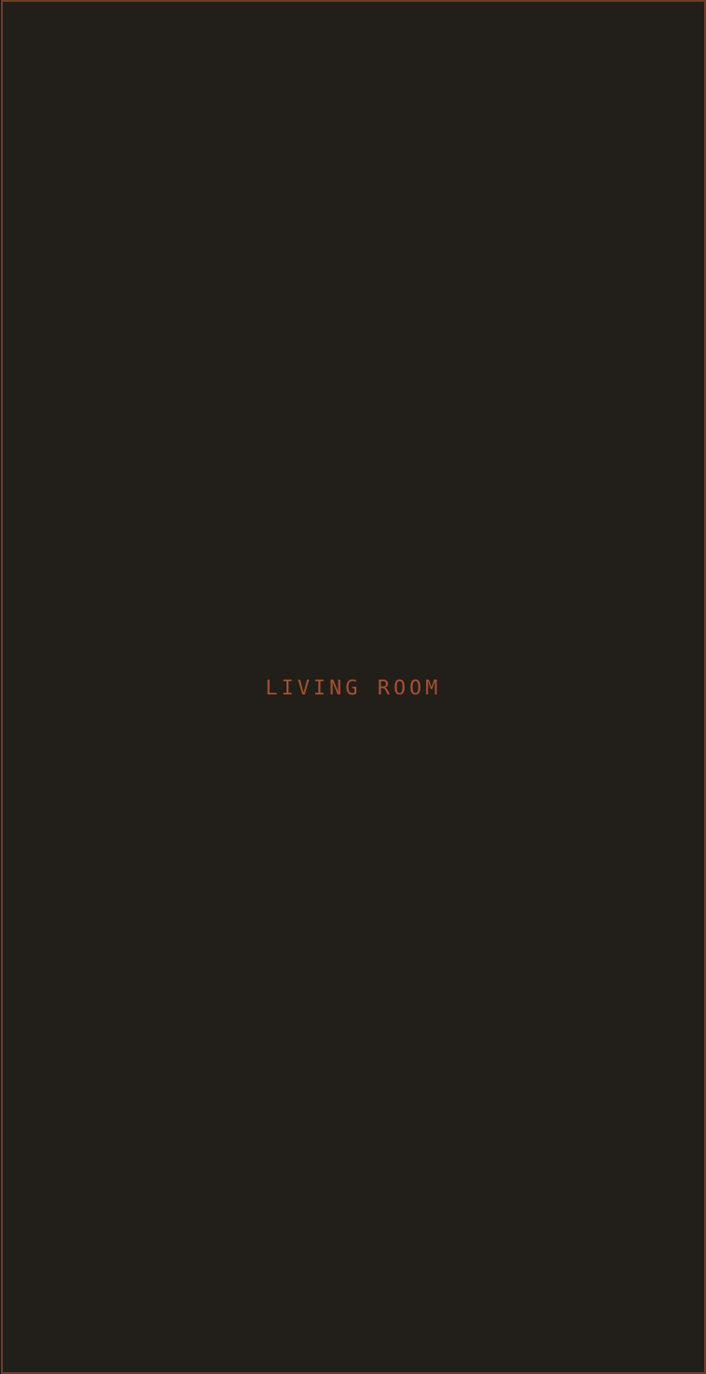
SM
STUDIO MAEVE
01 · PROJECT REVEAL
INTERIOR DESIGN & STYLING
PROJECT REVEAL
The Hawthorne Project
PORTLAND, OREGON
FULL-HOME DESIGN
5 Rooms · 2,400 SF
Full-home design & styling
Custom Millwork
White oak · unlacquered brass
Reading Nook
Bouclé · vintage kilim · oak
@STUDIOMAEVE · STUDIOMAEVE.COM
DM TO START YOUR PROJECT

