Slide 1
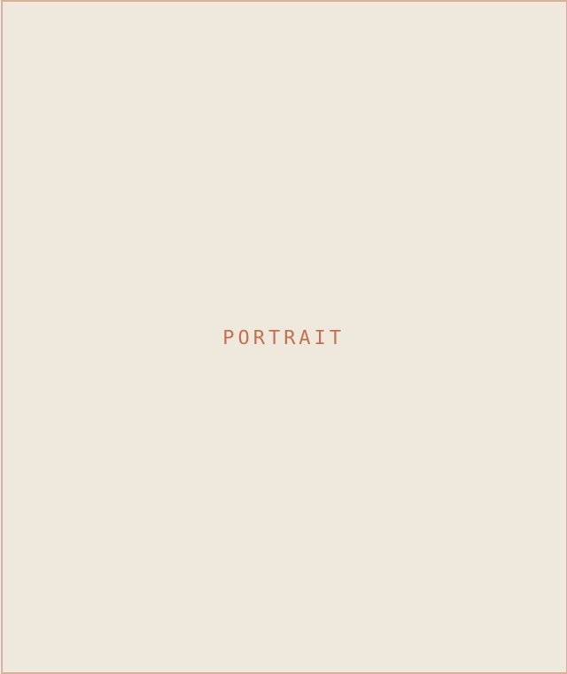
SM
STUDIO MAEVE
07 · ABOUT
INTERIOR DESIGN & STYLING
MEET THE DESIGNER
Maeve Sullivan
PRINCIPAL DESIGNER · STUDIO MAEVE
I help busy households turn houses into calm, collected homes — layered, warm, and made to actually be lived in. Twelve years, a hundred-odd rooms, and one rule: design that looks like you, not like me.
PHONE
EMAIL
WEB
503 · 555 · 0142
hello@studiomaeve.com
studiomaeve.com
@STUDIOMAEVE · STUDIOMAEVE.COM
BOOK A CONSULT

