Slide 1
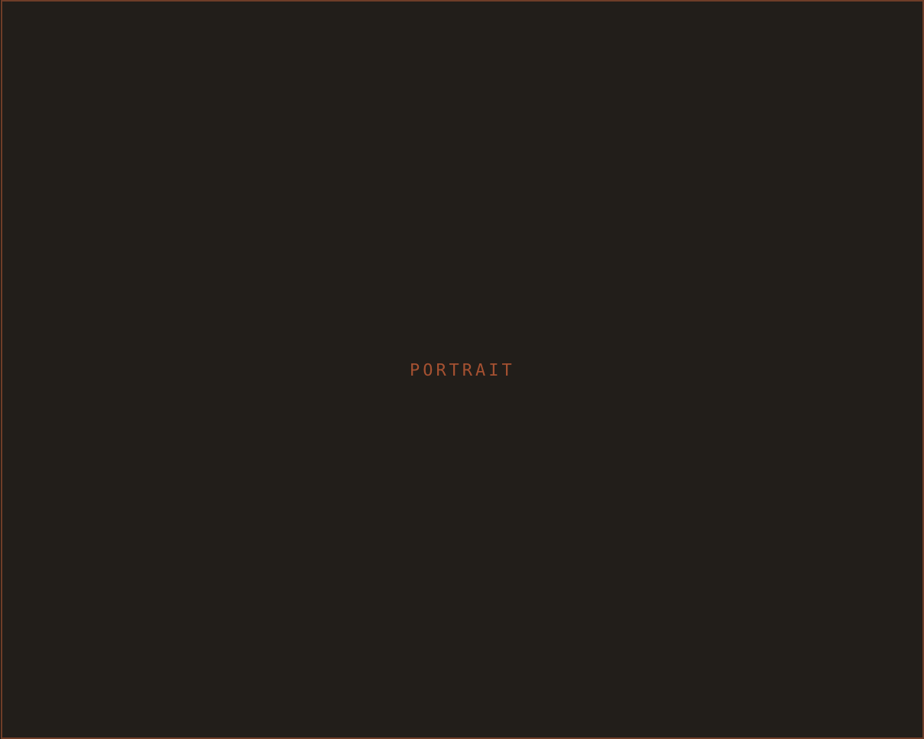
SM
THE STUDIO
Studio Maeve
PORTLAND · STUDIO · INTERIORS
Rooms that feel like you.
PHONE
EMAIL
WEB
503 · 555 · 0142
hello@studiomaeve.com
studiomaeve.com

