Slide 1
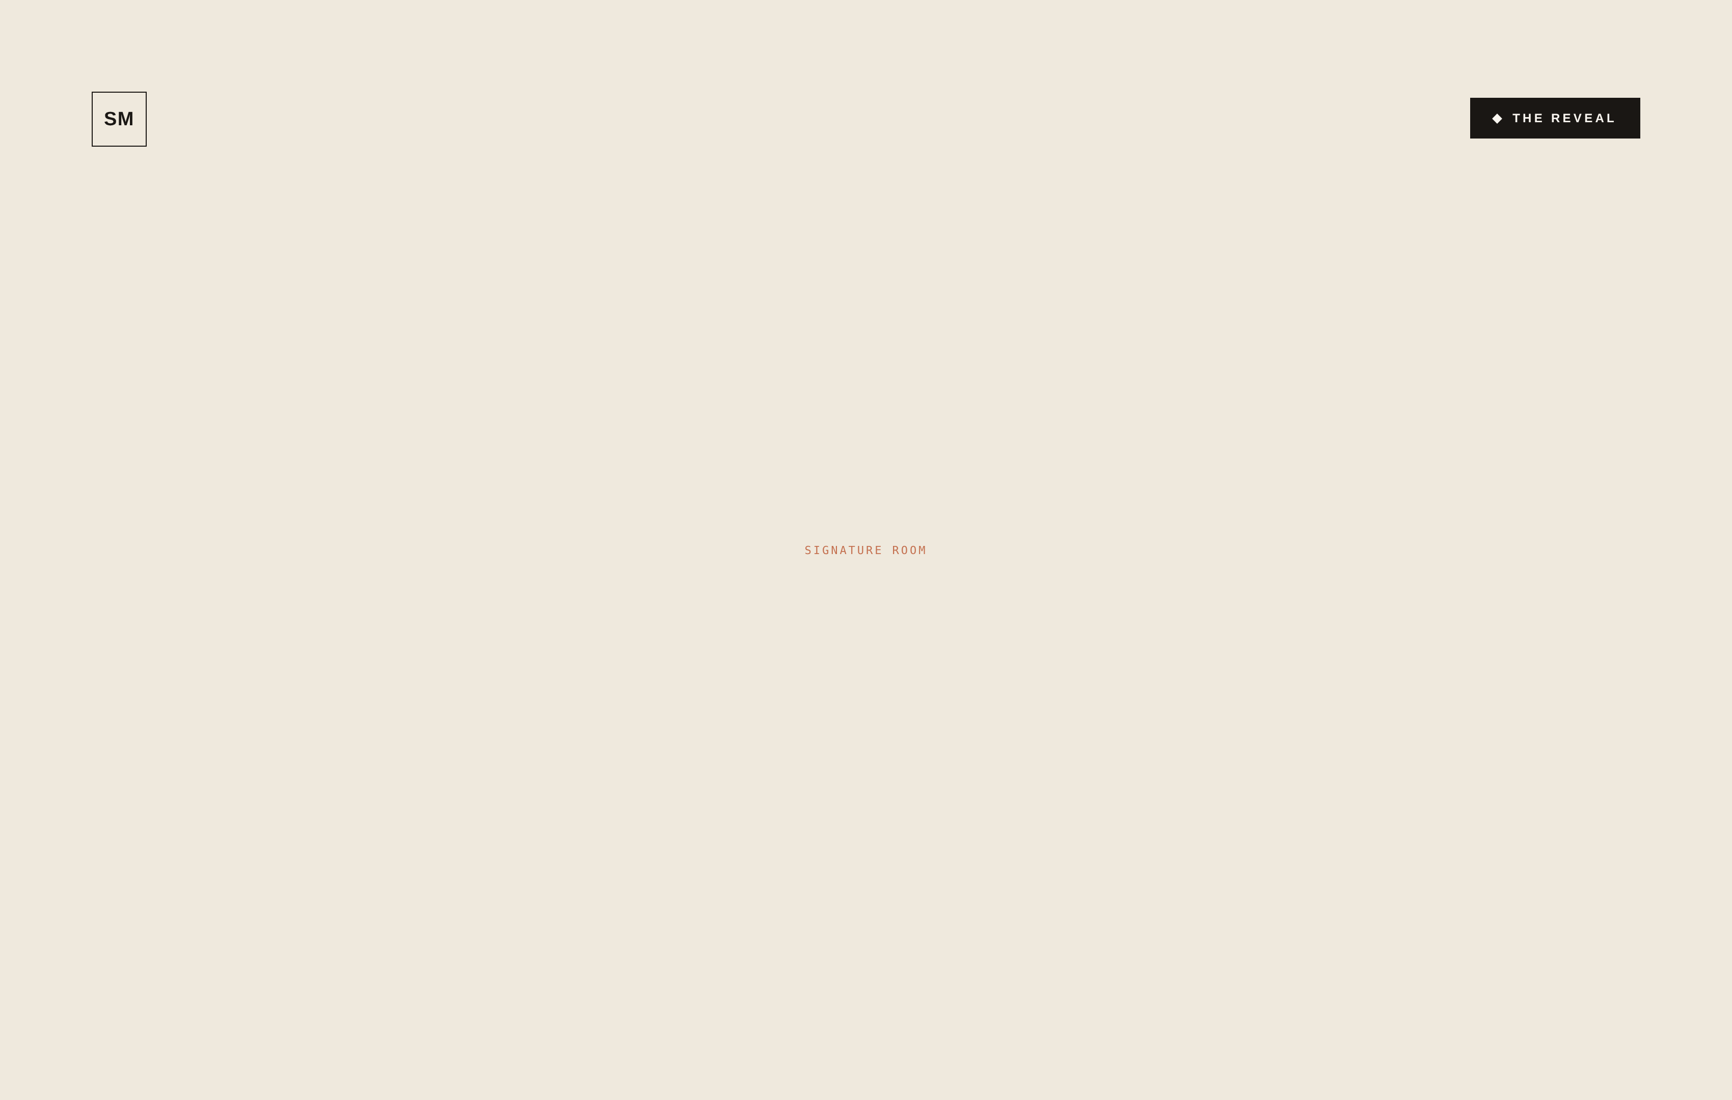
JUST COMPLETED
The Hawthorne Project
Portland, Oregon
STYLE
SCOPE
ROOMS
YEAR
1910 Craftsman
Full home
5
2024
A warm, lived-in renovation of a 1910 Craftsman — original millwork restored, rooms layered in oak, brass, and bouclé. Calm, collected, and unmistakably theirs.
Maeve Sullivan
503 · 555 · 0142 · hello@studiomaeve.com · studiomaeve.com
PRINCIPAL DESIGNER

