Slide 1
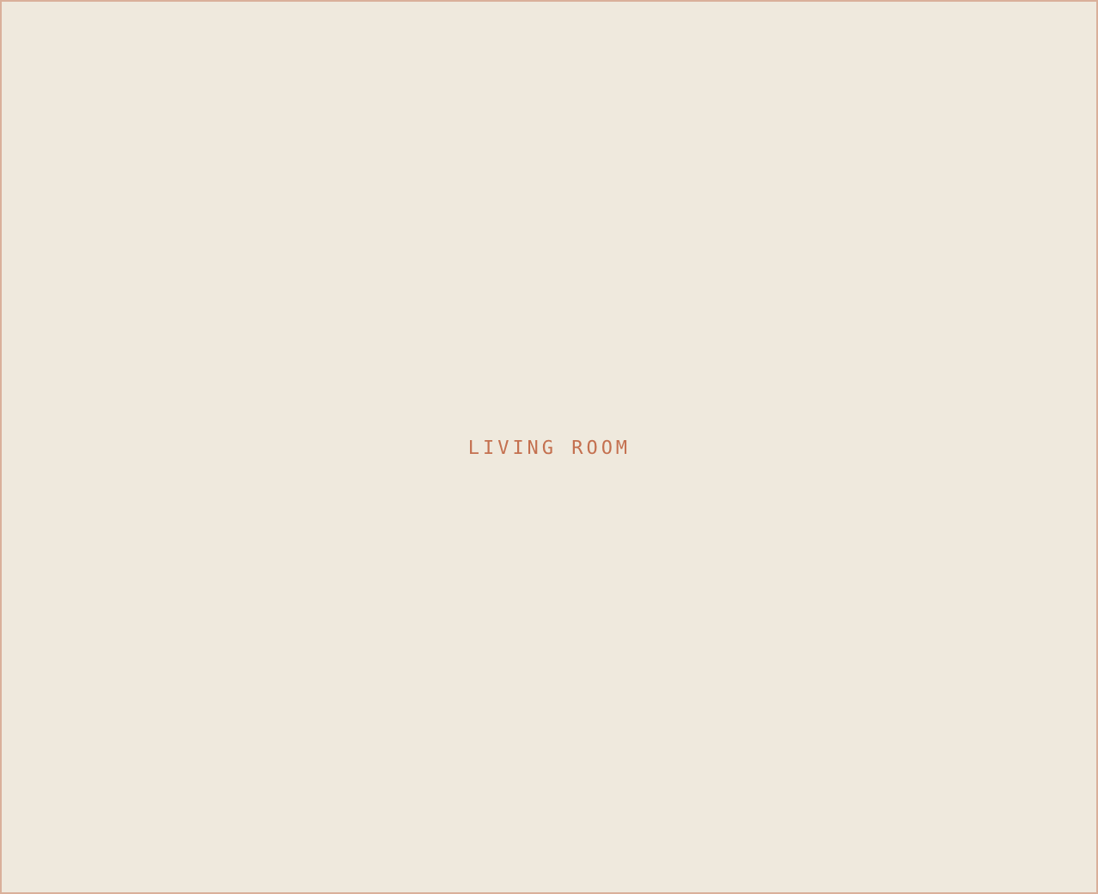
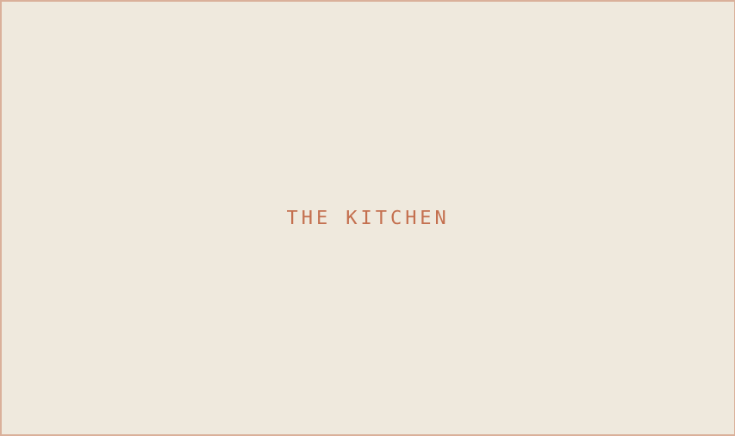
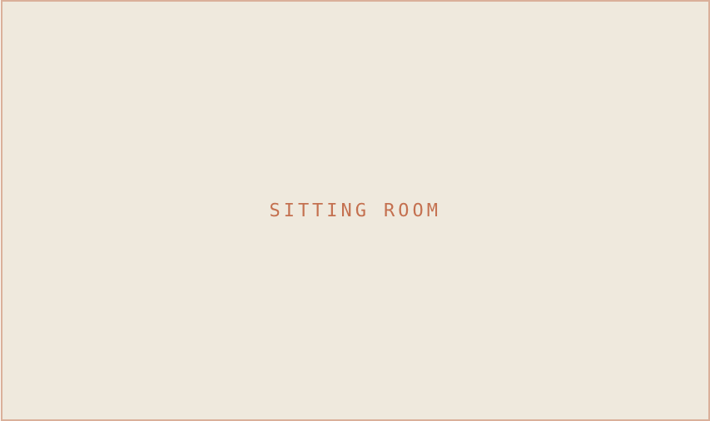
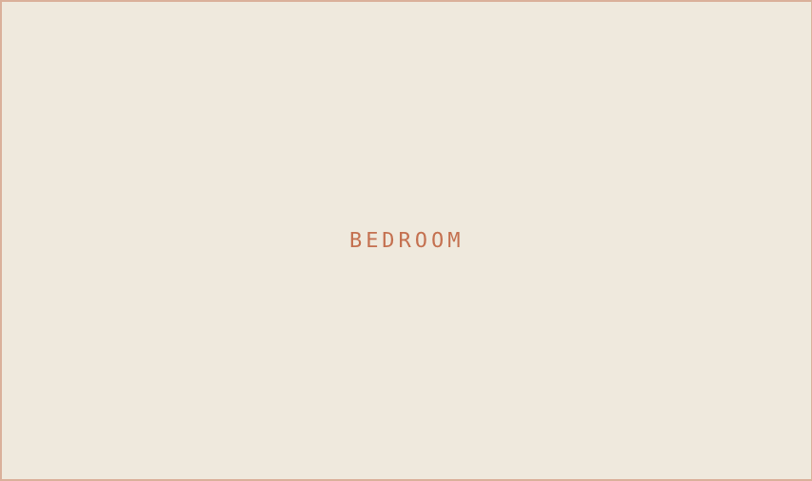
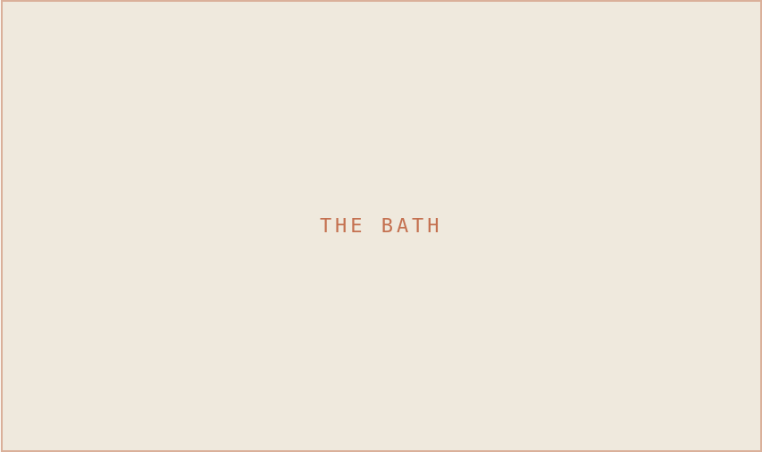
SM
STUDIO MAEVE
PROJECT FEATURE SHEET
JUST COMPLETED · PORTLAND
The Hawthorne Project
FULL-HOME DESIGN
5 Rooms · 2,400 SF · 1910 Craftsman
01
The kitchen
04
Lighting plan
Custom white-oak millwork, unlacquered brass, honed marble.
Layered sconces, picture lights, and dimmers in every room.
02
Primary suite
05
Sourcing
Limewashed walls, vintage rug, linen drapery, brass sconces.
Vintage finds mixed with a few investment anchors.
03
Sitting room
06
The details
Bouclé seating, walnut coffee table, a quiet gallery wall.
Hand-thrown ceramics, art, and styling, down to the books.
STUDIO MAEVE · VOL. 01
503 · 555 · 0142 · studiomaeve.com

