Slide 1
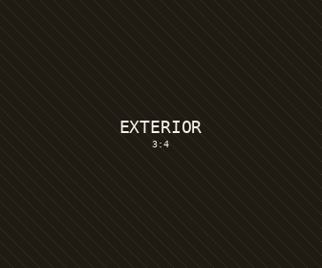

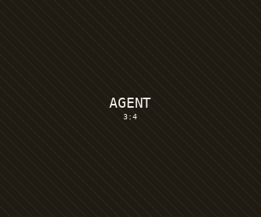
The Luxe Agent · Collection
01 / 03 — THE COVER
THE COMPLETE BRAND & MARKETING BUNDLE
The
Luxe Agent
Collection.
Thirty-eight templates. One luxury system. Everything a realtor needs to look premium on social, in print, and in the inbox — done for you.
VOLUME 01 · BRAND & MARKETING KIT
ALEXANDRAMONROE.COM

