Slide 1
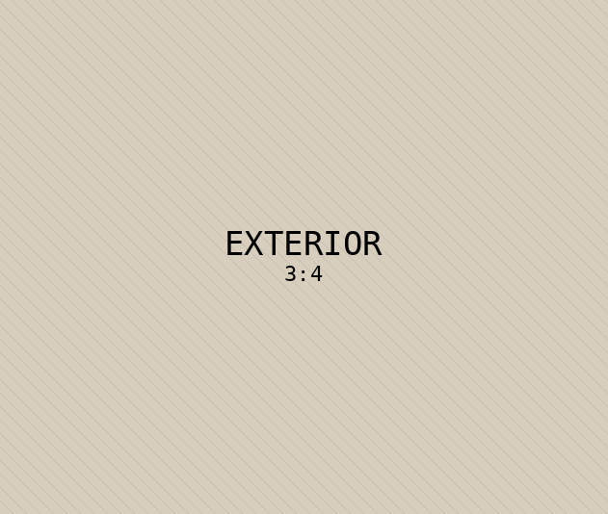




AM
Alexandra Monroe
PROPERTY FEATURE SHEET
JUST LISTED · SCOTTSDALE
428 Ridgemont Drive
$1,250,000
4 BD · 3.5 BA · 3,820 SF · 0.38 ac
01
Chef's kitchen
02
Primary suite
Calacatta marble island, Wolf range, custom millwork.
Spa bath, soaking tub, dual vanities, view balcony.
03
Resort pool
04
Smart systems
Heated pool, outdoor kitchen, fire feature.
Crestron home automation, integrated audio, climate.
05
Mountain views
06
Walk-in wine room
Floor-to-ceiling glazing onto the McDowell preserve.
Climate-controlled, 460-bottle capacity, walnut racks.
FOR PRIVATE SHOWINGS, PLEASE CONTACT
(480) 555-0182 · hello@alexandramonroe.com · alexandramonroe.com

