Slide 1
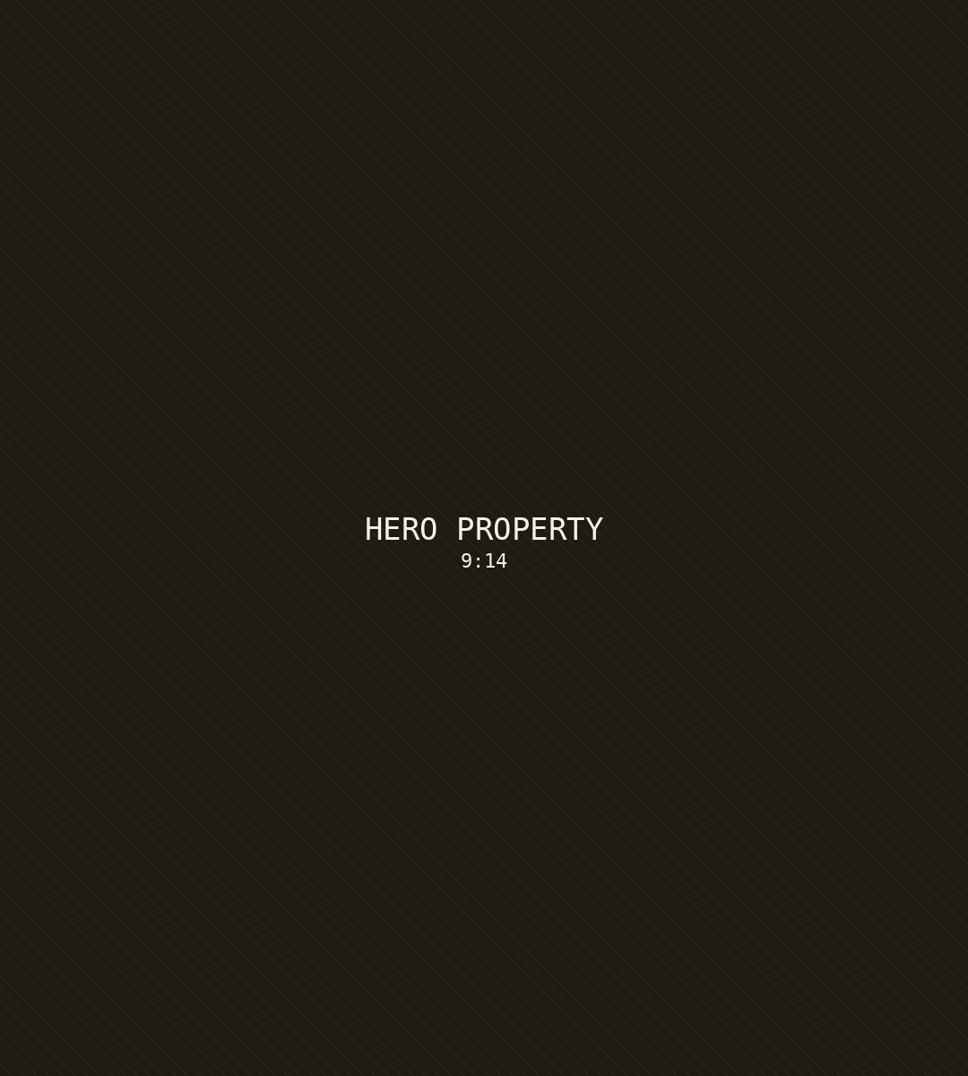
AM
JUST LISTED
NEW ON THE MARKET
428 Ridgemont Drive
SCOTTSDALE, ARIZONA · 4 BD · 3.5 BA · 3,820 SF
$1,250,000
SEE THE FULL TOUR
↗

