Slide 1
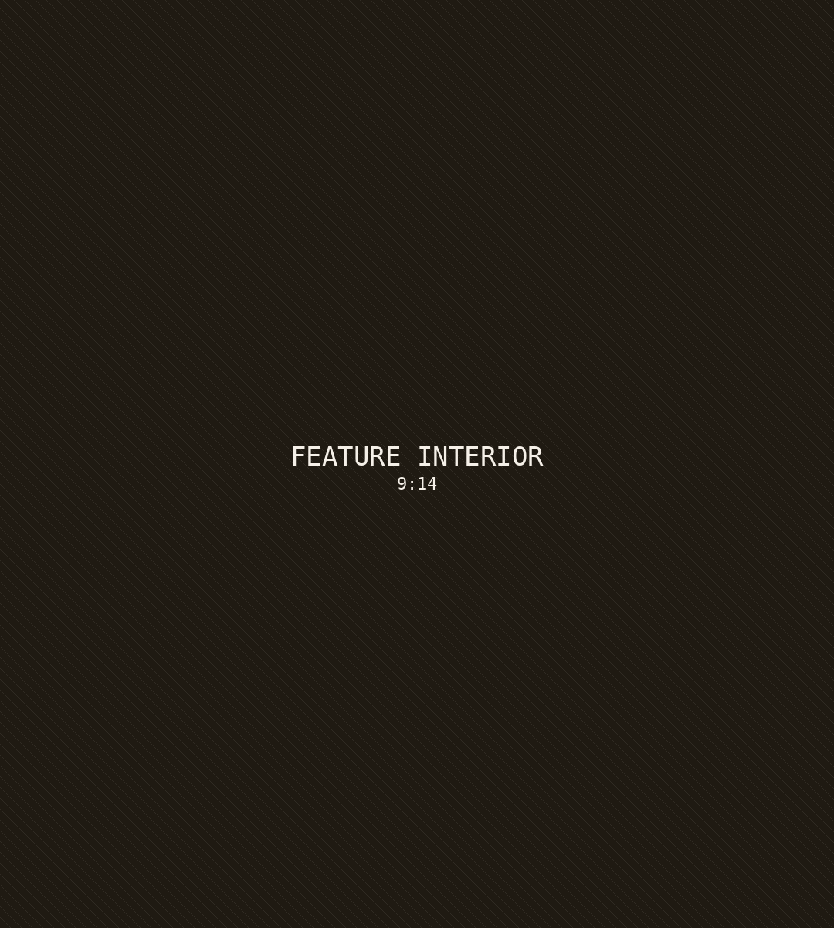
AM
STORY 07 · HIGHLIGHT
BEHIND THE DOOR
428 Ridgemont Drive
01
Chef's kitchen with Calacatta marble island
02
Floor-to-ceiling glazing, mountain views
03
Resort-style pool and outdoor kitchen
SEE ALL PHOTOS
↗

