Slide 1
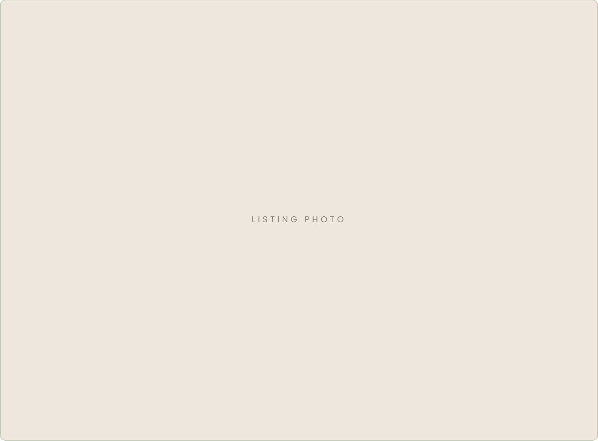
JUST LISTED
New on
the Market
117 Larkspur Lane
AUSTIN, TX · $740,000
SEE THE FULL TOUR

