Slide 1



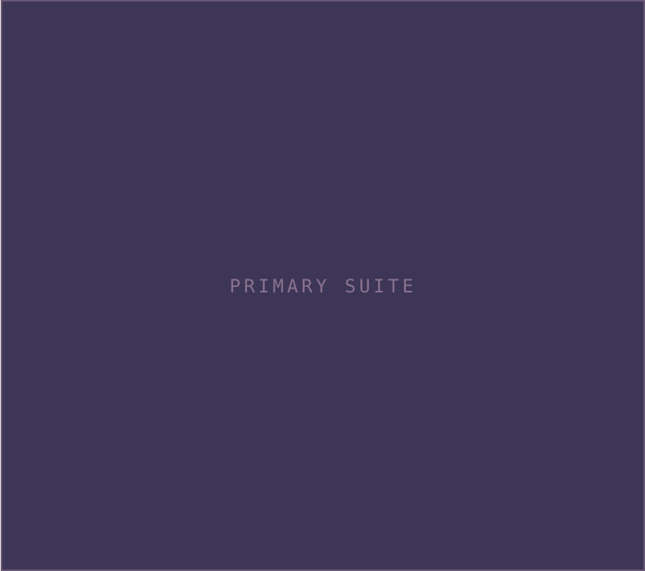

MV
Marisol Vance
PROPERTY FEATURE SHEET
JUST LISTED · SANTA LUCIA
17 Tidewater Lane
$3,250,000
4 BD · 3 BA · 3,140 SF · 0.42 ac
01
Chef’s kitchen
02
03
— Sea-salt oak island, Lacanche range, honed limestone.
Primary suite
— Spa bath, soaking tub, dual vanities, ocean balcony.
Sun deck
04
05
— Heated plunge, outdoor shower, fire pit.
Smart systems
— Automation, integrated audio, climate.
Ocean views
06
— Floor-to-ceiling glazing onto open water.
Wine room
— Climate-controlled, 460-bottle capacity.
(805) 555-0188 · HELLO@MARISOLVANCE.COM · MARISOLVANCE.COM

