Slide 1
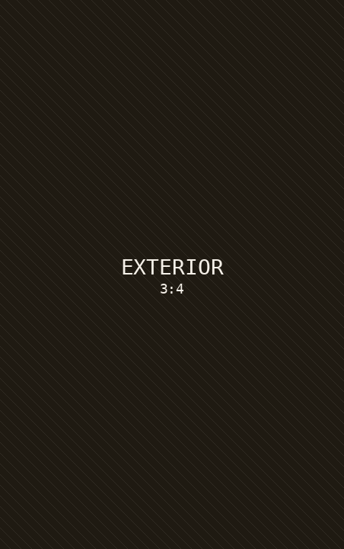
AM
Alexandra Monroe
01 · JUST LISTED
REALTOR® | LUXURY SPECIALIST
JUST LISTED
428 Ridgemont Drive
SCOTTSDALE, ARIZONA
$1,250,000
4 Bedrooms · 3.5 Bathrooms
3,820 Square Feet
Chef's Kitchen · Resort Pool
Mountain Views · Smart Home
@ALEXANDRAMONROE · ALEXANDRAMONROE.COM
DM FOR THE FULL TOUR

