Slide 1
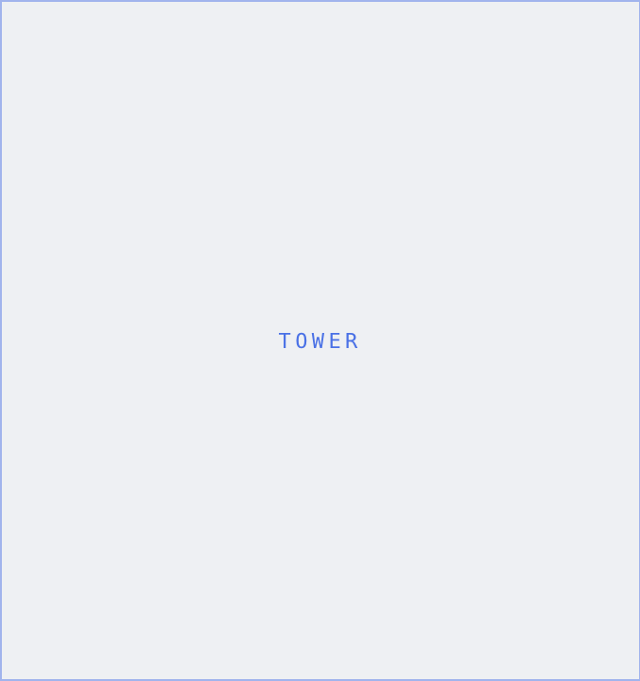


North & Oak
VOL. 01 / INDEX
URBAN RESIDENCES — CHICAGO
THE
METRO
EDIT.
40
Forty templates. One precise system — built on a grid, run on the numbers. Everything a downtown condo & loft specialist needs to move listings fast and look sharp doing it.
TEMPLATES
SECTIONS
05
FORMATS
Social / Print
VOLUME
01 / 2026
BRAND & MARKETING KIT · VOL. 01
NORTHANDOAK.CO

