Slide 1
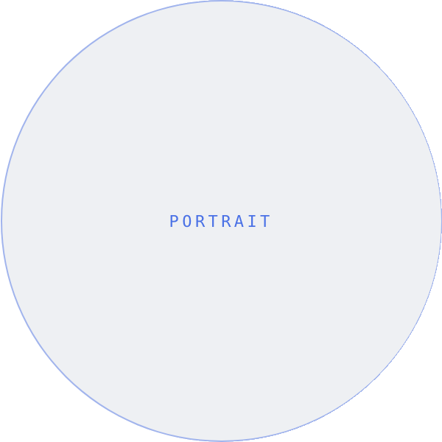
NO
North & Oak
07 · ABOUT
REALTOR® · CONDO & LOFT SPECIALIST
MEET YOUR AGENT
Julian Reyes
REALTOR® · CONDO & LOFT SPECIALIST
I help buyers and sellers move with intention in Chicago’s condo market. Eight years in. Hundreds of doors opened. One quiet rule — represent every client the way I’d want my own family represented.
PHONE
EMAIL
WEB
312 · 555 · 0148
julian@northandoak.co
northandoak.co
@NORTHANDOAK · NORTHANDOAK.CO
BOOK A COFFEE

