Slide 1

Idea for Test Planning
of
SML Accounts & Office Management
Presented By
Mahbubur Rahman
Matrikel Nr: 250154
M.Sc in Global Software Development
Hochschule Fulda University of Applied Sciences

Slide 2
System Overview
Module Overview
Test Planning
To-Do Test Cases
Test Tools

Slide 3
System Overview
Technology Used:
Java7, Spring 4, Spring JPA, Hibernate, Tiles, JSP
Database Server:
Oracle 11g
Development IDE:
IntelliJ IDEA, Sql Developer

Slide 4
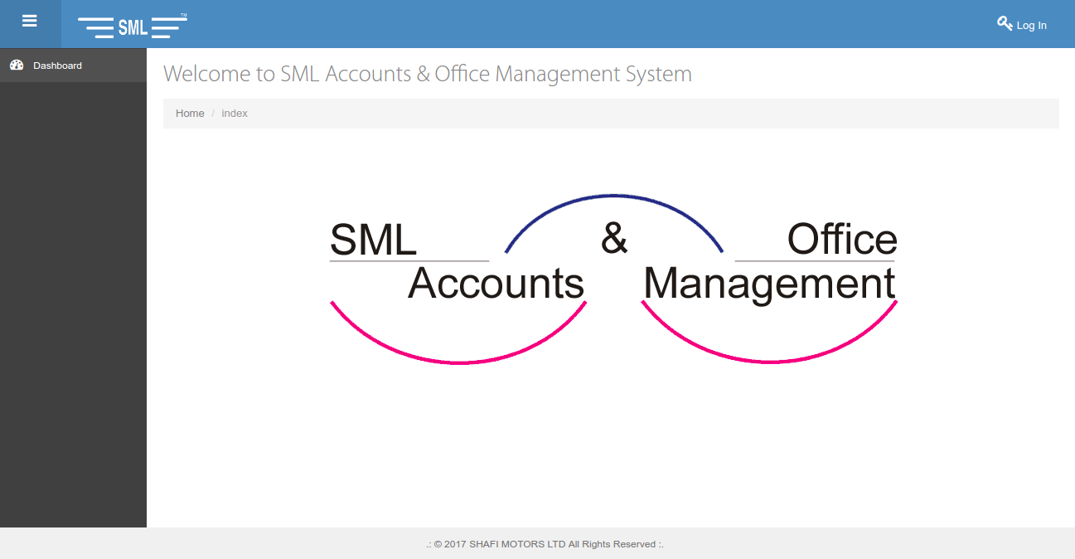
System Overview

Slide 5
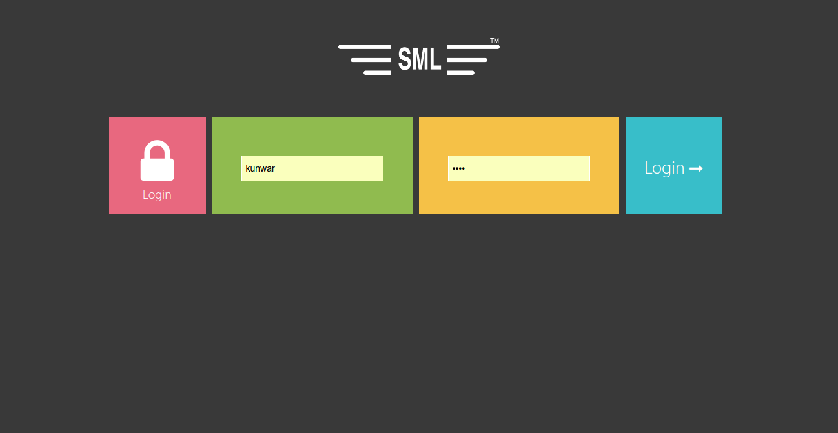
System Overview

Slide 6
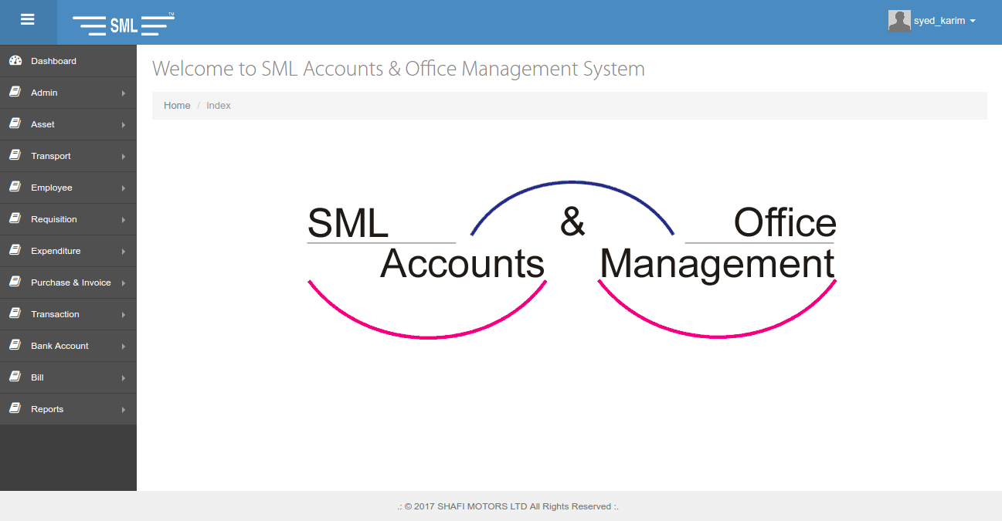
System Overview

Slide 7
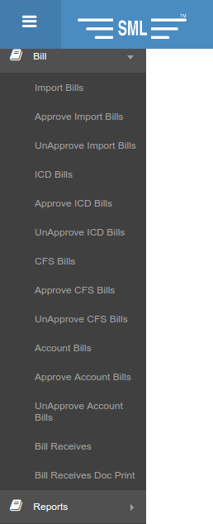
Module Overview
To-Do test module is Billing module.
Importers, Exporters, Clearing Agents and Forwarders pay bills
5 types of bill.
Import
ICD
CFS FF
CFS AGENT
Account

Slide 8
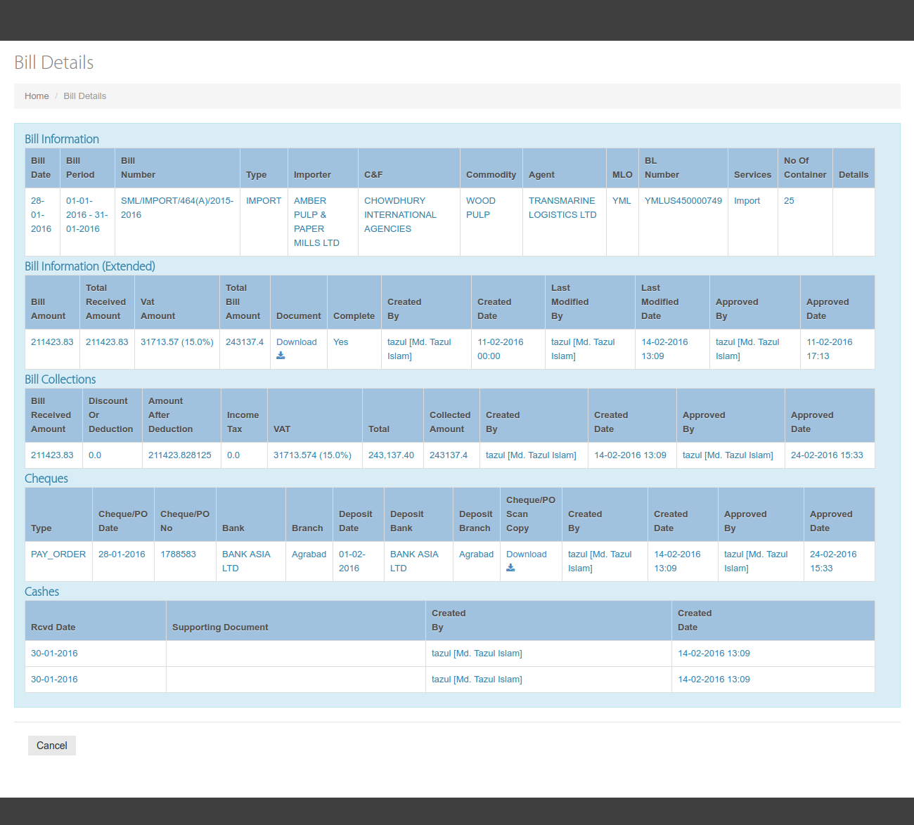
Module Overview

Slide 9
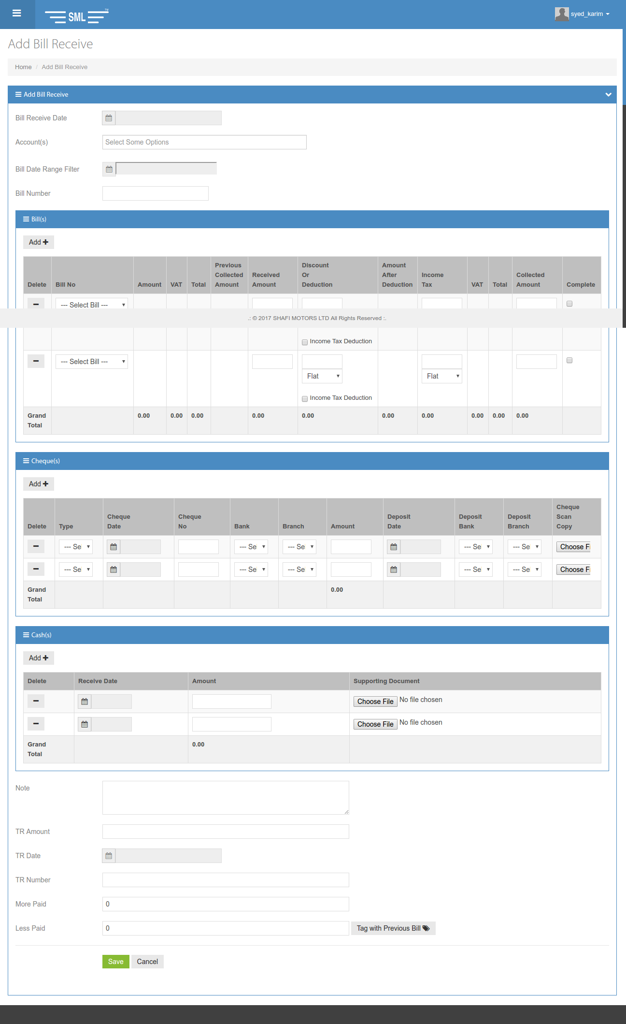
Module Overview

Slide 10
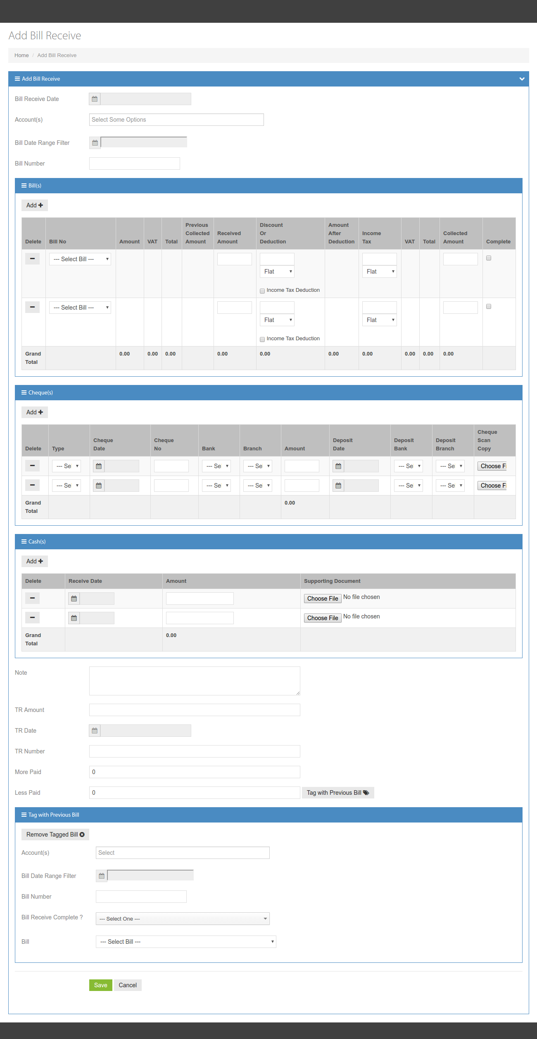
Module Overview

Slide 11
Test Planning
Component Test
Integration Test
System Test
Acceptance Test

Slide 12
To-Do Test Cases
Component Test:
Bill CRUD operations
Bill State Transitions
[ New, Modified, Approved, Unapproved, Canceled, Received, Deleted ]
Bill Receive
Boundary Value Analysis
Decisions and Conditions Test
Money Calculation Test

Slide 13
To-Do Test Cases
Integration Test:
Connection with database server (Oracle 11g)
Pdf document generation
PVS
PVS Summary
Money Receipt
Excel report generation
Bill Collections [ Cash, Cheque, Pay Order (PO) ]
Bill VAT Details
Bill Outstanding

Slide 14
Test Tools
Junit
Mockito
Spring Integration Test Packages

Slide 15
References
https://docs.spring.io/spring/docs/4.0.6.RELEASE/spring-framework-reference/htmlsingle/#testing
Software Testing Foundations 4th Edition By Andreas Spillner, Tilo Linz, Hans Schaefer
http://junit.org/junit5/
http://site.mockito.org/

Slide 16


