Slide 1

Mid Evaluation
Team
Murtaza Mehdi 22F-3101
Ammar Akbar 22F-3102
Sardar Sameer 22F-3162
Supervised by
Ms. Juhinah Batool

Slide 2

OmniDrive

Slide 3
Introduction
Our project “OmniDrive” introduces an intelligent, integrated ecosystem designed to assist automotive enthusiasts and car owners in identifying vehicle components and optimizing performance with greater accuracy and expertise. The system addresses key challenges in the fragmented local automotive market, including the difficulty of accurate part identification, lack of expert modification advice, and the absence of a streamlined supply chain between vendors and customers.

Slide 4
Outline (FYP Report v 1.0)
Project Vision
Use Case Diagram
Activity Diagram
Sequence Diagram
Class Diagram
DFD level 0
DFD level 1
DFD level 2
Component Diagram
Deployment Diagram
Entity Relationship Diagram (ERD)
Architecture Diagram

Slide 5
Project Vision
Scan car parts using phone camera.
Identify components with cloud-based AI.
Get smart recommendations for car modification.
Connect with vendors under one roof.
Browse real-time local parts inventory easily.
Riders deliver orders to your doorstep.

Slide 6
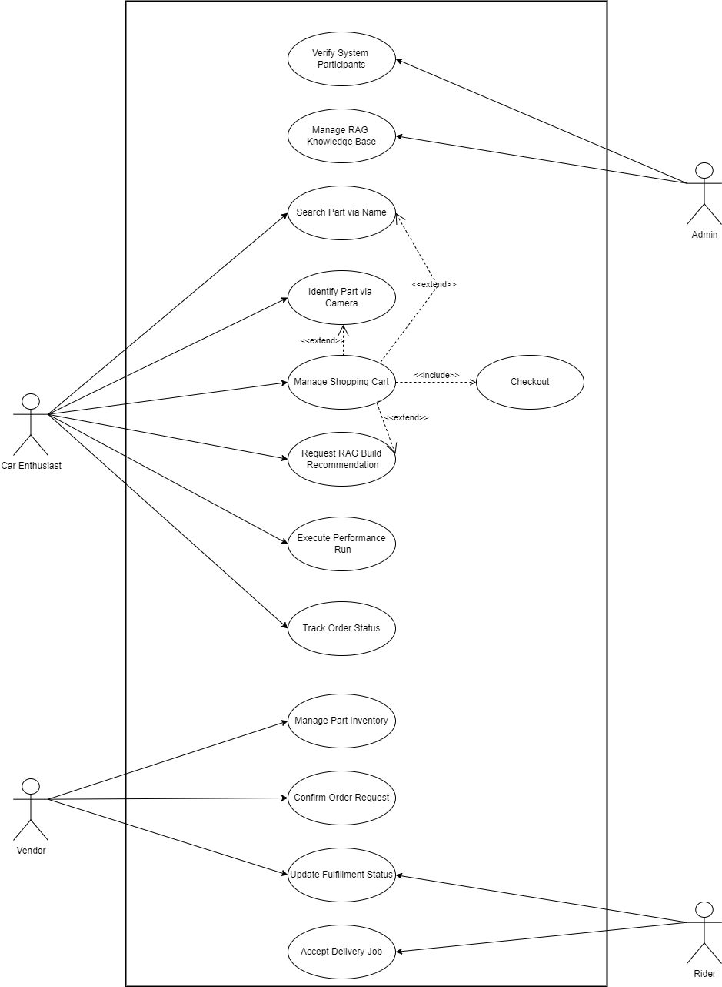
Use Case Diagram

Slide 7
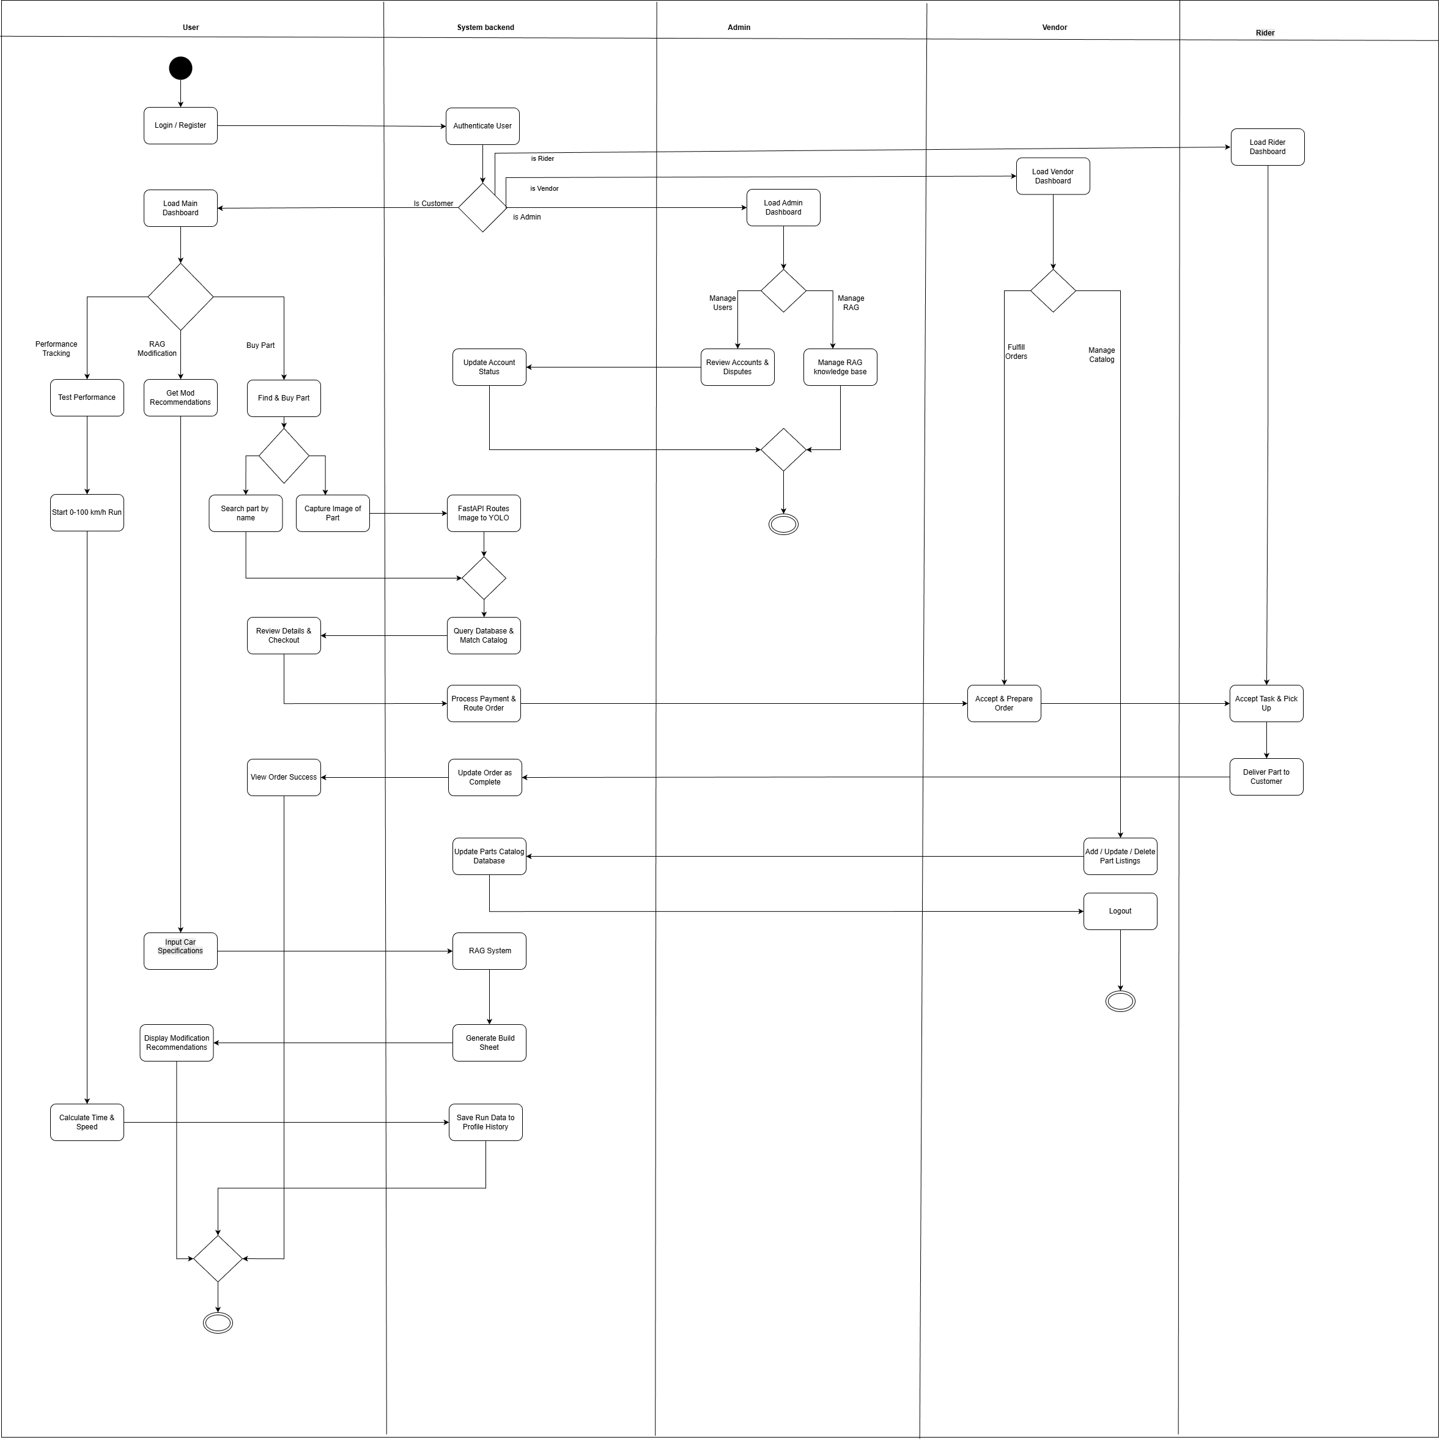
Activity Diagram

Slide 8
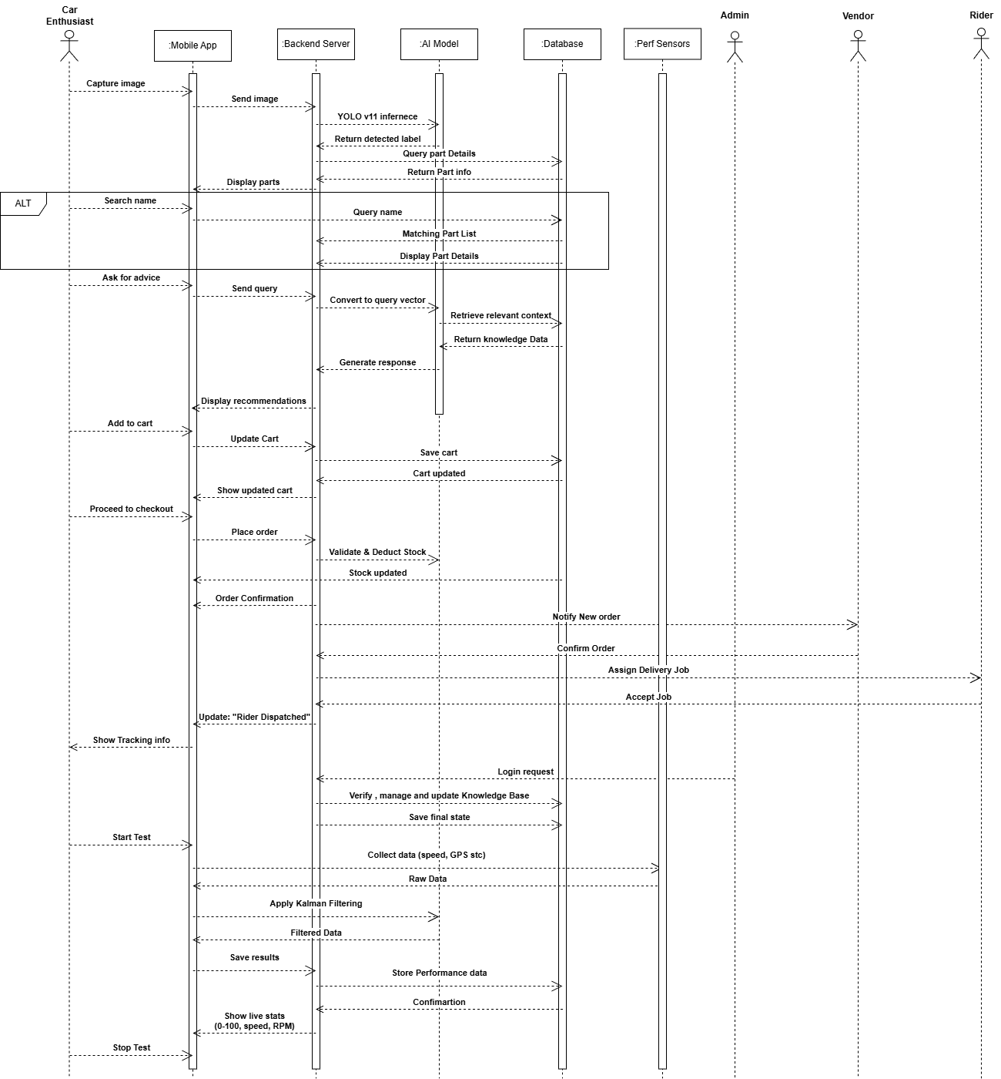
Sequence Diagram

Slide 9
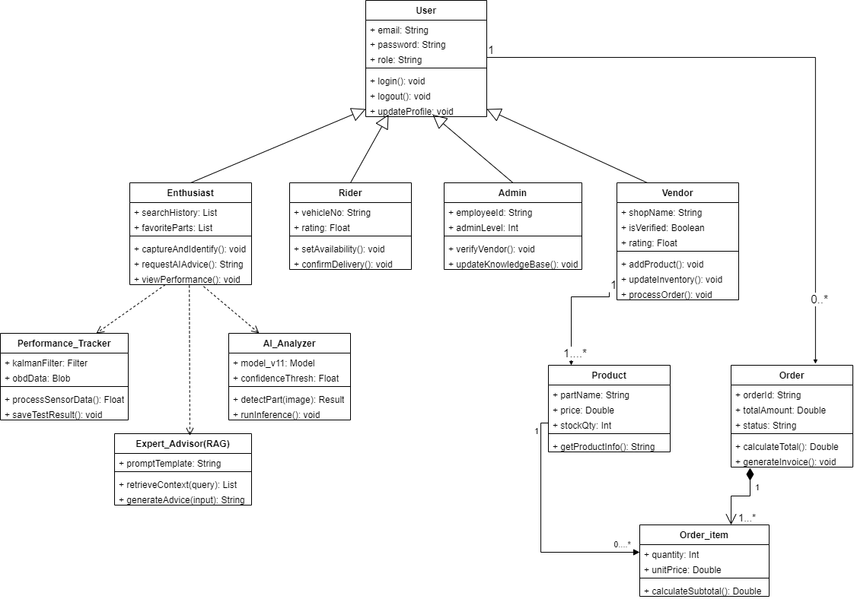
Class Diagram

Slide 10
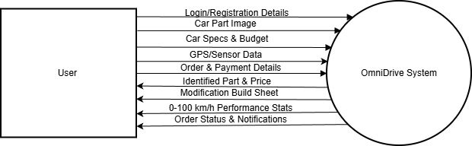
DFD level 0

Slide 11
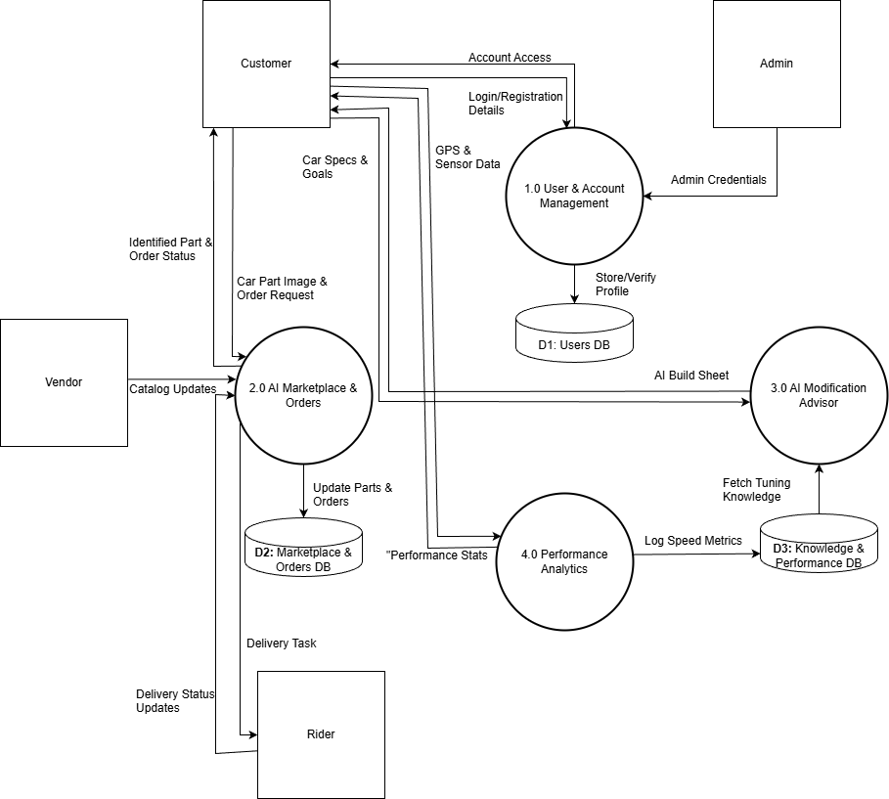
DFD level 1

Slide 12
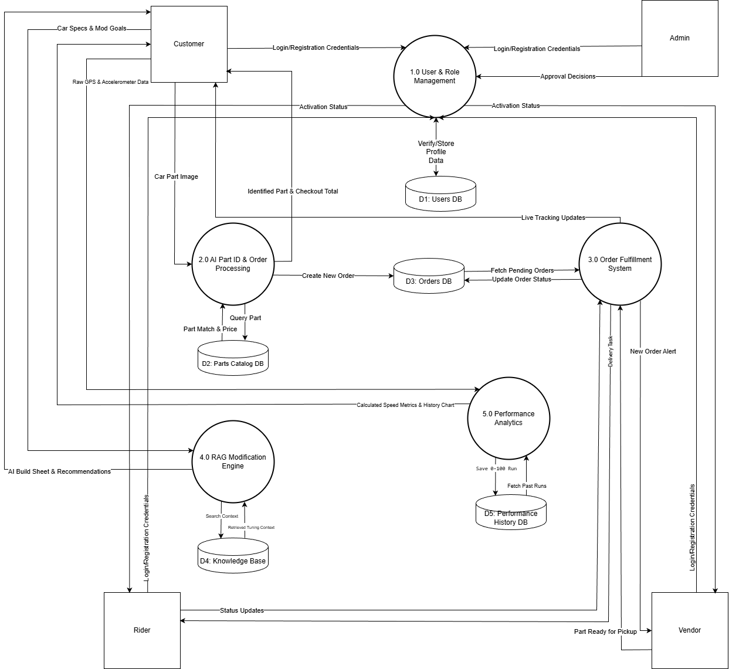
DFD level 2

Slide 13
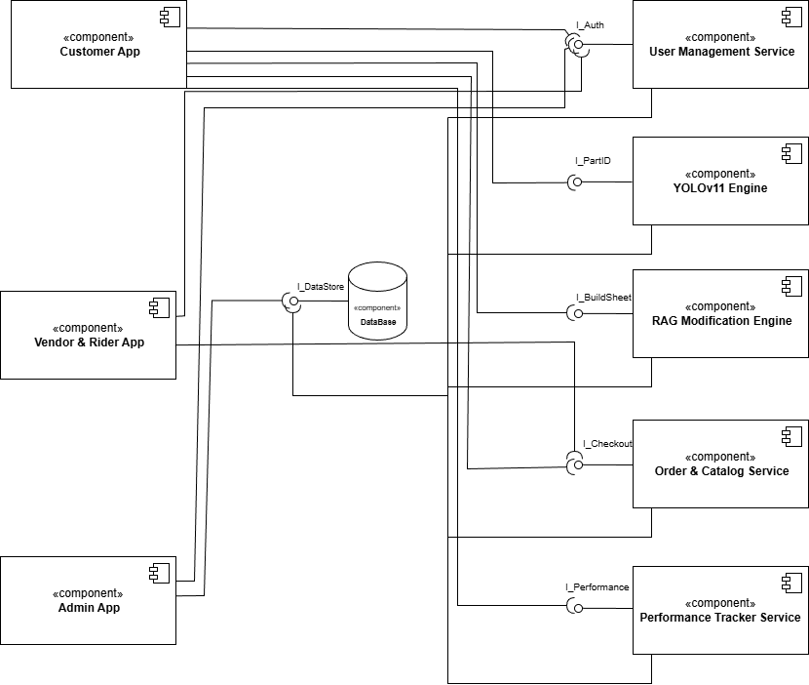
Component Diagram

Slide 14
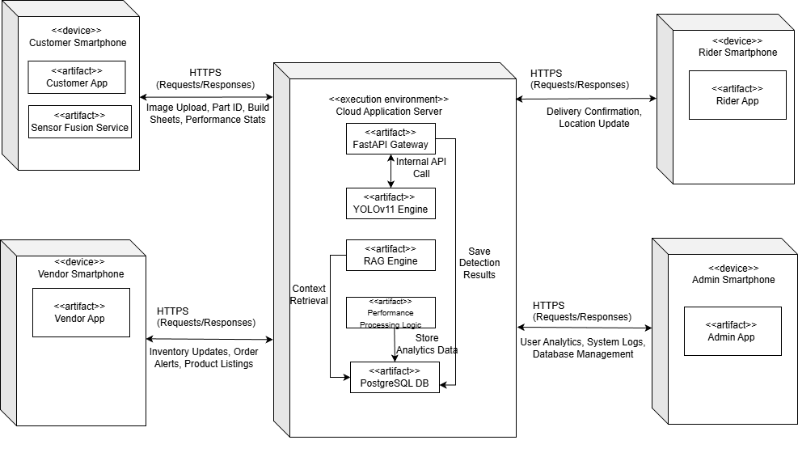
Deployment Diagram

Slide 15
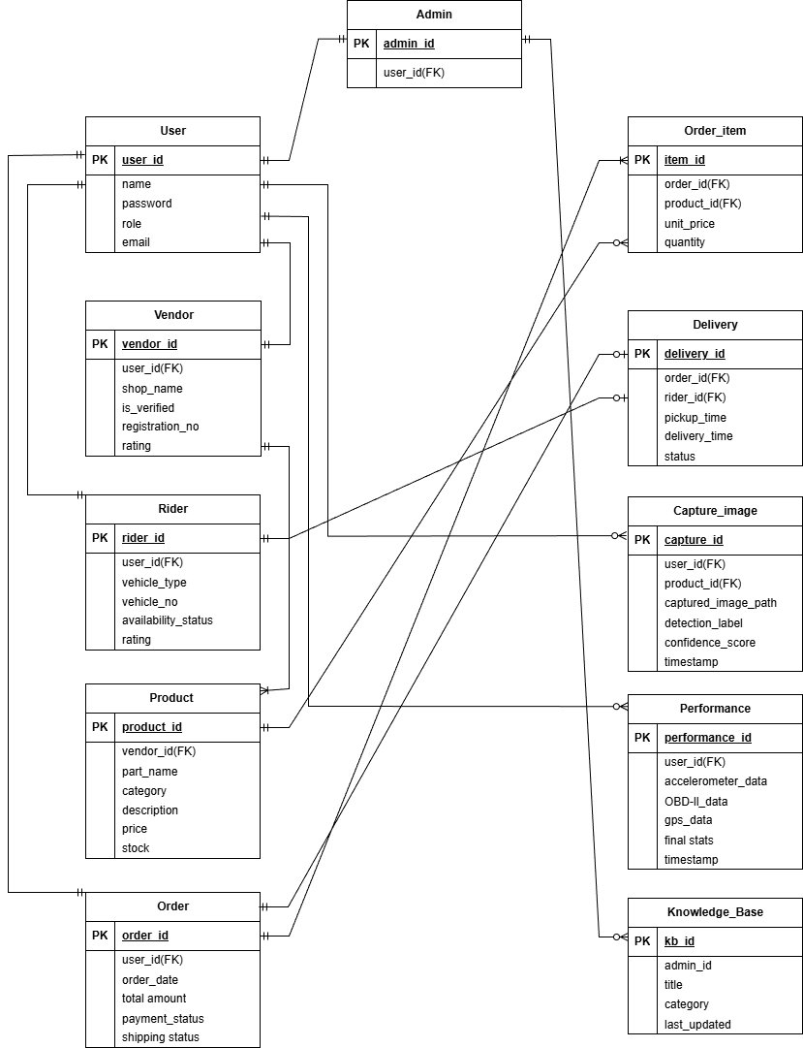
Entity Relationship Diagram (ERD)

Slide 16
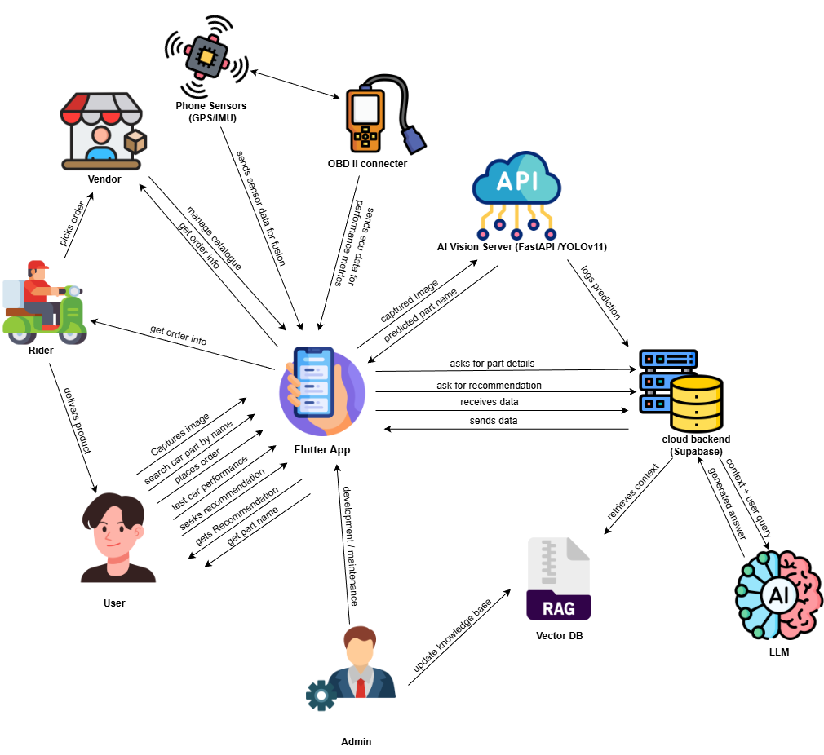
Architecture Diagram

Slide 17
Thank You!

