Slide 1
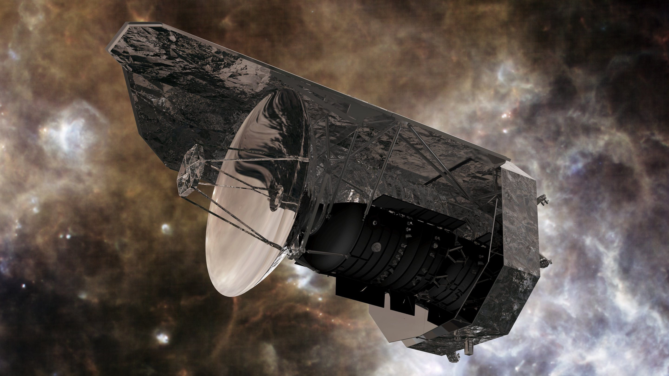

From Herschel data to Temperature and column density maps
-Rohit Chaudhary
IISER Tirupati

Slide 2
Workflow
Downloading Herchel Data
Common Physical Unit
Convolution to common beam size
Reprojection (regirding)
Cropping to same physical area
SED fitting

Slide 3
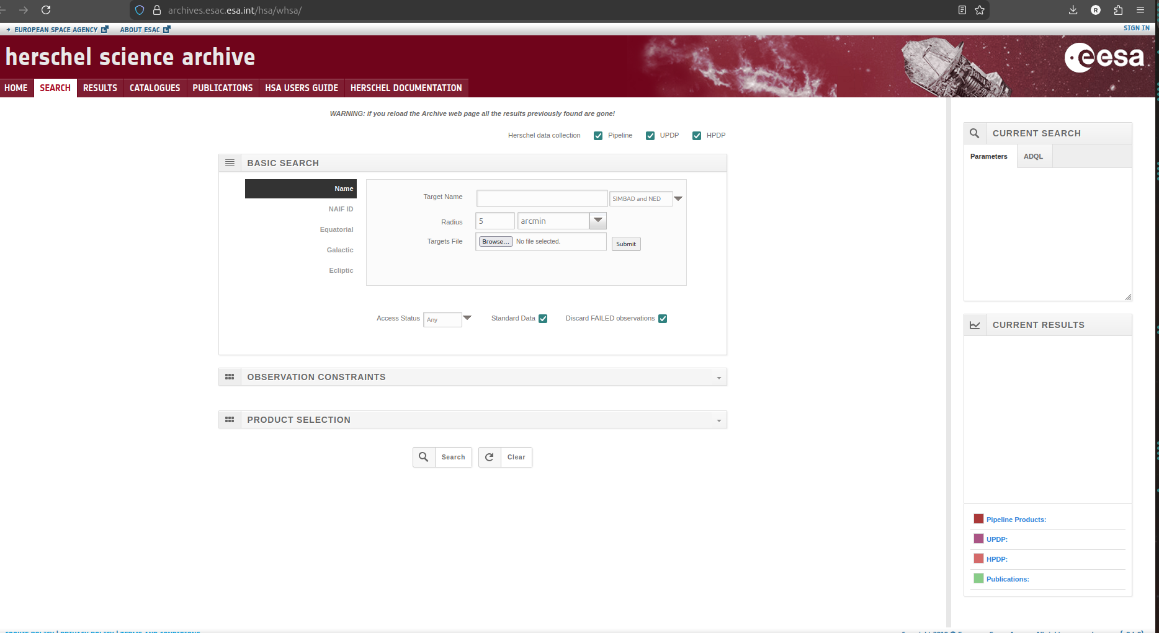
Downloading Herschel Data
Link: https://archives.esac.esa.int/hsa/whsa/

Slide 4

Unit Conversion
All maps are converted to surface brightness units (Jy/sr).
This is essential because:
SED fitting compares intensities across wavelengths
Jy/beam values depend on beam size and are not directly comparable
Conversion:

Slide 5
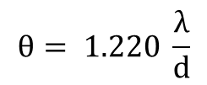
Beam matching
Band | Wavelength | Beam FWHM
PACS (Red Channel) | 160 µm | ~12"
PSW | 250 µm | ~18″
PMW | 350 µm | ~25″
PLW | 500 µm | ~36–37"
Herschel telescope diameter: 3.5 m
$$θ= 1.220 \frac{λ}{d}$$
Substituting for different values of λ, we can get the corresponding beam size (θ)

Slide 6
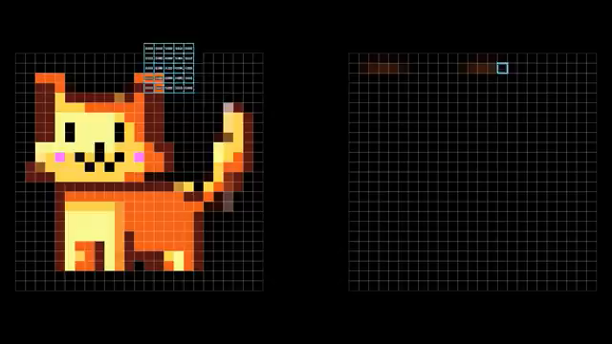

Convolution
Credit: 3Blue1Brown

Slide 7
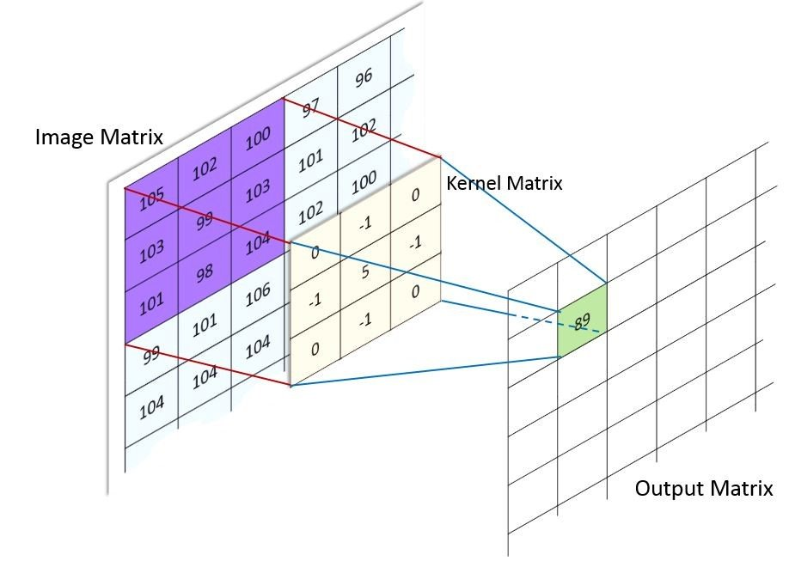

Slide 8
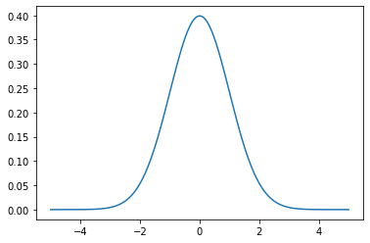
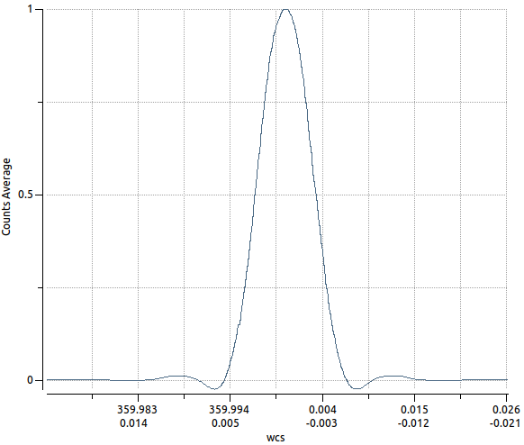
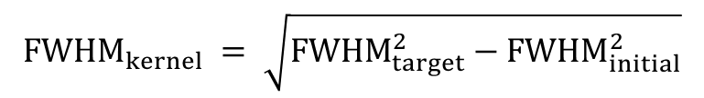
Kernel
from astropy.convolution import convolve_fft
If gaussian kernel is assumed:
$${FWHM}_{kernel} = \sqrt{{FWHM}_{target}^{2}−{FWHM}_{initial}^{2}}$$
Spire 250 to 500 Kernel
FWHM_initial → your current resolution
FWHM_target → desired (larger) beam
FWHM_kernel → Gaussian you must convolve with
https://www.astro.princeton.edu/~draine/Kernels.html

Slide 9
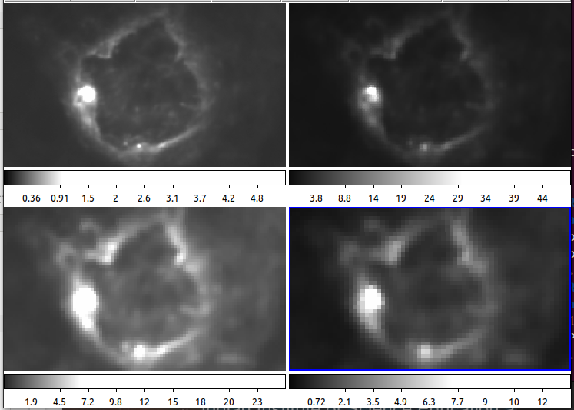
Original images

Slide 10
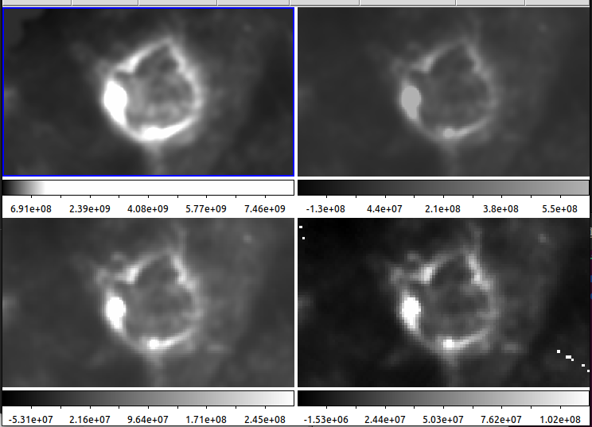
After Convolution

Slide 11
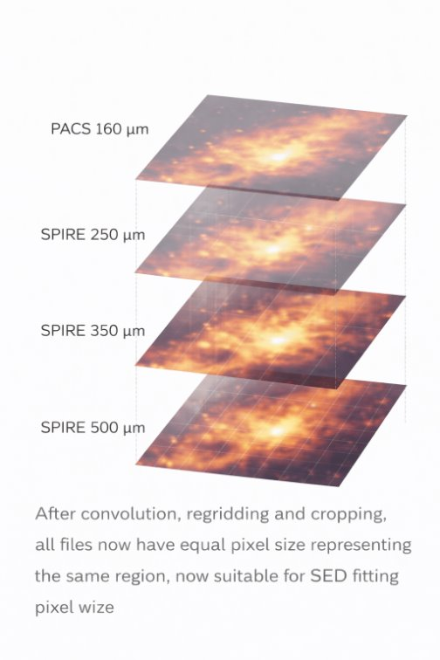
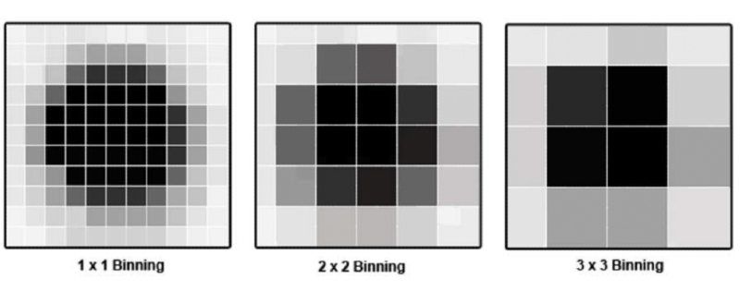
Reprojection (Binning) and cropping
from reproject import reproject_interp

Slide 12
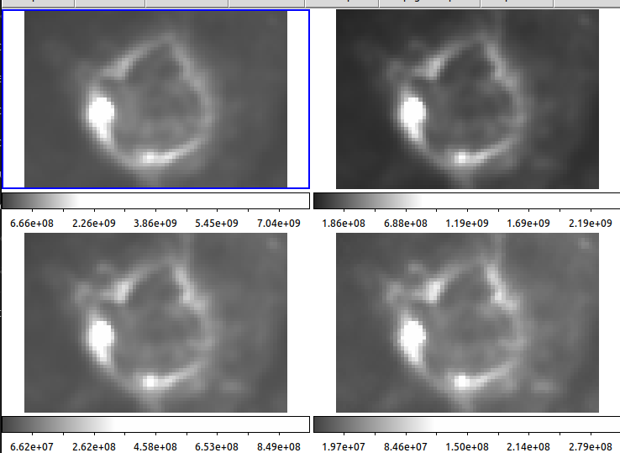
After reprojection and cropping

Slide 13
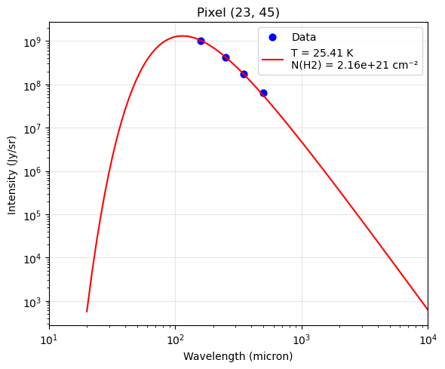



Modified Blackbody (Greybody)
Plank Function:
where the amplitude A contains all the column density and opacity terms:

Slide 14
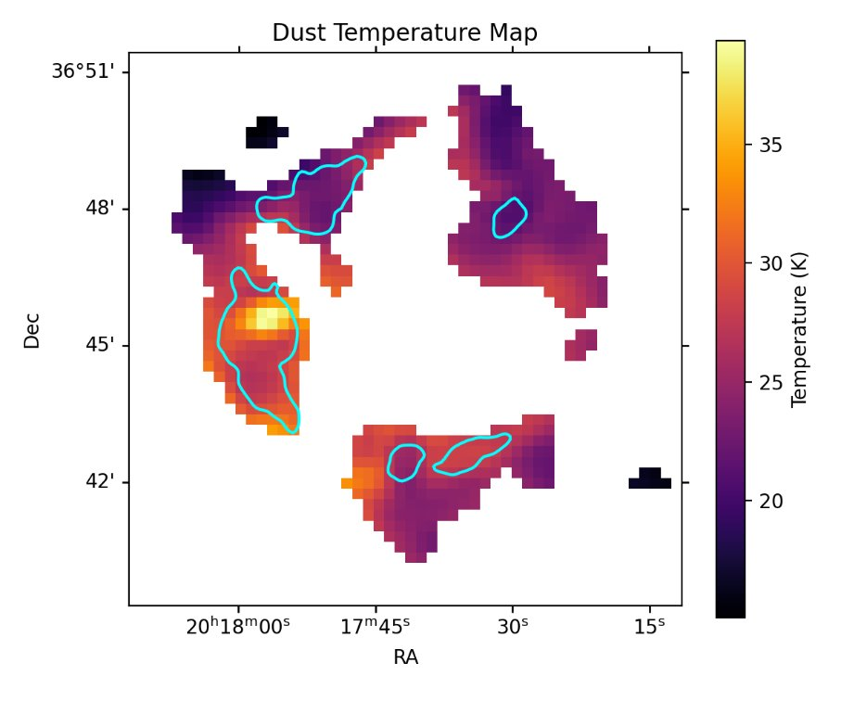
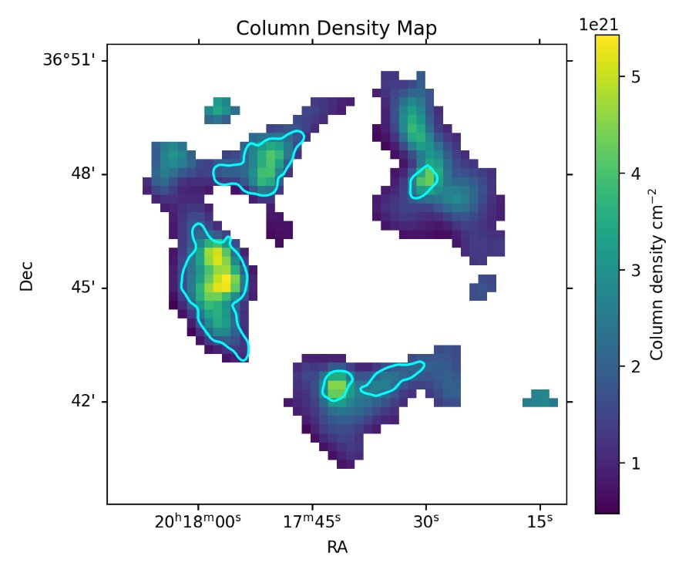
Resultant map

Slide 15
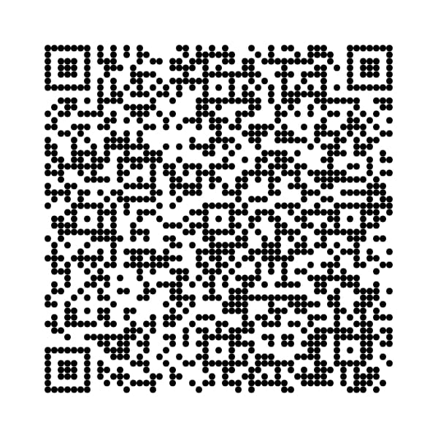
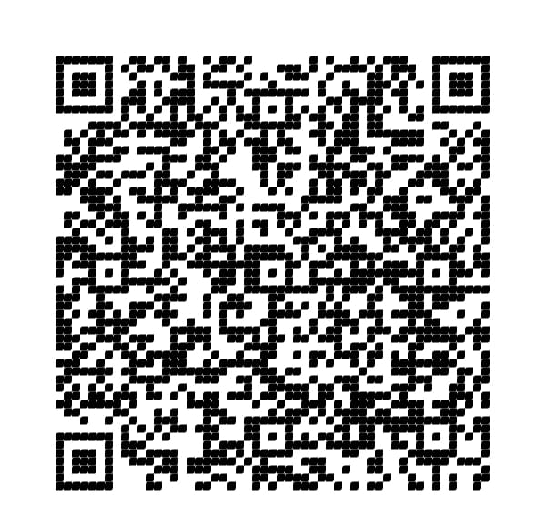
Let's Try!
Colab notebook
Gdrive link
https://l1nk.dev/dust-temp
https://acesse.one/G-drive

Slide 16
Thank you!

