Slide 1
Capstone Project - The Battle of Neighborhoods:
Comparison of New York Manhattan neighborhoods for the coffee shop Biz investors
Jan. 2019
S.B. Park

Slide 2

Problem statement :
[Objective]
: To provide analysis data to our customer who want to open Korean style coffee shop brand in big cities in North America (such as NY, Toronto), the best quality areas for the determine of the coffee shop business.
[Problem statement]
: Our customer wish to start a new coffee shop franchise business in New York city. Because there are already many coffee shops and cafés in this big city, in order to catch new market opportunities, our customers want to open coffee shop brand with differentiated characteristics. The customer is preparing a Korean style coffee shop brand considering the popularity of the K-pop music culture which has many fans in this area recently.
The customer wants to determine which of the area(s) in New York city are better suited to open coffee shop businesses.

Slide 3
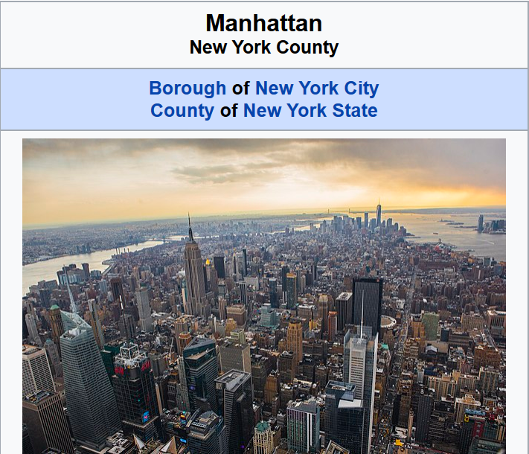
Data description :
Following data are used for this Capstone project.
[FourSquare API]
Query to get such categories information. . Number of coffee shop & café categories. . Number of (Korean) restaurant category.
[Neighborhood data]
- Geospatial postal data for NY, USA http://cocl.us/Geospatial_data

Slide 4
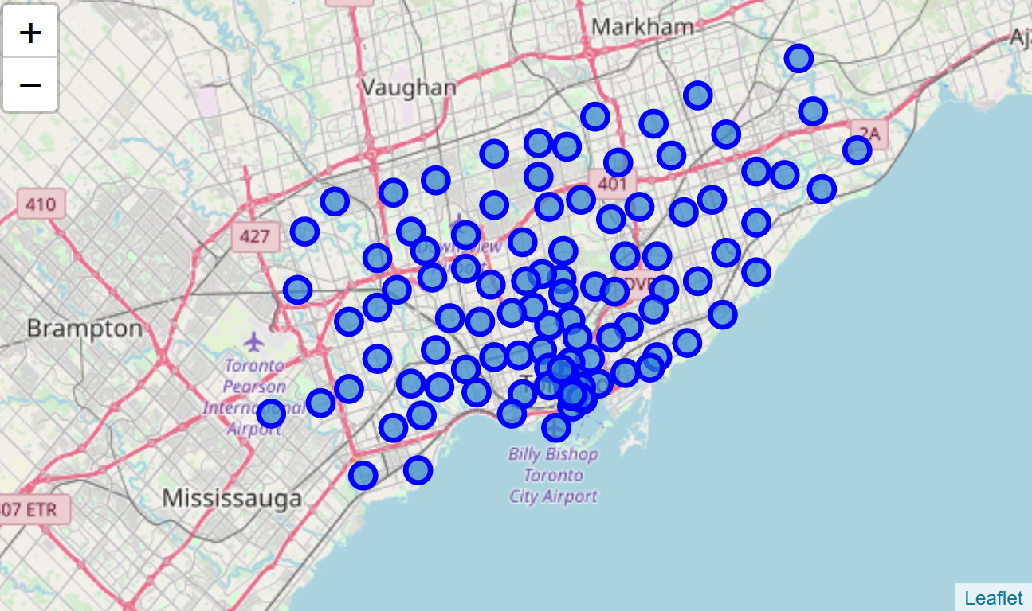
Data Analysis :
Identifying neighborhoods in Manhattan, New York.

Slide 5
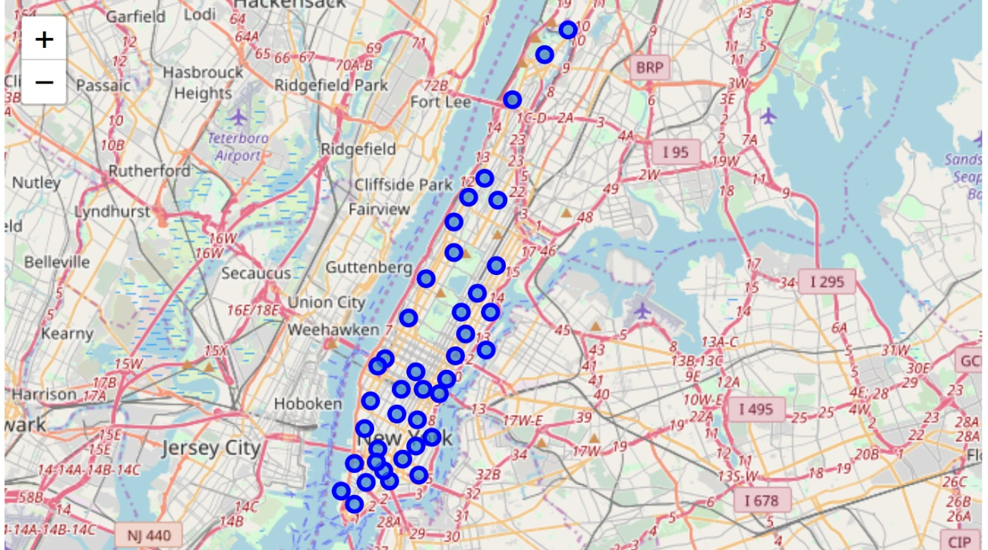
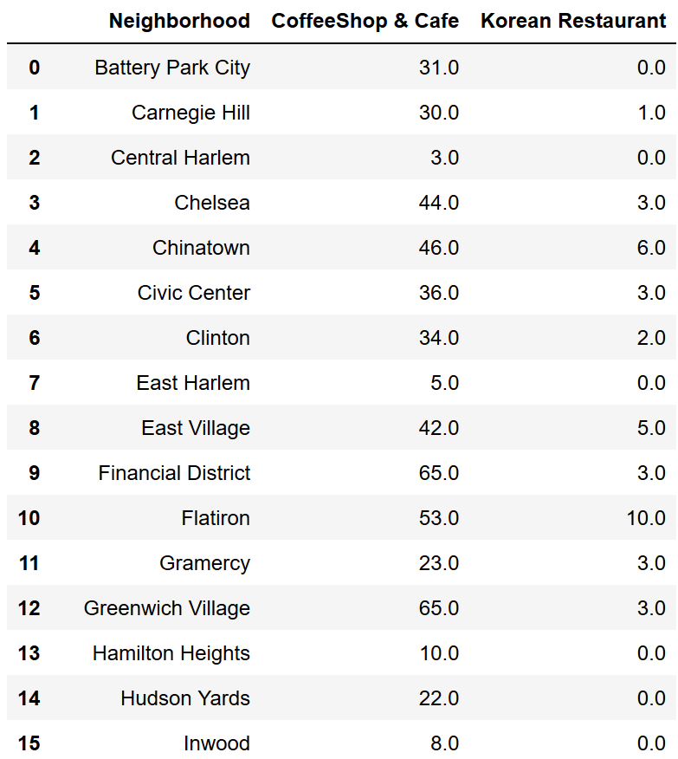
Data Analysis :
Explore and cleansing venues data of ‘Manhattan’ which retrieved using Foursquare API

Slide 6
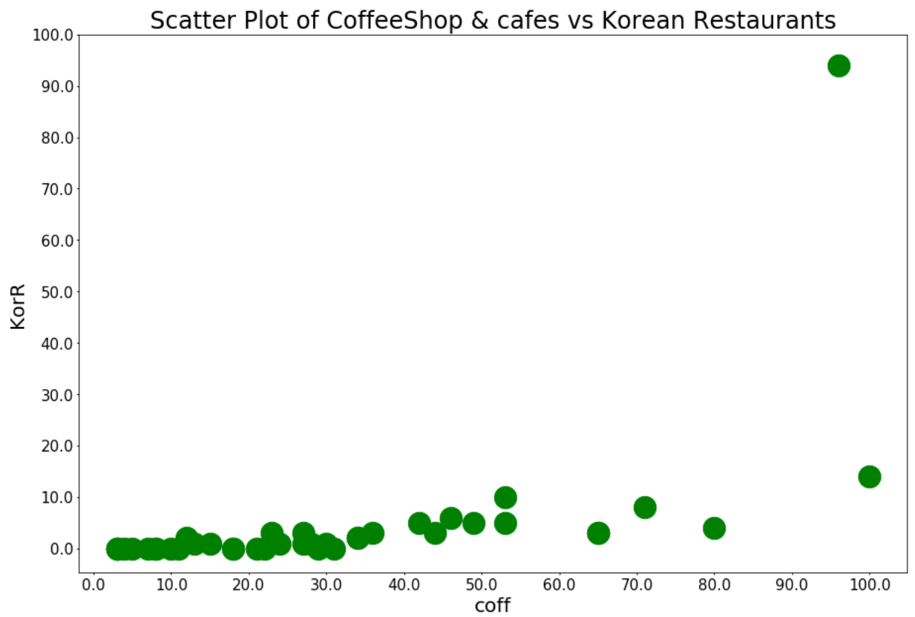
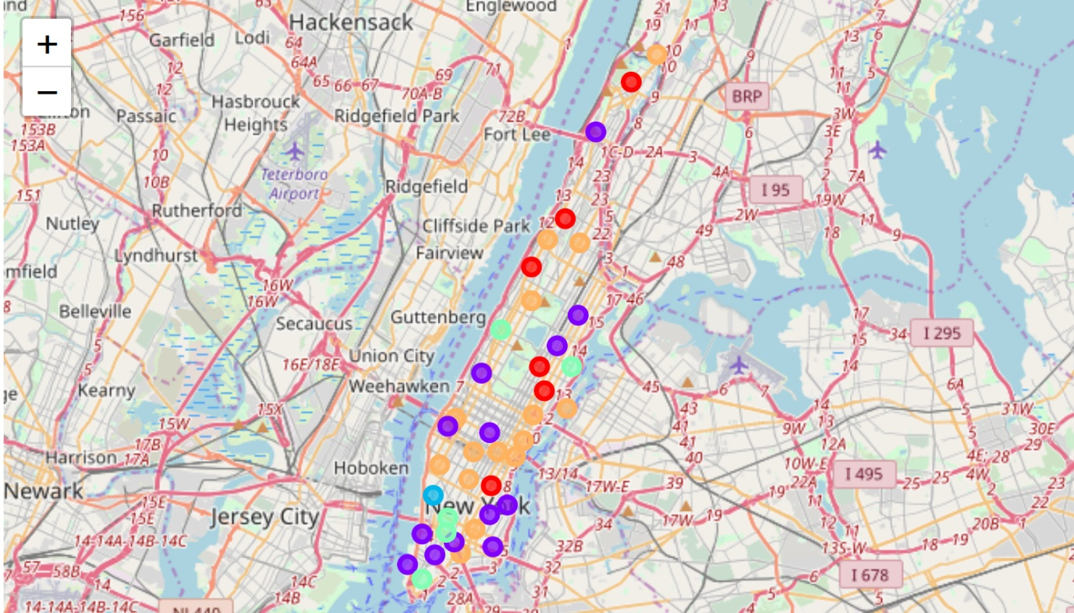
ML Analysis :
It’s been analyzed using two machine learning algorithms.
[k-means plot-data] [k-means clustering]

Slide 7
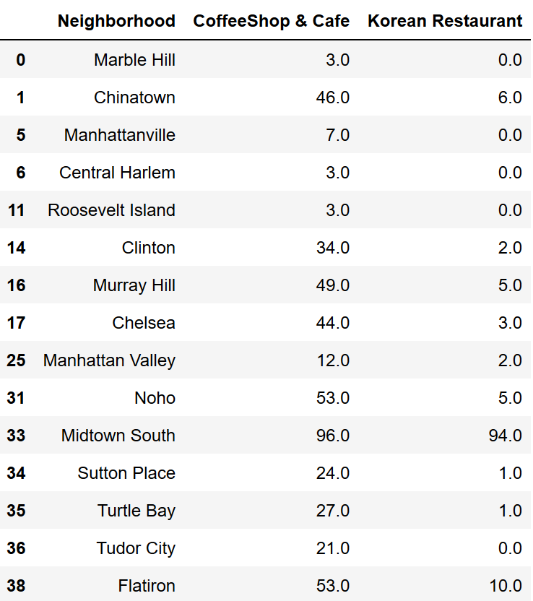
Recommend :
Conclusion
Best recommending neighbor is : Midtown South
Second recommending neighbor is : Flatiron
Third recommending neighbor is : Chinatown

