Slide 1
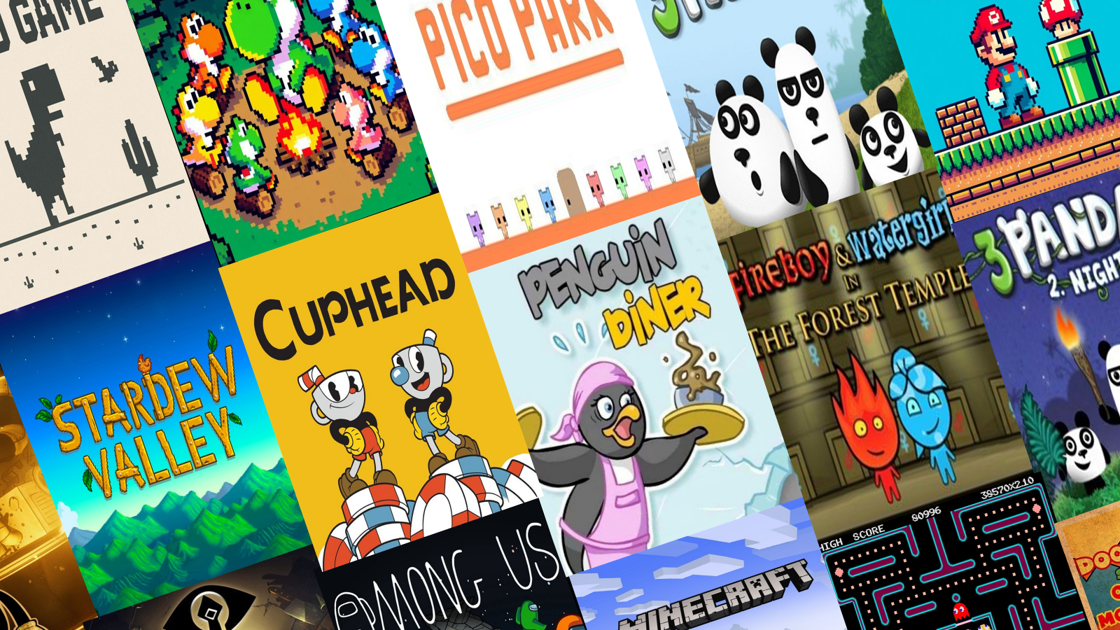
Multiplayer
Game Engine

Slide 2
Project Structure​
Header Files (.h)
Header files contain class declarations, function prototypes, and variable definitions. They serve as an interface that allows other files to access a class without exposing its implementation. Any source file that requires access to a class simply includes its corresponding header file.
Source Files (.cpp)
Source files contain the full implementation of the functions and classes declared in the header files. This is where the actual logic and functionality of the program resides.
Why separate?
Separating the code into multiple files allows team members to work independently without conflicts. It also improves code maintainability, reduces compilation time, and makes debugging significantly easier by isolating each component of the system.
To align with this modular architecture, the development team was structured into
3 sub-teams, each managing specific components independently

Slide 3
THE CORE
ENGINE TEAM
Collective Responsibilities
Team Members
Game Loop Architecture: Syncing input, physics, and rendering for stability
Yassin Athula
Mohraeel Khalaf
Entity Manager: Managing object life-cycles and dynamic memory allocation
Physics Engine: Implementing custom AABB collision detection and resolution
System Integration: Connecting core modules with Gameplay and Networking

Slide 4
GAMEPLAY
LOGIC TEAM
Collective Responsibilities
Team Members
Character Class System: Designing Heavy, Tall, and Nimble abilities
Eman Mohammad
Abanoub Hany Fahim
Helen Hany
Haneen Amr
Puzzle Interaction Logic: Developing pressure plates and timed doors
Entity State Management: Handling movement physics and interaction triggers
Cooperative Mechanics: Implementing multi-player environmental challenges.

Slide 5
NETWORK
SYNCHRONIZATION
Collective Responsibilities
Team Members
Relay Server Infrastructure: Establishing raw Socket communication
Youssef Sameh
Seif Allah Wael
Data Serialization: Designing efficient packet transfer protocols
State Synchronization: Ensuring zero latency between players

Slide 6
Why Vector over Array?
During the research phase of our project, we identified a critical limitation of standard C++ arrays: their size must be defined at compile time and cannot be modified during runtime. In the context of a game engine, where the number of active entities — including players, push-able boxes, and buttons — changes dynamically throughout gameplay, this constraint is unacceptable.
Array | Vector
Fixed size | Dynamic size
Defined at compile time | Resizes at runtime
Cannot add/remove | Add/remove freely
We therefore adopted vector from the C++ Standard Template Library, which provides a dynamically resizable array. This allows the engine to efficiently manage game objects in real time, adding and removing entities as needed without any predefined size restrictions.
Compile-time | runtime-Resize
Manual Memory | Auto Managed

Slide 7
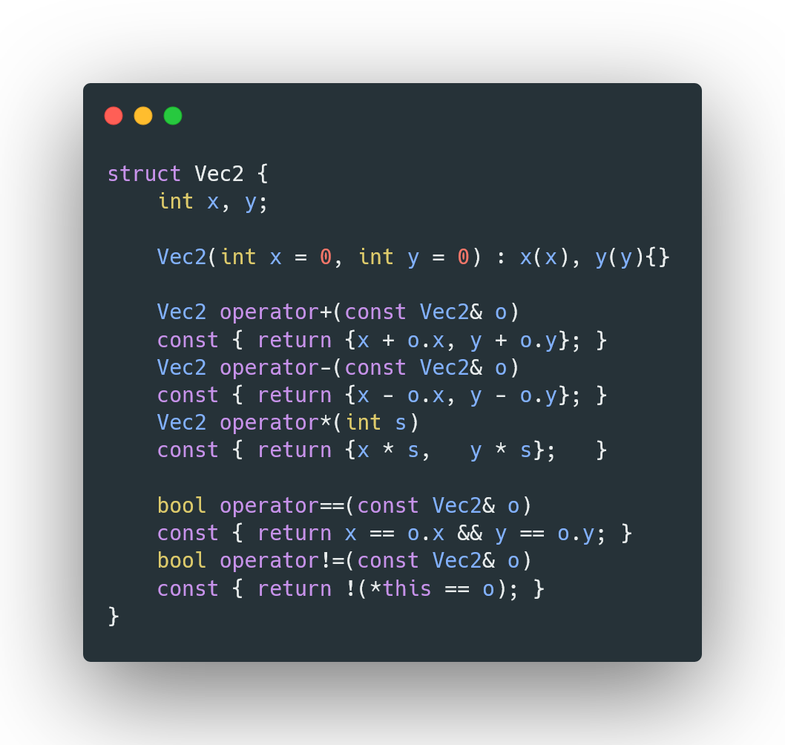
Struct
What is it?
A struct is similar to a class but members are public by default.
In our engine, Vec2 is a struct that holds x and y coordinates. It is used everywhere — position, velocity, direction — shared by all teams.
 | Class | Struct
Members | Private | Public
Usage | Complex logic | Data Only
Our Engine | Entity, Engine,… | Vec2
Why Struct and not Class? Vec2 only holds two integers with no logic or access restrictions needed — a struct keeps it simple, lightweight, and directly accessible by all teams.

Slide 8
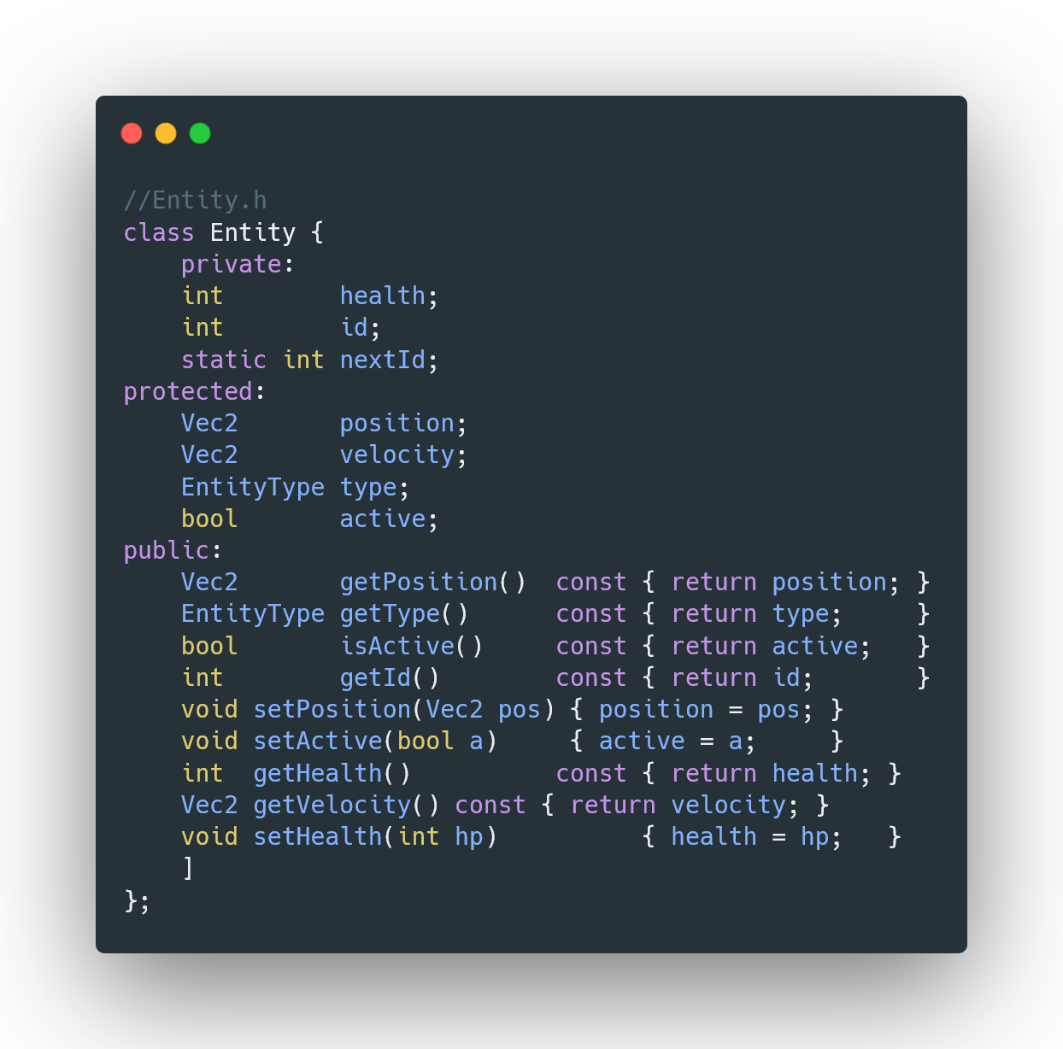
Classes
What is it?
A class is a blueprint that bundles data and behavior into one unit. Our engine is built from classes each with a clear responsibility:
Engine
Singleton — master game loop
Entity
Base object — all game entities
EntityManager
Manages entity lifecycle
PhysicsEngine
Collision detection & positions
EventManager
Observer pattern — event bus
GameWorld
World state & entity spawning

Slide 9
Encapsulation
What is it?
Hiding internal data and only exposing what is necessary through public methods. In our engine, Entity keeps health and id as private — accessed only via safe public methods.
private:
Only accessible inside the Entity class itself — no other class can read or modify it directly.
health, id, nextId — no direct access
protected:
Accessible inside Entity and any class that inherits from it — hidden from the outside world.
position, velocity, type, active
public:
Accessible by anyone — this is the safe interface we expose to interact with the entity.
getPosition(), takeDamage() — safe API

Slide 10
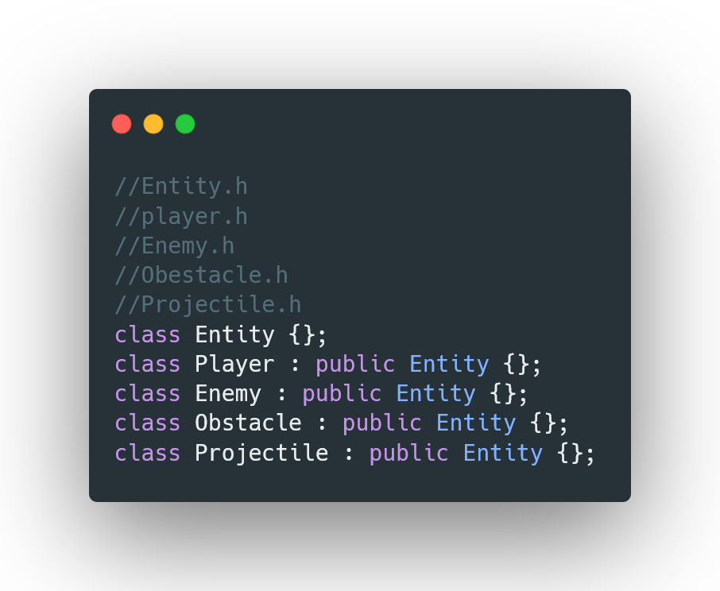
Inheritance
What is it?
A derived class inherits attributes and methods from a base class, allowing code reuse and specialization.
In our engine, Entity is the base class. Player, Enemy, Projectile and Obstacle all inherit from it — they automatically get position, velocity, health and all shared methods.
Entity (Base Class)
Player Enemy Projectile Obstacle

Slide 11
Overloading
What is it?
Overloading means defining multiple versions of a function or operator with the same name but different parameters.
In our engine, the Vec2 struct overloads 5 operators so that positions and velocities can be added, subtracted, scaled, and compared naturally in code:
operator+
→ add positions
operator-
→ distance / direction
operator*
→ scale velocity
operator==
→ compare positions
operator!=
→ check movement

Slide 12
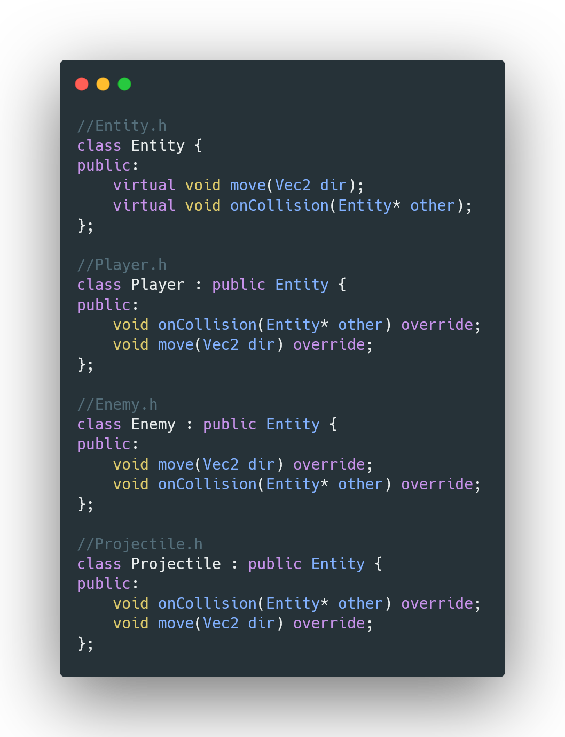
Overriding
What is it?
Overriding means redefining a virtual method from the base class inside a derived class to give it a different behavior.
In our engine, every Entity has virtual move() and onCollision(). Each derived class overrides them differently:
Player::move()
slides left/right, applies gravity
Enemy::move()
moves left with random vertical drift
Projectile::move()
travels by its own velocity vector
Obstacle::move()
does nothing — static object

Slide 13
Pointers 💡
Pointers store memory addresses. Our engine uses both raw pointers (for non-owning references) and smart pointers (unique_ptr) for automatic memory management.
Raw Pointers (Entity*)
Smart Pointers (unique_ptr<Entity>)
Engine* instance → Singleton self-reference
EntityManager stores vector<unique_ptr<Entity>>
Entity* getEntityById() → non-owning lookup
EntityFactory::createEntity() returns unique_ptr
PhysicsEngine* in GameWorld → injected dependency
Auto-deleted when removed from the vector
onCollision(Entity* other) → temporary reference
Zero manual delete — no memory leaks
Polymorphism in Our Engine
Since we used virtual functions with overriding across all derived classes,
and accessed them through an Entity* base pointer, we achieved Runtime Polymorphism in our engine.

Slide 14
ANY
QUESTIONS?
Thank you for your attention

