Slide 1
Analyzing Customer Behaviour
for E-commerce Insights
Churn prediction on 867,000 records of Ghanaian e-commerce activity
Technical Assignment · Npontu Technologies Intelligent Systems Services Engineer Harrison Nana Kwaku Agyako
Notes:
I generated a six-table dataset, cleaned it, engineered features, built a Random Forest churn model, then pruned it and ran the streaming pipeline on Docker.

Slide 2
The brief, and what I delivered
Six requirements, each mapped to a section of the notebook
1
Dataset
Six related tables, 18 months, deliberately dirty
2
Data cleaning
281,569 logged corrections across duplicates, nulls, formats
3
Feature engineering
98 features engineered, pruned to 28 for the final model
4
Predictive model
Random Forest churn classifier, 0.849 test AUC
5
Big data tooling
Kafka -> Elasticsearch -> Kibana, running on Docker
6
Business insight
Six recommendations, each backed by evidence

Slide 3
The dataset
Six related tables simulating 18 months on a Ghana-based platform
TABLE
ROWS
CONTENT
867,265
customers
20,706
demographics, acquisition, loyalty tier
total records ingested
products
1,555
catalogue, price, cost, category
~106 MB across six tables
orders
62,880
order header, payment, delivery
order_items
116,236
line items, quantity, discount
Why generate it?
Real e-commerce data is dirty. I injected the defects deliberately so the cleaning stage had something genuine to solve, and so every fix is verifiable against a known count.
events
646,969
Clickstream - views, carts, purchases
reviews
18,919
ratings and review text

Slide 4
What was wrong with the data
Findings from exploratory analysis — before a single fix
10,188
25 → 6
32.7%
duplicate events
payment spellings
dates mis-parsed
The same click logged twice by a double-fired analytics tag. Left in, every funnel metric inflates.
"MTN MoMo", "momo", "MOMO" counted as separate methods. Any revenue-by-payment chart would be wrong.
The obvious parser silently reads 2024-07-11 as 7 November. No error, no warning, just wrong.
3 kinds
401
300
of missing value
impossible orders
duplicate people
Real nulls, empty strings, and the literal text "N/A" , all in one column.
Orders dated before the customer signed up. A referential violation, not a typo.
Same human, new customer_id. Exact de-duplication cannot catch these.

Slide 5
Cleaning: 281,569 corrections, fully audited
Every step logs what it changed and how many rows it touched
281,569
13,340
6
100%
CORRECTIONS APPLIED
DUPLICATE ROWS REMOVED
TABLES RECONCILED
STEPS LOGGED
Principles applied
Recover, don't impute
Void, don't invent
Missing line prices were joined from the product catalogue, the real value, not a guess.
A 1899 birthday is wrong but unknowable. It becomes null; the row survives.
Consolidate, don't delete
Log everything
Duplicate accounts were merged and their order history re-pointed, not discarded.
Cleaning silently mutates data. An audit trail makes it reviewable rather than trusted.

Slide 6
Avoiding target leakage
The single most important design decision in the project
The trap
Build features from all 18 months, then label churn as "no purchase in the last 90 days." Recency then IS the label. The model scores ~0.99 AUC and is useless at prediction time when you do not know the future.
features built here
label defined here
OBSERVATION
PREDICT
2025-01-01
2026-04-01
2026-06-30
The fix
Split the timeline. Features come only from before the cutoff; the label comes only from the 90 days after it. Recency measured at the cutoff is now honest showing exactly what a live system would know.
Verified: strongest single feature correlates 0.52 with churn.
No feature gives the answer away.

Slide 7
98 features across four data sources
Engineered broadly because which source carries the signal was not obvious
52
Purchase / RFM
Two features I am
proudest of
Recency, frequency, monetary, basket size, discount dependency, delivery experience
recency vs cadence Not days since last order — days relative to that customer's own rhythm. A weekly buyer silent for a month is a far stronger signal than the raw number. discount dependency What share of their spend is subsidised by promotions. Separates customers loyal to the brand from those loyal to the discount.
31
Behavioural
Sessions, dwell time, funnel conversion, bounce rate, device mix, recent activity
11
Demographics
Age, region, acquisition channel, loyalty tier, tenure, income
4
Reviews
Review count, average rating given, helpfulness

Slide 8
Model selection: floor, baseline, candidate
A score means nothing without a reference point
Reading this honestly
The dummy sits at exactly 0.50 confirming AUC is measured correctly, since a no-skill model must score chance. Logistic regression essentially ties the Random Forest (0.843 vs 0.844). The forest wins on recall and F1 and gives usable feature importances, but this is not a decisive victory. When a linear model matches an ensemble, the signal is largely linear, which later justified using an L1 selector to prune.

Slide 9
Held-out test performance
A 25% test set touched by no cleaning statistic, no fold, no tuning run
0.846
89.2%
71.5%
0.07
ROC-AUC
CHURNERS CAUGHT
PRECISION
TRAIN–TEST GAP
Threshold tuned to 0.337, not 0.50
Test AUC matches CV AUC
The default treats both errors as equal. A missed churner costs the customer, a false alarm costs one voucher. Lowering the threshold raised recall from 68% to 89%, deliberately trading precision for the cheaper error.
0.846 on held-out data against 0.844 in cross-validation. The model did not overfit the training process, the payoff of keeping every imputation and scaling step inside the pipeline, refitted per fold.

Slide 10
Which data source actually drives the model?
Each feature block retrained in isolation — the answer was not the obvious one
The finding
Clickstream behaviour alone (0.839) essentially matches the full model (0.844). Demographics barely beat chance. Purchase history helps. But browsing behaviour is carrying the prediction. Why it matters: people go quiet in their browsing before they stop buying. The clickstream is the early-warning signal — and that justifies the streaming architecture as capturing the asset that actually predicts churn.

Slide 11
Feature selection: 98 down to 28
Engineering and selection are different steps, the ablation showed 67 features bought 0.006 AUC
Two selectors compared
SELECTOR
N
TEST AUC
All features
98
0.8456
L1 / Lasso
28
0.8487
Concept-grouped
25
0.8471
Behavioural only
31
0.8485
L1-penalised logistic regression drives uninformative coefficients to zero and resolves redundancy automatically, given a correlated group it keeps one and drops the rest. Pruning 71% of the features did not cost accuracy. The honest claim is "no loss", not "a better model“, 0.003 is within fold noise. But the pruned model is explainable, cheaper to maintain, and its importances are interpretable.
Engineer broadly to explore. Select to ship.

Slide 12
What separates churners from loyal customers
Churn rate by acquisition channel — a 21-point spread
Three other drivers
Discount dependency
Customers whose spend is heavily promo-subsidised churn more. Loyal to the discount, not the brand.
Delivery time
Churn rises steadily with average delivery days — reframing logistics as a retention lever.
Loyalty tier
Higher tiers retain better, but tier is a symptom as much as a cause.
These are associations, not proven causes. Confirming causation would need a controlled experiment — speed up delivery for a random subset and measure the difference.

Slide 13
From model score to retention campaign
The deliverable is a ranked call list, not an AUC
Target the riskiest 20%
The output file
98%
57%
churn_risk_scores.csv
churn_probability — model score per customer
of the contacted list
really does churn
if you contacted
people at random
risk_decile — 1 to 10, for operational triage
expected_revenue_at_risk — probability × value
Same retention budget, nearly double the hit rate. Capture rate is capped by the budget itself with fewer contacts than churners, precision is the metric that matters, and the model reaches 98% of what is achievable at that spend.
acquisition_channel, loyalty_tier — context
Ranked by expected revenue at risk, not raw probability. A 90%-likely churner who spent GHS 50 matters less than a 60%-likely one who spent GHS 5,000.

Slide 14
Production architecture
Why streaming, and why these three tools
Kafka
Elasticsearch
Kibana / Grafana
Ingestion buffer
Serving store
Dashboards + alerting
Decouples producers from consumers, a traffic spike grows the backlog instead of dropping data. Its replayable log would let us reprocess the duplicate-event window after a fix. Partitioning by customer_id is what makes correct sessionisation possible.
The queries are time-filtered aggregations over semi-structured events, exactly its index-and-aggregate model. Near-real-time indexing puts a funnel dashboard seconds behind live traffic, not a day.
Kibana serves the operational dashboards. Grafana adds threshold alerting: if hourly conversion drops below its rolling baseline, the growth team is paged rather than finding out next week.
▶
▶

Slide 15
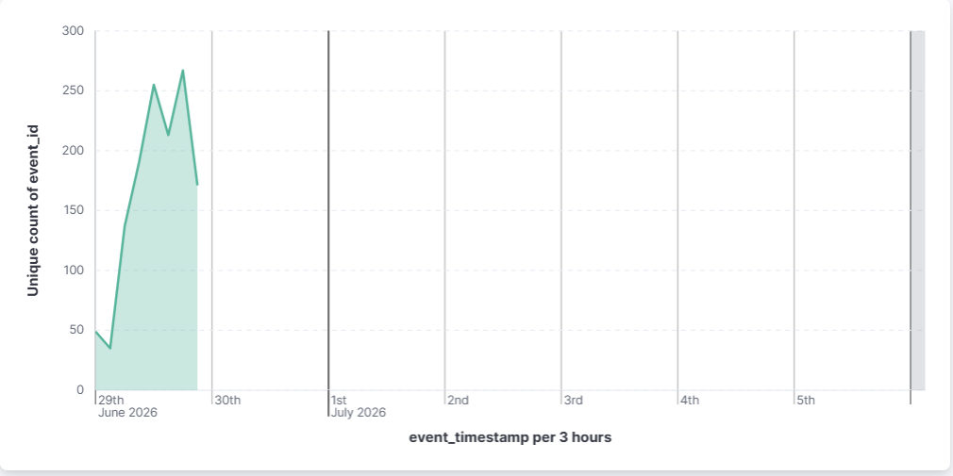
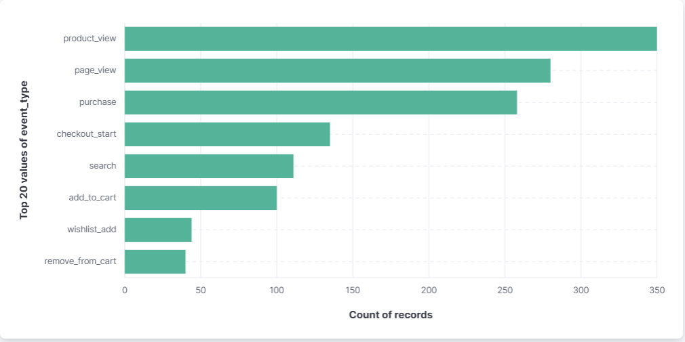
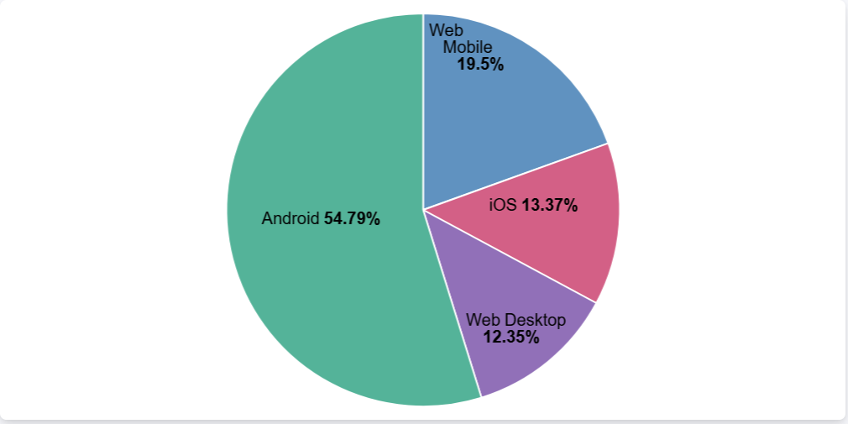
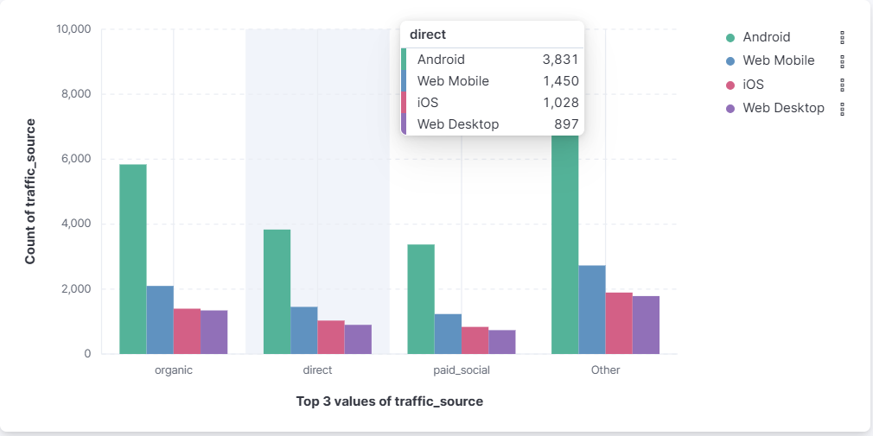
The live dashboard
Kibana over 40,000 events indexed by the streaming consumer
Hourly event volume
Funnel by stage
Device mix — Android 54.8%
Traffic source by device
Notes:
Indexed count is 40,000 against 40,640 published — that gap is the double-fired-tag problem from cleaning, now handled at the streaming layer.

Slide 16
Six recommendations
Each one backed by a specific finding, not a general principle
1
Reallocate acquisition spend
2
Treat delivery as retention
Paid social churns at 67%, referral at 46%. Judge paid channels on 90-day retention, not first-order volume.
Churn rises with delivery time. A northern pickup point is a retention investment, not just logistics.
3
Cap discount dependency
4
Fix sessionisation, then the funnel
Heavy promo users churn more. Move them to loyalty benefits and free-delivery thresholds that raise order value instead of eroding margin.
Carts and purchases are not stitched into one session — a tracking gap that blocks measurement. Fix it, then run the MoMo one-tap checkout experiment.
5
Operationalise the model
Score every active customer nightly and hand retention the top 20%. That list is 98% churners against a 57% base rate.

Slide 17
What I would do differently
Limitations stated plainly, and the next steps they imply
Synthetic data
I generated it, so effect sizes are indicative rather than measured. The pipeline transfers unchanged; the coefficients would need re-estimating on real data.
One cutoff date
The model is validated at a single point in time. Production should use rolling-origin validation across several cutoffs to confirm stability.
Cost-blind threshold
F1 treats both errors as equal. With real customer lifetime value and voucher cost, the threshold should minimise expected cost instead.
Random Forest was not a decisive win
Logistic regression matched it on AUC. Gradient boosting typically edges out both on tabular data and handles missing values natively.
A sessionisation gap I could not close
Session-level funnel metrics are unmeasurable on this data. I reported the customer-level figure and flagged the gap rather than quoting a number I do not trust.
No text modelling
Review text is untouched. Sentiment features and a market-basket recommender are the clearest unexploited signal.

Slide 18
The through-line
Clean rigorously → engineer without leakage → validate honestly → select to ship → translate to action
867,265
98 → 28
0.849
40,640
records cleaned
features, no loss
test ROC-AUC
events streamed
Harrison Nana Kwaku Agyako · Npontu Technologies Technical Assignment

