Slide 1
Spring Framework
http://projects.spring.io/spring-framework/
報告者：李佳學
簡報日：2014/01/15

Slide 2
Outline
Introduction
Spring Framework
Modules
IoC
AOP

Slide 3
Introduction

Slide 4
Spring Framework 舉例ejb and spring
Since 2004
Rod Johnson 對 Java EE 官方 EJB 方案表示懷疑
開發不易
依賴強，依賴 container: Glassfish, Jboss
輕量級的 Java EE Framework
核心價值: IoC 與 AOP
Current Release 4.0.0
Version 4.0 is the latest major release of the Spring Framework and the first to fully support Java 8 features
Intro
Notes:
4.0
Improved Getting Started Experience
Removed Deprecated Packages and Methods
Java 8 (as well as 6 and 7)
Java EE 6 and 7 (Java EE version 6 or above is now considered the baseline for Spring Framework 4) , 可能只支援4.0以上
Groovy Bean Definition DSL
Core Container Improvements
General Web Improvements (Spring Framework 4.0 is now focused primarily on Servlet 3.0+ environments), 要用要小心
WebSocket, SockJS, and STOMP Messaging
Testing Improvements

Slide 5
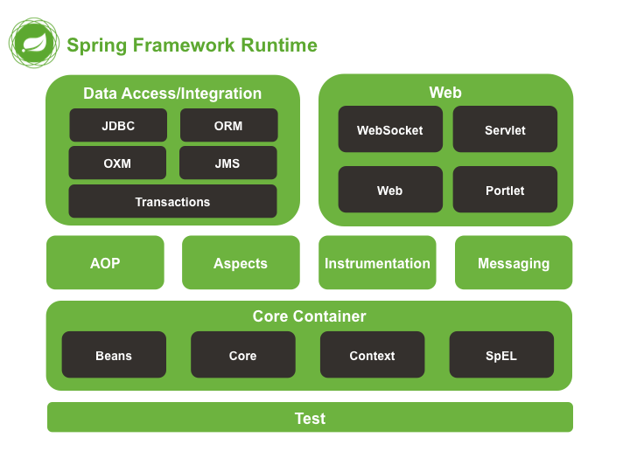
Spring Framework
Intro

Slide 6
Modules
IOC

Slide 7
Inverse of Control - IoC
實現依賴抽象、模組依賴抽象
類似 design pattern 中的, factory, builder, service locator
Two Way
Dependency Injection – DI
Service Locator
Ref: http://martinfowler.com/articles/injection.html
Modules – IoC
Notes:
Patterns: Factory, Abstract Factory, Builder, Decorator, and Service Locator to compose …etc
Formalized design patterns
IoC 的 Control 是控制的意思，其實其背後的意義也是一種依賴關係的轉移，如果A依賴於B，其意義即是B擁有控制權
Martin Fowler – IoC = DI and Service Location
Testing easier (常見原因，但不是絕對) – badly design, 順便批評EJB

Slide 8
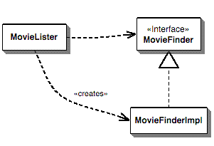
Inverse of Control - IoC
一般寫法
Ref: http://martinfowler.com/articles/injection.html
Modules – IoC
Notes:
MovieLister 依賴兩個
抽換時作需修改原本code
清單維護或抽換的不易
demo

Slide 9
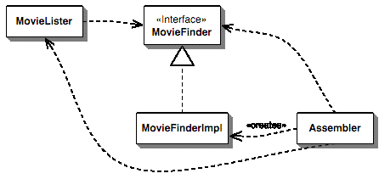
Inverse of Control - IoC
Dependency Injection
Ref: http://martinfowler.com/articles/injection.html
Modules – IoC
Notes:
1.簡單方便
demo

Slide 10
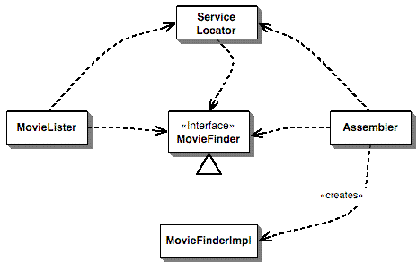
Inverse of Control - IoC
Service Locator
Ref: http://martinfowler.com/articles/injection.html
Modules – IoC
Notes:
註冊 finder
Singleton
Framework: Apache Avalon, http://avalon.apache.org/closed.html has closed, 不重複造車
demo

Slide 11
Inverse of Control - IoC
Why dose SPRING choose DI
依賴關係可見性
Testing easier (常見原因，但不是絕對)
簡單利用、開發 (以提供框架來說)
Ref: http://martinfowler.com/articles/injection.html
Modules – IoC
Notes:
Patterns: Factory, Abstract Factory, Builder, Decorator, and Service Locator to compose …etc
Formalized design patterns
IoC 的 Control 是控制的意思，其實其背後的意義也是一種依賴關係的轉移，如果A依賴於B，其意義即是B擁有控制權
Martin Fowler – IoC = DI and Service Location
Testing easier (常見原因，但不是絕對) – badly design, 順便批評EJB

Slide 12
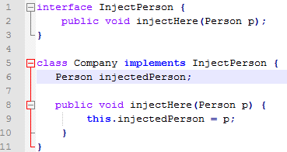
Inverse of Control - IoC
3 main styles
Type 1 IoC (interface injection)
複雜不易使用
須先implement inject interface
Type 2 IoC (setter injection) (spring support)
優點：簡單，擴充方便
缺點：需提供 setter，有可能在 running time 時被改變
Type 3 IoC (constructor injection) (spring support)
優點：Object被初始時，已初始屬性，具有保護性(不被改變)
缺點；當太多 constructor 時容易混淆不易記
缺點； constructor 參數位置不容易記得
Modules – IoC
Notes:
demo

Slide 13
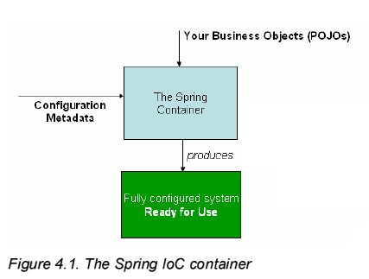
IoC Container
Modules - IoC
Notes:
These days many developers choose Java-based configuration for their Spring applications

Slide 14
IoC Container
Configuration
XML-based
ClassPathXmlApplicationContext
FileSystemXmlApplicationContext
WebApplicationContext
Annotation-based (Spring 2.5+)
An alternative to XML setups
java-based (Spring 3.0+)
Class with @Configuration
Class with @Component
Modules - IoC
Notes:
demo

Slide 15
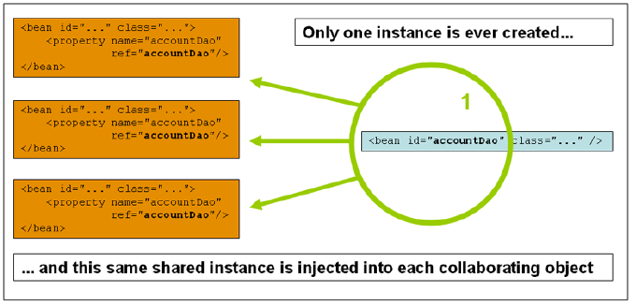
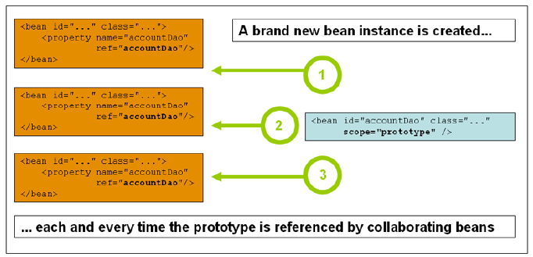
IoC Container
Bean
Injection
Constructor-based
Setter-based
Singleton (default)
Non- Singleton
scope=“prototype”
Lazy-initialized beans
lazy-init=“true”
Modules - IoC
Notes:
demo

Slide 16
Modules
AOP

Slide 17
Aspect Oriented Programming (AOP)
Aspect
在一個服務的流程中插入與服務無關的邏輯（例如Logging、Security），這樣的邏輯稱為 Cross-cutting concerns，將 Crossing-cutting concerns 獨立出來為一個物件，這樣的特殊物件稱之為 Aspect – by 林信良
AOP
AspectJ, annotation-style
AOP with Spring
Spring AOP, enable to integrate with AspectJ
Proxy-based
Modules - AOP
Notes:
Aspect-Oriented Programming (AOP) complements Object-Oriented Programming (OOP) by providing another way of thinking about program structure.
Aspect: 在一個服務的流程中插入與服務無關的邏輯（例如Logging、Security），這樣的邏輯稱為 Cross-cutting concerns，將 Crossing-cutting concerns 獨立出來為一個物件，這樣的特殊物件稱之為 Aspect
AspectJ:
Proxy demo

Slide 18
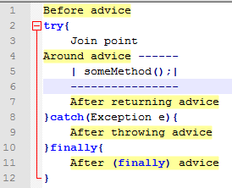
AOP – Concept
Aspect
Join point
切入點 ( Spring, exec method or handle exception )
Advice
實際在 joint point 運作的動作
包含 before advice, after returning advice, after throwing advice, after (finally) advice, around advice
Pointcut
描述切入點, 符合的皆會執行對應的 advice
AspectJ pointcut expression language (spring used by default)
Modules - AOP
Notes:
縫合（Weave）

Slide 19
AOP – Concept
Introduction
Spring treats introduction advice as a special kind of interception advice Target Object
AOP Proxy
Weaving
Modules - AOP
Notes:
Weave:縫合
Target Object : 被cut的對象
JDK Dynamic proxy can only proxy by interface (so your target class needs to implement an interface, which will also be implemented by the proxy class). CGLIB (and javassist) can create a proxy by subclassing. In this scenario the proxy becomes a subclass of the target class. No need for interfaces. So Java Dynamic proxies can proxy: public class Foo implements iFoo where CGLIB can proxy: public class Foo

Slide 20
@AspectJ with Spring, spring aop 2.0
Pointcut expression
execution(modifiers-pattern? ret-type-pattern declaring-type-pattern? name-pattern(param pattern) throws-pattern?)
execution(public * *(..))
execution(* set*(..))
execution(* com.xyz.service.AccountService.*(..))
execution(* com.xyz.service...(..)
Demo
Notes:
execution(public * *(..)) : the execution of any public method
execution(* set*(..)) : the execution of any method with a name beginning with "set“
execution(* com.xyz.service.AccountService.*(..)) the execution of any method defined by the AccountService interface:
execution(* com.xyz.service...(..)) the execution of any method defined in the service package or a sub-package:
(*,String)

Slide 21
Spring aop proxy-based, spring aop 1.2+
Aspect = proxy
ProxyFactory
Advice types in Spring
Interception around advice
Class implements MethodInterceptor
Before advice
Class Implements MethodBeforeAdvice

Slide 22
Spring aop proxy-based, spring aop 1.2+
Advice types in Spring
After Returning advice
implements AfterReturningAdvice
Introduction advice
a special kind of interception advice.
Advisor = aspect = proxy
contains just a single advice object associated with a pointcut expression.

Slide 23
Q & A
謝謝

Slide 24
Q1: 當一 bean 使用 byType Injection 時，有一個以上 bean type 同時存在，可以嗎?
Ans: Allows a property to be autowired if exactly one bean of the property type exists in the container. If more than one exists, a fatal exception is thrown, which indicates that you may not use byType autowiring for that bean. If there are no matching beans, nothing happens; the property is not set. 根據以上 Spring doc 解釋，當啟動時會 throws a fatal exception

