Slide 1

Customer Billing System
Project Review - 2
- Group 11

Slide 2
System Design

Slide 3
Algorithm
MENU: This contains all the options that can be carried out by the program
OPTION: Option Number according to the menu
NAME: Name of the Customer entered by the user
BALANCE: Money Available in Customer’s Account
Step 1: START
Step 2: Print MENU
Step 3: Input OPTION
Step 4: IF OPTION==1:
Input Customer Details
Dump customer details in NAME.dat file
Print “Details of NAME Saved Successfully”
GOTO Step 2

Slide 4
Algorithm
Step 8: IF OPTION==5:
Print “Program Terminated”
STOP
Step 5: IF OPTION==2:
Input Customer Name to be Searched
Search for the NAME.dat file
Output Customer Details
GOTO Step 2
Step 6: IF OPTION==3:
Input Customer Name and Bill Details
Search and Update for the NAME.dat file
Print “Updated Customer Balance: Rs. BALANCE”
GOTO Step 2
Step 7: IF OPTION==4:
Input Customer Name and Amount to be added
Search and Update the NAME.dat file
Print “Updated Customer Balance: Rs. BALANCE”
GOTO Step 2

Slide 5
Block Diagram

Slide 6
Start
Display MENU OPTIONS
IF MENU OPTION = 1
IF MENU OPTION = 2
IF MENU OPTION = 3
IF MENU OPTION = 4
Input Customer Details
Input Customer Name
Input Customer Name and Bill Details
Input Customer Name and Amount
Create Customer Data File
Load Customer Details
Update Customer Data File
Update Customer Data File
Output Confirmation
Output Confirmation
Output Confirmation
Output Confirmation
Stop
Output Confirmation
IF MENU OPTION =5

Slide 7
System Implementation
The program is an amalgamation of 5 Modules that are accessed by the users using the Main Module

Slide 8
Main Module
Main Module has an infinite loop that Executes the User Command as per the value returned by the Option Module. The loop can only be exited when the Value returned by the Option Module is “5”.

Slide 9
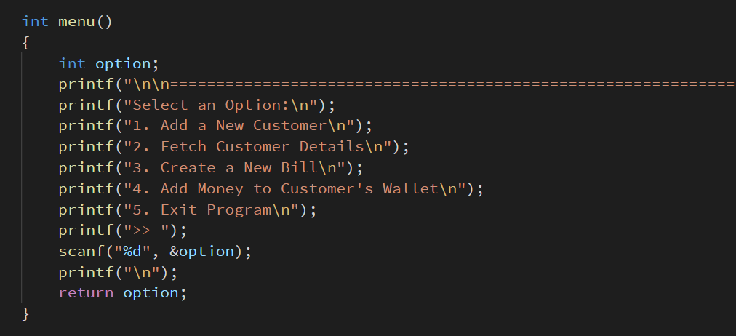
Menu Module
Menu Module prints the available functions that can be executed by the program and then inputs a number from the user which is then returned to the function call.

Slide 10
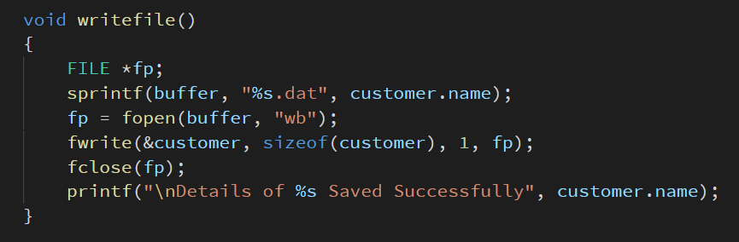
Write File Module
Write File Module dumps the Account Structure named “Customer” in a Generic Data File in the form of “CustomerName.dat” and then outputs a confirmation message.

Slide 11
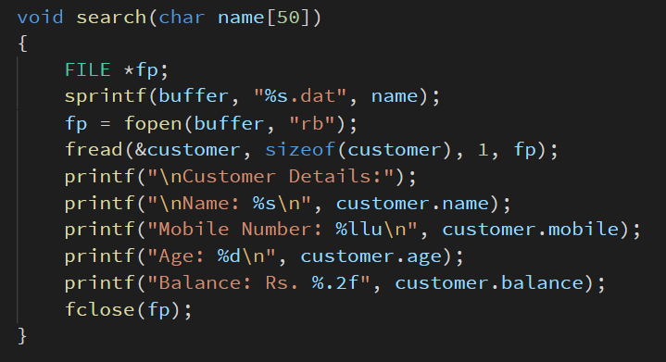
Search Module
Search Module takes Customer Name as an input and then reads the “CustomerName.dat” file after which it outputs the Customer’s Details in a Structured Format.

Slide 12
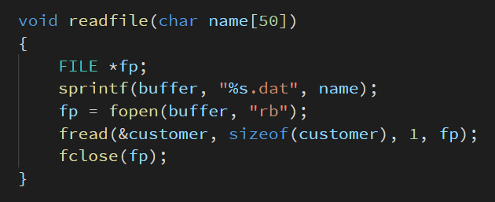
Read File Module
Read File Module takes Customer Name as an input and then reads the “CustomerName.dat” file after which it loads the read data into the Account Structure named “Customer”.

