Slide 1
Twitter Emotion Analysis
By
Hari Krishna
2015103017

Slide 2
Problem definition
In the current world of business analytics, analysts are constantly trying to identify the information about their users that can help them with providing better services.
But to collect this information, which has to be credible and reliable, it’s not a very easy task.
Today with microblogging websites like Twitter which provides developers to collect the information of the users, we can easily collect the information of the users and perform emotion analysis and figure what the general audience feel about any particular problem they face or any product in the market.

Slide 3
Literature survey
S.No. | Author|Publication|Year | Methodology | Advantages | Disadvantages
1. | Alekh Agarwal and Pushpak Bhattacharyya. Sentiment analysis: A new approach for effective use linguistic knowledge and exploiting similarities in a set of documents to be classified. In Proceedings of the International Conference on Natural Language Processing (ICON), 2005. | WordNet and POS tagging as feature. SVM classifier. | Classifying words as good and bad idea. | Very poor classifier and much better results were obtained later on
2. | Shaikh Mostafa Al Masum, Helmut Prendinger, and Mitsuru Ishizuka. SenseNet: A linguistic tool to visualize numerical-valence based sentiment of textual data. In Proceedings of the International Conference on Natural Language Processing (ICON), pages 147–152, 2007. Poster. | Contextual valence assessment based on biased POS tagging. | Recognize sentiment at sentence level | Doesn’t take into account the emotion.
3. | Theresa Wilson, Janyce Wiebe, and Rebecca Hwa. Just how mad are you? Finding strong and weak opinion clauses. In Proceedings of AAAI, pages 761–769, 2004. Extended version in Computational Intelligence 22(2, Special Issue on Sentiment Analysis):73–99, 2006. | Syntax clues to determine the strength of phrases. | Q-A and sum- marization will benefit from the rich subjectivity | -
4. | Casey Whitelaw, Navendu Garg, and Shlomo Argamon. Using appraisal groups for sentiment analysis. In Proceedings of the ACM SIGIR Conference on Information and Knowledge Management (CIKM), pages 625–631. ACM, 2005. | Creating different appraisal groups to classify sentiments | Easily classifies a lot of words | A very small database was covered.

Slide 4
S.No. | Author|Publication|Year | Methodology | Advantages | Disadvantages
5. | Alexander Pak, Patrick Paroubek from Universit´e de Paris-Sud, Laboratoire LIMSI-CNRS, Bˆatiment 508,F-91405 Orsay Cedex, France, “Twitter as a Corpus for Sentiment Analysis and Opinion Mining.” | Twitter API, Naive Bayes Classifier | Better performance while using Bigrams | Multilingual data collection and improved accuracy
6. | Bo Pang and Lillian Lee from Yahoo! Research, 701 First Avenue, Sunnyvale, CA 94089, USA, Computer Science Department, Cornell University, Ithaca, NY 14853, USA. “Opinion Mining and Sentiment Analysis.” | Supervised and unsupervised approaches to the problem | Its very subjective and depends on arguments in the document | Improve accuracy using different classifiers
7. | O’Keefe. T and Koprinska I, “Feature Selection and Weighting in Sentiment Analysis,” in Proceeding of 14th Australasian Document Computing Symposium, Dec 2009, Sydney, Australia | SentiWordNet and SWN Subjectivity scores | Uses multiple classifiers to show the performance of SWN | Only uses basic features like POS and Bag-of-Words.
8. | Pragya Tripathi, Santosh Kr Vishwakarma, and Ajay Lala, “Sentiment Analysis of English Tweet Using Rapidminer,” in International Conference on Computational Intelligence and Communication Networks, 2015, pp. 668-672. | Used sentiment vectors and emotion vocabulary | Useful for product review understanding | Only basic classifiers were used with low accuracy

Slide 5
Issues
All the paper mentioned above worked on sentiment analysis from different perspectives.
Not all the methods produced very good results or promising models in order to tackle the emotion analysis.
To contribute to the already existing work in this field, I will be trying to approach this from a different perspective.
Using unsupervised learning models and collecting the data set myself I am trying to produce a more efficient model using CNN.

Slide 6
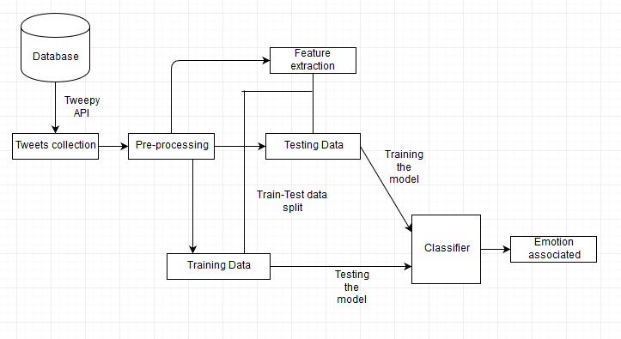
Block Diagram

Slide 7
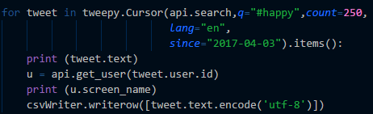
Modules
Tweet Collection:
Input: Twitter Streaming API
Output: A csv file containing raw uncleansed data.
Psuedocode:

Slide 8
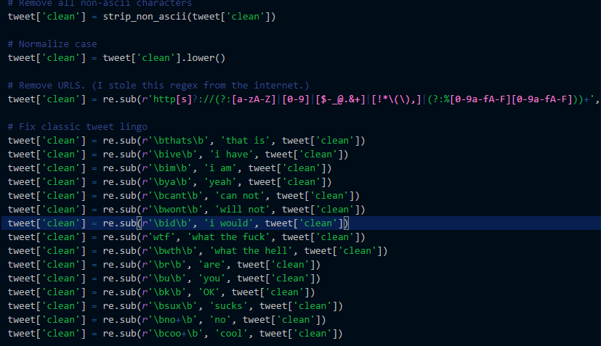
Pre-Processing:
Input: Raw csv file containing
Output: Csv file containing cleansed data
Pseudocode:

Slide 9

Feature Extraction:
Input: A cleaned csv file containing preprocessed data
Output: Tf_idf document vector
Pseudo code:
Training Data:
Input: Tf_idf document vector
Output: K-Means model

Slide 10
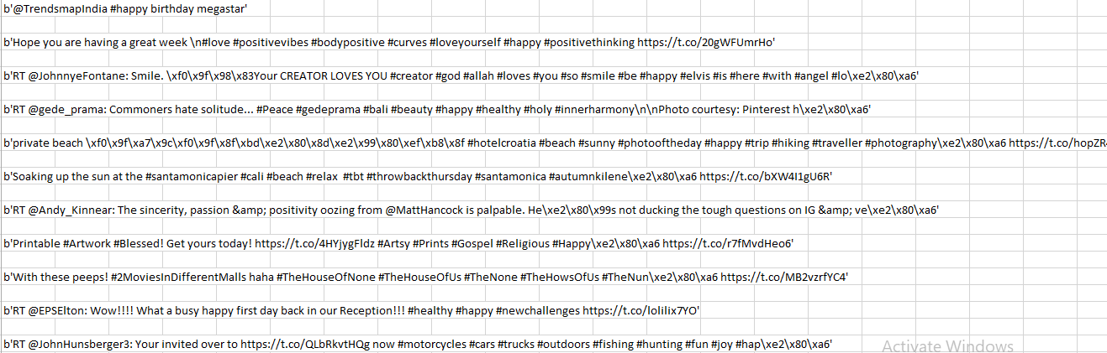
Intermediate Results
Raw Uncleansed Data

Slide 11
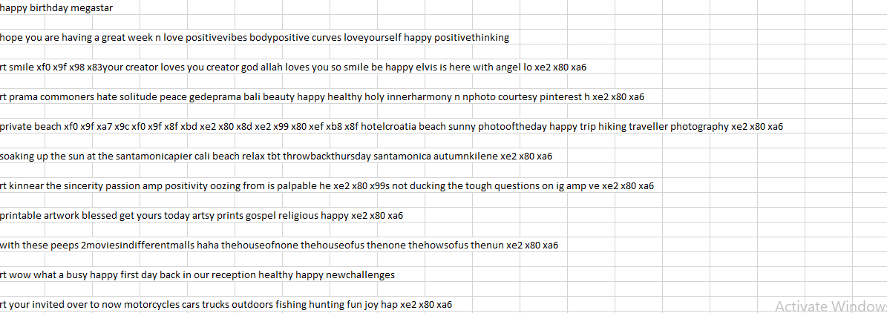
Cleansed Data

Slide 12
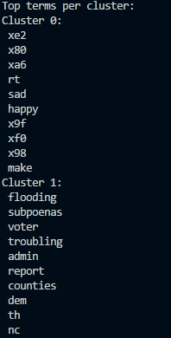
Words in the clusters of K-Means

Slide 13
References
O’Keefe. T and Koprinska I, “Feature Selection and Weighting in Sentiment Analysis,” in Proceeding of 14th Australasian Document Computing Symposium, Dec 2009, Sydney, Australia
Alexander Pak, Patrick Paroubek from Universit´e de Paris-Sud, Laboratoire LIMSI-CNRS, Bˆatiment 508,F-91405 Orsay Cedex, France, “Twitter as a Corpus for Sentiment Analysis and Opinion Mining.”
Bo Pang and Lillian Lee from Yahoo! Research, 701 First Avenue, Sunnyvale, CA 94089, USA, Computer Science Department, Cornell University, Ithaca, NY 14853, USA. “Opinion Mining and Sentiment Analysis.”
Pragya Tripathi, Santosh Kr Vishwakarma, and Ajay Lala, “Sentiment Analysis of English Tweet Using Rapidminer,” in International Conference on Computational Intelligence and Communication Networks, 2015, pp. 668-672.

Slide 14
Alekh Agarwal and Pushpak Bhattacharyya. Sentiment analysis: A new approach for effective use linguistic knowledge and exploiting similarities in a set of documents to be classified. In Proceedingsof the International Conference on Natural Language Processing (ICON), 2005.
Shaikh Mostafa Al Masum, Helmut Prendinger, and Mitsuru Ishizuka. SenseNet: A linguistic toolto visualize numerical-valence based sentiment of textual data. In Proceedings of the InternationalConference on Natural Language Processing (ICON), pages 147–152, 2007. Poster.
Theresa Wilson, Janyce Wiebe, and Rebecca Hwa. Just how mad are you? Finding strong and weakopinion clauses. In Proceedings of AAAI, pages 761–769, 2004. Extended version in Computational lntelligence 22(2, Special Issue on Sentiment Analysis):73–99, 2006.
Casey Whitelaw, Navendu Garg, and Shlomo Argamon. Using appraisal groups for sentiment analysis. In Proceedings of the ACM SIGIR Conference on Information and Knowledge Management(CIKM), pages 625–631. ACM, 2005.

