Slide 1
Twitter Emotion Analysis
By
Hari Krishna
2015103017

Slide 2
Problem definition
In the current world of business analytics, analysts are constantly trying to identify the information about their users that can help them with providing better services.
But to collect this information, which has to be credible and reliable, it’s not a very easy task.
Today with microblogging websites like Twitter which provides developers to collect the information of the users, we can easily collect the information of the users and perform emotion analysis and figure what the general audience feel about any particular problem they face or any product in the market.

Slide 3
Literature survey
S.No. | Author|Publication|Year | Methodology | Advantages | Disadvantages
1. | Alekh Agarwal and Pushpak Bhattacharyya. Sentiment analysis: A new approach for effective use linguistic knowledge and exploiting similarities in a set of documents to be classified. In Proceedings of the International Conference on Natural Language Processing (ICON), 2005. | WordNet and POS tagging as feature. SVM classifier. | Classifying words as good and bad idea. | Very poor classifier and much better results were obtained later on
2. | Shaikh Mostafa Al Masum, Helmut Prendinger, and Mitsuru Ishizuka. SenseNet: A linguistic tool to visualize numerical-valence based sentiment of textual data. In Proceedings of the International Conference on Natural Language Processing (ICON), pages 147–152, 2007. Poster. | Contextual valence assessment based on biased POS tagging. | Recognize sentiment at sentence level | Doesn’t take into account the emotion.
3. | Theresa Wilson, Janyce Wiebe, and Rebecca Hwa. Just how mad are you? Finding strong and weak opinion clauses. In Proceedings of AAAI, pages 761–769, 2004. Extended version in Computational Intelligence 22(2, Special Issue on Sentiment Analysis):73–99, 2006. | Syntax clues to determine the strength of phrases. | Q-A and sum- marization will benefit from the rich subjectivity | -
4. | Casey Whitelaw, Navendu Garg, and Shlomo Argamon. Using appraisal groups for sentiment analysis. In Proceedings of the ACM SIGIR Conference on Information and Knowledge Management (CIKM), pages 625–631. ACM, 2005. | Creating different appraisal groups to classify sentiments | Easily classifies a lot of words | A very small database was covered.

Slide 4
S.No. | Author|Publication|Year | Methodology | Advantages | Disadvantages
5. | Alexander Pak, Patrick Paroubek from Universit´e de Paris-Sud, Laboratoire LIMSI-CNRS, Bˆatiment 508,F-91405 Orsay Cedex, France, “Twitter as a Corpus for Sentiment Analysis and Opinion Mining.” | Twitter API, Naive Bayes Classifier | Better performance while using Bigrams | Multilingual data collection and improved accuracy
6. | Bo Pang and Lillian Lee from Yahoo! Research, 701 First Avenue, Sunnyvale, CA 94089, USA, Computer Science Department, Cornell University, Ithaca, NY 14853, USA. “Opinion Mining and Sentiment Analysis.” | Supervised and unsupervised approaches to the problem | Its very subjective and depends on arguments in the document | Improve accuracy using different classifiers
7. | O’Keefe. T and Koprinska I, “Feature Selection and Weighting in Sentiment Analysis,” in Proceeding of 14th Australasian Document Computing Symposium, Dec 2009, Sydney, Australia | SentiWordNet and SWN Subjectivity scores | Uses multiple classifiers to show the performance of SWN | Only uses basic features like POS and Bag-of-Words.
8. | Pragya Tripathi, Santosh Kr Vishwakarma, and Ajay Lala, “Sentiment Analysis of English Tweet Using Rapidminer,” in International Conference on Computational Intelligence and Communication Networks, 2015, pp. 668-672. | Used sentiment vectors and emotion vocabulary | Useful for product review understanding | Only basic classifiers were used with low accuracy

Slide 5
Issues
All the paper mentioned above worked on sentiment analysis from different perspectives.
Not all the methods produced very good results or promising models in order to tackle the emotion analysis.
To contribute to the already existing work in this field, I will be trying to approach this from a different perspective.
Using unsupervised learning models and collecting the data set myself I am trying to produce a more efficient model using CNN.

Slide 6
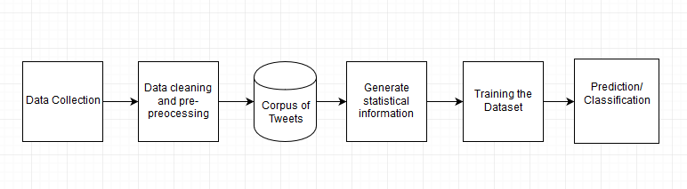
Block Diagram

Slide 7
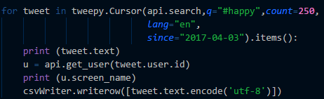
Modules
Data Collection:
Input: Twitter Streaming API
Output: A csv file containing raw uncleansed data.
Psuedocode:

Slide 8
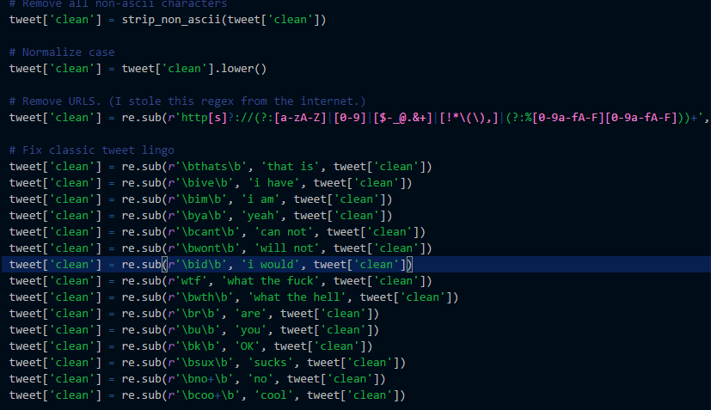
Data cleaning and Pre-Processing:
Input: Raw csv file containing
Output: Csv file containing cleansed data
Psuedocode:

Slide 9
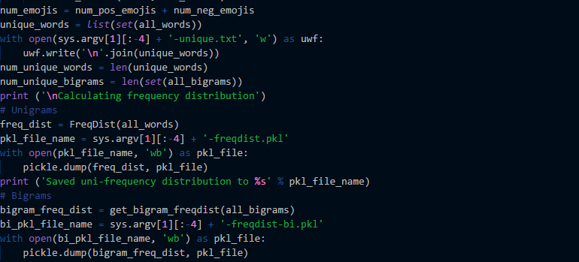
Generate Statistical information:
Input: A cleaned csv file containing preprocessed data
Output: Pickle file containing information about the cleaned data
Pseudo code:

Slide 10
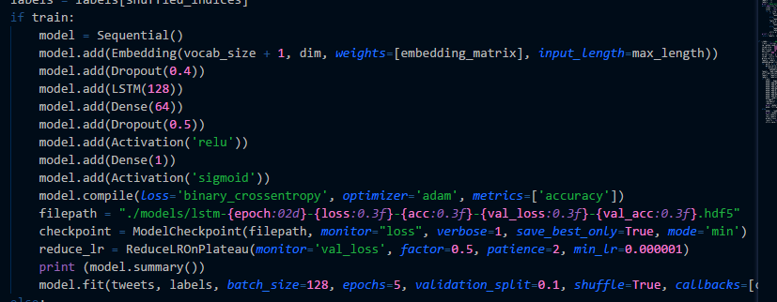
Training Data:
Input: Training Dataset and the respective pickle file containing data about the Training Dataset
Output: LSTM model stored in a hd5 format file.

Slide 11
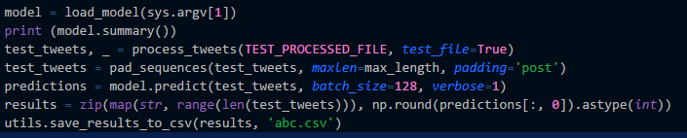
Prediction/Classification:
Input: LSTM model stored in a hd5 file.
Output: CSV file containing the tweet and the prediction
Psuedocode:

Slide 12
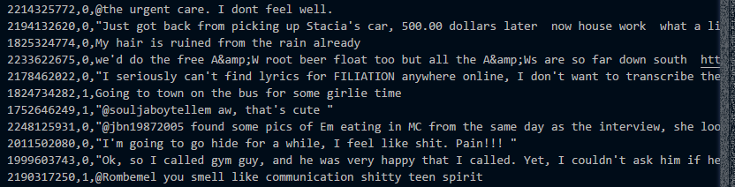
Intermediate Results
Raw Uncleansed Data

Slide 13
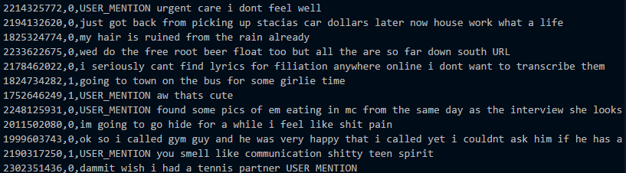
Cleansed Data

Slide 14
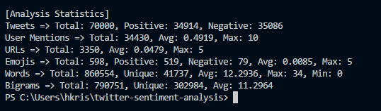
Statistical information about the Training Dataset

Slide 15
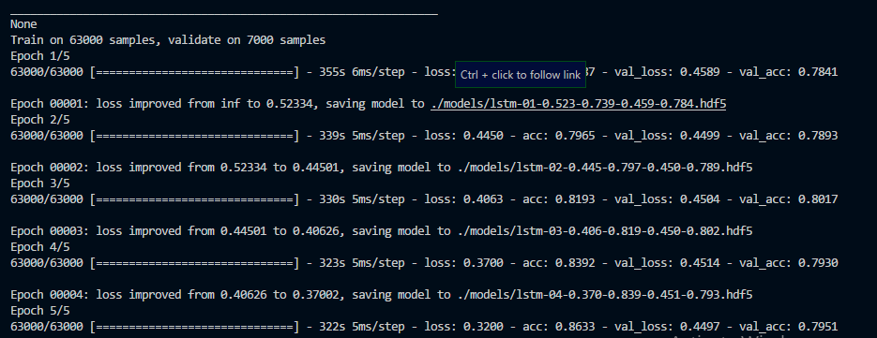
Intermediate screen while training

Slide 16
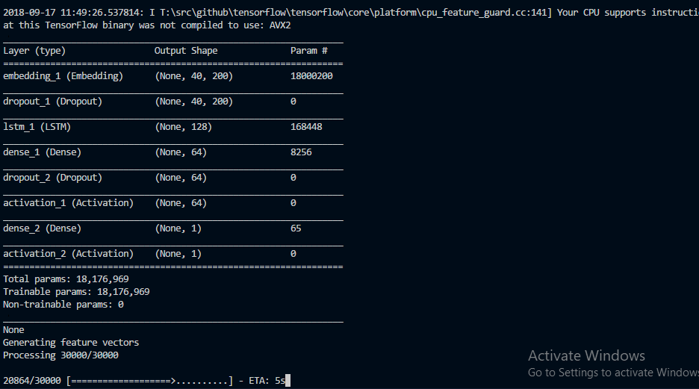
Intermediate result while Testing

Slide 17
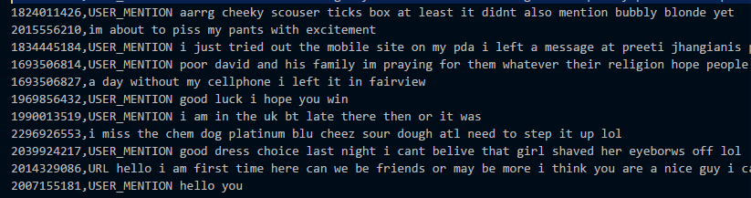

Testing Dataset
Predictions for Tweets

Slide 18
Performance Metrics
The performance of the system is evaluated using various parameters, including the precision, value loss, recall and the accuracy of the system. We also measure performance using parameters such as True Positive, True Negative, False positive and false negatives. In the case of predicting emotions we’d rather not have true negatives or false negatives as they will reduce the accuracy of the program.

Slide 19
True Negative Predictions
The possible example for true negative tweets are, “I am not happy today #nothappy” being classified as 1, just because it have the word happy doesn’t mean that the tweet is happy.
True Positive Predictions
The possible example for true positive tweets are, “I am not happy today #nothappy” being classified as 0.
False Positive Predictions
The possible example for false positive tweets are, “I am not happy today #nothappy” being classified as 1, just because it has the word happy doesn’t mean that the tweet is happy.

Slide 20
Conclusions
This is a standard twitter emotion predictor which predicts whether the given tweet. The dataset consists of neutral statements as well, which had to be manually removed. The major errors are caused due to the ambiguous nature of the tweets. Some might contain relatively happier words but are actually neutral messages. Other sad tweets may contain occasional happy words which cause the ambiguity. Also the dataset is relatively small. With a bigger dataset more accurate predictions can be made. s either happy or sad. The efficiency of the system is at a moderate level but with a better and more classified dataset, the results can be improved to a greater level of accuracy. Also using a different classifier can probably improve the accuracy of the whole system. We can also emoticons in our future to get the full essence of what the tweet really means (for example sarcasm). We can also try to include multiple languages into this system to have a greater reach.

Slide 21
References
O’Keefe. T and Koprinska I, “Feature Selection and Weighting in Sentiment Analysis,” in Proceeding of 14th Australasian Document Computing Symposium, Dec 2009, Sydney, Australia
Alexander Pak, Patrick Paroubek from Universit´e de Paris-Sud, Laboratoire LIMSI-CNRS, Bˆatiment 508,F-91405 Orsay Cedex, France, “Twitter as a Corpus for Sentiment Analysis and Opinion Mining.”
Bo Pang and Lillian Lee from Yahoo! Research, 701 First Avenue, Sunnyvale, CA 94089, USA, Computer Science Department, Cornell University, Ithaca, NY 14853, USA. “Opinion Mining and Sentiment Analysis.”
Pragya Tripathi, Santosh Kr Vishwakarma, and Ajay Lala, “Sentiment Analysis of English Tweet Using Rapidminer,” in International Conference on Computational Intelligence and Communication Networks, 2015, pp. 668-672.

Slide 22
Alekh Agarwal and Pushpak Bhattacharyya. Sentiment analysis: A new approach for effective use linguistic knowledge and exploiting similarities in a set of documents to be classified. In Proceedingsof the International Conference on Natural Language Processing (ICON), 2005.
Shaikh Mostafa Al Masum, Helmut Prendinger, and Mitsuru Ishizuka. SenseNet: A linguistic toolto visualize numerical-valence based sentiment of textual data. In Proceedings of the InternationalConference on Natural Language Processing (ICON), pages 147–152, 2007. Poster.
Theresa Wilson, Janyce Wiebe, and Rebecca Hwa. Just how mad are you? Finding strong and weakopinion clauses. In Proceedings of AAAI, pages 761–769, 2004. Extended version in Computational lntelligence 22(2, Special Issue on Sentiment Analysis):73–99, 2006.
Casey Whitelaw, Navendu Garg, and Shlomo Argamon. Using appraisal groups for sentiment analysis. In Proceedings of the ACM SIGIR Conference on Information and Knowledge Management(CIKM), pages 625–631. ACM, 2005.

