Slide 1
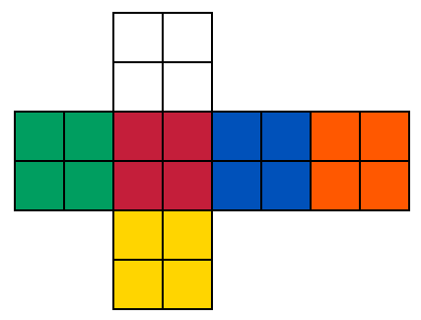

Slide 2
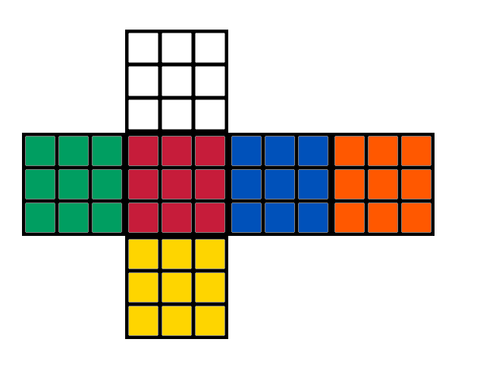
A
A

Slide 3
A
A

Slide 4
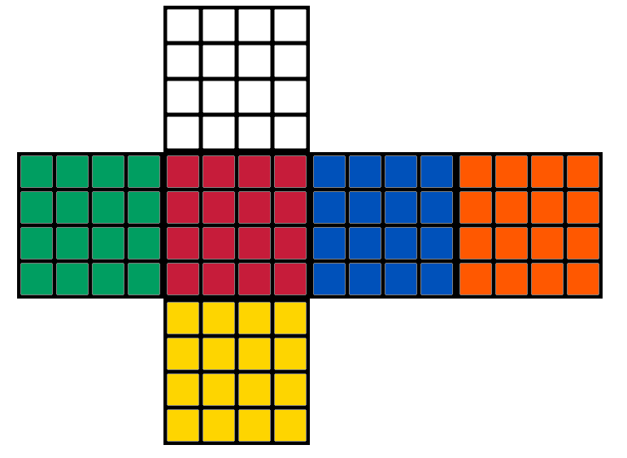
A
B
C
D
A
B
C
D

Slide 5
C
A
D
B
C
A
D
B

