Slide 1
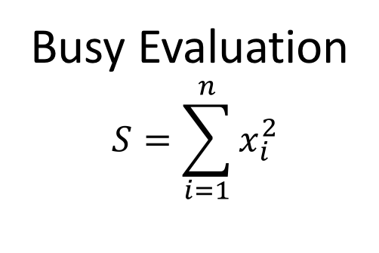
Busy Evaluation
$$S=\sum_{i=1}^{n}{x_{i}^{2}}$$
2 | 5 | -6 | 0 | 2 | 3 | -2 | 0 | 1

Slide 2
Busy Evaluation
$$S=\sum_{i=1}^{n}{x_{i}^{2}}$$
4 | 25 | 36 | 0 | 4 | 9 | 4 | 0 | 1
Map
2 | 5 | -6 | 0 | 2 | 3 | -2 | 0 | 1

Slide 3
Busy Evaluation
$$S=\sum_{i=1}^{n}{x_{i}^{2}}$$
83
Reduce
4 | 25 | 36 | 0 | 4 | 9 | 4 | 0 | 1
Map
2 | 5 | -6 | 0 | 2 | 3 | -2 | 0 | 1

Slide 4
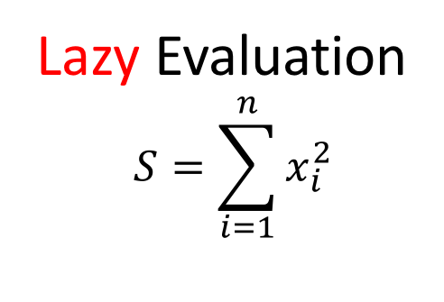
Lazy Evaluation
$$S=\sum_{i=1}^{n}{x_{i}^{2}}$$
29
Reduce
4 | 25
Map
2 | 5 | -6 | 0 | 2 | 3 | -2 | 0 | 1

Slide 5
Lazy Evaluation
$$S=\sum_{i=1}^{n}{x_{i}^{2}}$$
29
65
Reduce
 |  | 36
Map
2 | 5 | -6 | 0 | 2 | 3 | -2 | 0 | 1

