Slide 1
PROJECT DOCUMENT – CYBERSECURITY 1st Month
BY : Keshav Raj

Slide 2
Week - 1
Introduction to NIDS and Snort
  A Network Intrusion Detection System (NIDS) monitors network traffic in real-time to detect malicious activity, policy violations, or unusual behavior. It acts like a security camera for your network—alerting we to threats before they can cause damage .
One of the most popular NIDS tools is Snort, an open-source intrusion detection and prevention system developed by Cisco. Snort uses a rule- based language to analyze traffic and identify known attack patterns, such as port scans, buffer overflows, and malware.

Slide 3
Week - 1
Installations of Snort Linux ( Kali )
sudo apt update
sudo apt upgrade
sudo apt install libpcap-dev libpcre3-dev libdumbnet-dev bison flex zlib1g-dev
sudo apt intall snort

Slide 4
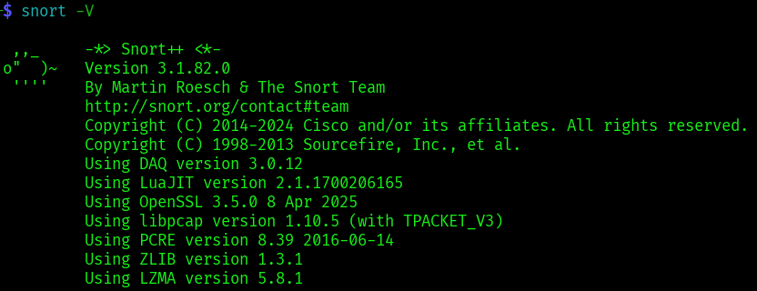
Week - 1
Snort installations check
snort -V

Slide 5
Week - 1
Basic Linux command-line navigation
pwd : Show current directory
ls : List files and directories
cd <folder> : Change directory
mkdir <name> : Create a folder
sudo :Run commands with admin rights
apt install <package> : Install software

Slide 6
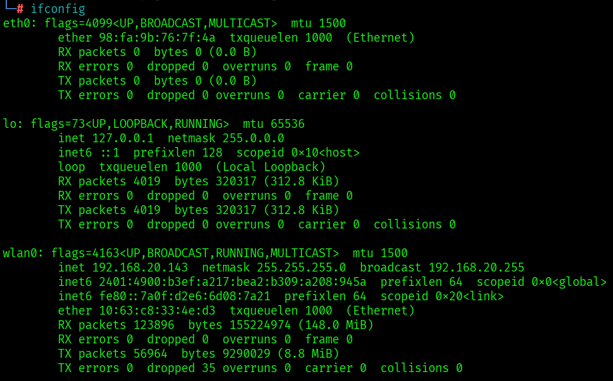
Week - 2
Identifying active network interface
ip a OR ifconfig

Slide 7
Week - 2
Configure Snort with Monitored IP Range
Editing the Snort configuration file ( nano/etc/snort/snort.conf )
Setting HOME_NET variable
var HOME_NET 192.168.20.0/24

Slide 8
Week - 2
Runing Snort in Detection Mode
sudo snort -A console -q -c /etc/snort/snort.conf -i wlan0
-A console → Alerts shown in terminal
-q → Quiet mode (less output)
-c → Config file path
-i → Network interface

Slide 9
Week – 2 configure Snort (snort.lua)
Editing config file
sudo nano/etc/snort.lua
Adding Local rule path
‘’’
references = default_references
classifications = default_classifications
ips =
{
rules = [[
include /etc/snort/rules/local.rules
]],
variables = default_variables
} ‘’’

Slide 10
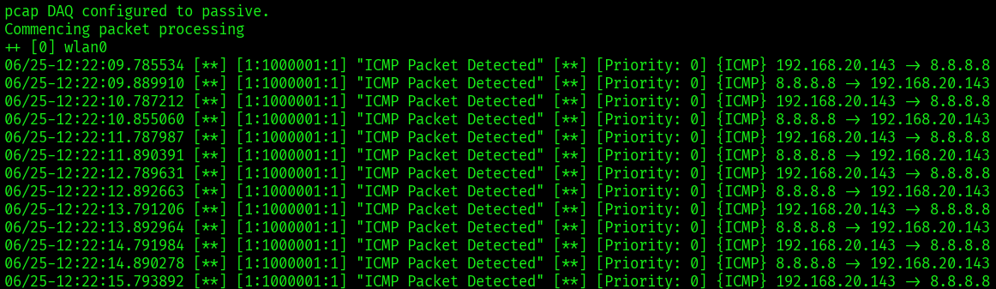
Week – 2 Monitor Live Traffic and Alerts
wWe’ll see live alerts in the terminal window when suspicious traffic is detected.

Slide 11
Week 3: Attack Simulation and Alert Observation
Ping Flood (ICMP Flood) Simulation
I used the ping command to generate excessive ICMP traffic:
ping -f 8.8.8.8
This command sends ICMP echo requests continuously (flooding).
I had a custom Snort rule in local.rules to detect ICMP:
alert icmp any any -> any any (msg:"ICMP Ping Detected"; sid:1000002; rev:1;)
Snort Alert Output:
[**] [1:1000002:1] ICMP Ping Detected [**]
[Priority: 0]
06/25-14:12:23.456789 IP 192.168.1.10 > 8.8.8.8: ICMP Echo Request

Slide 12
Week 4: Understanding Snort Rule Components
Components Breakdown:
Alert Action to take (alert, log, pass, drop)
Tcp Protocol (TCP, UDP, ICMP, IP)
Any Source IP (any means all IPs)
-> Direction of traffic
Any Destination IP
80 Destination Port (HTTP)
Msg: Message to display in alert
Sid: Snort ID (unique identifier)
Rev: Revision number of rule

Slide 13
Week 4: Default Snort rules and structure
/etc/snort/rules/
Common Default Rule Files
local.rules: Custom rules defined by user.
community.rules: General community-contributed rules.
snort.conf: Main configuration file that includes rule paths.
Example Rule (from local.rules)
alert tcp any any -> any 80 (msg:"Potential HTTP traffic detected"; sid:1000001; rev:1;)

Slide 14
Thank You.
Keshav Raj
Month 1st report PPT

