Slide 1
2022 JDP –
AI Detection and Causality Inferences for Fab Operations
Advisor: Wen-Chih Peng
Student: Zheng-Ming (Paul) Lin, Ching (Jason) Chang
Date: 2022/12/19

Slide 2
Problem Settings
Supervised or Unsupervised | Unsupervised
Offline or Online | Online
Data type | Metric + Log + Trace + Changelog
Data source | System log (kubernetes-related) Application log
Others | Multiple sources time mismatch log sparsity issue (error message) Log parsing Causality/Interpretability/Explainability
Keywords: microservices, causal graph, root cause analysis, causal inference

Slide 3
Problem Settings (New)
Supervised or Unsupervised | Unsupervised
AD or RCA | RCA
Offline or Online | Online
Data Source | Metric + Log + Trace + Activities
Others | Graph-based GNN Self-supervised Learning
Metric: intra-service, inter-service
Activities: code deployment, ML model deployment, configuration changes

Slide 4
Two main things
Implementation
MicroHECL with TSMC dataset
DeepTraLog with TrainTicket (Anomaly Detection)
Groot (?)
Jason’s paper
Create a graph using 4 data sources
Log, Trace, Metric, Activities (heterogeneous graph? multi-level node?)
GNN
RCA
Self-supervised learning (contrastive learning)

Slide 5
1. Service Call Graph Construction
RT
EC
QPS
10:00 10:05 … 11:00
7/1 11:00
S₁
S₃
S₅
S₇
S₉
S₂
S₄
S₆
S₈
S₁₀
topology: past 30 min (7/1 10:30~11:00)
KPIs: past 60 min (7/1 10:00~11:00)

Slide 6
2. Anomaly Propagation Chain Analysis
EC’s candidate root cause
QPS’s candidate root cause
S₁
S₃
S₅
S₇
S₉
S₂
S₄
S₆
S₈
S₁₀
RT’s candidate root cause

Slide 7
3. Candidate Root Cause Ranking
Pearson correlation
EC’s candidate root cause
QPS’s candidate root cause
S₁
S₃
S₅
S₇
S₉
S₂
S₄
S₆
S₈
S₁₀
RT’s candidate root cause

Slide 8
MicroHECL with TSMC dataset
Service Call Graph Construction
trigger_point
topology
KPI
Anomaly Propagation Chain Analysis
Propagation Chain Analysis
Service Anomaly Detection
Candidate Root Cause

Slide 9
1. Service Call Graph Construction - trigger point
7/1 11:00
def get_trigger_point(
trigger_point_path: str,
category: str = ‘iSOP’,
service: str = ‘wfauto-cim-order-api’,
threshold: float = 0.3,
trigger_point_index: int = -1,
) -> Dict:
S₅
NAME | RESULT | DETECT_TIME | category | service | …
iSOP-wfauto-cim-order-api(開單成功率 - 分類) | 0.25 | 2022-09-05 00:25:00 | iSOP | wfauto-cim-order-api
… | … | … | … | …
iSOP-wfauto-cim-order-api(開單成功率 - 分類) | 0 | 2022-09-15 14:50:00 | iSOP | wfauto-cim-order-api

Slide 10
1. Service Call Graph Construction - topolopy
def get_topology(
topology_path: str,
trigger_time: datetime,
topology_lookback_window: int,
service: str,
) -> nx.classes.digraph.Digraph:
7/1 11:00
S₁
S₃
S₅
S₇
S₉
S₂
S₄
S₆
S₈
S₁₀
topology: past 30 min (7/1 10:30~11:00)

Slide 11
1. Service Call Graph Construction - topolopy
def get_topology(
topology_path: str,
trigger_time: datetime,
topology_lookback_window: int,
service: str,
) -> nx.classes.digraph.Digraph:
S₁
S₃
S₅
S₇
S₉
7/1 10:05
S₂
S₄
S₆
S₈
S₁₀
S₁
S₃
S₅
S₇
S₉
Find the topologies that’s follow the time legitimacy
Graph-preprocessing
Drop useless nodes
Set trigger point
Drop isolated nodes (check weakly-connected)
Merge all topologies into one single topology
compose, not union
7/1 10:10
S₂
S₄
S₆
S₈
S₁₀
…

Slide 12
1. Service Call Graph Construction - KPI
RT
EC
QPS
10:00 10:05 … 11:00
7/1 11:00
S₁
S₃
S₅
S₇
S₉
S₂
S₄
S₆
S₈
S₁₀
topology: past 30 min (7/1 10:30~11:00)
KPIs: past 60 min (7/1 10:00~11:00)

Slide 13
1. Service Call Graph Construction - KPI
def accumulate_KPI(
KPI_path_dict: Dict[str, str],
) -> Dict[str, Dict]:
time value attr
S₁
S₃
2022-07-01
08:00:37
{'source_app': xxx,
…}
12.6
S₁
S₃
2022-07-01
13:42:56
{'source_app': xxx,
…}
14.9
…
time_series | attr
[ {‘time’: 2022-07-01 08:00:37, ‘value’: 12.6}, {‘time’: 2022-07-01 13:42:56, ‘value’: 14.9}, … ] | { 'source_app': xxx, … }
S₁
S₃

Slide 14
1. Service Call Graph Construction - KPI
What about the case that we don’t have any sample data in given time range?
def set_KPI(
G: nx.classes.digraph.Digraph,
KPI_dict: Dict[str, Dict],
trigger_time: datetime,
KPI_lookback_window: int,
sample_rate: int,
) -> nx.classes.digraph.DiGraph:
[{‘time’: 2022-07-01
08:00:37,
‘value’: 12.6},
{‘time’: 2022-07-01
13:42:56,
‘value’: 14.9},
…
]
S₁
S₃
{'source_app': xxx,
…}
if we have this (KPI_name, edge)
S₁
S₃
{'source_app': xxx,
…}
time | value
2022-07-01 10:00:00 | 0.25
… | …
2022-07-01 11:00:00 | 0
create df
df.resample
select corresponding time_range

Slide 15
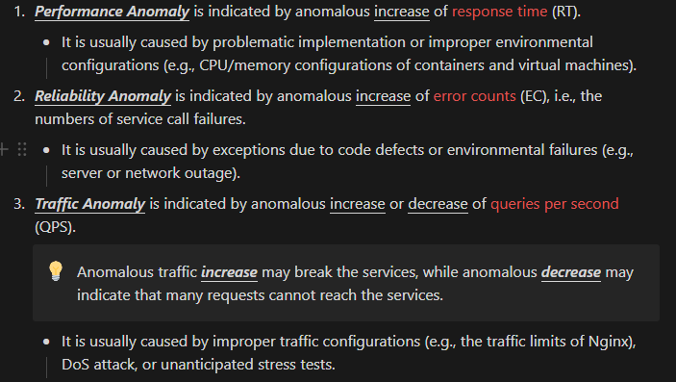
1. Service Call Graph Construction - KPI
What about the case that we don’t have any sample data in given time range?
We only allow RT, EC to be empty.

Slide 16
1. Service Call Graph Construction - Problems
3 data source
trigger_point
topology
KPI
We can select ‘iSOP’ for trigger_point, but for topology and KPI, we can only get the aggregated data across all categories
Data Source | Grouped by Category
trigger_point | V
topology | X
KPI | X
Ideal | Now
V | X
V | X
V | X
開單成功率 - 分類 → 開單成功率
Solution

Slide 17
1. Service Call Graph Construction - Final Output
S₁
S₃
S₅
S₇
S₉
S₂
S₄
S₆
S₈
S₁₀

Slide 18
1. Service Call Graph Construction - Node
node_id | node_attr
wfauto-order-api | { ‘id’: ‘83cffbdd-dd16-4b’, ‘namespace’: ‘wfauto-a’, ‘workload’: ‘wfauto-order-api’, ‘app’: ‘wfauto-order-api’, ‘version’: ‘0.0.0’, ‘trigger_point’: True, ‘trigger_time’: Timestamp, ‘trigger_value’: 0.5, ‘business_KPI’: Series, }
S₅
S₇
Timestamp(‘2022-09-25 03:00:00’)
time
2022-09-25 02:00:00 | 1.0
… | …
2022-09-25 03:00:00 | 0.5

Slide 19
1. Service Call Graph Construction - Edge
We label an edge as anomalous iff it’s anomalous AND its KPI has a similar trend compared to previous edges.
source | dest | edge_attr
wfauto-order-api | wfauto-general-cfg | { ‘id’: ‘2a19b3de-8b13-43’, ‘RT: { ‘KPI’: Series, ‘anomalous’: False, }, ‘EC’: {...}, ‘QPS’: {...}, }
S₅
S₇
time
2022-09-25 02:00:00 | 0.0
… | …
2022-09-25 03:00:00 | 0.0

Slide 20
MicroHECL with TSMC dataset
Service Call Graph Construction
trigger_point
topology
KPI
Anomaly Propagation Chain Analysis
Propagation Chain Analysis
Service Anomaly Detection
Candidate Root Cause

Slide 21
2. Anomaly Propagation Chain Analysis (RT)
S₁
S₃
S₅
S₇
S₉
S₂
S₄
S₆
S₈
S₁₀

Slide 22
2. Anomaly Propagation Chain Analysis (RT)
S₁
S₃
S₅
S₇
S₉
S₇
S₂
S₄
S₆
S₈
S₁₀

Slide 23
2. Anomaly Propagation Chain Analysis (RT)
S₁
S₃
S₅
S₇
S₉
S₂
S₄
S₆
S₈
S₁₀

Slide 24
2. Anomaly Propagation Chain Analysis (RT)
S₅ ≈ S₇
No need
S₇ ≉ S₉
Pearson correlation
S₁
S₃
S₅
S₇
S₉
S₂
S₄
S₆
S₈
S₁₀

Slide 25
2. Anomaly Propagation Chain Analysis (RT)
S₁
S₃
S₅
S₇
S₉
S₂
S₄
S₆
S₈
S₁₀
S₁₀
S₇ ≈ S₁₀

Slide 26
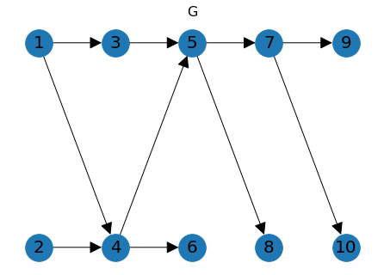
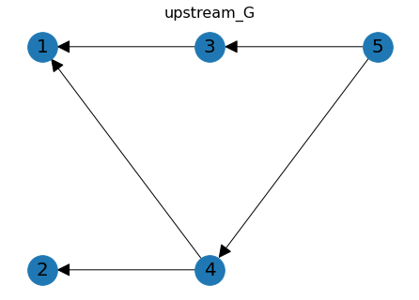
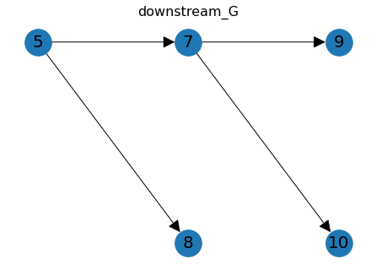
Anomaly Propagation Chain Analysis
First, we need to keep the useful half of the graph
downstream_G = G.subgraph([ n for n in nx.bfs_tree(G, trigger_service) ])
upstream_G = G.subgraph([ n for n in nx.bfs_tree(G, trigger_service, reverse = True) ])
upstream_G = upstream_G.reverse()

Slide 27
Anomaly Propagation Chain Analysis
It’s time consuming to perform anomaly detection on one edge
We need to collect old data
We need to train the model
Two ways to perform anomaly propagation chain analysis
Perform anomaly detection for each edge, and then perform propagation chain analysis
Perfom propagation chain analysis while performing anomaly detection for desired edge
We need to know:
1. How to get edges in the right order
2. How to perform anomaly detection on one edge

Slide 28
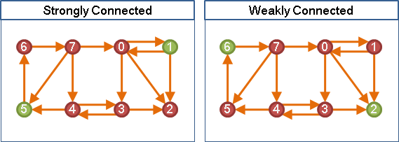
Preliminaries 1 – Weakly Connected (Di)Graph
Strongly Connected: (1, 5)
1 → 5: V
5 → 1: V
Weakly Connected: (2. 6)
2 → 6: X
6 → 2: V
Weakly Connected Graph: Every pair of nodes is weakly connected

Slide 29
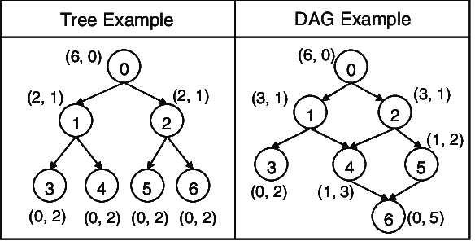
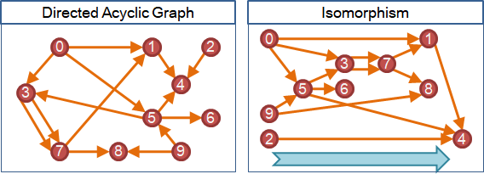
Preliminaries 2 – Directed Acyclic Graph (DAG)
Tree: w/o circle, w/o direction
DAG: w/o circle, w/ direction
DAG: Always go forward!

Slide 30
How do we get ‘ordered’ edges?
1
For pruning strategy, we need to check previous edges.
(For example, we only need to do anomaly detection on edge 6 if and only if edge 3 or edge 4 is anomalous and has high correlation.)
S₁
2
S₂
5
S₄
4
3
6
‘ordered’ edges:
1 → 2 → 3 → 4 → 5 → 6 → 7
S₂
7
S₂

Slide 31
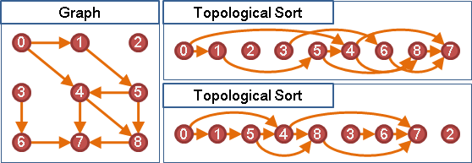
Preliminaries 3 – Topological Sort
A linear ordering of its vertices such that for every directed edge uv from vertex u to vertex v, u comes before v in the ordering.

Slide 32
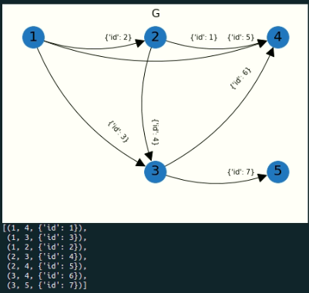
How do we get ‘ordered’ edges? Topological Sort
Get a list of nodes using nx.topological_sort
For each node, we collect its (out) edges
1
S₁
2
S₂
5
S₄
4
3
6
S₂
7
S₂
‘ordered’ edges:
1 → 3 → 2 → 4 → 5 → 6 → 7

Slide 33
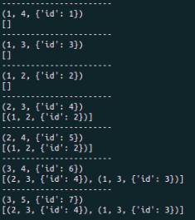
How do we get ‘ordered’ edges? Topological Sort
1
S₁
2
S₂
5
S₄
4
3
6
S₂
7
S₂
‘ordered’ edges:
1 → 3 → 2 → 4 → 5 → 6 → 7

Slide 34
Traverse through ‘ordered’ edges
legal for previous edges: (OR)
We don’t have previous edges
We have previous edges, and there’s at least one edge that is anomalous and highly correlated
1
S₁
2
S₂
5
S₄
for edge in ordered_edge_list:
prev_edge_list = get_prev_edges(edge)
legal_prev_edge_list = …
if len(prev_edge_list) == 0 or \
len(legal_prev_edge_list) > 0:
perform_anomaly_detection(edge)
add_into_chain_if_anomalous(edge)
4
3
6
S₂
7
S₂
‘ordered’ edges:
1 → 3 → 2 → 4 → 5 → 6 → 7

Slide 35
Anomaly Propagation Chain Analysis - PoC
1
3
5
7
9
2
4
6
8
10

Slide 36
Anomaly Propagation Chain Analysis - PoC (RT)
Extract the useful half of graph (downstream)
7
5
8
7
11
9
10
12
9
8
13
10

Slide 37
Anomaly Propagation Chain Analysis - PoC (QPS)
Extract the useful half of graph (upstream)
Reverse the graph
1
1
3
5
5
4
6
2
2
3
4

Slide 38
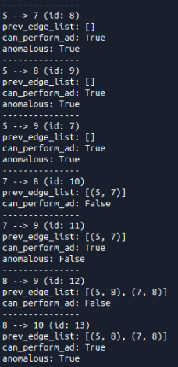
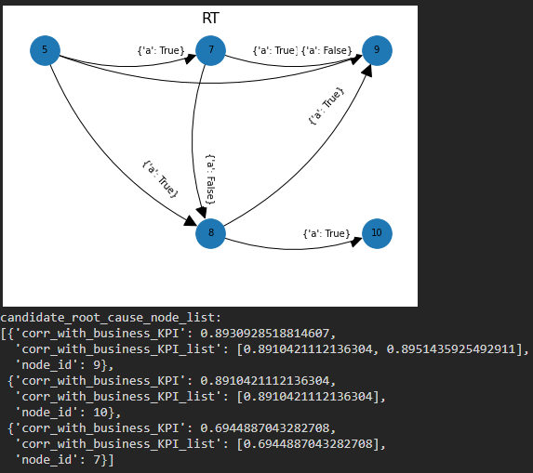
Anomaly Propagation Chain Analysis - PoC (RT)
7
5
8
7
11
9
10
12
9
8
13
10

Slide 39
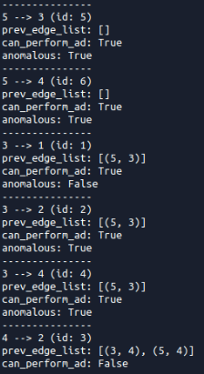
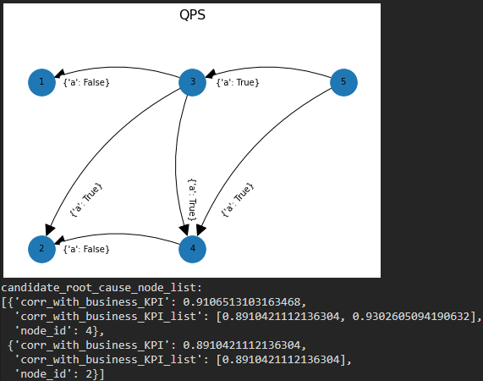
Anomaly Propagation Chain Analysis - PoC (QPS)
1
1
3
5
5
4
6
2
2
3
4

Slide 40
MicroHECL with TSMC dataset
Service Call Graph Construction
trigger_point
topology
KPI
Anomaly Propagation Chain Analysis
Propagation Chain Analysis
Service Anomaly Detection
Candidate Root Cause

Slide 41
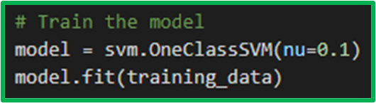
Service Anomaly Detection - RT
Parameter nu approximates the fraction of training errors and support vectors.
60 minutes (because sample_rate = 5min)
Method: OC-SVM (unsupervised)
Current Detection Window: last 10 minutes (10 values)
4 kinds of features:
Number of Over-Max Values -> int
Delta of Maximum Values -> float
Number of Over-Average Values -> int
Ratio of Average Values -> float
Comparison Periods: (1 hour)
The last one hour before the current detection window
The same hour of the previous day
The same hour of the same day of the previous week
There are 12 features in total.
4
4
4
60
60
60
10
60

Slide 42
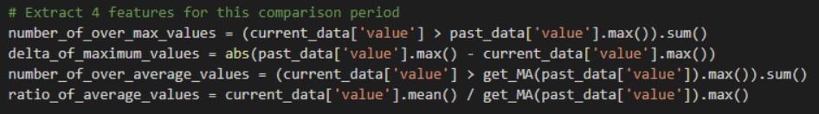
Service Anomaly Detection - RT
Number of Over-Max Values -> int
The number of RT values in the current detection window that exceed the maximum RT value of a given comparison period.
Comparison Period:
The last one hour before the current detection window
4
4
4
60
60
60
10
max: 17
#elements > max = 3

Slide 43
Service Anomaly Detection - RT
Delta of Maximum Values -> float
The delta between the maximum RT value in the current detection window and the maximum RT value of a given comparison period.
Comparison Period:
The last one hour before the current detection window
4
4
4
60
60
60
10
max: 17
max: 19.5
delta = 2.5

Slide 44
Service Anomaly Detection - RT
Number of Over-Average Values -> int
The number of RT values in the current detection window that exceed the maximum moving average of the RT values of a given comparison period.
Comparison Period:
The last one hour before the current detection window
4
4
4
60
60
60
10
max MA: 15.5
#elements > max MA = 4

Slide 45
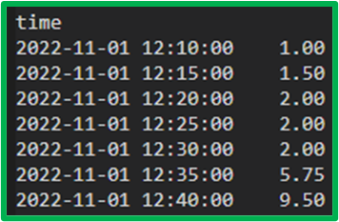
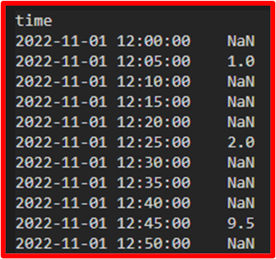
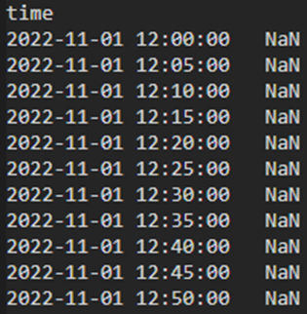
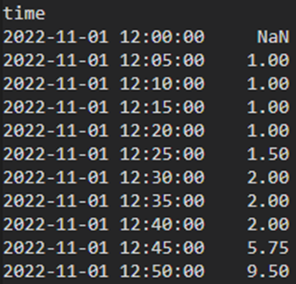
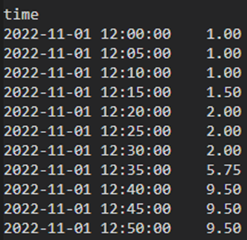
Service Anomaly Detection - RT
We must set min_periods = 1
Missing rate too high
.rolling(window=5).mean()
min_periods=1
center=True

Slide 46
Service Anomaly Detection - RT
Ratio of Average Values -> float
The ratio of the average of the RT values in the current detection window to the maximum moving average of the RT values of a given comparison period.
Comparison Period:
The last one hour before the current detection window
4
4
4
60
60
60
10
max MA: 15.5
average: 13
ratio = average / max MA = 0.839

Slide 47
Service Anomaly Detection - RT
Training set: 100,000 cases
Test set: 600 cases (pos : neg = 1 : 1)
5 min (because sample_rate = 5min)
4
4
4
60
60
60
10
1 min
60
60
60
10
60
60
60
10
60
60
60
10
…
60
60
60
10
100,000 min ≈ 69.4 days
Current status: ≈ 10,000 (1 month)

Slide 48
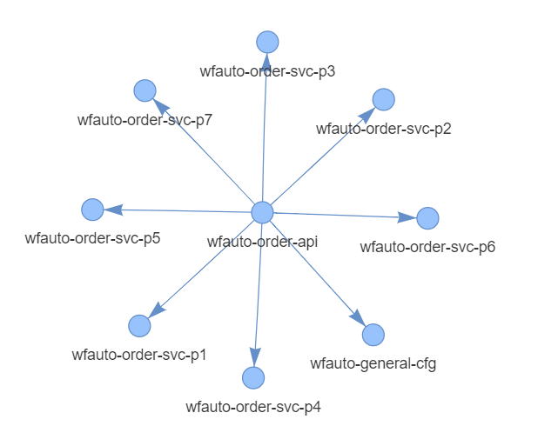
Service Anomaly Detection - RT
Trigger point + Topology

Slide 49
Service Anomaly Detection - RT
True
False
None
Anomalous =
Current result
Anomalous = None for every edge
OC-SVM won’t allow sample data with missing features.

Slide 50
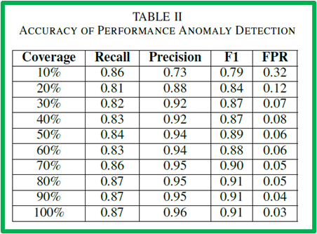
Problems Encountered
Let’s think of log clustering:
How do we determine a “good performance” result?
Manual inspection
An example to justify
Downstream task
Data
Missing rate too high (it’s not a big problem for RT/EC, but it’s a big issue for QPS)
None != 0
Inconsistent topology (it’s not a big problem)
Service Anomaly Detection model
No ground truth or any criteria to examine/verify the results
Which model? Hyperparameter in the model?
MicroHECL
Good at complex topology
We don’t care what model we use (ex: OC-SVM for RT) as long as we have “good performance”.

Slide 51
Service Anomaly Detection - EC
Method: Random Forest (supervised)
Current Detection Window: last 10 minutes (10 values)
5 features: (combine RT)
Previous Day Delta Outlier Value -> float
Previous Minute Delta Outlier Value -> float
Response Time Over Threshold -> bool
Maximum Error Rate -> float
Correlation with Response Time -> float
60
60
10

Slide 52
Service Anomaly Detection - EC
Previous Day Delta Outlier Value -> float
Calculate the deltas of the EC values in the last one hour and the EC values in the same hour of the previous day
Use the 3-sigma rule to identify possible outliers of the deltas in the current detection window
if exist return the average of the outliers as the feature value, otherwise return 0
current detection window
10
10
=
60
60
60
the same hour of the previous day
the last one hour
deltas
3-sigma
if exist
average
outliers of deltas
0

Slide 53
Service Anomaly Detection - EC
Previous Minute Delta Outlier Value -> float
Calculate the deltas of the EC values and the values of the previous minute in the last one hour
Use the 3-sigma rule to identify possible outliers of the deltas in the current detection window
if exist return the average of the outliers as the feature value, otherwise return 0
current detection window
10
10
=
60
60
60
the last one hour (1 min earlier)
the last one hour
deltas
3-sigma
if exist
average
outliers of deltas
0

Slide 54
Service Anomaly Detection - EC
Response Time Over Threshold -> bool
whether the average RT in the current detection window exceed a predefined threshold (e.g., 50ms)
current detection window
RT
10
average: 24
60
the last one hour (1 min earlier)
> threshold
True
False

Slide 55
Service Anomaly Detection - EC
Maximum Error Rate -> float
The maximum error rate (i.e., EC divided by number of requests) in the current detection window
current detection window
EC
10
÷
number of requests
10
=
error rate
10
max: 3.1

Slide 56
Service Anomaly Detection - EC
Correlation with Response Time -> float
The Pearson correlation coefficient between EC and RT in the current detection
current detection window
EC
10
corr: 0.78
RT
10
10

Slide 57
Service Anomaly Detection - EC
Training set: 1,000 labelled cases (pos : neg = 1 : 3)
Test set: 400 cases (pos : neg = 5 : 3)

Slide 58
Service Anomaly Detection - QPS
Method: 3-sigma (no training)
Current Detection Window: last 10 minutes (10 values)
Workflow:
Based on the QPS values in the last one hour, we use the 3-sigma rule to detect outliers in the current detection window.
current detection window
> threshold
True
To further eliminate false positives, we also check the Pearson correlation coefficient between the QPS values and the business metric values of the initial anomalous service.
10
60
False
the last one hour
< threshold
check Pearson correlation with business metric of the initial anomalous service
3-sigma
if exist
outliers of deltas
False

Slide 59
Service Anomaly Detection
 | RT | EC | QPS
Training Manner | Unsupervised | Supervised | No training
Method | OC-SVM | Random Forest | 3-sigma + corr
Features | Number of Over-Max Values Delta of Maximum Values Number of Over-Average Values Ratio of Average Values … | Previous Day Delta Outlier Value Previous Minute Delta Outlier Value Response Time Over Threshold Maximum Error Rate Correlation with Response Time | No features
Note | Need lots of training data | Need labelled data (but not a lot)

Slide 60
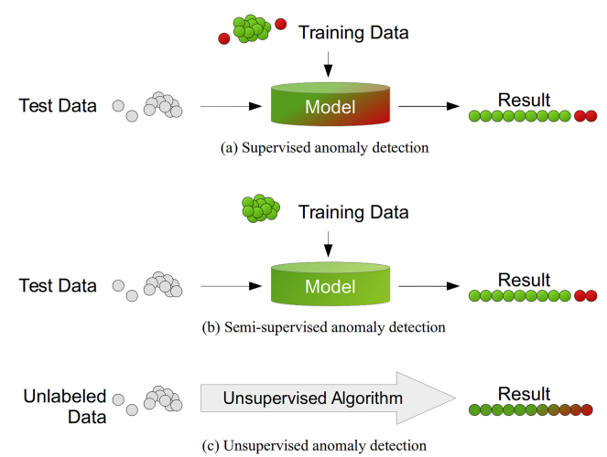
Anomaly Detection - Outlier and Novelty Detection
 | Outlier Detection | Novelty Detection
Training Data | May contain outliers | Not polluted
Alias | Unsupervised Anomaly Detection | Semi-supervised Anomaly Detection
Outliers/ Anomalies | Cannot form a dense cluster | Can form a dense cluster

Slide 61
Common Unsupervised Anomaly Detection Methods
Although unsupervised anomaly detection does not utilize any labe information in practice, they are needed for evaluation and comparison.
 | Robust covariance | One-Class SVM | One-Class SCM (SGD) | Isolation Forest | Local Outlier Factor
Support Missing Data

Slide 62
MicroHECL with TSMC dataset
Service Call Graph Construction
trigger_point
topology
KPI
Anomaly Propagation Chain Analysis
Propagation Chain Analysis
Service Anomaly Detection
Candidate Root Cause

Slide 63
3. Candidate Root Cause Ranking
Pearson correlation
EC’s candidate root cause
QPS’s candidate root cause
S₁
S₃
S₅
S₇
S₉
S₂
S₄
S₆
S₈
S₁₀
RT’s candidate root cause

Slide 64
Data Storage
Store networkx
Format
Neo4j (database) (Need help)
json
pickle
Time Range of input data (trigger_point, topology, KPI)

Slide 65
~~~~~~~~~~~~~~~~~~~~~~~~~~~~~~~

Slide 66
To Do
Log clustering
Validate more AP for the effectiveness
Improve the method of calculating the text similarity
Case study
Improve the method of feature selection
Analyze the result
Output top-10 root cause
Graph visualization
Highlight the root cause of the output of the model

Slide 67
To Do
Log clustering
Validate more AP for the effectiveness
Improve the method of calculating the text similarity
Case study
Improve the method of feature selection
Analyze the result
Output top-10 root cause
Graph visualization
Highlight the root cause of the output of the model

Slide 68
Log Clustering
Validate on more AP for the effectiveness
AP: OMID, MyTSMC, CCM, Supply Management, PQO, tsmc Online, Bonded, TNA
I have run my model and get new results (禮拜一補個圖片）
Verify the result with the Grafana visualization
Need some time for checking the result

Slide 69
Log Clustering
Improve the method of calculating the text similarity
Use sentence-BERT for encoding the log template for calculating the text similarity
Sentence-BERT: Sentence Embeddings using Siamese BERT-Networks
EMNLP 2019, #citation = 4080
Pros
It will get the embedding with the fixed size, and we can easily to calculate the cosine similarity between two log templates
Remain issue
The word will be [UNK] if it is not in the vocabulary of BERT

Slide 70
Sentence-BERT
SBERT adds a pooling operation to the output of BERT / RoBERTa to derive a fixed sized sentence embedding
Fine-tune with three tasks
Classification Objective Function
Regression Objective Function
Triplet Objective Function

Slide 71
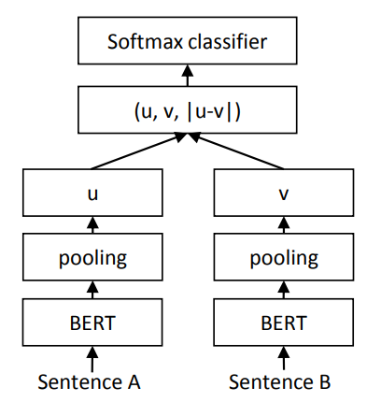

Sentence-BERT
Classification Objective Function
Sentence pairs annotated with the labels contradiction, eintailment, and neutral
Loss function: Cross-entropy loss

Slide 72
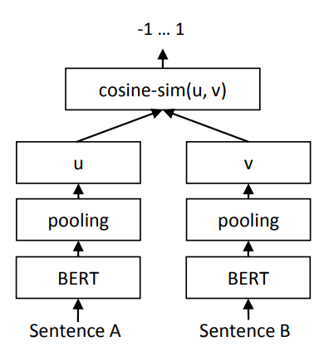
Sentence-BERT
Regression Objective Function
The cosine similarity between the two sentence embeddings u and v is computed
Loss function: Mean squared-error
Input consists of two texts and a float label

Slide 73
Sentence-BERT
Triplet Objective Function (contrastive learning)
An anchor sentence a, a positive sentence p, and a negative sentence n
The positive sentence comes from the same article and the same section
The negative sentence comes from the same article and the different section

Slide 74
Log Clustering
Improve the method of calculating the text similarity
Remain issue
The word will be [UNK] if it is not in the vocabulary of BERT
TSMC has surveyed exBERT
exBERT: Extending pre-trained models with domain-specific vocabulary under constrained training resources

Slide 75
exBERT
exBERT augment the original BERT’s embedding layer with an extension embedding layer and corresponding domain-specific extension vocabulary
Add an extension module to each transformer layer

Slide 76
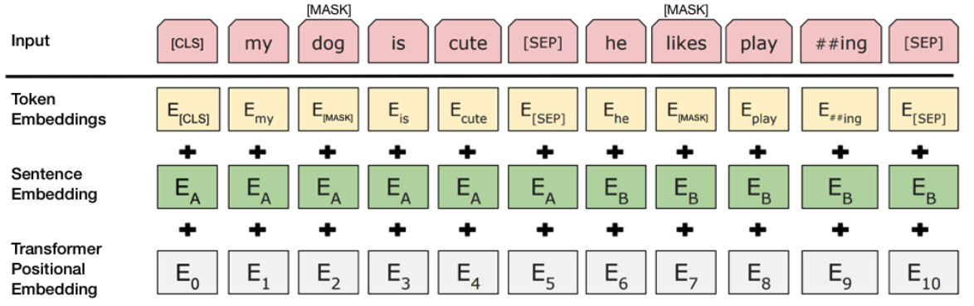
exBERT
How BERT works?

Slide 77
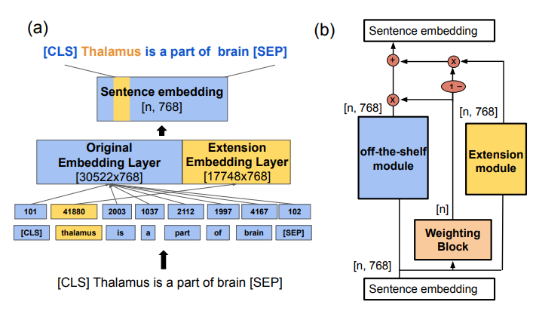
exBERT

Slide 78
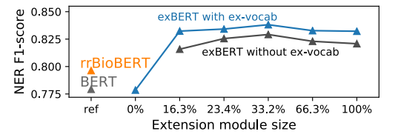
exBERT
It can be seem as fine-tune with domain knowledge for the extension module
Cons:
It needs ex-vocabulary to tokenize the domain word
So we have to collect our own vocabulary
In experiment, they have experimented without ex-vocabulary

Slide 79
To Do
Log clustering
Validate more AP for the effectiveness
Improve the method of calculating the text similarity
Case study
Improve the method of feature selection
Analyze the result
Output top-10 root cause
Graph visualization
Highlight the root cause of the output of the model

Slide 80
Case Study
Improve the method of feature selection

