Slide 1
2022 JDP –
AI Detection and Causality Inferences for Fab Operations
Advisor: Wen-Chih Peng
Student: Zheng-Ming (Paul) Lin, Ching (Jason) Chang
Date: 2022/08/11

Slide 2
Outline
Thoughs on log parsing
Surveyed Paper
On Automatic Parsing of Log Records
ICSE 2021 (#15 conference), #citations = 2
Prefix-Graph: A Versatile Log Parsing Approach Merging Prefix Tree with Probabilistic Graph
ICDE, 2021, unsupervised

Slide 3
Review - 張敬
Done in the past two weeks
Understand kubernetes, Helm, Istio
Train Ticket with k8s + isio (using minikube to create k8s cluster)
Thoughs on log parsing
To do
Produce all 14 possible anomalies from Train Ticket
Unsupervised POS tagging papers

Slide 4
Review - 正明
Done in the past two weeks
Log parsing post-processing
Merge the different cluster but similar template
To do
Apply the method from paper to TSMC data

Slide 5
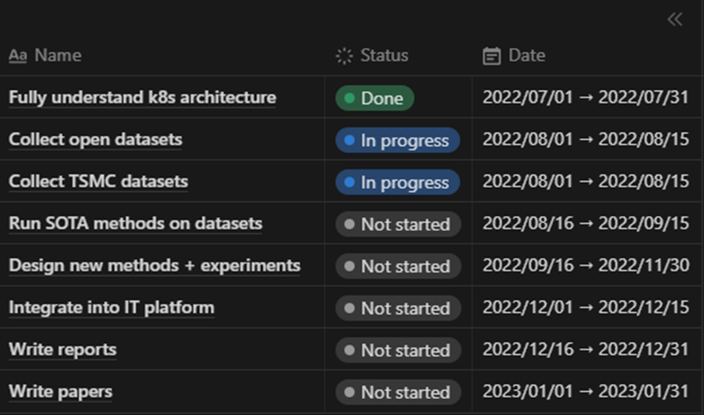
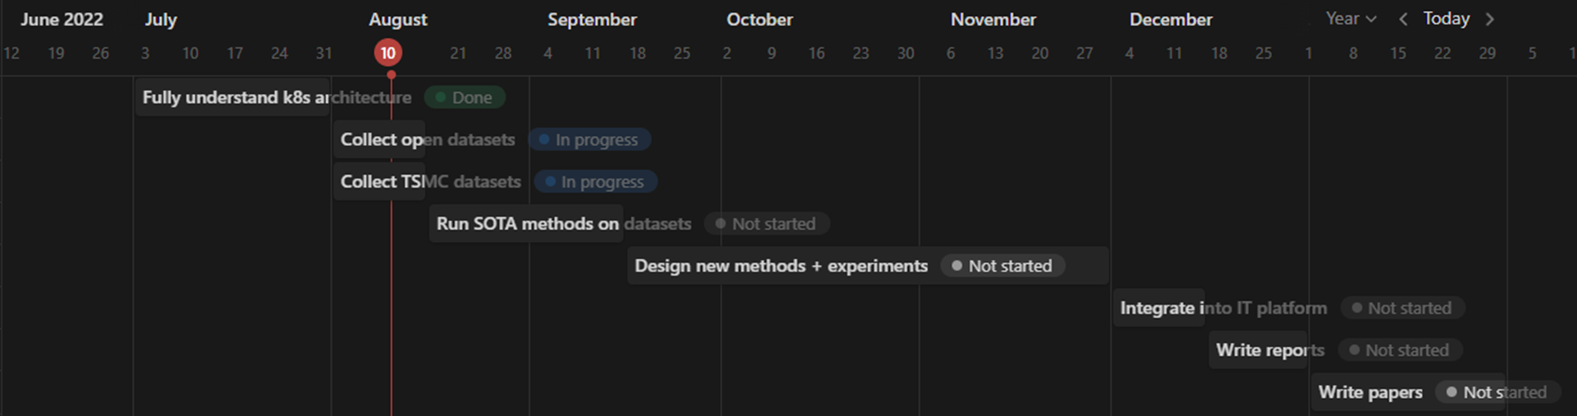
Internship plan (from NYCU)

Slide 6
Problem Settings
Supervised or Unsupervised | Unsupervised
Offline or Online | Online
Data type | Metric + Log + Trace + Changelog
Data source | System log (kubernetes-related) Application log
Others | Multiple sources time mismatch log sparsity issue (error message) Log parsing Causality/Interpretability/Explainability
Keywords: micro services, causal graph, root cause analysis, causal inference

Slide 7
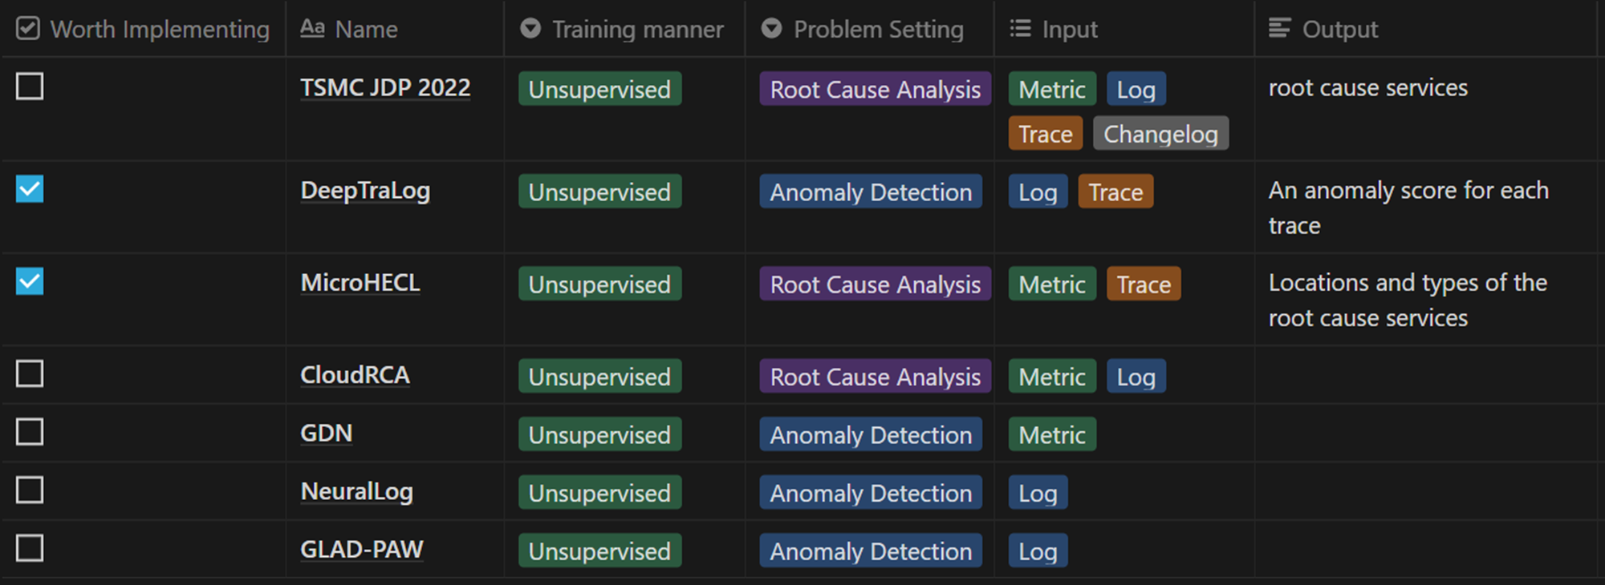
Problem Settings

Slide 8
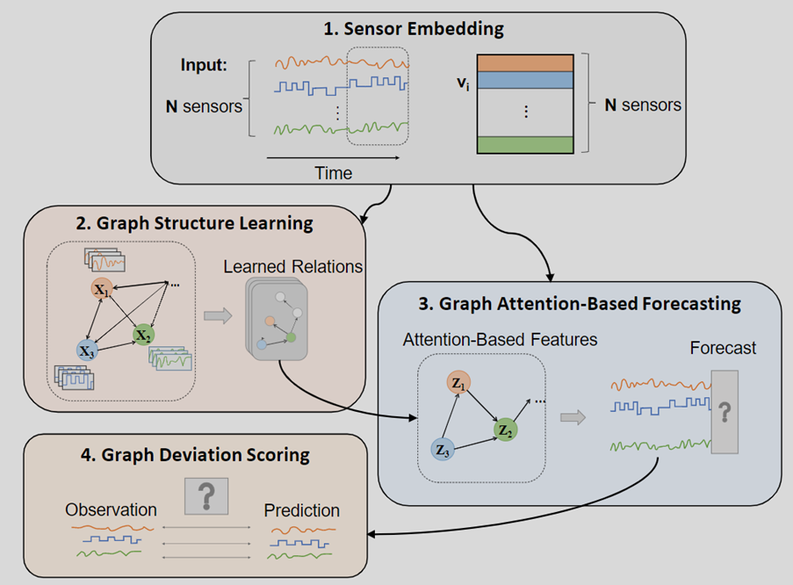

Single source – Metric
GDN (AAAI 2021)
GNN-based MTS AD
If using Graph Deviation Scoring, output will be anomalous label for each timestamp
Darts
Nbeats, TCN, TFT, NHiTs
Not specified for microservices

Slide 9
Single source – Log
NeuralLog
Log AD without log parsing
GLAD-PAW
Log AD with GNN
LogAnomaly
…

Slide 10
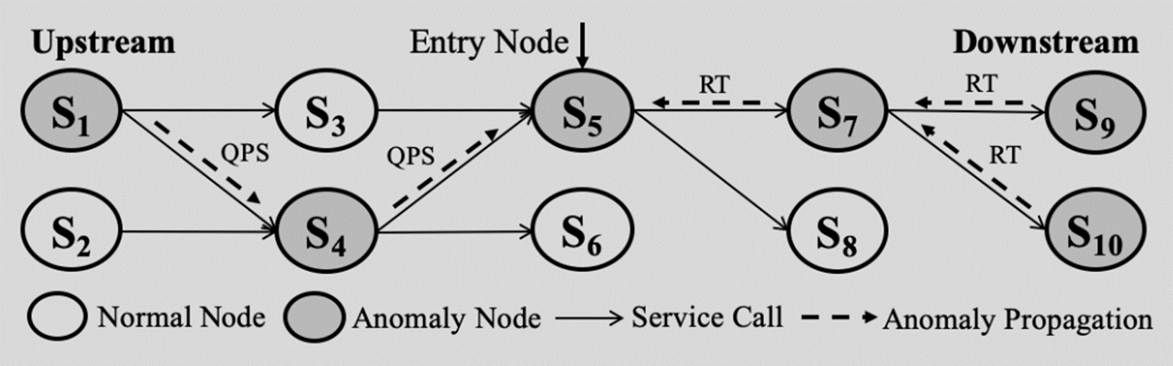
Multiple sources – Metric + Trace Single source – Trace
MicroHECL
“Trace” is not just about the topology/edges. We can have some metric/KPI on the edges.

Slide 11
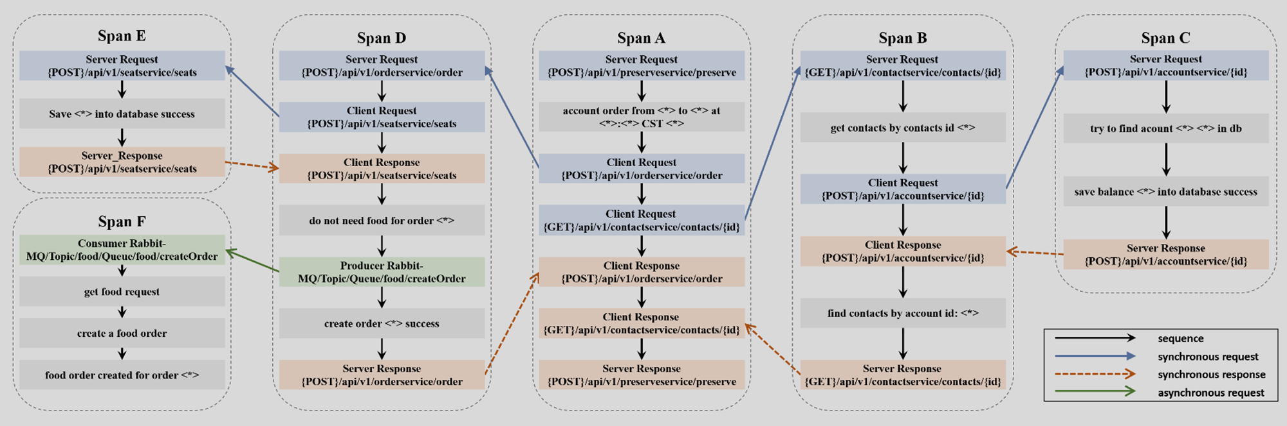
Multiple sources – Log + Trace
DeepTraLog

Slide 12
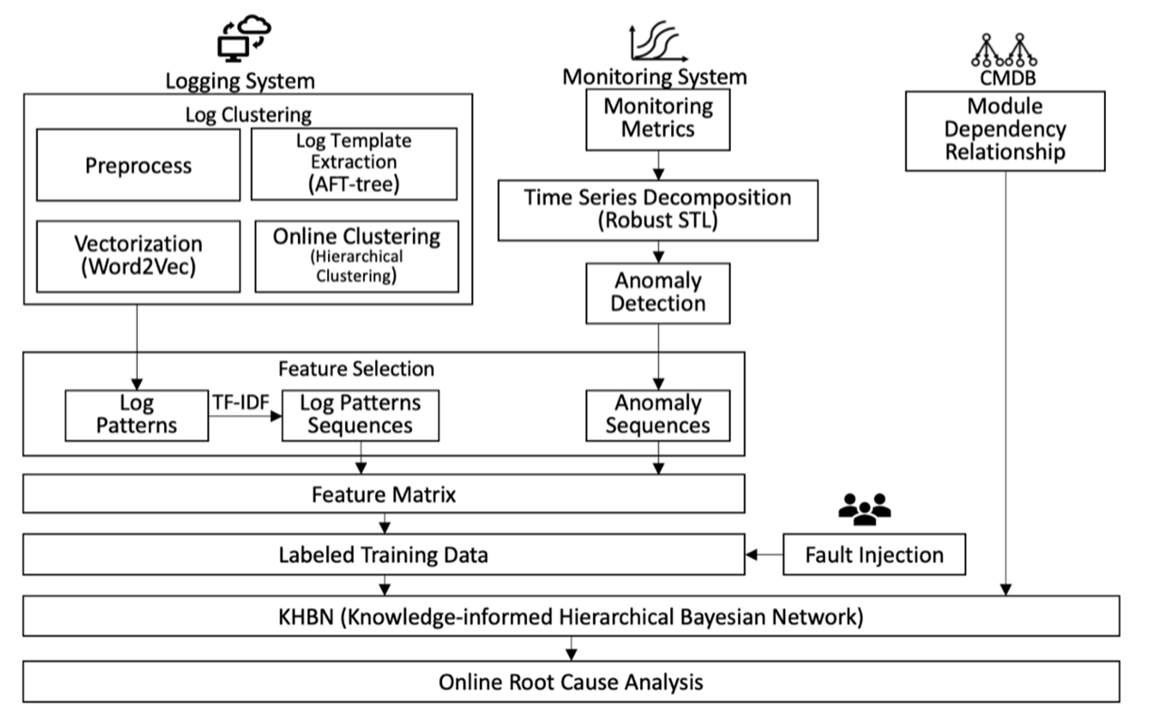
Multiple sources – Metric + Log
CloudRCA

Slide 13
3 Selling points for my own paper
Combine 3 data sources
Log, Trace, Metric
Change “Changelog” to “Metric”, like TSMC did
GNN with RCA
Self-supervised learning (with GNN)
Contrastive learning

Slide 14
Tsinghua NetMan Lab – NetManAIOps Autonomizing IT Operations
Open Source!
TraceAnomaly
ISSRE 2020
TraceRCA
IWQoS 2021
DejaVu
Actionable and Interpretable Fault Localization for Recurring Failures in Online Service Systems
FSE 2022
CIRCA
Causal Inference-Based Root Cause Analysis for Online Service Systems with Intervention Recognition
KDD 2022

Slide 15
Implementation
MicroHECL with TSMC dataset
DeepTraLog with Train Ticket

Slide 16
MicroHECL
Trigger point: having availability issue (business metric)
Service Call Graph Construction (in the latest time window, e.g., the last 30 min)
Anomaly Propagation Chain Analysis
Candidate Root Cause Ranking

Slide 17
1. Service Call Graph Construction
RT
EC
QPS
10:00 10:05 … 10:55
S₁
S₃
S₅
S₇
S₉
S₂
S₄
S₆
S₈
S₁₀

Slide 18
2. Anomaly Propagation Chain Analysis (RT)
S₁
S₃
S₅
S₇
S₉
S₂
S₄
S₆
S₈
S₁₀

Slide 19
2. Anomaly Propagation Chain Analysis (EC)
S₁
S₃
S₅
S₇
S₉
S₂
S₄
S₆
S₈
S₁₀

Slide 20
2. Anomaly Propagation Chain Analysis (QPS)
S₁
S₃
S₅
S₇
S₉
S₂
S₄
S₆
S₈
S₁₀

Slide 21
2. Anomaly Propagation Chain Analysis (RT)
S₁
S₃
S₅
S₇
S₉
S₂
S₄
S₆
S₈
S₁₀

Slide 22
2. Anomaly Propagation Chain Analysis (RT)
S₁
S₃
S₅
S₇
S₉
S₇
S₂
S₄
S₆
S₈
S₁₀

Slide 23
2. Anomaly Propagation Chain Analysis (RT)
S₁
S₃
S₅
S₇
S₉
S₂
S₄
S₆
S₈
S₁₀

Slide 24
2. Anomaly Propagation Chain Analysis (RT)
S₅ ≈ S₇
No need
S₇ ≉ S₉
Pearson correlation
S₁
S₃
S₅
S₇
S₉
S₂
S₄
S₆
S₈
S₁₀

Slide 25
2. Anomaly Propagation Chain Analysis (RT)
S₁
S₃
S₅
S₇
S₉
S₂
S₄
S₆
S₈
S₁₀
S₁₀
S₇ ≈ S₁₀

Slide 26
2. Anomaly Propagation Chain Analysis
EC’s candidate root cause
QPS’s candidate root cause
S₁
S₃
S₅
S₇
S₉
S₂
S₄
S₆
S₈
S₁₀
RT’s candidate root cause

Slide 27
3. Candidate Root Cause Ranking
Pearson correlation
EC’s candidate root cause
QPS’s candidate root cause
S₁
S₃
S₅
S₇
S₉
S₂
S₄
S₆
S₈
S₁₀
RT’s candidate root cause

Slide 28
MicroHECL with TSMC dataset
get_metric.py
Find the business metric (開單成功率)
Initial anomalous service
Problem:
開單成功率的sample rate從SAO看起來很大，是每小時一筆，但是從CY的圖片可以觀察到，其實開單率的sample rate應該要很小，像是每5分鐘就會有一筆資料
從SAO撈出來的每小時的資料，如果我們用service的名稱來篩選開單成功率的話，會有很多筆records。我不確定我這邊是要取哪一筆。

Slide 29
MicroHECL with TSMC dataset
get_trace.py
Find the topology and quality metrics around the given initial anomalous service
Problem:
不確定是否能直接用service name來跟metric資料做結合

Slide 30
~~~~~~~~~~~~~~~~~~~~~~~~~~~~~~~

Slide 31
Current Problem
Undermasking
Similar template diff cluster / Different template same cluster

Slide 32
Method
First, calculate the similarity of two log templates
Use pretrained model Sentence-BERT to embed log template
Then, calculate the cosine of two embedding vectors as the similarity
Then, calculate the similarity of the appearance time of two log templates
The size of the time vector is 288 (Per 5 minutes in 1 day)
As the same as first step, calculate the cosine of two time vectors as the similarity

Slide 33
Pros
Successfully to merge some different cluster but their are same event (as we can check the result by auto-feedback)
Find the same event but doesn’t be discovered by feedback
Ex: cluster11473, cluster14870

Slide 34
Cons
Different appearance time but similar raw log (only different parameters)
Ex: cluster15689, cluster16044

Slide 35
Discussion
How to define the performance
Recall or precision

