Slide 1
GPT

Slide 2
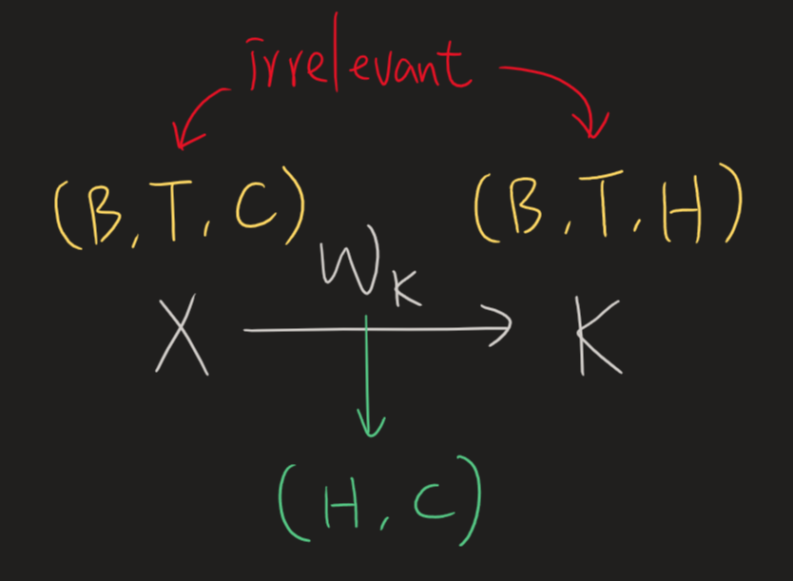







Causal LM – Training vs. Inference
(also known as block_size, n_positions, or max_seq_len)
The context window size won't affect the model size (except for the positional embedding part).
$$\hat{1},\hat{2},\hat{3},\hat{4},\hat{5},\hat{6},\hat{7},\hat{8}$$
$$1, 2, 3, 4, 5, 6, 7, 8$$
loss
$$\hat{1},\hat{2},\hat{3},\hat{4},\hat{5},\hat{6},\hat{7},\hat{8}$$
$$0, 1, 2, 3, 4, 5, 6, 7$$
$$1$$
$$0, 1, 2, 3, 4, 5, 6, 7$$
$$0$$
We'd like the transformer to be accustomed to seeing contexts ranging from as little as one token up to the block size.
Transformers can accept input lengths ranging from 1 to the block size.
True for both training and inference

Slide 3
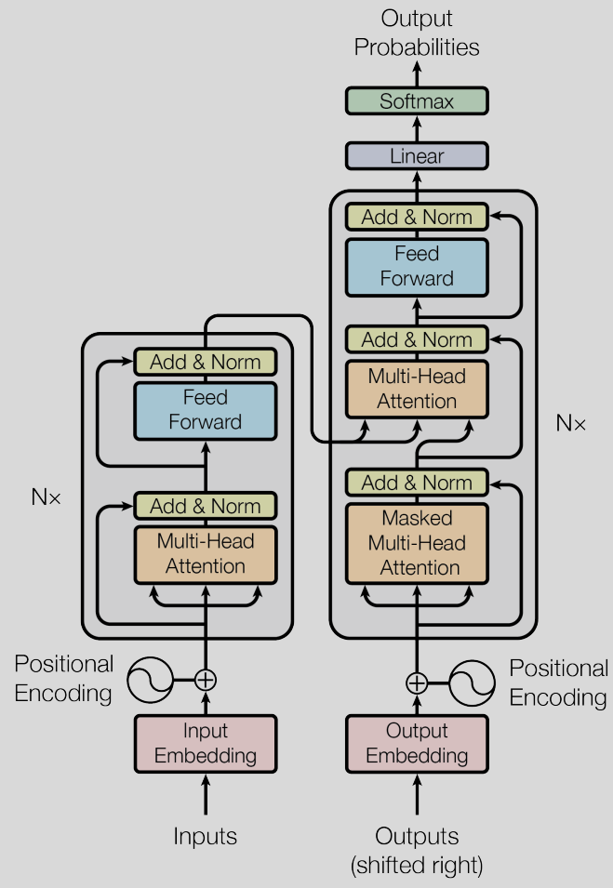
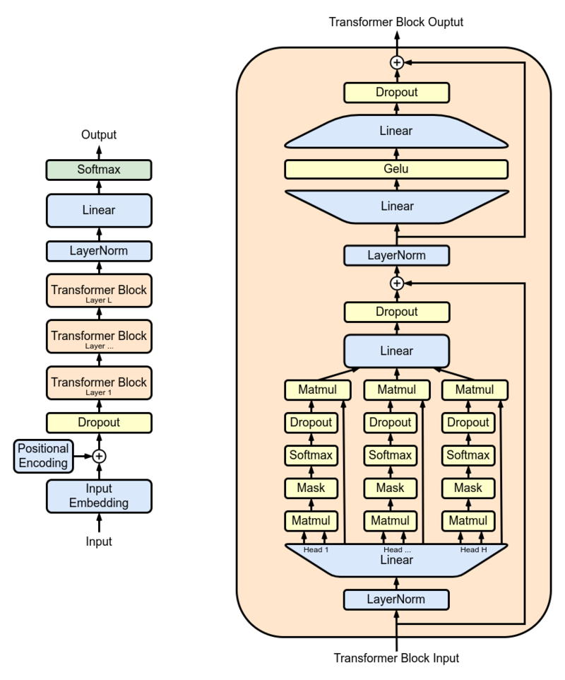
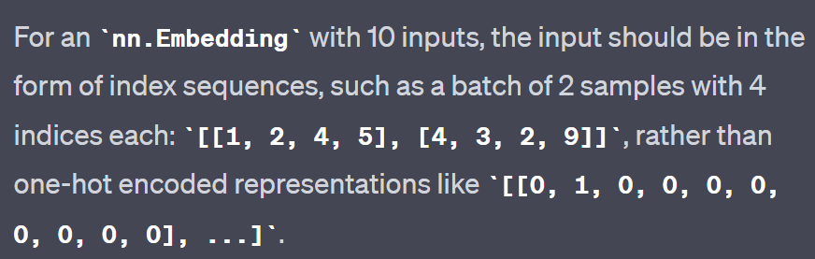
GPT2
Output layer
Hugging Face’s gpt2
(can bypass input embedding by using `inputs_embeds` instead of `input_ids`)
Trainable instead of fixed sinusoidal functions
bypassable
Input layer
Input
`nn.Embedding` is a trainable lookup table, resembling a bias-free linear layer with one-hot inputs.

Slide 4




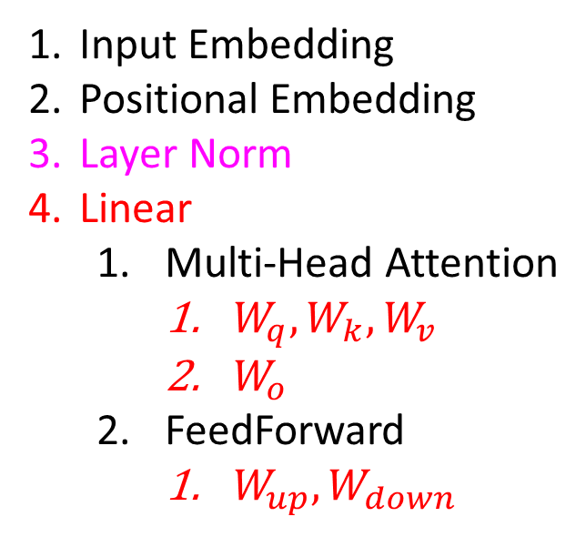

GPT2 – All trainable components
$$W_{down}$$
Output layer
$$W_{up}$$
Hugging Face’s gpt2
(can bypass input embedding by using `inputs_embeds` instead of `input_ids`)
Input Embedding
Positional Embedding
Layer Norm
Linear
Multi-Head Attention
$W_{q},W_{k},W_{v}$
$W_{o}$
FeedForward
$W_{up},W_{down}$
$$W_{o}$$
Trainable instead of fixed sinusoidal functions
bypassable
Input layer
$$W_{q},W_{k},W_{v}$$
`nn.Embedding` is a trainable lookup table, resembling a bias-free linear layer with one-hot inputs.

Slide 5
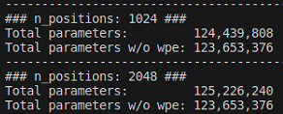

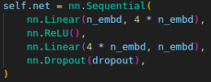
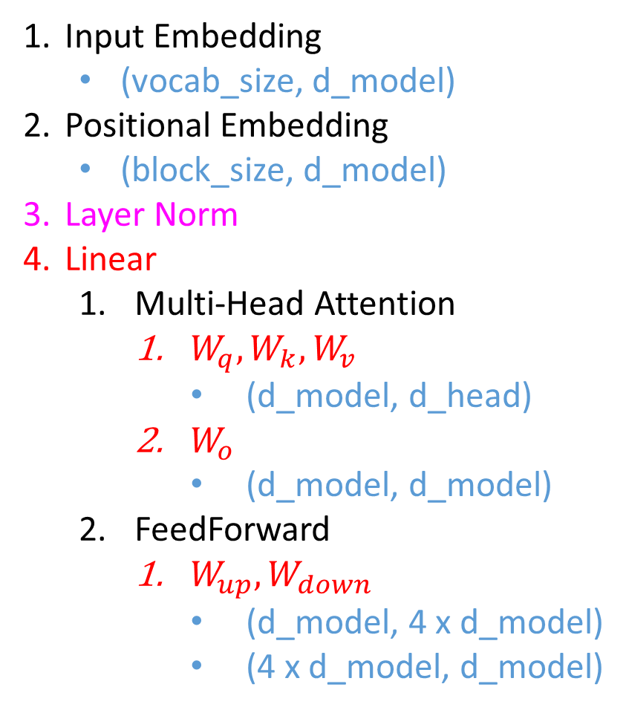
GPT2 – All trainable components
(also known as block_size, n_positions, or max_seq_len)
The context window size won't affect the model size (except for the positional embedding part).
n_embd = d_model
head_size = d_head
Input Embedding
(vocab_size, d_model)
Positional Embedding
(block_size, d_model)
Layer Norm
Linear
Multi-Head Attention
$W_{q},W_{k},W_{v}$
(d_model, d_head)
$W_{o}$
(d_model, d_model)
FeedForward
$W_{up},W_{down}$
(d_model, 4 x d_model)
(4 x d_model, d_model)

Slide 6
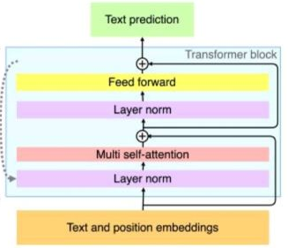
GPT2 – 4 Important hyperparameters
4 important hp for the model:
n_positions
n_embd
n_layer
n_head
n_layer
n_embd
n_head
n_positions

