Slide 1
2023 JDP –
AI Causality Inferences for TSMC Operations
Advisor: Wen-Chih Peng
Student: Zheng-Ming (Paul) Lin, Ching (Jason) Chang
Date: 2023/05/08

Slide 2
Outline
Problem Definition
RCA vs. Causal Learning

Slide 3
Problem Definition

Slide 4
Problem Settings
Supervised or Unsupervised | Unsupervised
AD or RCA | RCA
Offline or Online | Online
Data Format | Time-series Tabular Data
Individual or Group | Group Individual
Others | Graph-based GNN Self-supervised Learning

Slide 5
Input Format with Provided Dataset
step
stage
Data format:
For each stage, mutiple steps can be involved.
Two categories of steps exist: manufacturing and measurements.
For each step, we only have one record.
Measurement steps are not always required in a stage.
We make use of wafers that exist in both the measurement steps and the manufacturing steps.
Each step has a clear sequential relationship (a distinct linear progression).
The wafer manufacturing process does not change over time.
Measurement steps consistently act as outcomes, rather than contributing factors.
manufacturing step
stage 1
measurement step
stage 2
stage 3

Slide 6
Input Format with Provided Dataset
Data format:
For each stage, mutiple steps can be involved.
Two categories of steps exist: manufacturing and measurements.
For each step, we only have one record.
Measurement steps are not always required in a stage.
We make use of wafers that exist in both the measurement steps and the manufacturing steps.
Each step has a clear sequential relationship (a distinct linear progression).
The wafer manufacturing process does not change over time.
Measurement steps consistently act as outcomes, rather than contributing factors.
M1
M2
Q3
M4
M5
M6
Assumptions for the causal graph based on the data format:
No edge is allowed to point back to a previous step
The causal graph remains unchanged over time
No edge is allowed to point back to a measurement step, as measurement steps are not considered causal factors.
Q7
causal graph

Slide 7
Wafer POV
Same wafer id
Varying multiple features for manufacturing steps
Varying multiple features for measurements steps
Single record for each step
M1
M2
root cause
Q3
Single feature
time/
step id
M4
M5
M6
Q7
trigger point
causal graph
t

Slide 8
Received CSV
Same wafer id
manufacturing steps’ features
measurements steps’ features
time | wafer id | step | M_f1 | M_f2 | M_f3 | Q_f1 | Q_f2 | Q_f3
10:00 | W1 | M1 | RCP1 | TOOL1 | -
10:05 | W1 | M2 | RCP1 | TOOL1 | -
10:10 | W1 | Q3 |  |  |  | 30 | - | 0.4
10:15 | W1 | M4 | RCP1 | - | 3.4
10:20 | W1 | M5 | RCP3 | - | 2.5
10:25 | W1 | M6 | RCP2 | - | 1.9
10:30 | W1 | Q7 |  |  |  | 30 | 81 | -
M1
M2
Q3
M4
M5
M6
Q7
causal graph

Slide 9
Organized CSV
Removed aspects:
Some features are shared across steps
Time within one single wafer
M1
M2
Q3
M4
M5
M6
Q7
M1
M2
wafer id | M1_f1 | M2_f1 | M2_f2 | Q3_f1 | Q3_f2 | … | Q7_f1
W1 | TOOL1 | RCP1 | 7.3 | XXX | 23 | … | 22
W2 | TOOL1 | RCP1 | 1.6 | XXX | 45 | … | 31
W3 | TOOL1 | RCP1 | 0.4 | XXX | 30 | … | 13
W4 | TOOL1 | RCP2 | 0.2 | XXX | 14 | … | 24
W5 | TOOL1 | RCP2 | 0.9 | XXX | 36 | … | 34
… | … | … | … | … | … | … | …
W97 | TOOL1 | RCP1 | 3.7 | XXX | 30 | … | 23
W98 | TOOL1 | RCP2 | 1.6 | XXX | 45 | … | 67
W99 | TOOL1 | RCP2 | 0.5 | XXX | 64 | … | 83
W100 | TOOL1 | RCP2 | 3.5 | XXX | 12 | … | 80
Q3
M4
M5
M6
Q7
causal graph

Slide 10
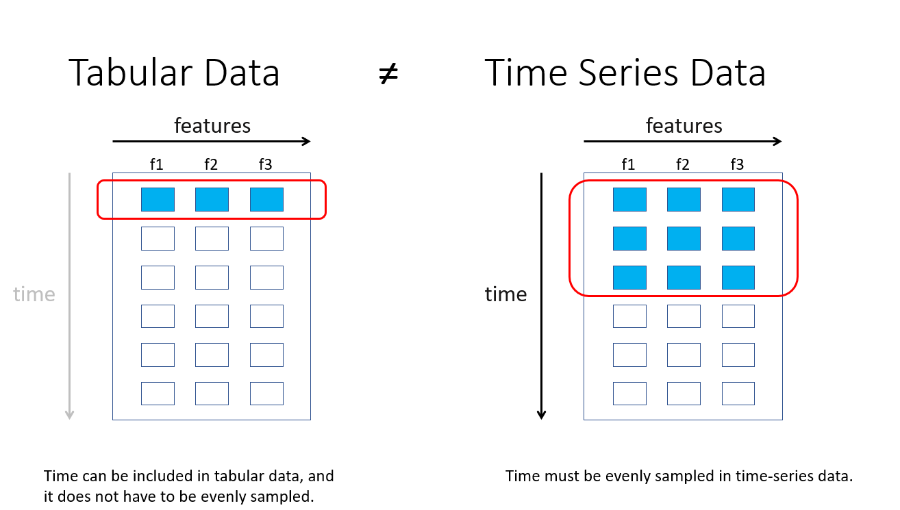

Slide 11
Group POV
Time-Series Data
M1
M2
Q3
M4
M5
M6
Q7
M1
M2
wafer id | M1_f1 | M2_f1 | M2_f2 | Q3_f1 | Q3_f2 | … | Q7_f1
W1 | TOOL1 | RCP1 | 7.3 | XXX | 23 | … | 22
W2 | TOOL1 | RCP1 | 1.6 | XXX | 45 | … | 31
W3 | TOOL1 | RCP1 | 0.4 | XXX | 30 | … | 13
W4 | TOOL1 | RCP2 | 0.2 | XXX | 14 | … | 24
W5 | TOOL1 | RCP2 | 0.9 | XXX | 36 | … | 34
… | … | … | … | … | … | … | …
W97 | TOOL1 | RCP1 | 3.7 | XXX | 30 | … | 23
W98 | TOOL1 | RCP2 | 1.6 | XXX | 45 | … | 67
W99 | TOOL1 | RCP2 | 0.5 | XXX | 64 | … | 83
W100 | TOOL1 | RCP2 | 3.5 | XXX | 12 | … | 80
Q3
M4
M5
M6
Q7
causal graph

Slide 12
Individual POV
Tabular Data
M1
M2
Q3
M4
M5
M6
Q7
M1
M2
wafer id | M1_f1 | M2_f1 | M2_f2 | Q3_f1 | Q3_f2 | … | Q7_f1
W1 | TOOL1 | RCP1 | 7.3 | XXX | 23 | … | 22
W2 | TOOL1 | RCP1 | 1.6 | XXX | 45 | … | 31
W3 | TOOL1 | RCP1 | 0.4 | XXX | 30 | … | 13
W4 | TOOL1 | RCP2 | 0.2 | XXX | 14 | … | 24
W5 | TOOL1 | RCP2 | 0.9 | XXX | 36 | … | 34
… | … | … | … | … | … | … | …
W97 | TOOL1 | RCP1 | 3.7 | XXX | 30 | … | 23
W98 | TOOL1 | RCP2 | 1.6 | XXX | 45 | … | 67
W99 | TOOL1 | RCP2 | 0.5 | XXX | 64 | … | 83
W100 | TOOL1 | RCP2 | 3.5 | XXX | 12 | … | 80
Q3
M4
M5
M6
Q7
causal graph

Slide 13
Similarity between tabular-data-format and AISPC
C
C
#req
#req
f₁
A
B
f₁
A
f₁
A
f_{T}
A
#err
B
#err
f₂
C
f₂
f₂
C
A
C
A
C
cpu
B
The root cause of C should be different from A's root cause.
cpu
f_{T}
f_{T}

Slide 14
RCA vs. Causal Learning

Slide 15
Connections
Causal Inference ⟷ Root Cause Analysis
(CIRCA) Causal Inference-Based Root Cause Analysis for Online Service Systems with Intervention Recognition
KDD 2022
Causal Discovery ⟷ Root Cause Analysis
(RCD) Root Cause Analysis of Failures in Microservices through Causal Discovery
NeruIPS 2022
SCM ⟷ GNN
Relating Graph Neural Networks to Structural Causal Models

Slide 16
Problem Encountered at TSMC
Categorical and numerical features
Out-of-vocabulary in categorical features
Enormous amount of features
Missing Data

Slide 17
A Two-Stage Solution
(Causal Discovery) When creating the causal graph, we can add some constraints on edges that:
Some edges shouldn’t exist (ex: next step → previous step)
Some edges should exist (ex: domain knowledge)
(Causal Inference) Use learned [causal graph/…] to perform root cause analysis (RCA)
Evaluation (TBD)
Open manufacturing dataset
Open tabular dataset with self-added constraints
Synthetic dataset

