Slide 1
2022 JDP –
AI Detection and Causality Inferences for Fab Operations
Advisor: Wen-Chih Peng
Student: Zheng-Ming (Paul) Lin, Ching (Jason) Chang
Date: 2022/07/14

Slide 2
Outline
LotAction - TSMC’s solutions and pain points
Open Dataset
Log parser
Anomaly Detection/Localization
Root Cause Analysis
Surveyed Paper
Uniparser
WWW 2022

Slide 3
Review - 張敬
Done in the past two weeks
Collect open dataset
Graph-based root cause analysis for service-oriented and microservice architectures
JSS 2020 (Q1 journal), #citations = 38
To do
Reproduce the results in DeepTraLog

Slide 4
Review - 正明
Done in the past two weeks
Survey the method of the log clustering
UniParser: A Unified Log Parser for Heterogeneous Log Data
WWW, 2022
SwissLog: Robust Anomaly Detection and Localization for Interleaved Unstructured Logs
IEEE Transactions on Dependable and Secure Computing, 2022
To do
Review the paper that we have surveyed and try to reproduce the result

Slide 5
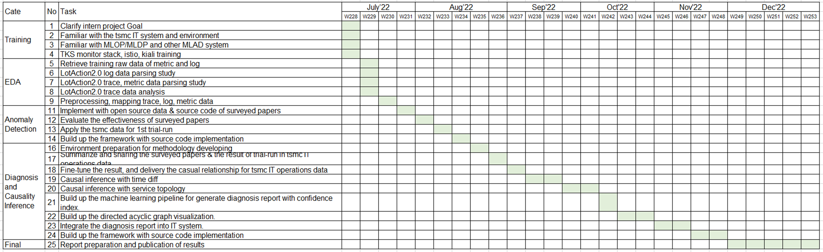
Internship plan
11月底前完成演算法設計與程式開發
12月底前完成報告撰寫 (論文明年2月底前完成即可)

Slide 6
Problem Settings
Supervised or Unsupervised | Unsupervised
Offline or Online | Online
Data type | Metric + Log + Trace + Changelog
Data source | System log (kubernetes-related) Application log
Others | Multiple sources time mismatch log sparsity issue (error message) Log parsing Causality/Interpretability/Explainability
Keywords: micro services, causal graph, root cause analysis, causal inference

Slide 7
LotAction - TSMC’s solutions
Metric跟Log分開分析
Metric
單變量 (why?)
預測模型 + 卡threshold
Log
單變量
使用Drain來parse log，轉成time series
與Metric相同的模型 (預測模型 + 卡threshold)
Trace
Not ready

Slide 8
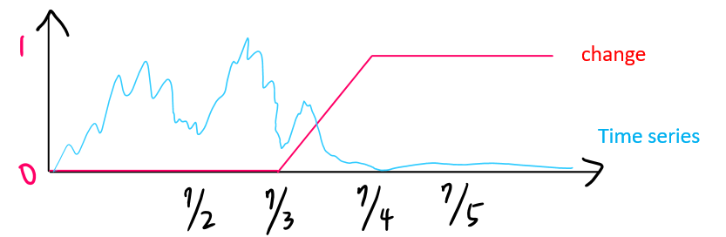
LotAction - TSMC’s solutions
Changelog
大部分的anomaly其實都來自於change
根據changelog產生”change”
Ex: DB要change，2022/07/03 00:00 ~ 2022/07/04 00:00
跟time series計算相似度
change非常多，加入filter來決定要比對的change

Slide 9
LotAction - TSMC’s pain points
Log Parser - Drain
Parse到後面會有大量wildcard的問題
同樣屬性的log會對應到不同的template (?)
Combine multiple data sources (Anomaly Detection)
同時使用多個data source的"raw" data
Changelog其實佔大宗
Causal Relations (Root Cause Analysis)
嘗試演算法：BBN、TCDF
問題：
超參數微調會有完全不同的結果
執行時間過久

Slide 10
Open Dataset
Log parser
Anomaly Detection/Localization
Root Cause Analysis

Slide 11
~~~~~~~~~~~~~~~~~~~~~~~~~~~~~~~

Slide 12
UniParser: A Unified Log Parser for Heterogeneous Log Data
Yudong Liu, Xu Zhang, Shilin He, Hongyu Zhang, Liqun Li, Yu Kang, Yong Xu, Minghua Ma, Qingwei Lin, Yingnong Dang, Saravan Rajmohan, Dongmei Zhang
WWW 2022
Speaker: Zheng-Ming Lin
Date: 2022/7/11

Slide 13
Related Work
Drain: An Online Log Parsing Approach with Fixed Depth Tree (ICWS 2017)
When a new raw log message arrives, Drain will preprocess it by simple regular expressions based on domain knowledge
Then we search a log group (i.e., leaf node of the tree) by following the specially-designed rules encoded in the internal nodes of the tree
If a suitable log group is found, the log message will be matched with the log event stored in that log group
Otherwise, a new log group will be created based on the log message

Slide 14
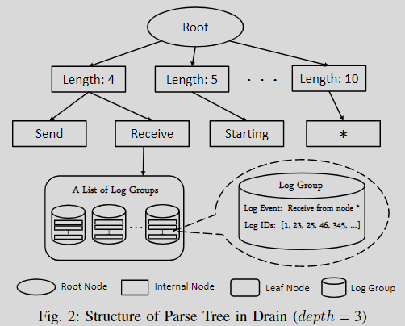
Related Work
Internal nodes encode specially-designed rules to guide the search process
Each path in the parse tree ends with a leaf node, which stores a list of log groups
Each log group has two parts: log event and log IDs
Log event is the template that best describes the log messages in this group, which consists of the constant part of a log message
Log IDs records the IDs of log messages in this group

Slide 15
Related Work
The depth of all leaf nodes are the same and are fixed by a predefined parameter depth
This parameter bounds the number of nodes Drain visits during the search process
To avoid tree branch explosion, we employ a parameter maxChild, which restricts the maximum number of children of a node

Slide 16
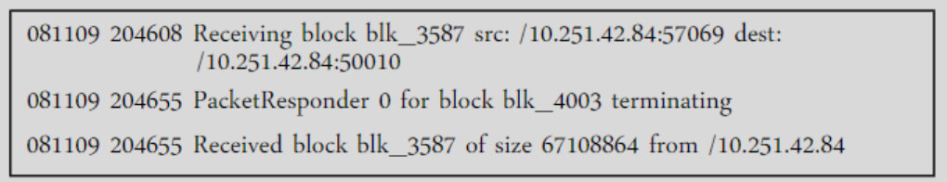
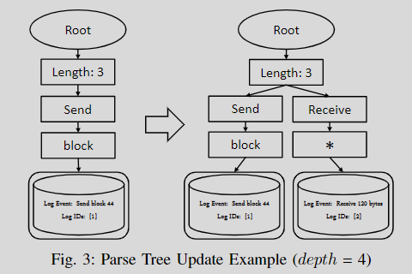
Related Work

Slide 17
Problem
Ignoring semantic meaning of log tokens
Barrier among different log sources
Log contents from different systems or services are characterized by their high diversity
Improper evaluation metrics

Slide 18
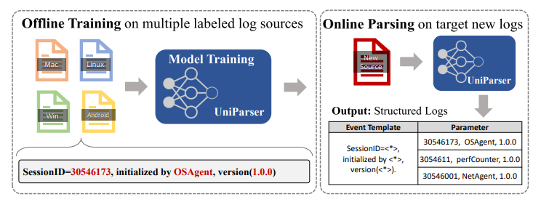
Problem statement
Input: A raw log message L with n tokens [t₁, t₂, …, t_{n}]
Output: Predict whether each log token 𝑡_{𝑖} belongs to template part (𝑦_{𝑖} = 0) or parameter part (𝑦_{𝑖} = 1)
During the training phase, we take labeled log data from multiple sources as a training dataset

Slide 19
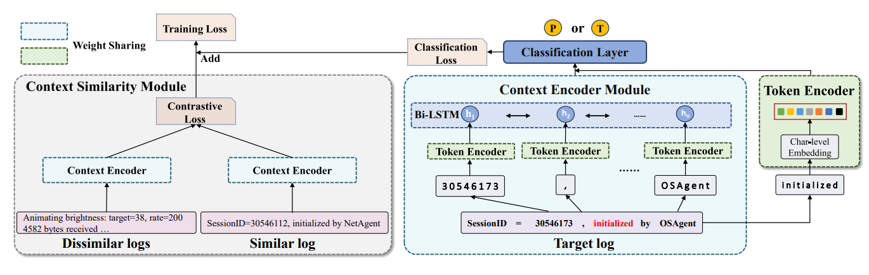
UniParser Framework

Slide 20
Token Encoder

Slide 21
Token Encoder
Given a raw log message, conduct word splitting with spaces, tabs, special characters
Token Encoder module encodes each split log token into a high-dimensional embedding vector as the model input
Diverse and dynamic log words pose a barrier in embedding matrix construction
The endless unseen log tokens would incur the out-of-vocabulary problem
To deal with this problem, utilize the char-level embedding[1] to encode log tokens
Build up an embedding layer to encode each character (1-of-m encoding)
Sum up all char-level embedding vectors together within in a log token as its encoding vector
Xiang Zhang and Yann LeCun. 2015. Text understanding from scratch. arXiv
preprint arXiv:1502.01710 (2015)

Slide 22
Context Encoder

Slide 23
Context Encoder
The category (template or parameter) of a target log token is related to itself and its neighboring tokens
Parameters tend to emerge conjointly with some special characters or symbols
For example, "30546173" is on the heels of an equal sign "="
If we are not so confident in determining the class of log token "/etc/data/" only depending on itself, its context "from" is conducive to classifying it as a parameter

Slide 24
Context Encoder
Not every log token within a log message should be treated as the context of the target log token
Those log tokens far from the target one tend to be useless for classification
Regard the range from left 𝑘 to right 𝑘 tokens around the target token as its context
It is noted that the target token is masked during this process
The purpose is expected to independently capture the patterns reflected by context tokens without the aid of the target log token itself

Slide 25
Context Similarity Encoder

Slide 26
Context Similarity Encoder
Char-level embedding is content-aware and will lead to dispersive encoding vectors
For example, when we target to predict the class of token "initialized", its context "by OSAgent" in line 1 and "by perfCounter" in line 2 are very different
To mitigate the effect of the content diversity, guide Context Encoder module through the contrast learning between the similar or dissimilar log messages
Contrastive learning
Maximize the representation similarity of the positive pair, while minimize the negatives

Slide 27
Context Similarity Encoder
To obtain similar log messages, first cluster the training log data from heterogeneous log sources into several groups
The log messages in each group are identical in token length, as well as on the first token (as same as Drain)
After clustering, utilize contrastive learning to assist the training of Context Encoder module
Randomly select one similar log messages and |𝑉_{𝑑}| dissimilar ones
The distance between two encoding vectors from similar contexts should be closer
For the dissimilar ones, their distances should be far apart

Slide 28

Loss Function
Token-level classification loss
Concatenate the encoding vectors generated from Token Encoder module and Context Encoder module
Add the classification layer on top of it to make predictions

Slide 29
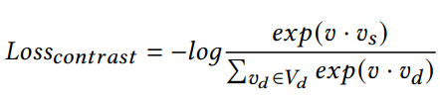

Loss Function
Context-level contrastive loss
1
2
3
4
𝑣: Represent encoding vector for target log context produced by the Context Encoder module
𝑣_{𝑠}: Denote the similar log vector
𝑣_{𝑑}: Denote the log vector from the dissimilar set
The total loss is the weighted sum of the two losses, which can be formulated as

Slide 30
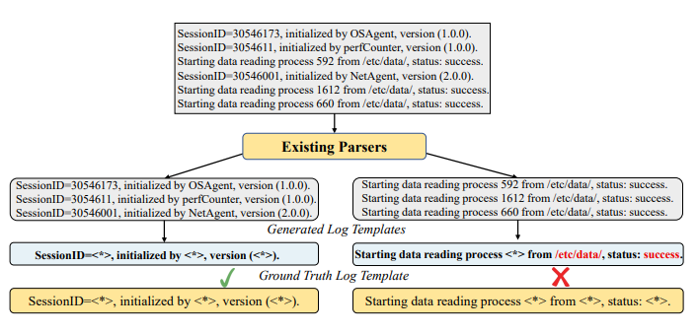
Metrics
Group Accuracy
Measure the corresponding set of log messages belonging to the same true log template
However, Group Accuracy prefers properly grouping logs under the same templates together, while the log templates and parameters may not be correctly identified
Message-Level Accuracy
A log message is considered correctly
parsed if and only if every token of
the message is correctly identified as
template or parameter

Slide 31
Conclusion
Problem
Ignoring semantic meaning of log tokens
Barrier among different log sources
Improper evaluation metrics
Solution
Utilize Token Encoder module and Context Encoder module to capture the patterns of templates and parameters
Context Similarity module is designed to focus on the commonalities of patterns
Experiment
Use the new metrics Message-level Accuracy to evaluate the model

