Slide 1
GLAD-PAW: Graph-Based Log Anomaly Detection by Position Aware Weighted Graph Attention Network
Jason Chang
Wan, Yi, et al. "GLAD-PAW: Graph-Based Log Anomaly Detection by Position Aware Weighted Graph Attention Network." Pacific-Asia Conference on Knowledge Discovery and Data Mining. Springer, Cham, 2021.

Slide 2
Outline
Situation
Problem Formulation
Solution
Evaluation
Conclusion

Slide 3
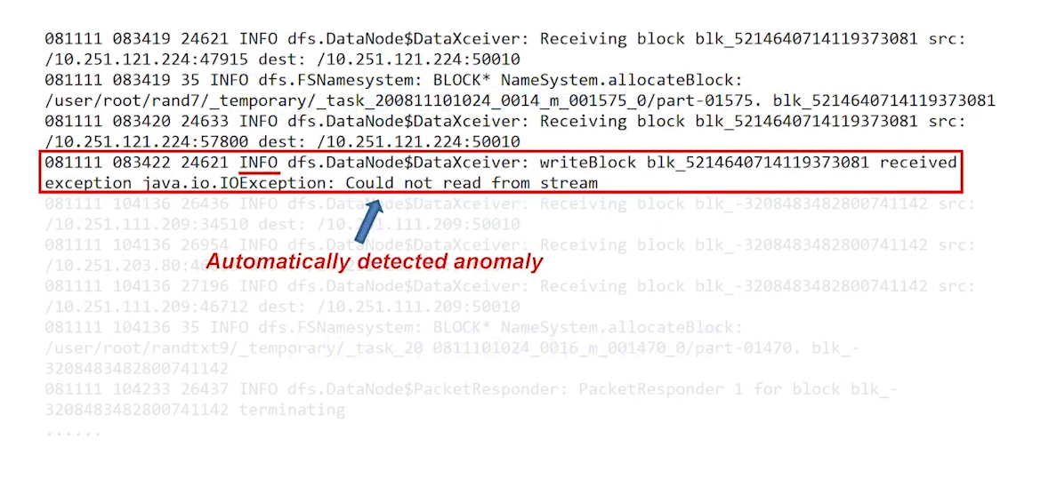
Log-based Anomaly Detection
Log is available practically on every computer system
Automatic Analysis

Slide 4
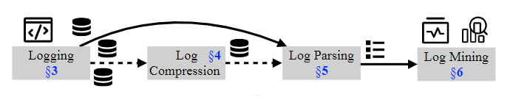
An overall framework for automated log analysis
He, Shilin, et al. "A survey on automated log analysis for reliability engineering." ACM Computing Surveys (CSUR) 54.6 (2021): 1-37.

Slide 5
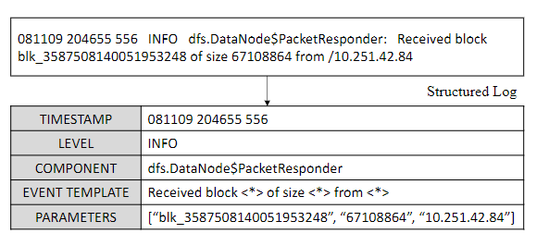
Log Parsing
Most of the existing log mining tools require structured input data
We need to parse the semi-structured log messages into structured log events

Slide 6
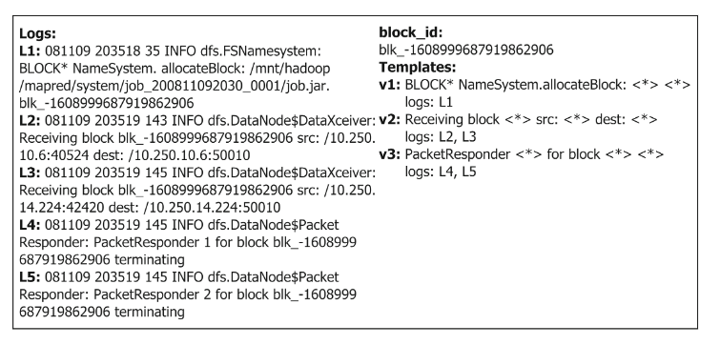
Log Partition (or Session Creation)
Parsed logs are usually grouped by one of the three following windows
fixed window
sliding window
session window (this paper)

Slide 7
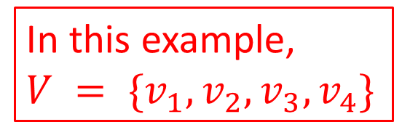
Log Partition (or Session Creation)
Group events into session
Logs:
L1, L2, L3, L4, L5, L6, L7, L8, L9, L10
Blocks:
b1, b2, b1, b1, b2, b1, b2, b1, b2, b2
Templates:
v1, v2, v1, v3, v4, v1, v2, v4, v3, v3
b1: v1, v1, v3, v1, v4
In this example, $V = \{v_{1}, v_{2},v_{3}, v_{4}\}$
b2: v2, v4, v2, v3, v3
After log parsing, we have the set of all unique events $V = \{v_{1}, v_{2}, …, v_{\left|V\right|}\}$

Slide 8
Related Work – Log Anomaly Detection
Maching Learning
Principal component analysis (PCA) constructs normal and abnormal subspaces, and computes the squared distance of the projection of event frequency vectors onto the anomaly subspace.
Invariant Mining method tries to estimate the invariant space via singular value decomposition (SVD) on the input matrix
Log Clustering clusters the logs to ease log-based problem identification and utilizes a knowledge base to check if the log sequences occurred before.
Isolation Forest constructs isolation trees assuming that anomalies are more susceptible to isolation.

Slide 9
Related Work – Log Anomaly Detection
Deep Learning
DeepLog models log sequences as natural language and utilize Long Short-Term Memory (LSTM) architecture to learn log patterns from normal executions.
LogAnomaly adds attention mechanism and frequency features to DeepLog

Slide 10
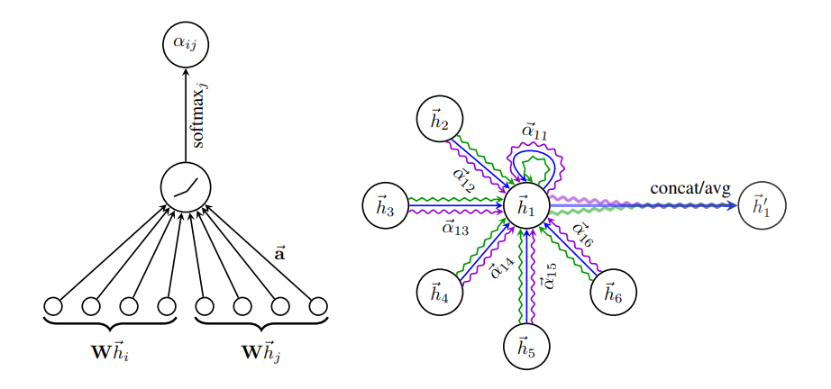
Related Work – GNN
GAT

Slide 11
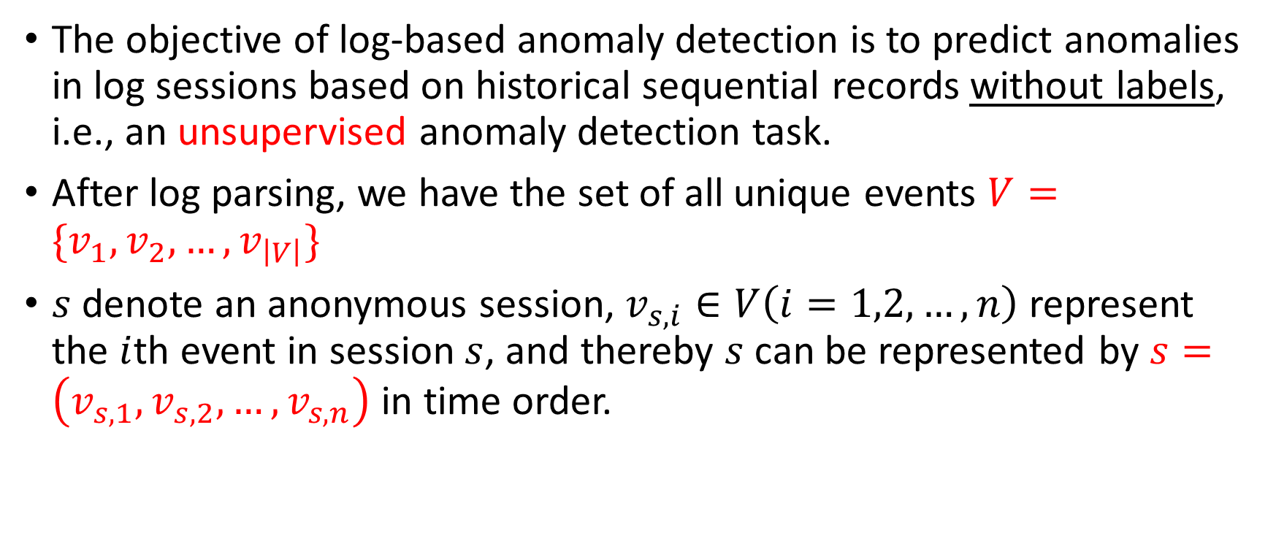
Problem Formulation
The objective of log-based anomaly detection is to predict anomalies in log sessions based on historical sequential records without labels, i.e., an unsupervised anomaly detection task.
After log parsing, we have the set of all unique events $V=\{v_{1},v_{2},…,v_{\left|V\right|}\}$
$s$ denote an anonymous session, $v_{s,i}∈V\left(i=1,2,…,n\right)$ represent the $i$th event in session $s$, and thereby $s$can be represented by $s=\left(v_{s,1},v_{s,2},…,v_{s,n}\right)$ in time order.

Slide 12
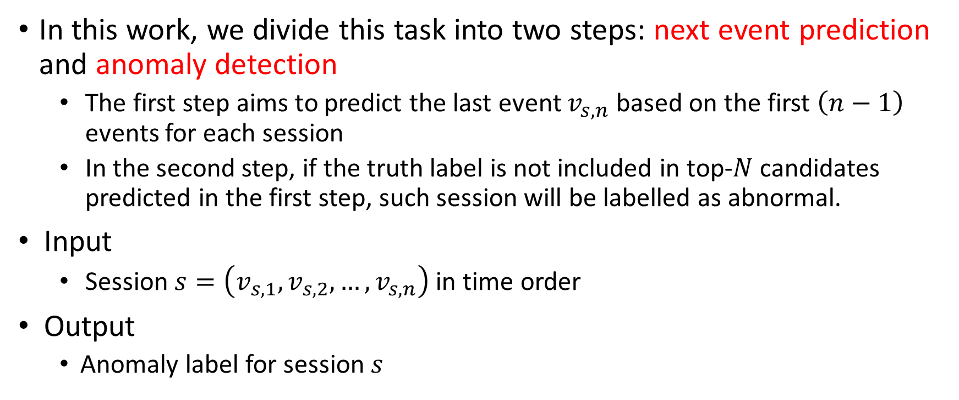
Problem Formulation
In this work, we divide this task into two steps: next event prediction and anomaly detection
The first step aims to predict the last event $v_{s,n}$ based on the first $\left(n−1\right)$ events for each session
In the second step, if the truth label is not included in top-$N$ candidates predicted in the first step, such session will be labelled as abnormal.
Input
Session $s=\left(v_{s,1},v_{s,2},…,v_{s,n}\right)$ in time order
Output
Anomaly label for session $s$

Slide 13
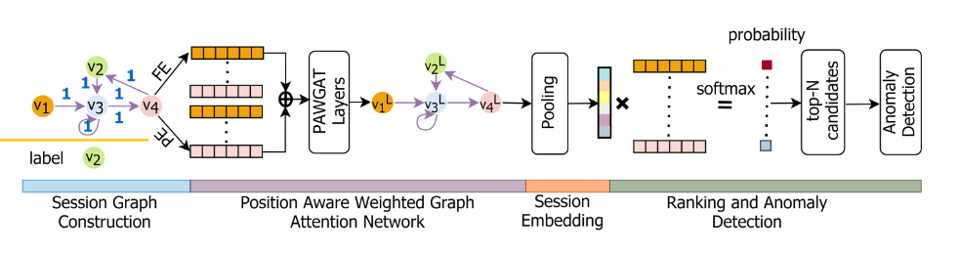
The overall architecture of GLAD-PAW

Slide 14
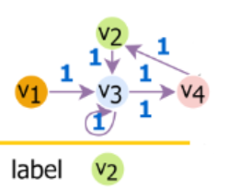
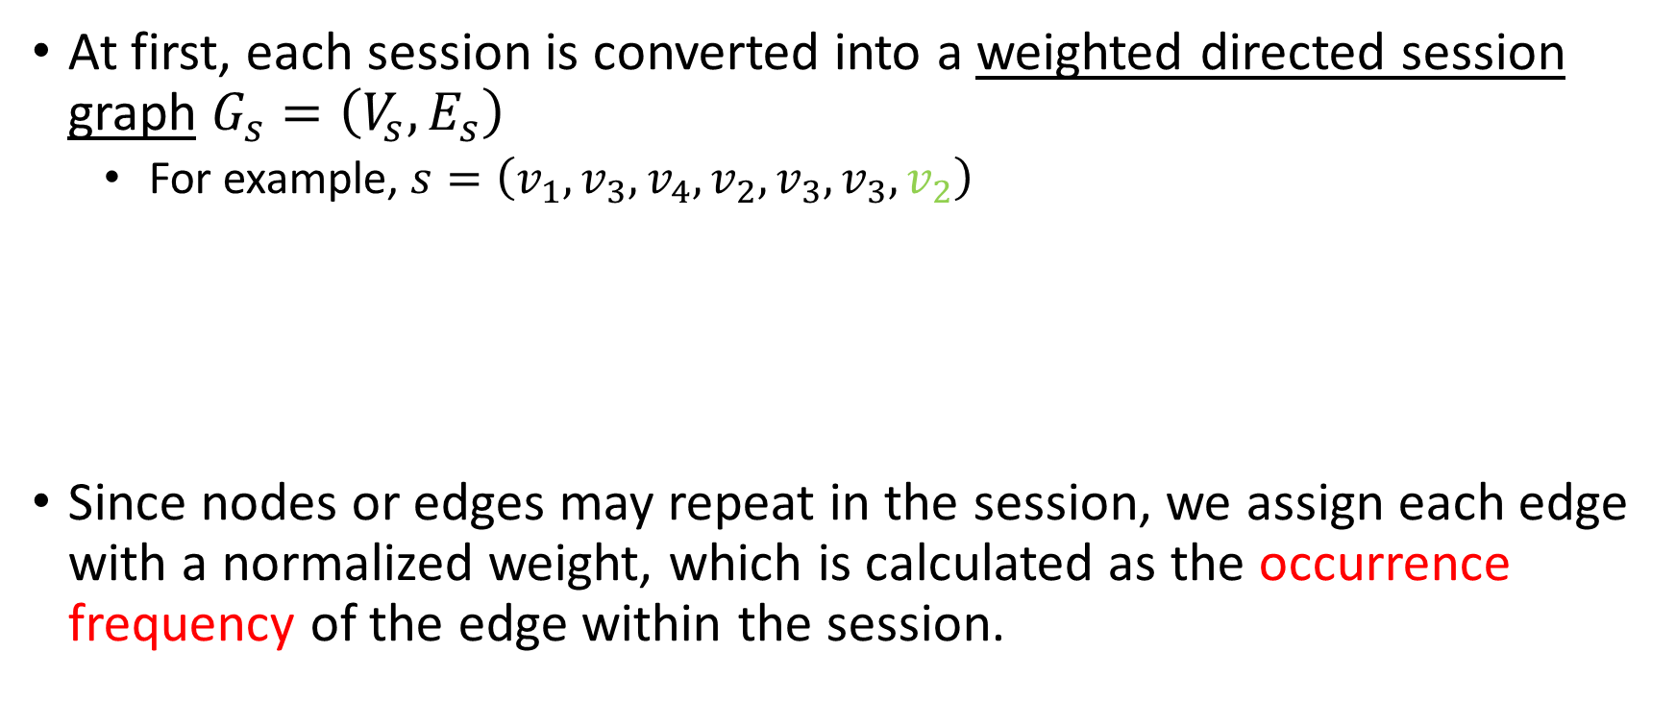
Session Graph Construction
At first, each session is converted into a weighted directed session graph $G_{s}=\left(V_{s},E_{s}\right)$
For example, $s=\left(v_{1},v_{3},v_{4},v_{2},v_{3},v_{3},v_{2}\right)$
Since nodes or edges may repeat in the session, we assign each edge with a normalized weight, which is calculated as the occurrence frequency of the edge within the session.

Slide 15
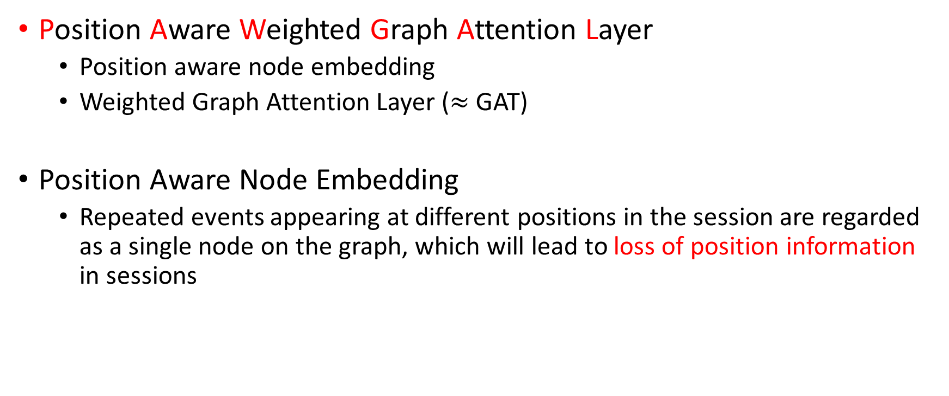
PAWGAT
Position Aware Weighted Graph Attention Layer
Position aware node embedding
Weighted Graph Attention Layer ($≈$ GAT)
Position Aware Node Embedding
Repeated events appearing at different positions in the session are regarded as a single node on the graph, which will lead to loss of position information in sessions

Slide 16
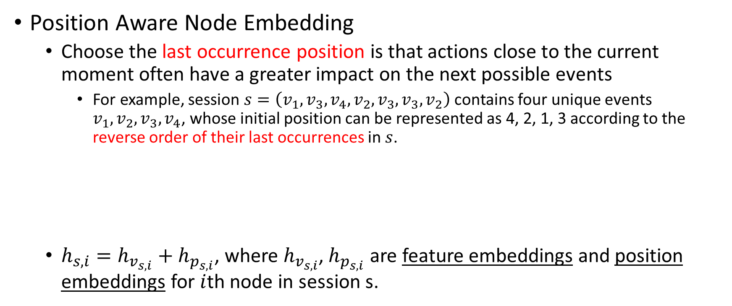
PAWGAT
Position Aware Node Embedding
Choose the last occurrence position is that actions close to the current moment often have a greater impact on the next possible events
For example, session $s=\left(v_{1},v_{3},v_{4},v_{2},v_{3},v_{3},v_{2}\right)$ contains four unique events $v_{1},v_{2},v_{3},v_{4}$, whose initial position can be represented as 4, 2, 1, 3 according to the reverse order of their last occurrences in $s$.
$h_{s,i}=h_{v_{s,i}}+h_{p_{s,i}}$, where $h_{v_{s,i}}$, $h_{p_{s,i}}$ are feature embeddings and position embeddings for $i$th node in session s.
v1:
v2:
v3:
v4:
4
2
v1, v3, v4, v2, v3, v3, v2
1
3

Slide 17
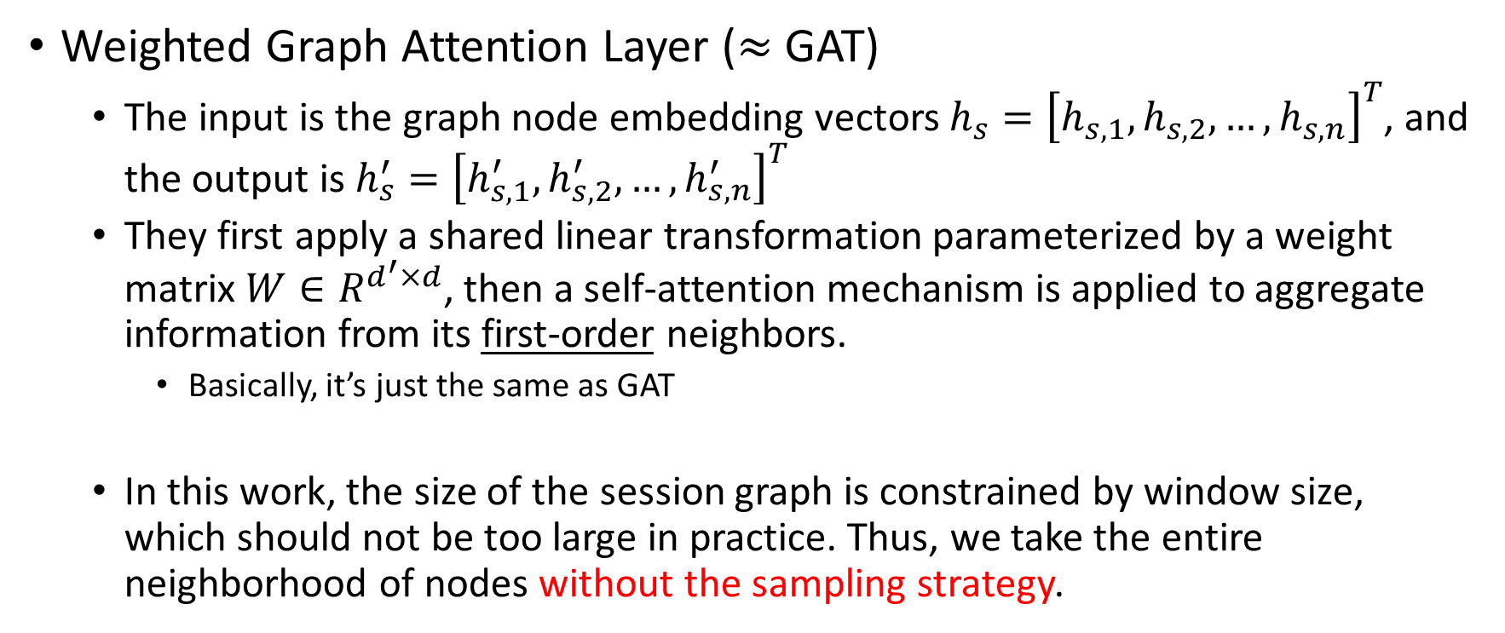
PAWGAT
Weighted Graph Attention Layer ($≈$ GAT)
The input is the graph node embedding vectors $h_{s}={\left[h_{s,1},h_{s,2},…,h_{s,n}\right]}^{T}$, and the output is $h_{s}^{′}={\left[h_{s,1}^{′},h_{s,2}^{′},…,h_{s,n}^{′}\right]}^{T}$
They first apply a shared linear transformation parameterized by a weight matrix $W∈R^{d^{′}×d}$, then a self-attention mechanism is applied to aggregate information from its first-order neighbors.
Basically, it’s just the same as GAT
In this work, the size of the session graph is constrained by window size, which should not be too large in practice. Thus, we take the entire neighborhood of nodes without the sampling strategy.

Slide 18






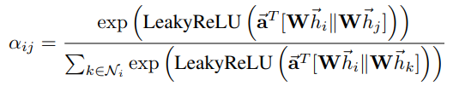
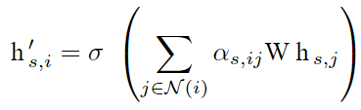
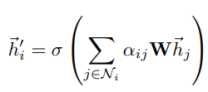
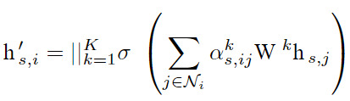

PAWGAT
The only difference: here they also consider the edge’s weight
In this Paper
GAT

Slide 19
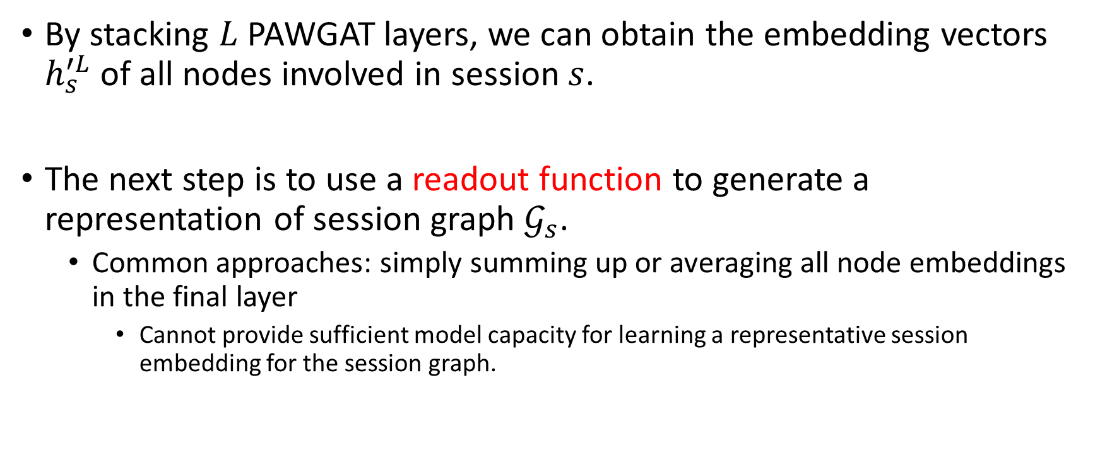
Session Embeddings
By stacking $L$ PAWGAT layers, we can obtain the embedding vectors $h_{s}^{′L}$ of all nodes involved in session $s$.
The next step is to use a readout function to generate a representation of session graph $𝒢_{s}$.
Common approaches: simply summing up or averaging all node embeddings in the final layer
Cannot provide sufficient model capacity for learning a representative session embedding for the session graph.

Slide 20
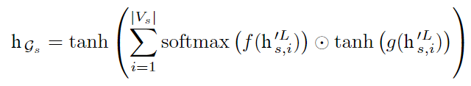
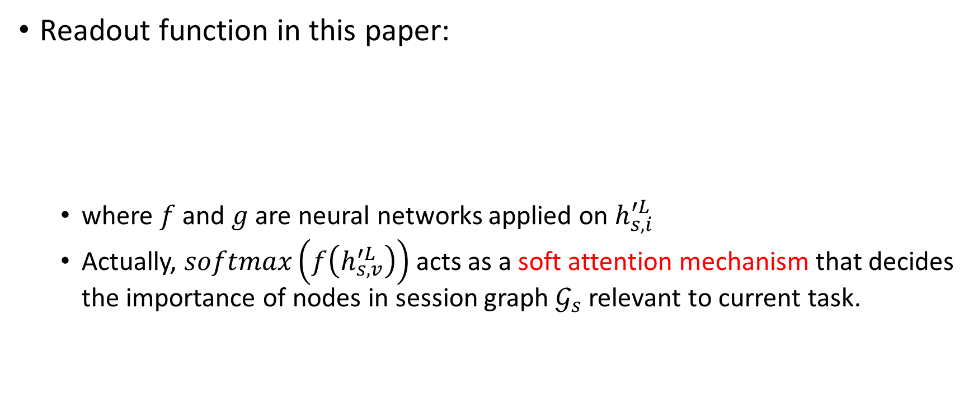
Session Embeddings
Readout function in this paper:
where $f$ and $g$ are neural networks applied on $h_{s,i}^{′L}$
Actually, $softmax\left(f\left(h_{s,v}^{′L}\right)\right)$ acts as a soft attention mechanism that decides the importance of nodes in session graph $𝒢_{s}$ relevant to current task.

Slide 21


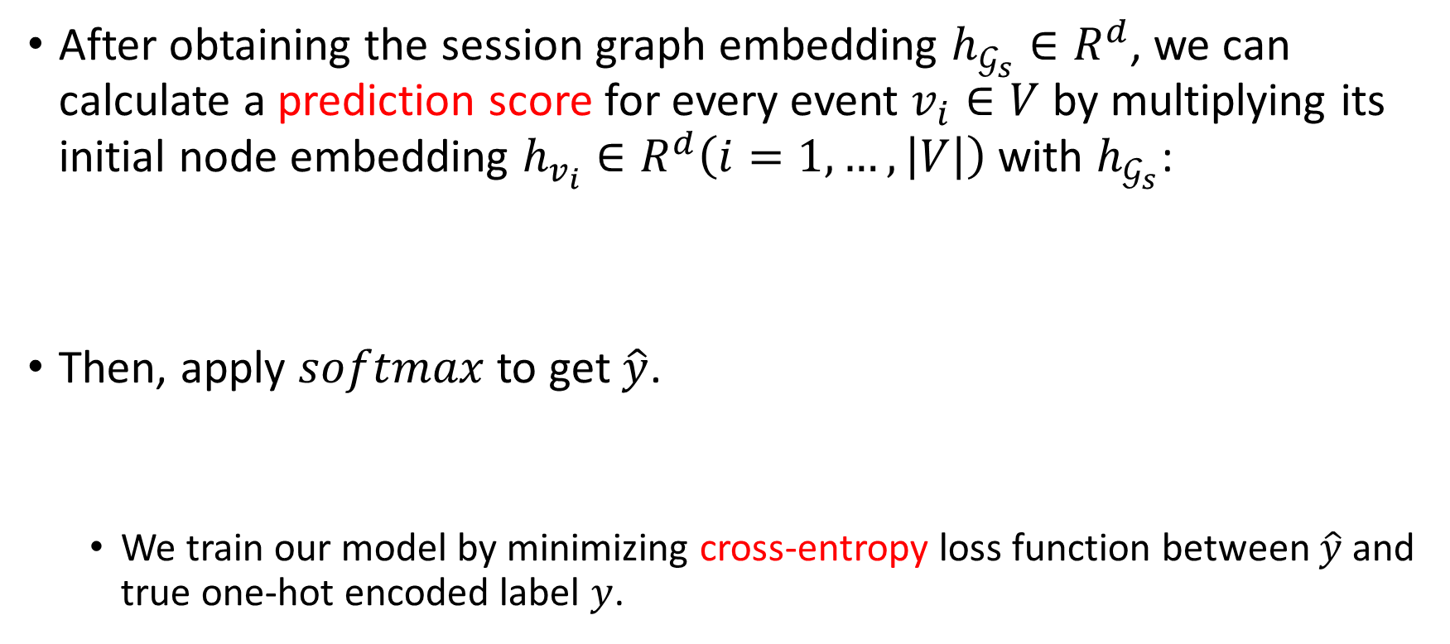
Prediction and Anomaly Detection
After obtaining the session graph embedding $h_{𝒢_{s}}∈R^{d}$, we can calculate a prediction score for every event $v_{i}∈V$ by multiplying its initial node embedding $h_{v_{i}}∈R^{d}\left(i=1,…,\left|V\right|\right)$ with $h_{𝒢_{s}}$:
Then, apply $softmax$ to get $\hat{y}$.
We train our model by minimizing cross-entropy loss function between $\hat{y}$ and true one-hot encoded label $y$.

Slide 22

Prediction and Anomaly Detection
For the top-$N$ candidates, we simply pick the highest $N$ probabilities over all events based on $\hat{y}$.
If the truth label is not included in top-$N$ candidates, a session will be labelled as abnormal.

Slide 23
Evaluation
Does GLAD-PAW achieve the state-of-the-art performance?
How does PAWGAT layer work for anomaly detection problem com-pared with other graph layers (including ablation test)?
How do the key hyperparameters affect model performance, such as the graph layer and number of heads?

Slide 24
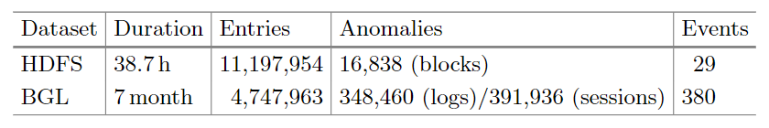
Dataset
HDFS
HDFS dataset is generated and collected from Amazon EC2 platform through running Hadoop-based map-reduce jobs.
BGL
BGL dataset is Blue Gene/L supercomputer system logs, which consists of 128K processors and is deployed at Lawrence Livermore National Laboratory (LLNL)

Slide 25
Things to be aware of
They randomly take 80% of normal sessions as training data and the rest 20% normal sessions along with all abnormal sessions as test data.
Since anomalies are rare in real life, instead of using Accuracy (very likely to achieve values close to 1), they use Precision, Recall and F1-measure as the evaluation metrics in their experiments.
BGL dataset contains a number of out-of-vocabulary (OOV) events, which are events that have never seen in the training set.

Slide 26
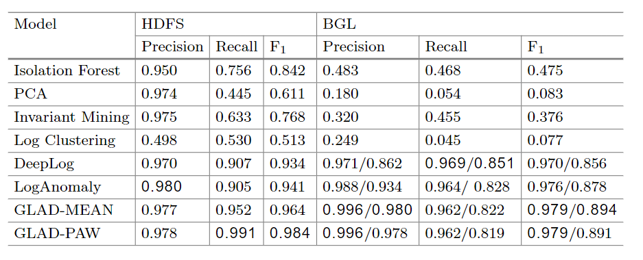
Comparison with Baseline Models

Slide 27
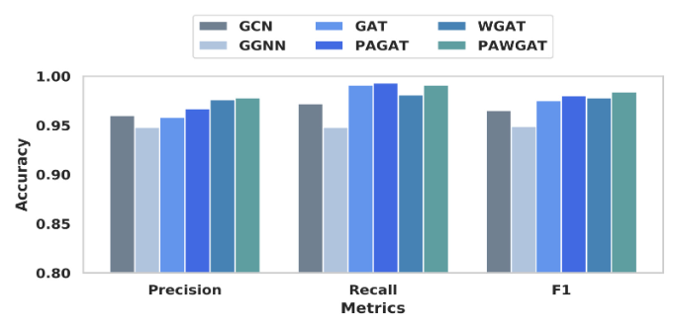
Comparison with Other GNN Layers

Slide 28
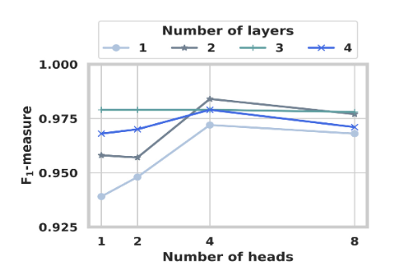
Parameter Sensitivity
Number of layers
Number of heads

Slide 29
Conclusion
Propose a novel architecture GLAD-PAW for log-based anomaly detection that incorporates graph models in representing log sessions
GLAD-PAW constructs directed session graphs from log records and applies a novel position aware weighted graph attention network (PAWGAT) to generate informative representations for all events.
Extensive evaluation on large system logs have clearly demonstrated the superior effectiveness of GLAD-PAW compared with previous methods.

Slide 30
My opinions
Pros
The very first paper to use GNN in log anomaly detection
It uses the unsupervised manner to train the model
They consider the position information
Cons
It’s an offline method (must have the “event bank”, so it cannot deal with unseen events)
Didn’t try other log parsing techniques
Didn’t consider the most important hyperparameters N in their experiments
They only use normal sessions to train the model, which is not right under the unsupervised premise

Slide 31
Thank you

