Slide 1
time_series_tools
Speaker: Ching (Jason) Chang

Slide 2
Outline
Introduction
time_series_tools
darts
Time-Series-Library
Ray Tune
Appendix

Slide 3
Introduction

Slide 4

The Ubiquity of Time-Series
https://cruiseresearchgroup.github.io/project/time-series_forecasting_and_segmentation/

Slide 5
Tabular Data ≠ Time Series Data
features
features
x1
x2
x3
y
f1
f2
f3
data window
data window
time

Slide 6
Group POV (case 1)
Irregular Time-Series Data
We also care about the ordering
S1
S2
S3
S4
S5
S6
S7
S1
S2
wafer id | f1 (M) | S1_f1 (M) | S2_f2 (M) | S3_f1 (Q) | S3_f2 (M) | … | S7_f1 (Q)
W1 | PART1 | RCP1 | 7.3 | XXX | 23 | … | 22
W2 | PART1 | RCP1 | 1.6 | XXX | 45 | … | 31
W3 | PART1 | RCP1 | 0.4 | XXX | 30 | … | 13
W4 | PART2 | RCP2 | 0.2 | XXX | 14 | … | 24
W5 | PART2 | RCP2 | 0.9 | XXX | 36 | … | 34
… | … | … | … | … | … | … | …
W97 | PART3 | RCP1 | 3.7 | XXX | 30 | … | 23
W98 | PART3 | RCP2 | 1.6 | XXX | 45 | … | 67
W99 | PART3 | RCP2 | 0.5 | XXX | 64 | … | 83
W100 | PART3 | RCP2 | 3.5 | XXX | 12 | … | 80
S3
S4
S5
S6
S7
causal graph

Slide 7
Individual POV (case 2)
Tabular Data
We treat each wafer individually
S1
S2
S3
S4
S5
S6
S7
S1
S2
wafer id | f1 (M) | S1_f1 (M) | S2_f2 (M) | S3_f1 (Q) | S3_f2 (M) | … | S7_f1 (Q)
W1 | PART1 | RCP1 | 7.3 | XXX | 23 | … | 22
W2 | PART1 | RCP1 | 1.6 | XXX | 45 | … | 31
W3 | PART1 | RCP1 | 0.4 | XXX | 30 | … | 13
W4 | PART2 | RCP2 | 0.2 | XXX | 14 | … | 24
W5 | PART2 | RCP2 | 0.9 | XXX | 36 | … | 34
… | … | … | … | … | … | … | …
W97 | PART3 | RCP1 | 3.7 | XXX | 30 | … | 23
W98 | PART3 | RCP2 | 1.6 | XXX | 45 | … | 67
W99 | PART3 | RCP2 | 0.5 | XXX | 64 | … | 83
W100 | PART3 | RCP2 | 3.5 | XXX | 12 | … | 80
S3
S4
S5
S6
S7
causal graph

Slide 8
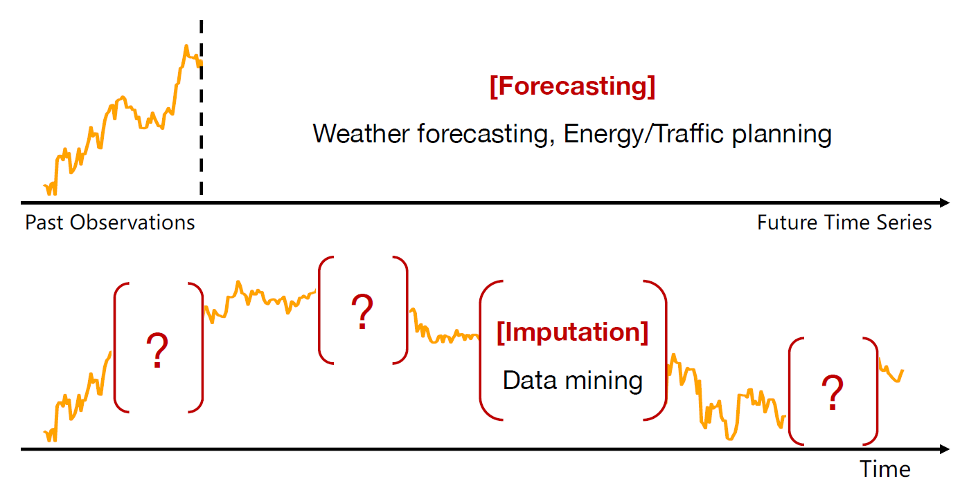
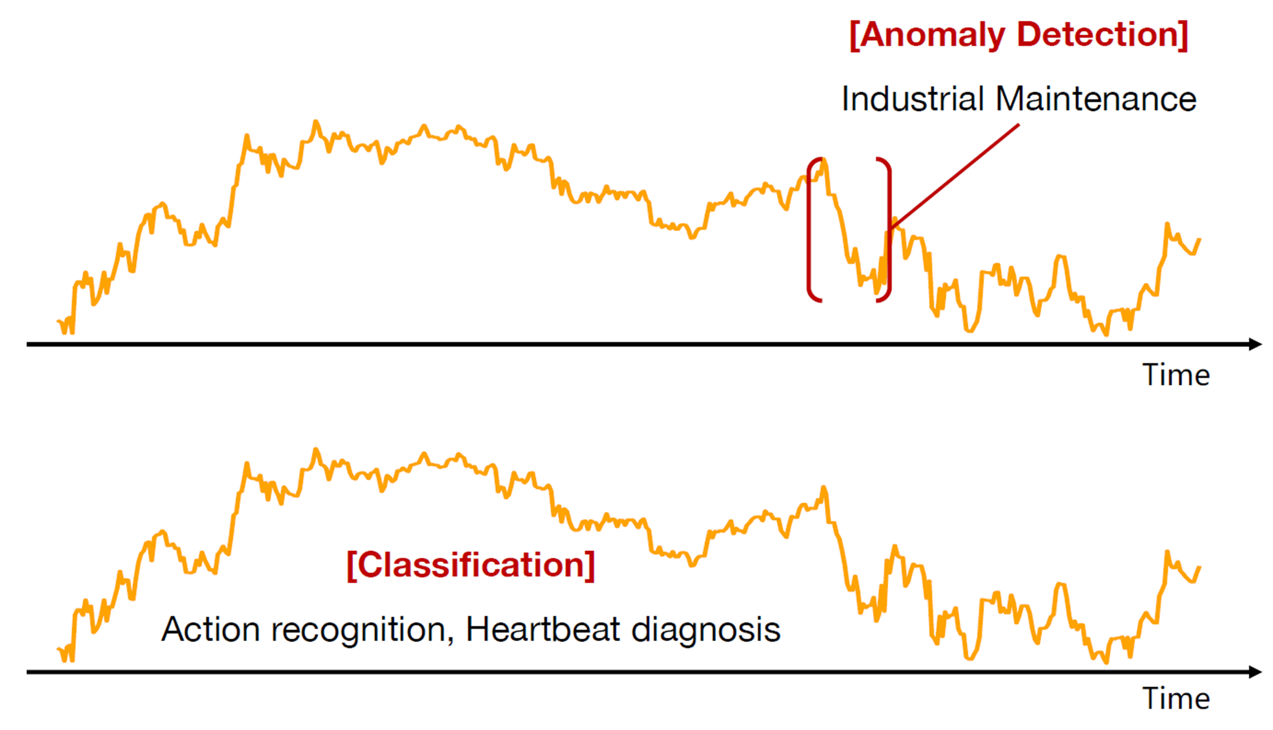
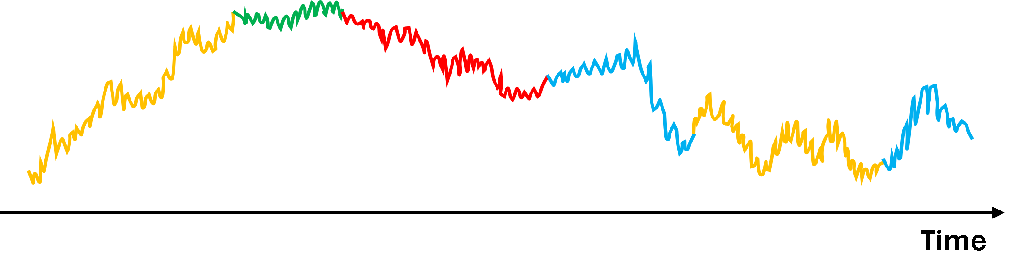
Time-Series Tasks
Forecasting
Long-term Forecasting
Short-term Forecasting
Imputation
Anomaly Detection
Classification
Segmentation
[Segmentation]
https://wuhaixu2016.github.io/pdf/ICLR2023_TimesNet.pdf

Slide 9



Problem Formulation for Forecasting
$$stride=1$$
past
future
$$X_{P}=(x_{1},…,x_{L})$$
$$X_{F}=(x_{L+1},…,x_{L+T})$$
forecast

Slide 10
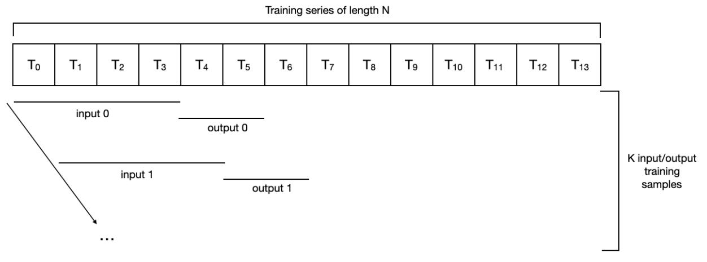
The idea of “sliding window”

Slide 11
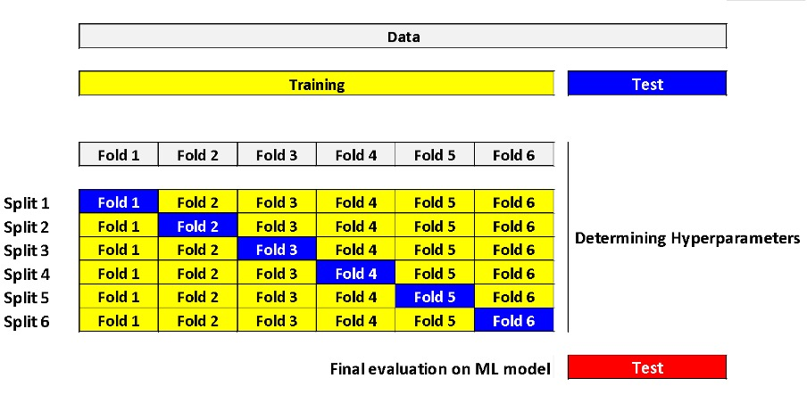
Tabular Data Cross Validation (K-Fold)

Slide 12
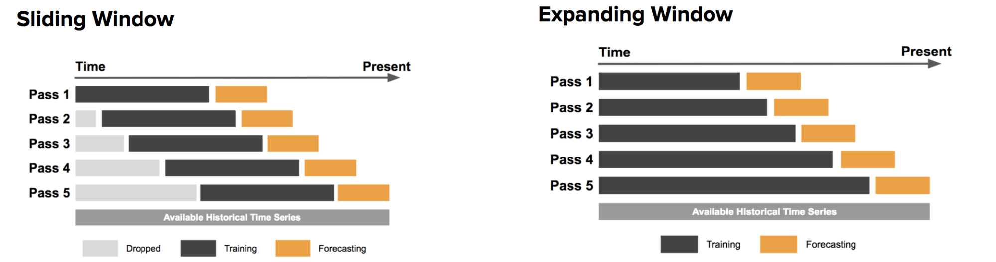
Time-Series Cross Validation

Slide 13
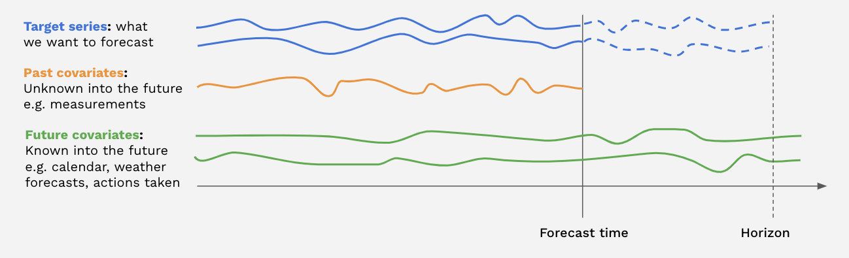
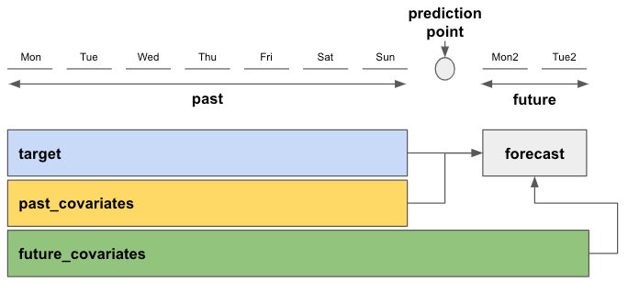
What are covariates?

Slide 14
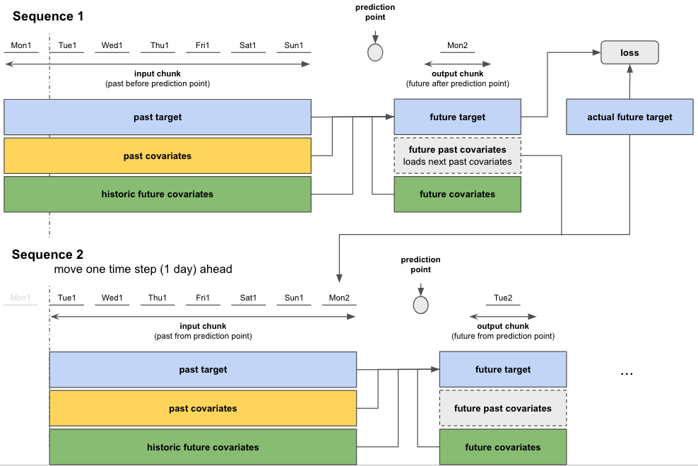

Slide 15
5 Types of Time-Series Forecasting Models
Type 1: Statistical and Machine Learning Models
Type 2: Deep Learning Models
Type 3: Transformers
Type 4: Graph Neural Networks (GNNs)
Type 5: Foundation Models

Slide 16
Type 1: Statistical and Machine Learning Models
Statistical Models
ARIMA
Machine Learning Models
Decision Tree
Boosting Tree
XGBoost
LightGBM
CatBoost
Linear Regression
… (any regressor in scikit-learn)

Slide 17
Type 2: Deep Learning Models
LSTM/GRU
CNN
TCN-based
TCN, TimesNet
N-BEATS, N-HiTS
Linear-based
DLinear/NLinear, RLinear
MLP-based
TSMixer
TiDE
TimeMixer

Slide 18
Type 3: Transformers
Informer
Autoformer
FEDformer
Crossformer
…
PatchTST
iTransformer

Slide 19
Type 4: Graph Neural Networks (GNNs)
GCN
GAT
GIN
TGN

Slide 20
Type 5: Foundation Models
Repurposed LLMs
GPT4TS, LLM4TS, TEMPO
Broadly Pre-trained on Time-Series Datasets
TimeGPT, TimesFM, Lag-Llama
Pre-trained on Domain-related Time-Series Datasets
AutoMixer
Multimodal with Text and Time-Series
Time-LLM, UniTime

Slide 21
time_series_tools

Slide 22
Three Main Packages
Time-Series
darts
A Python library for user-friendly forecasting and anomaly detection on time-series.
TSLib (Time-Series-Library)
A Library for Advanced Deep Time Series Models
Hyperparameter Tuning
Ray Tune

Slide 23
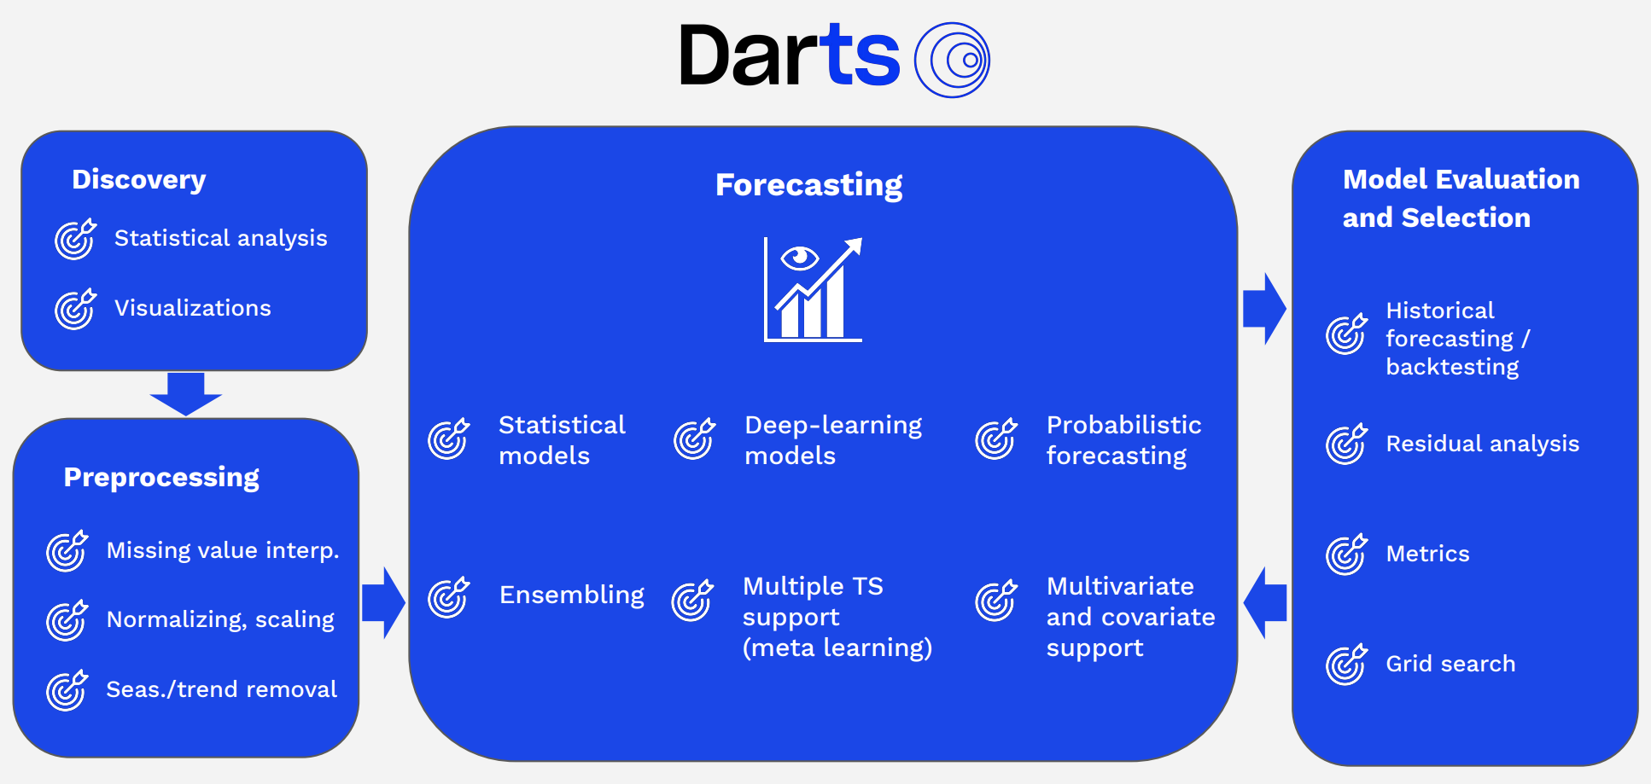
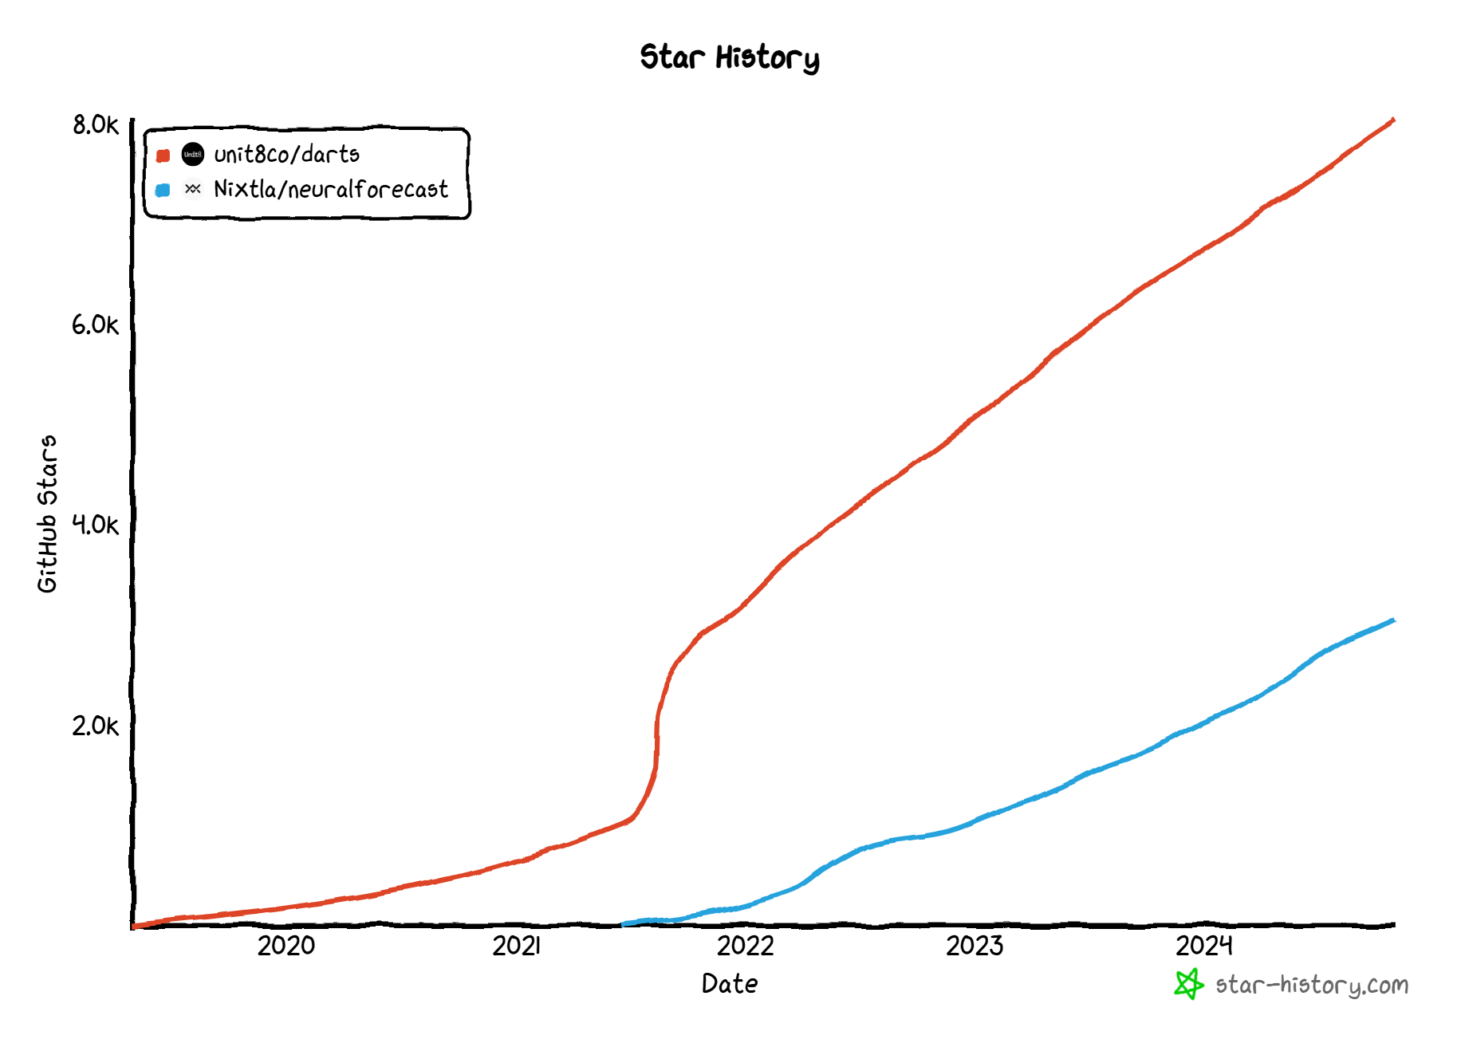
darts
darts vs. NeuralForecast

Slide 24
darts vs. NeuralForecast

Slide 25
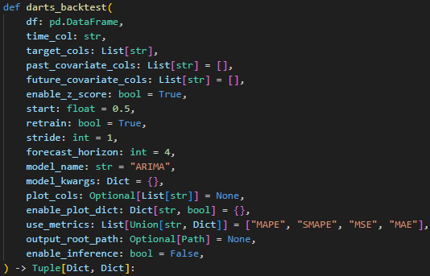
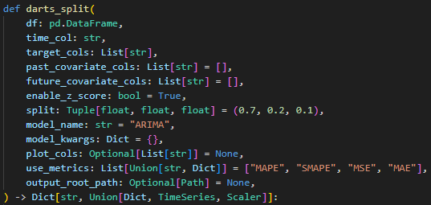
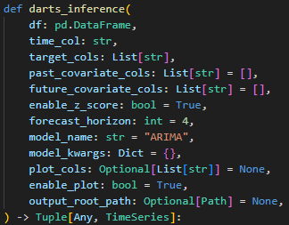
3 Main Functions

Slide 26
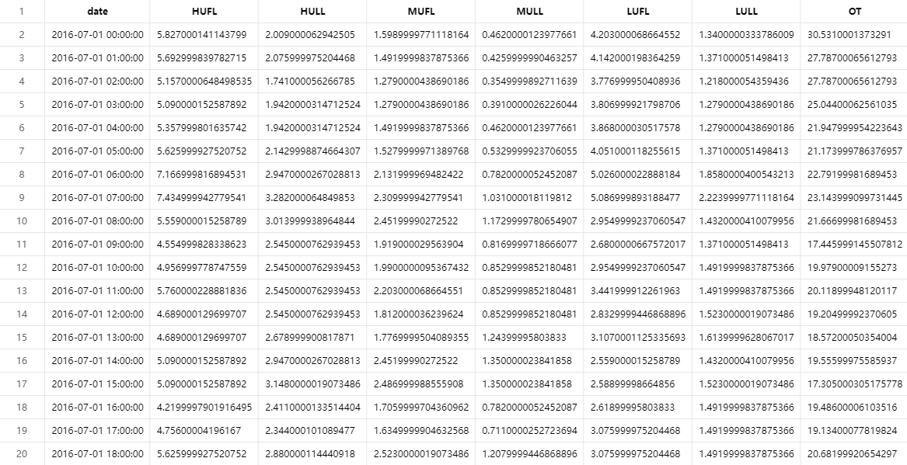
darts_backtest: Input Data Configs
past_covariate_cols
target_cols
time_col

Slide 27
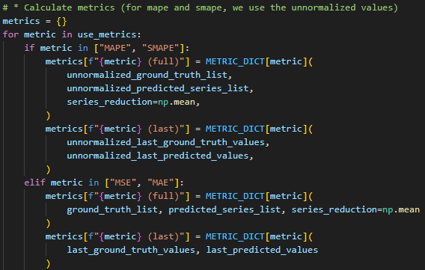
darts_backtest: Normalization
Remember to use unnormalized values
when there’s a P in the metric name.

Slide 28
darts_backtest: Backtest
forecast_horizon
stride
start

Slide 29
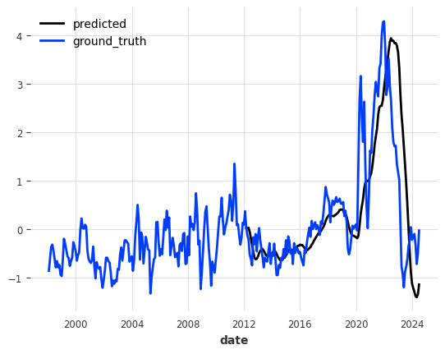
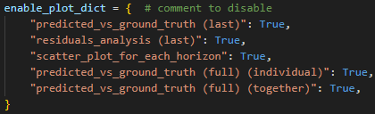
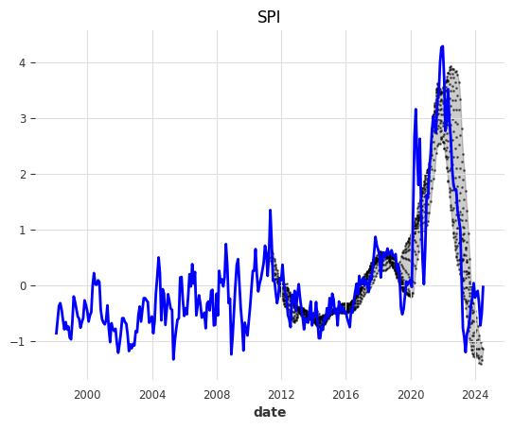
darts_backtest: Visualizing Backtest
v
v
last
full

Slide 30
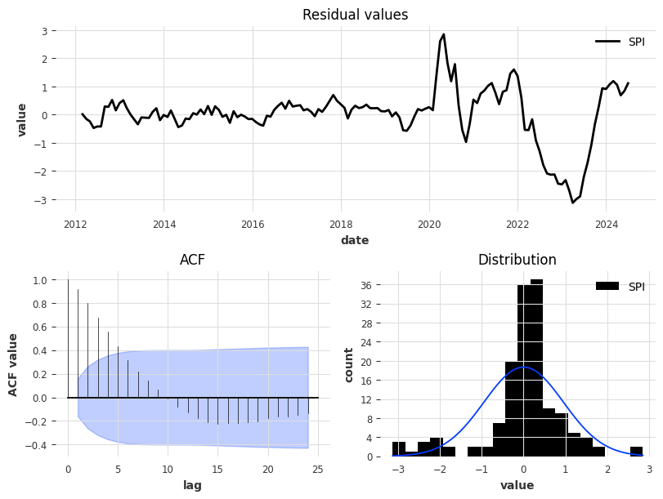
darts_backtest: Visualizing Backtest
last
v

Slide 31
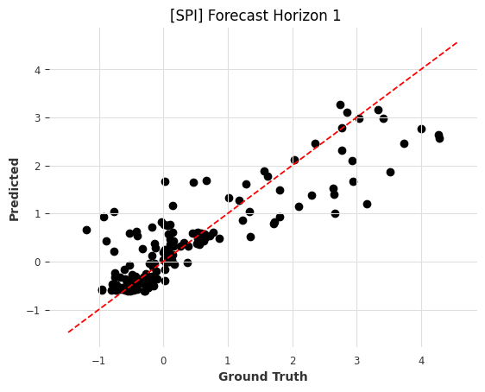
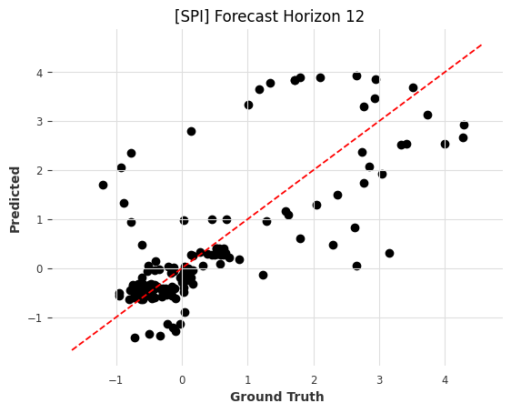
darts_backtest: Visualizing Backtest
v
…

Slide 32
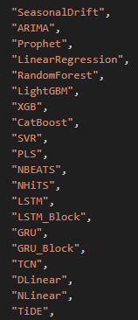
darts_backtest: Models

Slide 33
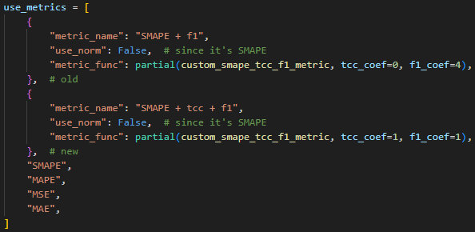
darts_backtest: Metrics

Slide 34
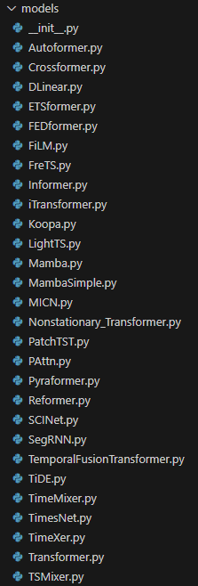
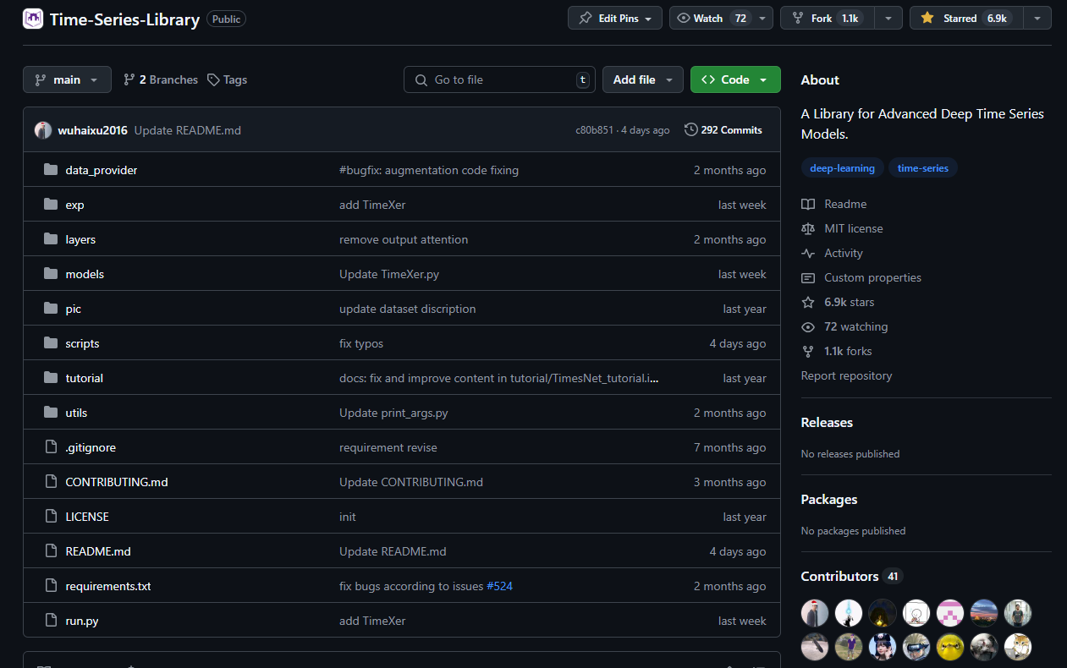
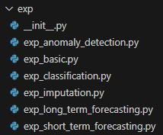
TSLib
Use git subtree to integrate time-series-library into time_series_tools

Slide 35

Ray Tune

Slide 36
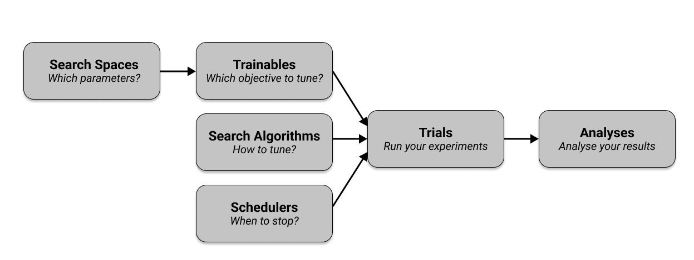
Key Concepts of Ray Tune
Search Algorithms: govern how hyperparameter space is sampled and optimized
Schedulers: stop, pause, or tweak the hyperparameters of running trials to improve the overall efficiency

Slide 37
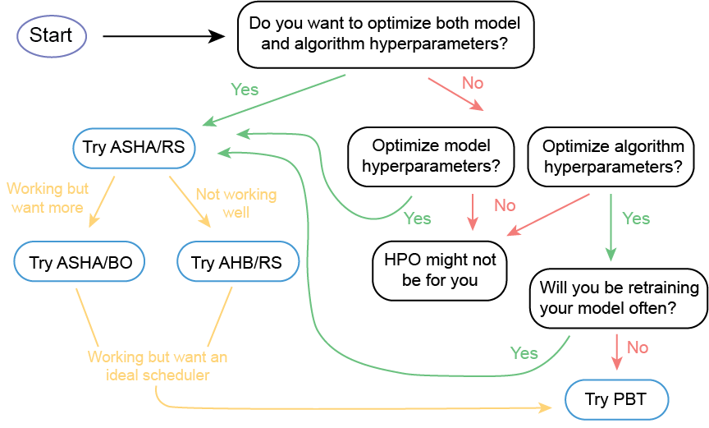
HPO Strategy
Model Hyperparameters: Establish model architecture
Number of convolutional layers, Number of fully connected layers
Algorithm Hyperparameters: Are involved in the learning process
Learning rates, Batch size, Optimizer
ASHA: Async Successive Halving Algorithm (scheduler)
RS: Random Search (search algorithm)
https://wood-b.github.io/post/a-novices-guide-to-hyperparameter-optimization-at-scale/

Slide 38
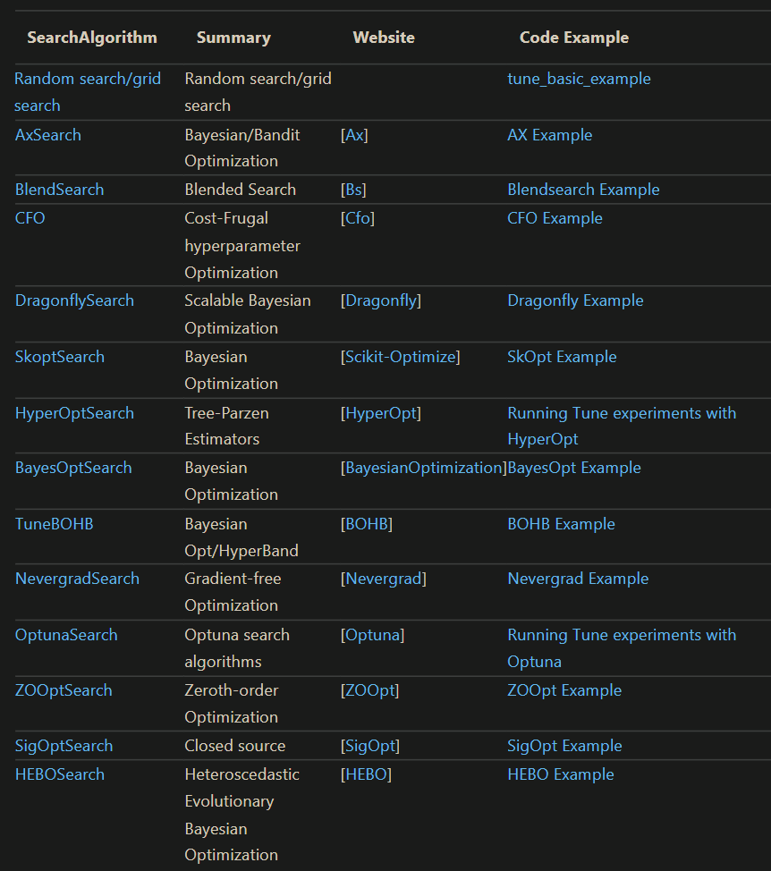
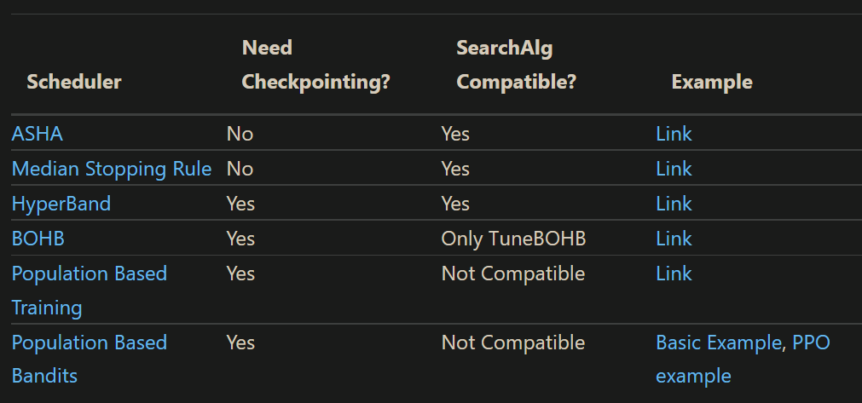
Scheduler vs. Search Algorithm

Slide 39
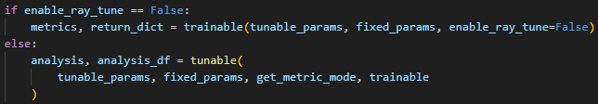
Define 2 Functions
trainable
An end-to-end function to train a model
Must return the metrics
tunable
Call `trainable` multiple times with ray tune
Search space for hyperparameters
Rank the best trial based on the returned metrics
Visualize the whole experiments

Slide 40
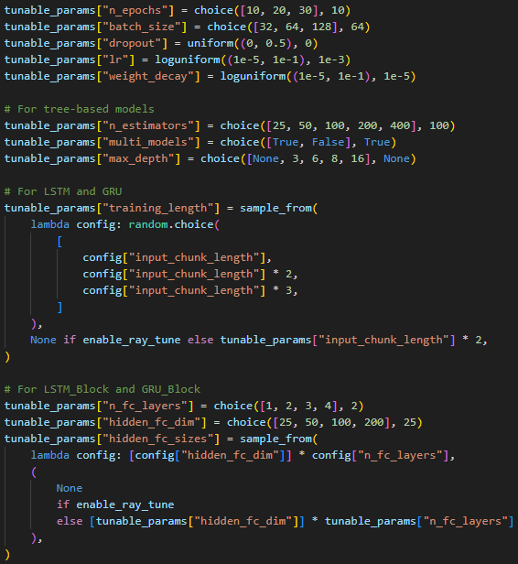
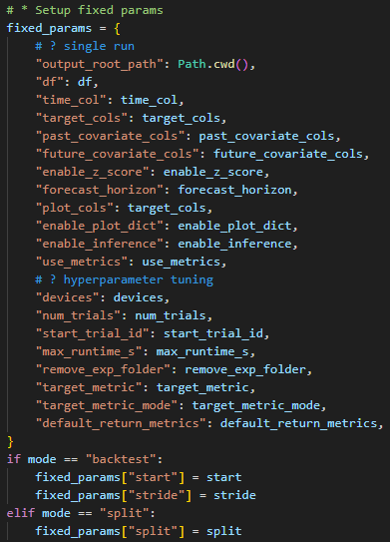
Define 2 `params`
tunable_params
fixed_params

Slide 41
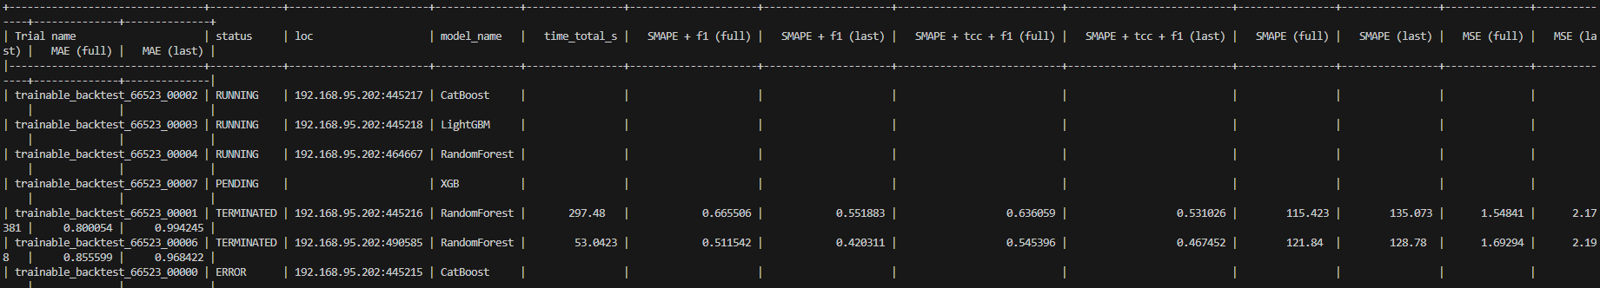
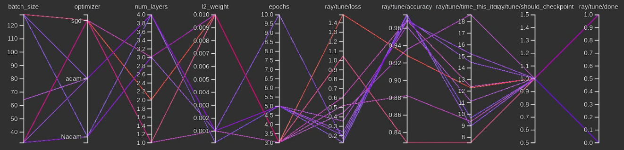
Report for Ray Tune
Also in csv
TensorBoard:

Slide 42
What I want to achieve for time_series_tools (in the future)
Uniform APIs for both packages
Time-series foundation models
Different training strategies
Custom dataloader
Appendix

Slide 43
Appendix

Slide 44
What I want to achieve for time_series_tools (in the future)
Uniform APIs for both packages
Time-series foundation models
Different training strategies
Custom dataloader

Slide 45
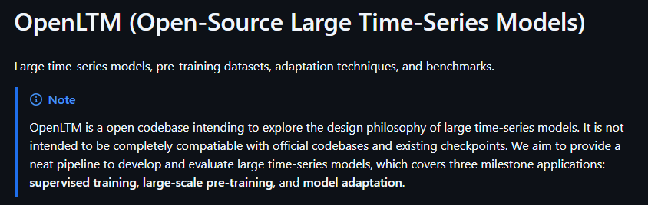
Honorable Mention: OpenLTM

Slide 46
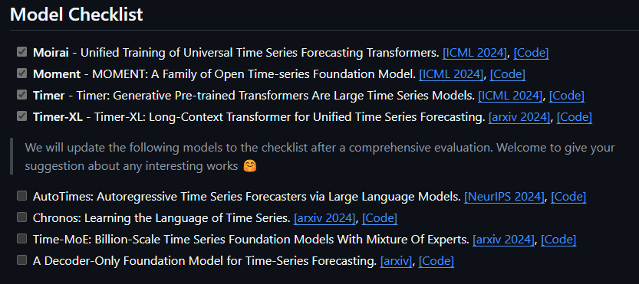
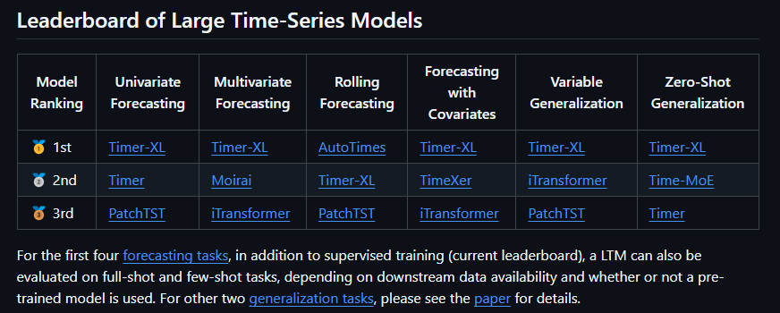
Models in OpenLTM

Slide 47
What I want to achieve for time_series_tools (in the future)
Uniform APIs for both packages
Time-series foundation models
Different training strategies
Custom dataloader

Slide 48
3 Strategies for Time-Series Forecasting
Problem settings:
input
output
Simultaneous Multi-Step Forecasting
Independent Single-Step Forecasting
Autoregressive One-Step-Ahead Forecasting
Single model
一次到位
各個擊破
Multiple models
Teacher-forcing (Training)
Free-running (Inference)
Single model
When reusing part of y as x, we need to ensure x_features and y_features are equal.

Slide 49
What I want to achieve for time_series_tools (in the future)
Uniform APIs for both packages
Time-series foundation models
Different training strategies
Custom dataloader

Slide 50
Problem Settings – Forecasting with MTS
features
f1
f2
f3
Station 1 (f1, f2) → Station 2 (f2, f3)
data window
x_time_indices
y_time_indices
x_features
y_features
window_len
stride
group_name
excluded_data_indices
x_time_indices = [0, 1]
window_len
= 5
time
y_time_indices = [3, 4]
Two rules to remove unwanted data windows:
Ensure that all data within the same window share the same group_name.
Ensure that any window containing one or more absolute time indices from excluded_data_indices is removed.
stride
= 1

Slide 51
3 scenarios
①- counts for x and y
①- final settings
①- why
C I C I C
p1
w1
w1
l1
c1
w2
Increasing dimensionality can result in two scenarios: consistent and inconsistent.
In the case of our settings where the stride is consistent, it's not possible to slide the window on an inconsistent dimension.
w3
w4
w1
l2
p2
w2
w3
w4
w5
p3
w1
l3
w2
w3
w4
p1 + p2 → p4
[w1, (p1, p2)] + [w2, (p2, p4)] → [w4, (p3)]
[l1, (p1, p2)] + [l2, (p2, p4)] → [l4, (p3)]
w1
l4
①
w2
p4
w3
w1
l5
p1
w2
w1
l1
c2
②
w2
w3
w4
w1
l2
p2
w2
w3
w4
③
w5
p3
w1
l3
w2
w3
w4
w1
l4
w2
p4
w3
w1
l5

Slide 52
p1 + p2 → p4
5 4 2
①- counts for x and y
p1
w1
w1
l1
c1
w2
p1
5 values
p2
4 values
p4
2 values
w3
w4
w1
l2
p2
w2
w3
w4
w5
p3
w1
l3
w2
w3
w4
w1
l4
w2
p4
w3
w1
l5
p1
w2
w1
l1
c2
w2
w3
w4
w1
l2
p2
w2
w3
w4
w5
p3
w1
l3
w2
w3
w4
w1
l4
w2
p4
w3
inconsistent
w1
l5

Slide 53
p1 + p2 → p4
5 4 2
①- final settings
p1
w1
w1
l1
c1
w2
w3
w4
w1
l2
x_time_indices = [0, 1, 2, 3, 4, 5, 6, 7, 8]
y_time_indices = [15, 16]
x_features
y_features
window_len = 17
stride = 17
group_idx = None
p2
w2
w3
w4
w5
p3
w1
l3
w2
w3
w4
w1
l4
w2
p4
w3
w1
l5
p1
w2
w1
l1
c2
w2
w3
w4
w1
l2
p2
w2
w3
w4
w5
p3
w1
l3
w2
w3
w4
w1
l4
w2
p4
w3
w1
l5

Slide 54
p1 + p2 → p4
5 4 2
p1
w1
l1
①- why
p2
p3
p4
window_len = 17
stride = 17 (one wafer)
group_idx = None
x_time_indices = [0, 1, 2, 3, 4, 5, 6, 7, 8]
p1 = [0, 1, 2, 3, 4]
p2 = [0, 1, 2, 3] + (5)
y_time_indices = [15, 16]
p4 = [0, 1] + (5+4+6)
p1
w2
p2
p3
p4
p1
w3
p2
p3
p4
p1
w4
p2
p3
p4
p1
w1
l2
p2
p3
p4

Slide 55
[w1, (p1, p2)] + [w2, (p2, p4)] → [w4, (p3)]
9 6 6
②- counts for x and y
p1
w1
w1
l1
c1
w2
w1
p1 has 5 values, and p2 has 4 values
5 + 4 = 9
w2
p2 has 4 values, and p4 has 2 values
4 + 2 = 6
w4
p3 has 6 values
6
w3
w4
w1
l2
p2
w2
w3
w4
w5
p3
w1
l3
w2
w3
w4
w1
l4
w2
p4
w3
w1
l5
p1
w2
w1
l1
c2
w2
w3
w4
w1
l2
p2
w2
w3
w4
w5
p3
w1
l3
w2
w3
w4
w1
l4
w2
consistent
p4
w3
w1
l5

Slide 56
[w1, (p1, p2)] + [w2, (p2, p4)] → [w4, (p3)]
9 6 6
②- final settings
p1
w1
w1
l1
c1
w2
w3
w4
w1
l2
x_time_indices = [0, 1, 2, 3, 4, 5, 6, 7, 8, 23, 24, 25, 26, 32, 33]
y_time_indices = [60, 61, 62, 63, 64, 65]
x_features
y_features
window_len = 68
stride = 17
group_idx = ‘lot’
p2
w2
w3
w4
w5
p3
w1
l3
w2
w3
w4
w1
l4
w2
p4
w3
w1
l5
p1
w2
w1
l1
c2
w2
w3
w4
w1
l2
p2
w2
w3
w4
w5
p3
w1
l3
w2
w3
w4
w1
l4
w2
p4
w3
w1
l5

Slide 57
[w1, (p1, p2)] + [w2, (p2, p4)] → [w4, (p3)]
9 6 6
p1
w1
l1
②- why
p2
p3
p4
window_len = 17 * 4 = 68
stride = 17 (one wafer)
group_idx = ‘lot_id’
x_time_indices = [0, 1, 2, 3, 4, 5, 6, 7, 8, 23, 24, 25, 26, 32, 33]
[w1, (p1)] = [0, 1, 2, 3, 4]
[w1, (p2)] = [0, 1, 2, 3] + (5)
[w2, (p2)] = [0, 1, 2, 3] + 17 + (5)
[w2, (p4)] = [0, 1] + 17 + (5+4+6)
y_time_indices = [60, 61, 62, 63, 64, 65]
[w4, (p3)] = [0, 1, 2, 3, 4, 5] + 17*3 + (5+4)
p1
w2
p2
p3
p4
p1
w3
p2
p3
p4
p1
w4
p2
p3
p4
p1
w1
l2
p2
Can we filter out [w2, (p1)]? (No)
p3
p4

Slide 58
[l1, (p1, p2)] + [l2, (p2, p4)] → [l4, (p3)]
36 30 18
③- counts for x and y
p1
w1
w1
l1
c1
w2
l1 has 4 wafers
For each wafer, p1 has 5 values, and p2 has 4 values
4 * (5 + 4) = 36
l2 has 5 wafers
For each wafer, p2 has 4 values, and p4 has 2 values
5 * (4 + 2) = 30
l4 has 3 wafers
For each wafer, p3 has 6 values
3 * 6 = 18
w3
w4
w1
l2
p2
w2
w3
w4
w5
p3
w1
l3
w2
w3
w4
w1
l4
w2
p4
w3
w1
l5
p1
w2
w1
l1
c2
w2
w3
w4
w1
l2
p2
w2
w3
w4
w5
p3
w1
l3
w2
w3
w4
w1
l4
w2
inconsistent
p4
w3
w1
l5

Slide 59
[l1, (p1, p2)] + [l2, (p2, p4)] → [l4, (p3)]
36 30 18
③- final settings
p1
w1
w1
l1
c1
w2
x_time_indices = [0, 1, 2, 3, 4, 5, 6, 7, 8, 17, 18, 19, 20, 21, 22, 23, 24, 25, 34, 35, 36, 37, 38, 39, 40, 41, 42, 51, 52, 53, 54, 55, 56, 57, 58, 59, 73, 74, 75, 76, 83, 84, 90, 91, 92, 93, 100, 101, 107, 108, 109, 110, 117, 118 , 124, 125, 126, 127, 134, 135, 141, 142, 143, 144, 151, 152]
y_time_indices = [230, 231, 232, 233, 234, 235, 247, 248, 249, 250, 251, 252, 264, 265, 266, 267, 268, 269]
x_features
y_features
window_len = 289
stride = 289
group_idx = None
w3
w4
w1
l2
p2
w2
w3
w4
w5
p3
w1
l3
w2
w3
w4
w1
l4
w2
p4
w3
w1
l5
p1
w2
w1
l1
c2
w2
w3
w4
w1
l2
p2
w2
w3
w4
w5
p3
w1
l3
w2
w3
w4
w1
l4
w2
p4
w3
w1
l5

Slide 60
[l1, (p1, p2)] + [l2, (p2, p4)] → [l4, (p3)]
36 30 18
③- why
p1
w1
l1
c1
p1
p2
p2
p3
p4
p1
w2
p1
p2
p2
p3
p4
p1
w3
p1
p2
p2
p3
p4
p1
w4
p1
window_len = 68 + 85 + 68 + 51 + 17 = 289
stride = 68 + 85 + 68 + 51 + 17 = 289 (one chamber)
group_idx = None
p2
p2
p3
p4
p1
w1
l2
p2
p2
p3
p4
p4
p1
w2
p2
p2
p3
p4
p4
p1
w3
p2
p2
p3
p4
p4
p1
w4
p2
p2
p3
p4
p4
p1
w5
p2
p2
p3
p4
p4
p1
w1
l3
p2
p3
p4
p1
w2
p2
p3
p4
p1
w3
p2
p3
p4
p1
w4
p2
p3
p4
p1
w1
l4
p2
p3
p3
p4
p1
w2
p2
p3
p3
p4
p1
w3
p2
p3
p3
p4
p1
w1
l5
p2
p3
p4

Slide 61
[l1, (p1, p2)] + [l2, (p2, p4)] → [l4, (p3)]
36 30 18
③- why
p1
w1
l1
c1
p1
p2
p2
p3
p4
p1
w2
p1
p2
p2
p3
p4
p1
w3
p1
p2
p2
p3
p4
p1
w4
p1
x_time_indices = [0, 1, 2, 3, 4, 5, 6, 7, 8, 17, 18, 19, 20, 21, 22, 23, 24, 25, 34, 35, 36, 37, 38, 39, 40, 41, 42, 51, 52, 53, 54, 55, 56, 57, 58, 59, 73, 74, 75, 76, 83, 84, 90, 91, 92, 93, 100, 101, 107, 108, 109, 110, 117, 118 , 124, 125, 126, 127, 134, 135, 141, 142, 143, 144, 151, 152]
l1
[w1, (p1)] = [0, 1, 2, 3, 4]
[w1, (p2)] = [0, 1, 2, 3] + (5)
[w2, (p1)] = [0, 1, 2, 3, 4] + 17
[w2, (p2)] = [0, 1, 2, 3] + 17 + (5)
[w3, (p1)] = [0, 1, 2, 3, 4] + 34
[w3, (p2)] = [0, 1, 2, 3] + 34 + (5)
[w4, (p1)] = [0, 1, 2, 3, 4] + 51
[w4, (p2)] = [0, 1, 2, 3] + 51 + (5)
l2
[w1, (p2)] = 68 + [0, 1, 2, 3] + (5)
[w1, (p4)] = 68 + [0, 1] + (5+4+6)
[w2, (p2)] = 68 + [0, 1, 2, 3] + 17 + (5)
[w2, (p4)] = 68 + [0, 1] + 17 + (5+4+6)
[w3, (p2)] = 68 + [0, 1, 2, 3] + 34 + (5)
[w3, (p4)] = 68 + [0, 1] + 34 + (5+4+6)
[w4, (p2)] = 68 + [0, 1, 2, 3] + 51 + (5)
[w4, (p4)] = 68 + [0, 1] + 51 + (5+4+6)
[w5, (p2)] = 68 + [0, 1, 2, 3] + 68 + (5)
[w5, (p4)] = 68 + [0, 1] + 68 + (5+4+6)
p2
p2
p3
p4
p1
w1
l2
p2
p2
p3
p4
p4
p1
w2
p2
p2
p3
p4
p4
p1
w3
p2
p2
p3
p4
p4
p1
w4
p2
p2
p3
p4
p4
p1
w5
p2
p2
p3
p4
p4
p1
w1
l3
p2
p3
p4
p1
w2
p2
p3
p4
p1
w3
p2
p3
p4
p1
w4
p2
p3
p4
p1
w1
l4
p2
p3
p3
p4
p1
w2
p2
p3
p3
p4
p1
w3
p2
p3
p3
p4
p1
w1
l5
p2
p3
p4

Slide 62
[l1, (p1, p2)] + [l2, (p2, p4)] → [l4, (p3)]
36 30 18
③- why
p1
w1
l1
c1
p1
p2
p2
p3
p4
p1
w2
p1
p2
p2
p3
p4
p1
w3
p1
p2
p2
p3
p4
p1
w4
p1
y_time_indices = [230, 231, 232, 233, 234, 235, 247, 248, 249, 250, 251, 252, 264, 265, 266, 267, 268, 269]
l4
[w1, (p3)] = 68 + 85 + 68 + [0, 1, 2, 3, 4, 5] + (5+4)
[w2, (p3)] = 68 + 85 + 68 + [0, 1, 2, 3, 4, 5] + 17 + (5+4)
[w3, (p3)] = 68 + 85 + 68 + [0, 1, 2, 3, 4, 5] + 34 + (5+4)
p2
p2
p3
p4
p1
w1
l2
p2
p2
p3
p4
p4
p1
w2
p2
p2
p3
p4
p4
p1
w3
p2
p2
p3
p4
p4
p1
w4
p2
p2
p3
p4
p4
p1
w5
p2
p2
p3
p4
p4
p1
w1
l3
p2
p3
p4
p1
w2
p2
p3
p4
p1
w3
p2
p3
p4
p1
w4
p2
p3
p4
p1
w1
l4
p2
p3
p3
p4
p1
w2
p2
p3
p3
p4
p1
w3
Can we filter out [12, (p1)]? (Yes)
p2
p3
p3
p4
p1
w1
l5
p2
p3
p4

Slide 63
Thanks!

