Slide 1
2023 JDP –
AI Causality Inferences for TSMC Operations
Advisor: Wen-Chih Peng
Student: Zheng-Ming (Paul) Lin, Ching (Jason) Chang
Date: 2023/04/17

Slide 2
Outline
Problem Definition
RCA vs. Causal Learning

Slide 3
Problem Definition

Slide 4
Problem Settings
Supervised or Unsupervised | Unsupervised
AD or RCA | RCA
Offline or Online | Online
Data Format | Time-series
Individual or Group | Group (?)
Others | Graph-based GNN Self-supervised Learning

Slide 5
Input Format with Provided Dataset
step
stage
Data format:
For each stage, mutiple steps can be involved.
Two categories of steps exist: manufacturing and measurements.
Measurement steps are not always required in a stage.
We make use of wafers that exist in both the measurement steps and the manufacturing steps.
Each step has a clear sequential relationship (a distinct linear progression).
The wafer manufacturing process does not change over time.
Measurement steps consistently act as outcomes, rather than contributing factors.
manufacturing step
stage 1
measurement step
stage 2
stage 3

Slide 6
Input Format with Provided Dataset
Data format:
For each stage, mutiple steps can be involved.
Two categories of steps exist: manufacturing and measurements.
Measurement steps are not always required in a stage.
We make use of wafers that exist in both the measurement steps and the manufacturing steps.
Each step has a clear sequential relationship (a distinct linear progression).
The wafer manufacturing process does not change over time.
Measurement steps consistently act as outcomes, rather than contributing factors.
M1
M2
Q3
M4
M5
M6
Assumptions for the causal graph based on the data format:
No edge is allowed to point back to a previous step
The causal graph remains unchanged over time
No edge is allowed to point back to a measurement step, as measurement steps are not considered causal factors.
Q7
causal graph

Slide 7

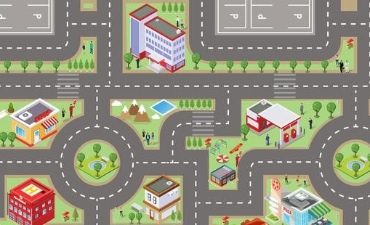
Cars POV vs. Environments POV
Individual
Group

Slide 8
Wafer POV
Very similar to DeepTraLog’s request-based approach
multiple timestamps
multiple features
M1
M2
root cause
Q3
f
M4
single timestamp
M5
M6
Q7
trigger point
causal graph
t

Slide 9
Machine POV
Very similar to MicroHECL’s service-based approach
M1
M2
root cause
Q3
f
M4
M5
M6
Q7
trigger point
causal graph
t
Same sample rate

Slide 10
Wafer POV vs. Machine POV
What’s the input format for TSMC’s up and running analysis tool? (ex: AISPC)
Individual
Group
M1
M2
root cause
Q3
f
M4
M5
M6
Q7
trigger point
causal graph
t
Same sample rate

Slide 11
RCA vs. Causal Learning

Slide 12
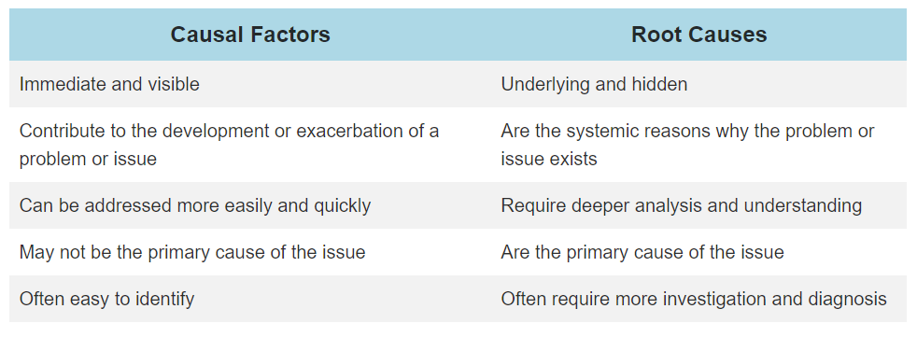
Causal Factors vs. Root Causes
https://www.qualitygurus.com/causal-factors-vs-root-causes-what-is-the-difference/

Slide 13
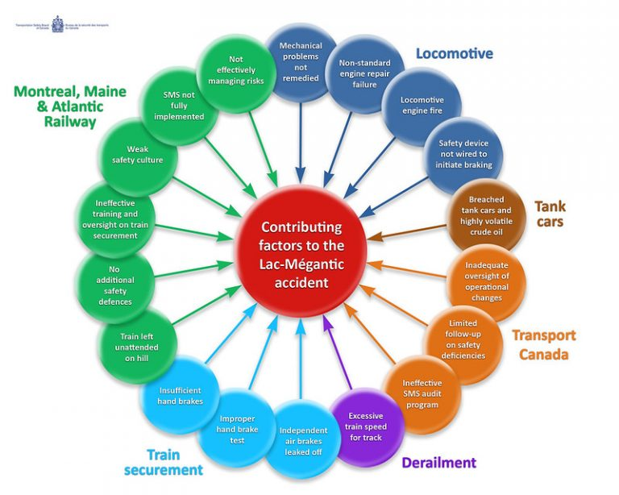
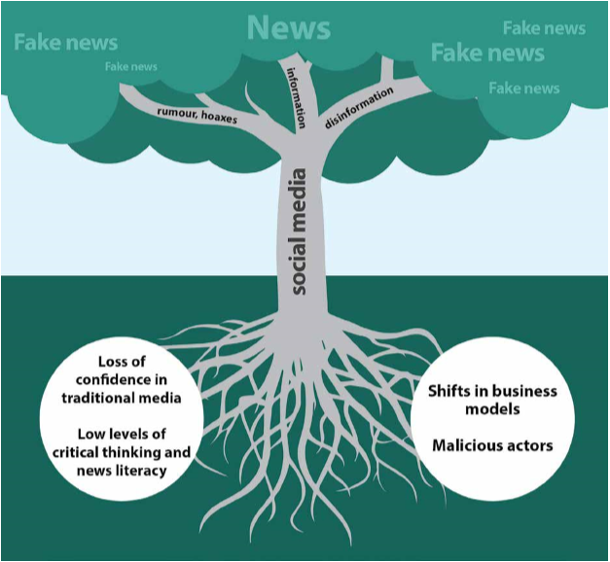
Causal/Contributing Factors vs. Root Causes
https://pediaa.com/what-is-the-difference-between-root-cause-and-contributing-factor/

Slide 14
Connections
Causal Inference ⟷ Root Cause Analysis
(CIRCA) Causal Inference-Based Root Cause Analysis for Online Service Systems with Intervention Recognition
KDD 2022
Causal Discovery ⟷ Root Cause Analysis
(RCD) Root Cause Analysis of Failures in Microservices through Causal Discovery
NeruIPS 2022
SCM ⟷ GNN
Relating Graph Neural Networks to Structural Causal Models

