Slide 1
2022 JDP –
AI Detection and Causality Inferences for Fab Operations
Advisor: Wen-Chih Peng
Student: Zheng-Ming (Paul) Lin, Ching (Jason) Chang
Date: 2022/07/28

Slide 2
Outline
LotAction - TSMC’s solutions and pain points
Open Dataset
Log parser
Anomaly Detection/Localization
Root Cause Analysis
Surveyed Paper
Prefix-Graph: A Versatile Log Parsing Approach Merging Prefix Tree with Probabilistic Graph
ICDE, 2021, unsupervised

Slide 3
Review - 張敬
Done in the past two weeks
Collect open dataset
Graph-based root cause analysis for service-oriented and microservice architectures
JSS 2020 (Q1 journal), #citations = 38
To do
Reproduce the results in DeepTraLog

Slide 4
Review - 正明
Done in the past two weeks
Survey the method of the log parsing
Prefix-Graph: A Versatile Log Parsing Approach Merging Prefix Tree with Probabilistic Graph
ICDE, 2021
To do
Survey the method for log parsing
USTEP: Unfixed Search Tree for Efficient Log Parsing
ICDM, 2021

Slide 5
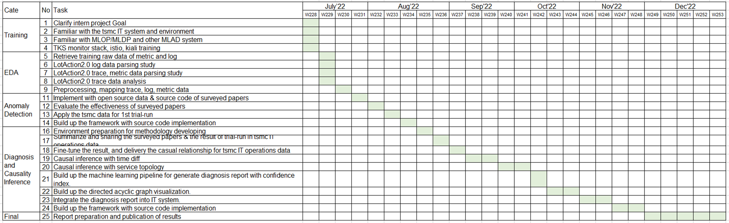
Internship plan
7
11月底前完成演算法設計與程式開發
12月底前完成報告撰寫 (論文明年2月底前完成即可)

Slide 6
Problem Settings
Supervised or Unsupervised | Unsupervised
Offline or Online | Online
Data type | Metric + Log + Trace + Changelog
Data source | System log (kubernetes-related) Application log
Others | Multiple sources time mismatch log sparsity issue (error message) Log parsing Causality/Interpretability/Explainability
Keywords: micro services, causal graph, root cause analysis, causal inference

Slide 7
LotAction - TSMC’s solutions
Metric跟Log分開分析
Metric
單變量 (why?)
預測模型 + 卡threshold
Log
單變量
使用Drain來parse log，轉成time series
與Metric相同的模型 (預測模型 + 卡threshold)
Trace
Not ready

Slide 8
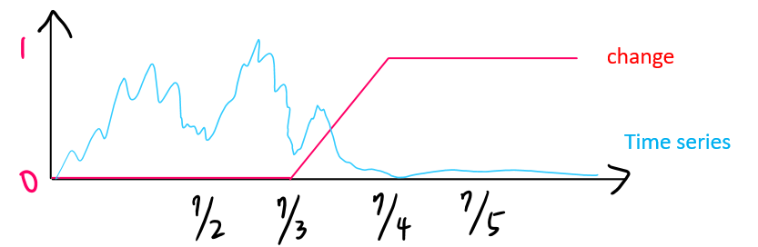
LotAction - TSMC’s solutions
Changelog
大部分的anomaly其實都來自於change
根據changelog產生”change”
Ex: DB要change，2022/07/03 00:00 ~ 2022/07/04 00:00
跟time series計算相似度
change非常多，加入filter來決定要比對的change

Slide 9
LotAction - TSMC’s pain points
Log Parser - Drain
Parse到後面會有大量wildcard的問題
同樣屬性的log會對應到不同的template (?)
Combine multiple data sources (Anomaly Detection)
同時使用多個data source的"raw" data
Changelog其實佔大宗
Causal Relations (Root Cause Analysis)
嘗試演算法：BBN、TCDF
問題：
超參數微調會有完全不同的結果
執行時間過久

Slide 10
Open Dataset
Log parser
Anomaly Detection/Localization
Root Cause Analysis

Slide 11
~~~~~~~~~~~~~~~~~~~~~~~~~~~~~~~

Slide 12
Prefix-Graph: A Versatile Log Parsing Approach Merging Prefix Tree with Probabilistic Graph
Guojun Chu, Jingyu Wang, Qi Qi, Haifeng Sun, Shimin Tao, Jianxin Liao
ICDE 2021

Slide 13
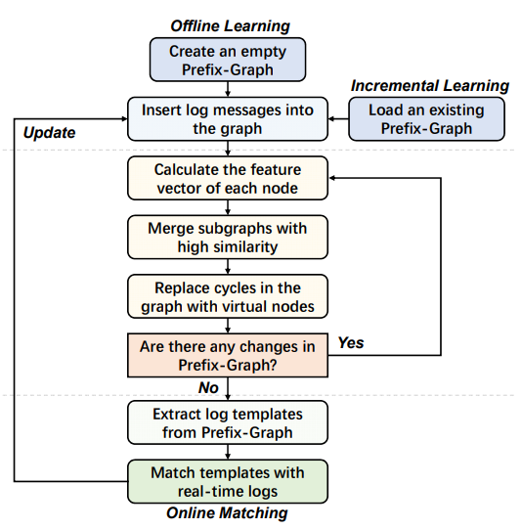
Workflow of Prefix-Graph
First step
Second step
Third step

Slide 14
First Step
Create an empty Prefix-Graph for offline learning or load an existing Prefix-Graph for incremental learning
Insert historical log data into this graph

Slide 15
Graph Construction
Prefix-Graph can be regarded as a directed acyclic graph (DAG)
Each edge e has two main attributes:
W(e) denotes the word corresponding to edge e
N(e) denotes the number of occurrence of edge e
A root-to-leaf path in the Prefix-Graph corresponds to a log message
Create an empty graph with the root and insert historical data into this graph
If there exists an edge UV connected from current node U to its child V with key W(UV)= w_{k}, then move the current node from U to V and increase N(UV) by one
Otherwise, create a new branch for node U
Replace digits (and letters next to digits) with “#” character

Slide 16
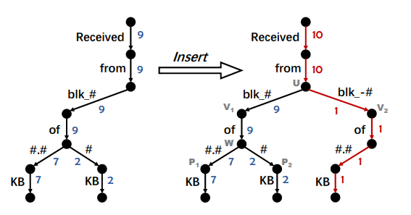
Insert of Log Message

Slide 17
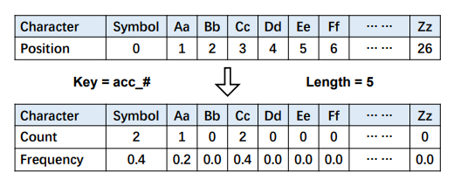
Second Step
Iteratively traverse the entire graph and merges together two branches with high similarity
Until there is no more change in the structure of the graph
During this process, the feature vector f(e) of each node is calculated
If the distance between the feature vector of two branches is less than the threshold, Prefix-Graph will merge these subgraphs and reconnect some relevant edges
Since cycles will possibly appear after merging subgraphs, each of the strongly connected components in the graph should be replaced with a virtual node

Slide 18
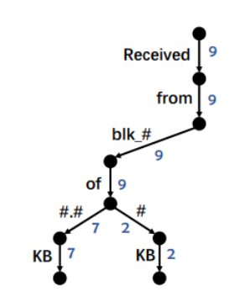

Similarity Measure
Determine whether two branches in Prefix-Graph should be merged together
Define the descendants of a node U
The set of all the nodes and edges which are reachable from node U
V_{S}(U) denote the descendant nodes
E_{S}(U) denote the descendant edges
G_{S}(U) = { V_{S}(U), E_{S}(U) } denote the subgraph with U as the root
Define P(e|U) as the conditional probability that a random walk passes the edge e
Use frequency to estimate the probability
The feature vector F(U) can also calculated

Slide 19
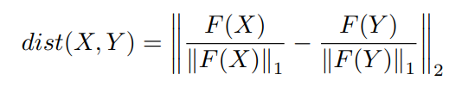
Distance
Calculate the distance between two nodes by their feature vector
If the distance between the feature vector of two branches is less than the threshold, Prefix-Graph will merge these subgraphs and reconnect some relevant edges

Slide 20
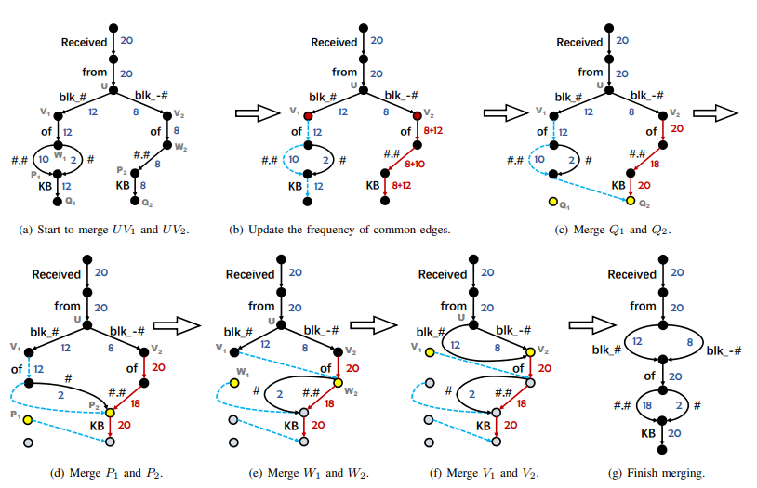
Merge

Slide 21
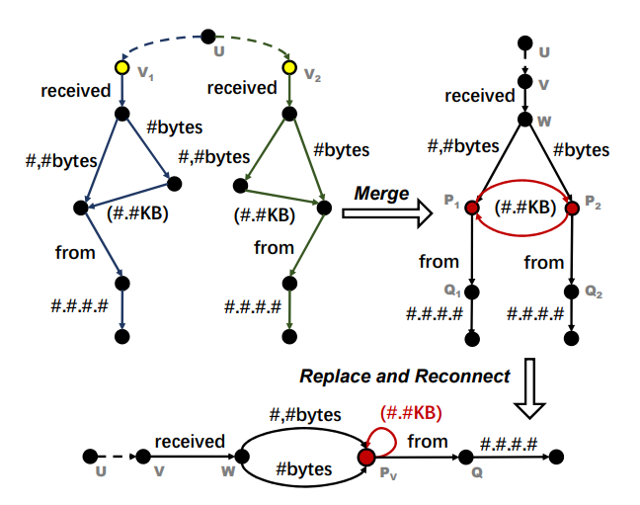
Special Scenario
Since cycles will possibly appear after merging subgraphs, each of the strongly connected components in the graph should be replaced with a virtual node

Slide 22
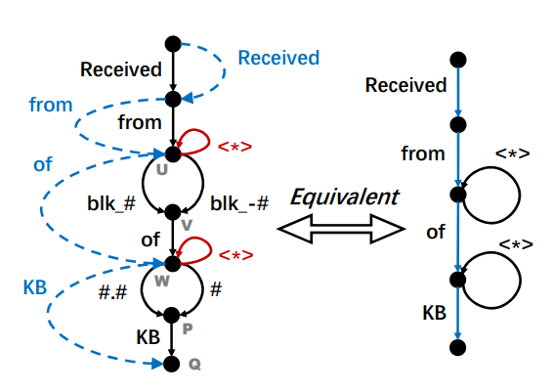

Third Step
Search for a path from each leaf node back to the root node
All the cut-edges in this path form a log template, while non-cut-edges are replaced with wildcard characters (e.g., “<*>”)
These templates can be employed to match raw log messages

Slide 23
Compare to Drain
Prefix-Graph doesn’t need the domain knowledge to preprocess
Prefix-Graph considers the frequency of the word

