Slide 1
2023 JDP –
AI Causality Inferences for TSMC Operations
Advisor: Wen-Chih Peng
Student: Zheng-Ming (Paul) Lin, Ching (Jason) Chang
Date: 2023/03/28

Slide 2
Outline
Problem Definition
Preliminaries
My understandings on RCA in industrial manufacturing data analysis
Open datasets

Slide 3
Problem Definition

Slide 4
Problem Settings
Microservices → Industrial time-series data
Supervised or Unsupervised | Unsupervised
AD or RCA | RCA
Offline or Online | Online
Data Source | Metric + Log + Trace + Activities
Others | Graph-based GNN Self-supervised Learning
Metric: intra-service, inter-service
Activities: code deployment, ML model deployment, configuration changes

Slide 5
Preliminaries

Slide 6
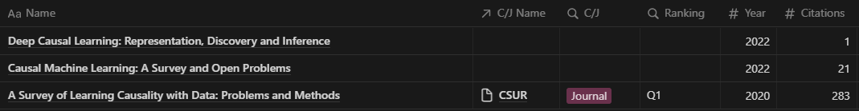
Survey Papers for “Causality”
Don’t want to spend a lot of time understanding the whole survey papers (if it’s not deep-learning-based)

Slide 7
Preliminaries
Correlation → Causation
Causal Discovery vs. Causal Inference
Root Cause Analysis (RCA)

Slide 8
Correlation → Causation
Correlation: A statistical measure that describes the degree to which two variables move in relation to each other.
Correlation coefficient (r) ranges from -1 (perfect negative correlation) to 1 (perfect positive correlation).
Example: A positive correlation between ice cream sales (S) and crime rate (C).
S ⟷ C

Slide 9
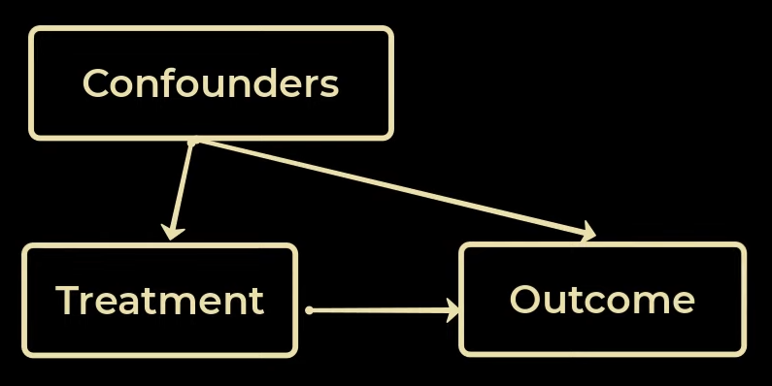
Correlation → Causation
Causation: The relationship between two events where one event (the cause) directly brings about another event (the effect).
Spurious correlations and confounding variables
Correlations can be misleading if there is a hidden variable affecting both observed variables.
Example: The correlation between ice cream sales (S) and crime rate (C) disappears when considering temperature (T) as a confounding variable.
S ← T → C

Slide 10
Causal Discovery vs. Causal Inference
Causal Discovery focuses on obtaining causal knowledge directly from observational data.
Causal Inference aims to estimate the impact deriving from a change of a certain variable over an outcome of interest.
Deng, Zizhen, et al. "Deep Causal Learning: Representation, Discovery and Inference." arXiv preprint arXiv:2211.03374 (2022).

Slide 11
Causal Discovery vs. Causal Inference
Causal Discovery
The process of identifying causal relationships between variables using data and statistical models.
Result: A DAG and SCM representing the causal relationships between variables.
Example: Ice Cream Sales (S), Crime Rate (C), and Temperature (T)
Input:
Data on ice cream sales (S), crime rate (C), and temperature (T).
Output:
DAG (S ← T → C)
SCM (S = aT + e1; C = bT + e2) representing the causal relationships.

Slide 12
Causal Discovery vs. Causal Inference
Causal Inference
The process of using the discovered causal relationships to make predictions or estimate the effects of interventions on variables.
Result: An expected change in the outcome variable due to the intervention.
Example: Ice Cream Sales (S), Crime Rate (C), and Temperature (T)
Input:
Causal model (DAG or SCM) and hypothetical intervention (e.g., setting ice cream sales to a fixed value S = s).
Output:
Expected change in crime rate (C) due to the intervention (no effect in this case, as the intervention on S does not influence C based on the model).

Slide 13
Causal Inference vs. Root Cause Analysis
CIRCA formulates RCA as Intervention Recognition (IR)
Definition 2.1 (Intervention Recognition, IR): For a given SCM M, let L1 be the observational distribution of M and 𝑃𝑚 = 𝑃(V | 𝑑𝑜(m)) be the interventional distribution of a certain intervention 𝑑𝑜(m). Intervention recognition is to find m based on L1 and 𝑃𝑚.
Definition 2.2 (Root Cause): The root cause is the intervened variables (M). Each element of M is named a root cause variable.
Input:
Observational distribution (L1), interventional distribution (𝑃𝑚), and an SCM M.
Output:
The identified intervention (m) and root cause variables (M).
Li, Mingjie, et al. "Causal Inference-Based Root Cause Analysis for Online Service Systems with Intervention Recognition." arXiv preprint arXiv:2206.05871 (2022).

Slide 14
My understandings on RCA in industrial manufacturing data analysis

Slide 15
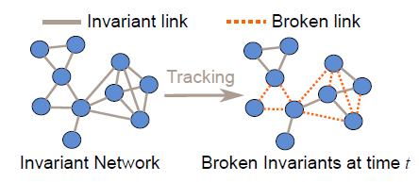
Invariant Network - Ranking Causal Anomalies
ML-based
Problem Definition
Input
Multivariate time series data
Output
Multiple abnormal nodes in 𝑔_𝑖 that are most responsible for causing the broken edges in 𝑔_𝑏 (multifaceted causal anomalies)
Ni, Jingchao, et al. "Ranking causal anomalies by modeling local propagations on networked systems." 2017 IEEE International Conference on Data Mining (ICDM). IEEE, 2017.

Slide 16
Connections
Causal Inference ⟷ Root Cause Analysis
Causal Inference-Based Root Cause Analysis for Online Service Systems with Intervention Recognition
SCM ⟷ GNN
Relating Graph Neural Networks to Structural Causal Models

Slide 17
Dataset format
Time-series only
For each “stage”
Different features
Different time length
f
t

