Slide 1
2023 JDP –
AI Causality Inferences for TSMC Operations
Advisor: Wen-Chih Peng
Student: Zheng-Ming Lin, Ching Chang, Ting-Yun Ou
Date: 2023/06/05

Slide 2
Outline
Problem Definition
RCA vs. Causal Learning

Slide 3
Problem Definition

Slide 4
Problem Settings
Supervised or Unsupervised | Unsupervised
AD or RCA | RCA
Offline or Online | Online
Data Format | Tabular Data
Others | Causal Graph Edge Existence Constraints (should or should not exist) Self-supervised Learning, GNN, Deep Causal Learning, …

Slide 5
Problem Definition
Input
Output

Slide 6
How do we evaluate the results?

Slide 7
Baseline
Causal Discovery
Score-based
NOTEARS
DAGMA
Constraint-based
PC
FCI
Functional-based
Causal Inference
Root Cause Analysis
paper

Slide 8
Datasets
Synthetic Datasets
Real-world Datasets

Slide 9
Input Format with Provided Dataset
stage
step
Data format:
For each stage, mutiple steps can be involved.
Two categories of steps exist: manufacturing and measurements.
For each step, we only have one record.
Measurement steps are not always required in a stage.
We utilize wafers present in both steps to create edges between these two steps.
Certain features are shared across all steps.
Each step has a clear sequential relationship (a distinct linear progression).
The wafer manufacturing process does not change over time.
Measurement steps consistently act as outcomes, rather than contributing factors.
manufacturing step
stage 1
measurement step
stage 2
stage 3

Slide 10
Input Format with Provided Dataset
Data format:
For each stage, mutiple steps can be involved.
Two categories of steps exist: manufacturing and measurements.
For each step, we only have one record.
Measurement steps are not always required in a stage.
We utilize wafers present in both steps to create edges between these two steps.
Certain features are shared across all steps.
Each step has a clear sequential relationship (a distinct linear progression).
The wafer manufacturing process does not change over time.
Measurement steps consistently act as outcomes, rather than contributing factors.
M1
M2
Q3
M4
M5
M6
Assumptions for the causal graph based on the data format:
No edge is allowed to point back to a previous step
The causal graph remains unchanged over time
No edge is allowed to point back to a measurement step, as measurement steps are not considered causal factors.
Q7
causal graph

Slide 11
Wafer POV
Same wafer id
Varying multiple features for manufacturing steps
Varying multiple features for measurements steps
Single record for each step
M1
M2
root cause
Q3
Single feature
time/
step id
M4
M5
M6
Q7
trigger point
causal graph
f

Slide 12
Received CSV
Same wafer id
manufacturing steps’ features
measurements steps’ features
time | wafer id | step | M_f1 | M_f2 | M_f3 | Q_f1 | Q_f2 | Q_f3
10:00 | W1 | M1 | RCP1 | TOOL1 | -
10:05 | W1 | M2 | RCP1 | TOOL1 | -
10:10 | W1 | Q3 |  |  |  | 30 | - | 0.4
10:15 | W1 | M4 | RCP1 | - | 3.4
10:20 | W1 | M5 | RCP3 | - | 2.5
10:25 | W1 | M6 | RCP2 | - | 1.9
10:30 | W1 | Q7 |  |  |  | 30 | 81 | -
M1
M2
Q3
M4
M5
M6
Q7
causal graph

Slide 13
Organized CSV
Removed aspects:
Some features are shared across steps
Time within one single wafer
M1
M2
Q3
M4
M5
M6
Q7
M1
M2
wafer id | M1_f1 | M2_f1 | M2_f2 | Q3_f1 | Q3_f2 | … | Q7_f1
W1 | TOOL1 | RCP1 | 7.3 | XXX | 23 | … | 22
W2 | TOOL1 | RCP1 | 1.6 | XXX | 45 | … | 31
W3 | TOOL1 | RCP1 | 0.4 | XXX | 30 | … | 13
W4 | TOOL1 | RCP2 | 0.2 | XXX | 14 | … | 24
W5 | TOOL1 | RCP2 | 0.9 | XXX | 36 | … | 34
… | … | … | … | … | … | … | …
W97 | TOOL1 | RCP1 | 3.7 | XXX | 30 | … | 23
W98 | TOOL1 | RCP2 | 1.6 | XXX | 45 | … | 67
W99 | TOOL1 | RCP2 | 0.5 | XXX | 64 | … | 83
W100 | TOOL1 | RCP2 | 3.5 | XXX | 12 | … | 80
Q3
M4
M5
M6
Q7
causal graph

Slide 14
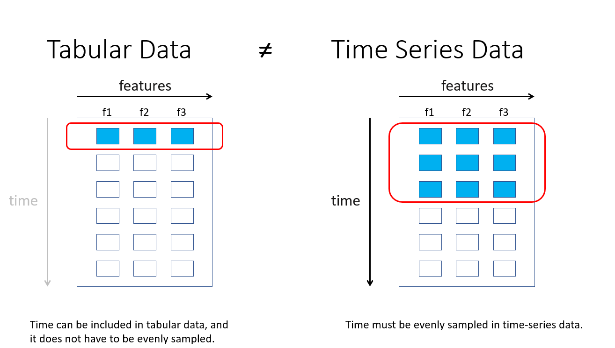

Slide 15
Group POV
Time-Series Data
M1
M2
Q3
M4
M5
M6
Q7
M1
M2
wafer id | M1_f1 | M2_f1 | M2_f2 | Q3_f1 | Q3_f2 | … | Q7_f1
W1 | TOOL1 | RCP1 | 7.3 | XXX | 23 | … | 22
W2 | TOOL1 | RCP1 | 1.6 | XXX | 45 | … | 31
W3 | TOOL1 | RCP1 | 0.4 | XXX | 30 | … | 13
W4 | TOOL1 | RCP2 | 0.2 | XXX | 14 | … | 24
W5 | TOOL1 | RCP2 | 0.9 | XXX | 36 | … | 34
… | … | … | … | … | … | … | …
W97 | TOOL1 | RCP1 | 3.7 | XXX | 30 | … | 23
W98 | TOOL1 | RCP2 | 1.6 | XXX | 45 | … | 67
W99 | TOOL1 | RCP2 | 0.5 | XXX | 64 | … | 83
W100 | TOOL1 | RCP2 | 3.5 | XXX | 12 | … | 80
Q3
M4
M5
M6
Q7
causal graph

Slide 16
Individual POV
Tabular Data
M1
M2
Q3
M4
M5
M6
Q7
M1
M2
wafer id | M1_f1 | M2_f1 | M2_f2 | Q3_f1 | Q3_f2 | … | Q7_f1
W1 | TOOL1 | RCP1 | 7.3 | XXX | 23 | … | 22
W2 | TOOL1 | RCP1 | 1.6 | XXX | 45 | … | 31
W3 | TOOL1 | RCP1 | 0.4 | XXX | 30 | … | 13
W4 | TOOL1 | RCP2 | 0.2 | XXX | 14 | … | 24
W5 | TOOL1 | RCP2 | 0.9 | XXX | 36 | … | 34
… | … | … | … | … | … | … | …
W97 | TOOL1 | RCP1 | 3.7 | XXX | 30 | … | 23
W98 | TOOL1 | RCP2 | 1.6 | XXX | 45 | … | 67
W99 | TOOL1 | RCP2 | 0.5 | XXX | 64 | … | 83
W100 | TOOL1 | RCP2 | 3.5 | XXX | 12 | … | 80
Q3
M4
M5
M6
Q7
causal graph

Slide 17
Similarity between tabular-data-format and AISPC
C
C
#req
#req
f₁
A
B
f₁
A
f₁
A
f_{T}
A
#err
B
#err
f₂
C
f₂
f₂
C
A
C
A
C
cpu
B
The root cause of C should be different from A's root cause.
cpu
f_{T}
f_{T}

Slide 18
RCA vs. Causal Learning

Slide 19
Connections
Causal Inference ⟷ Root Cause Analysis
(CIRCA) Causal Inference-Based Root Cause Analysis for Online Service Systems with Intervention Recognition
KDD 2022
Causal Discovery ⟷ Root Cause Analysis
(RCD) Root Cause Analysis of Failures in Microservices through Causal Discovery
NeruIPS 2022
SCM ⟷ GNN
Relating Graph Neural Networks to Structural Causal Models

Slide 20
Problem Encountered at TSMC
Categorical and numerical features
Out-of-vocabulary in categorical features
Enormous amount of features
Missing Data

Slide 21
A Two-Stage Solution
(Causal Discovery) When creating the causal graph, we can add some constraints on edges that:
Some edges shouldn’t exist
next step → previous step
measurement step → manufacturing step
Some edges should exist
domain knowledge
(Causal Inference) Use learned [causal graph/…] to perform root cause analysis (RCA)
Evaluation (TBD)
Open manufacturing dataset
Open tabular dataset with self-added constraints
Synthetic dataset

