Slide 1
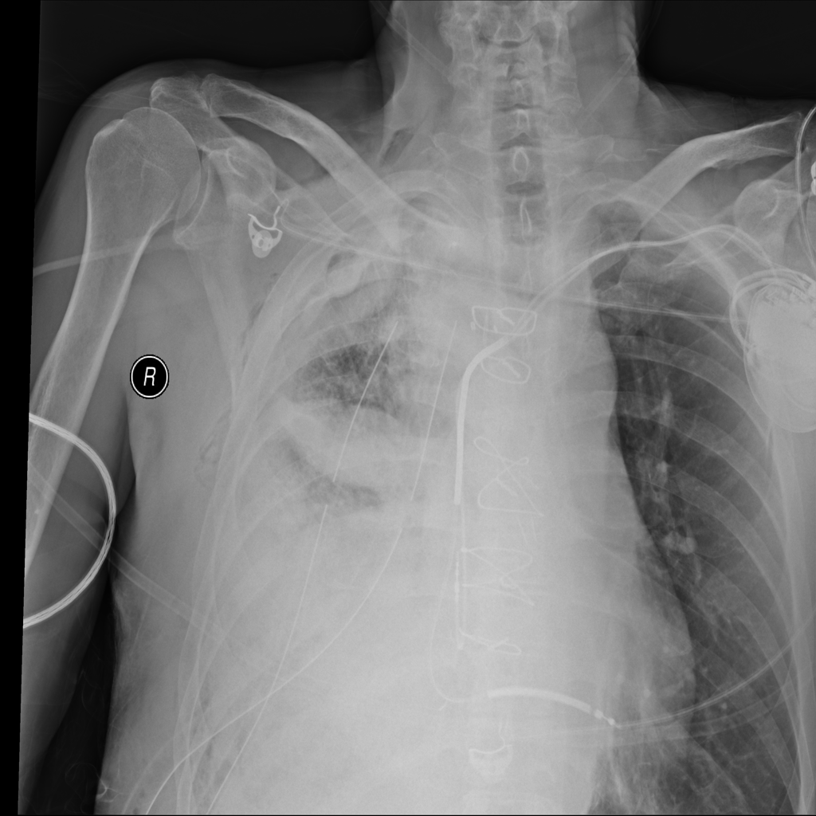
How It Works
🫁
Chest X-Ray
Patient radiograph uploaded
FedMed AI
↓
🤖
AI Analysis
DenseNet121 deep learning
Federated AI Medical Imaging Network
↓
🏥
4 Hospitals
for Disease Detection
Federated local training
College Project Competition
↓
📊
FedAvg
Global model aggregation
↓
✅
Diagnosis
Disease prediction + Grad-CAM
NIH ChestX-ray14 • 14 Disease Classes • DenseNet121
Notes:
Good [morning/afternoon], judges and everyone present. I'm here to present FedMed AI — a Federated AI Medical Imaging Network designed for disease detection from chest X-rays.
The central idea is powerful and timely: hospitals around the world collect enormous amounts of chest X-ray data — but they can't share it because of patient privacy. FedMed AI proposes a solution: what if hospitals could train a single, shared AI model together, without ever sending a single patient image outside their walls?
This is a fully implemented system — not just a concept — and over the next few minutes, I'll walk you through the problem it solves, the technology inside it, the actual dashboard you can use today, and the real results we achieved.
[Point to the right panel] You're already seeing the complete AI pipeline: from chest X-ray input, through our DenseNet121 deep learning model, through federated coordination across four hospitals, all the way to a final disease prediction with Grad-CAM explainability.

Slide 2
The Problem We Are Solving
SLIDE 02 / 07
📊
Massive Data Demand
🔒
Patient Privacy
Local Data (Siloed)
AI models for medical imaging need large, diverse datasets to generalize well.
Medical X-ray images are highly sensitive — they cannot be freely shared.
Hospital A
Hospital B
🏥
Institutional Silos
⚠️
Centralization Risk
Hospital C
Individual hospitals may not have enough data to train strong models alone.
Centralizing raw medical data creates critical privacy and security vulnerabilities.
Hospital D
↓
Privacy Barrier
"Can hospitals collaborate to build better AI without sharing raw medical data?"
Notes:
Let's start with the problem. Medical AI is only as good as the data it's trained on — and to achieve strong generalization, you need large, diverse datasets.
But here's the challenge [point to left panel]: patient medical records and X-ray images are among the most privacy-sensitive data that exists. You cannot freely share or centralize them across hospitals — legally, ethically, and practically.
And yet, any single hospital — even a large one — may not have enough data to build a truly robust diagnostic AI model by itself.
This creates a painful tradeoff: hospitals that want to collaborate for better AI are blocked by privacy barriers. And those that don't collaborate are limited by the data they have.
[Point to the hospital flow diagram] We have Hospital A, B, C, D — all with valuable local X-ray data — but with a hard privacy wall between them and any central system.
The question is: can we build better AI together, without breaking that privacy wall?

Slide 3
FedMed AI: Collaborative Intelligence Without Centralizing Data
SLIDE 03 / 07
🏥
🏥
🏥
🏥
❌ Raw images NEVER leave
Hospital A
Hospital B
Hospital C
Hospital D
✅ Only model weights shared
Local X-ray Data
Local X-ray Data
Local X-ray Data
Local X-ray Data
Local Training
Local Training
Local Training
Local Training
↓
↓
↓
↓
⚡ Federated Averaging (FedAvg)
→
→
→
→
Central server aggregates model weights from all hospitals
↓
🌐 Global Model (DenseNet121)
Distributed back → Better predictions at all hospitals
↓
🔍 Disease Prediction
🗺️ Grad-CAM
📈 Confidence Score
Notes:
FedMed AI is our answer.
The core idea is Federated Learning — a technique where the model goes to the data, rather than the data going to the model.
[Point to architecture] Here's how it works in our implementation: we have four virtual hospital nodes — Hospital A through D. Each one trains a local version of our DenseNet121 model on its own private X-ray dataset. When training is done locally, the hospital sends only its model weights — not any images — to a central server.
The central server performs what's called Federated Averaging — it computes a weighted average of all the hospital models and produces a single global model that has learned from everyone's data.
That global model is then sent back to all hospitals, improving their local predictions.
[Point to the output row] The result: disease prediction, confidence scores, and Grad-CAM visualizations — all powered by a model that saw data from four institutions, while not a single raw patient image ever left any hospital.

Slide 4
How FedMed AI Works
SLIDE 04 / 07
🫁
⚙️
🧠
🏷️
🤝
🌐
🗺️
Chest X-Ray
→
Preprocessing
→
DenseNet121
→
Multi-label Output
→
FedAvg
→
Global Model
→
Grad-CAM
224×224 px
Normalize + Augment
Transfer Learning
14 Disease Classes
5–10 FL Rounds
Aggregated Weights
Explainability
Dataset
Model
Training
Federated Learning Architecture
NIH ChestX-ray14 ~14,000 images (reduced)
DenseNet121 ImageNet pre-trained
Local epochs: 3/round FL rounds: 5–10
1.
Global model initialized, weights broadcast to all 4 hospitals
2.
Each hospital trains locally on its private X-ray subset (3 epochs)
3.
Local weight updates sent to central aggregation server
Loss/Opt
Output
Privacy
Binary CrossEntropy Adam optimizer
Sigmoid activation Multi-label per image
No raw images shared Weights only via FedAvg
4.
FedAvg computes weighted average of all hospital weights
5.
New global model deployed back to all hospitals
6.
Repeat for 5–10 communication rounds
7.
Final model evaluated on held-out test splits
Notes:
Let me go deeper on the actual implementation.
[Point to pipeline] At the top, you see the complete inference pipeline: a chest X-ray comes in at 224×224 pixels. It's preprocessed with normalization and augmentation — random flips, brightness, contrast adjustments. Then it passes through our DenseNet121 backbone pre-trained on ImageNet and fine-tuned for chest pathologies.
The output is a sigmoid-activated multi-label vector — meaning a single X-ray can simultaneously indicate multiple conditions out of 15 disease classes.
[Point to tech cards] Our key technical decisions: we use Binary Cross-Entropy loss with the Adam optimizer, which is standard for multi-label classification. We trained with 3 local epochs per hospital per federated round, running for 5 to 10 rounds of communication. The dataset is a reduced version of the NIH ChestX-ray14 benchmark.
[Point to right panel] And on the right, the complete 7-step federated process: from weight initialization, through local training, through FedAvg aggregation, back to model distribution. This cycle repeats until the global model converges.

Slide 5
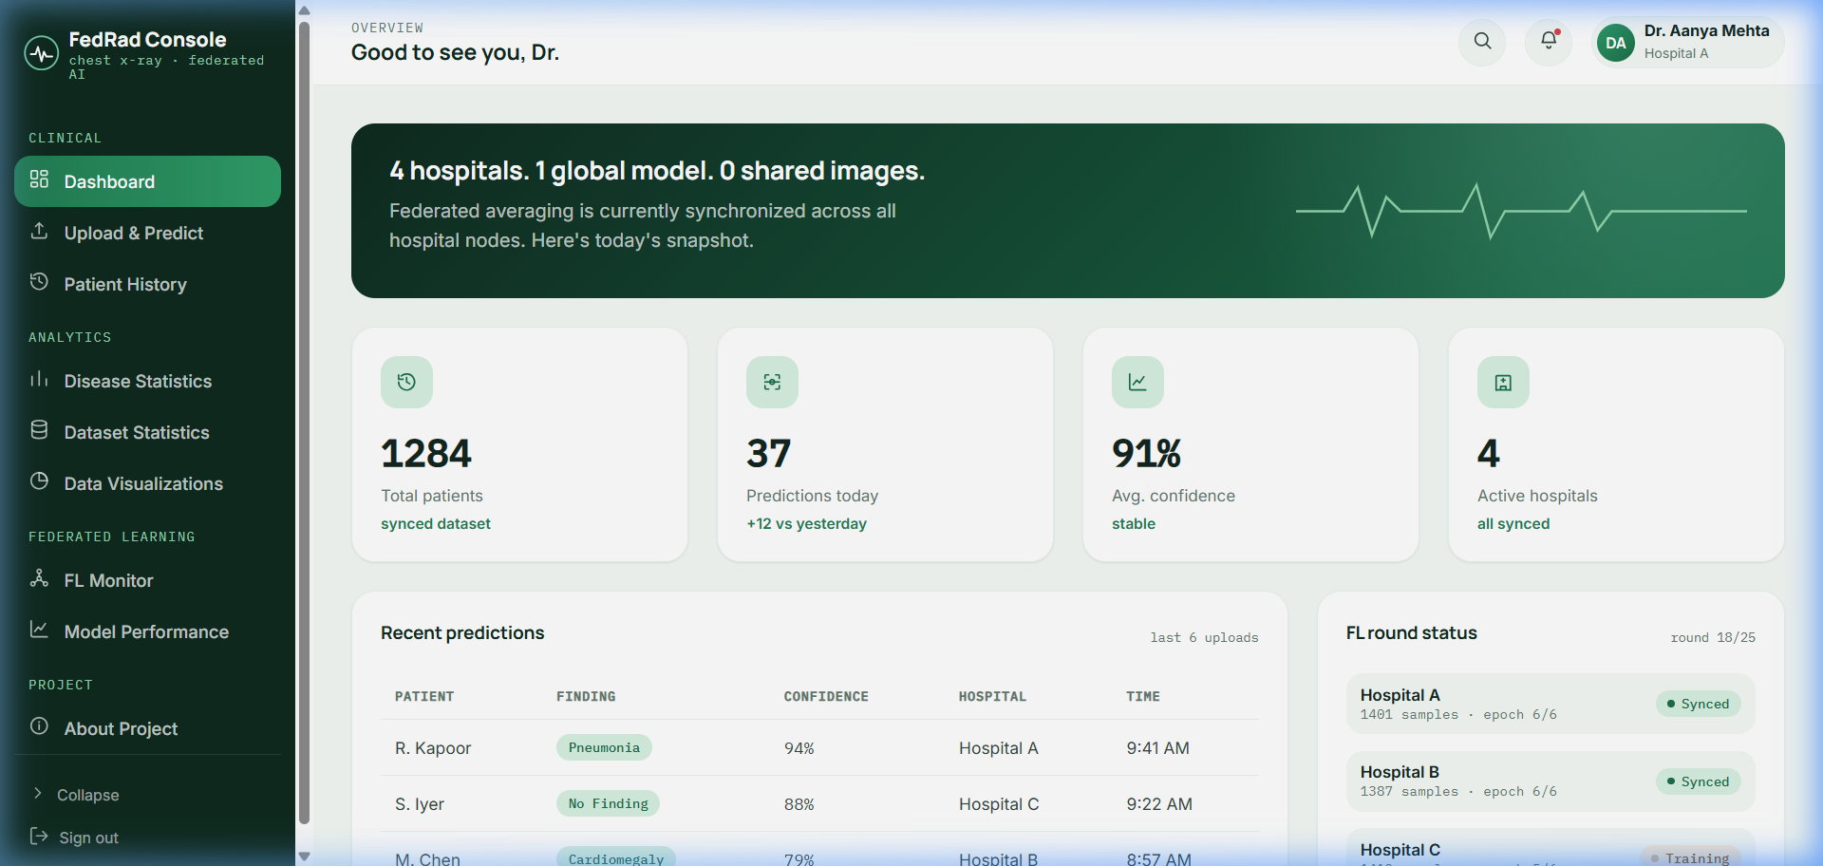
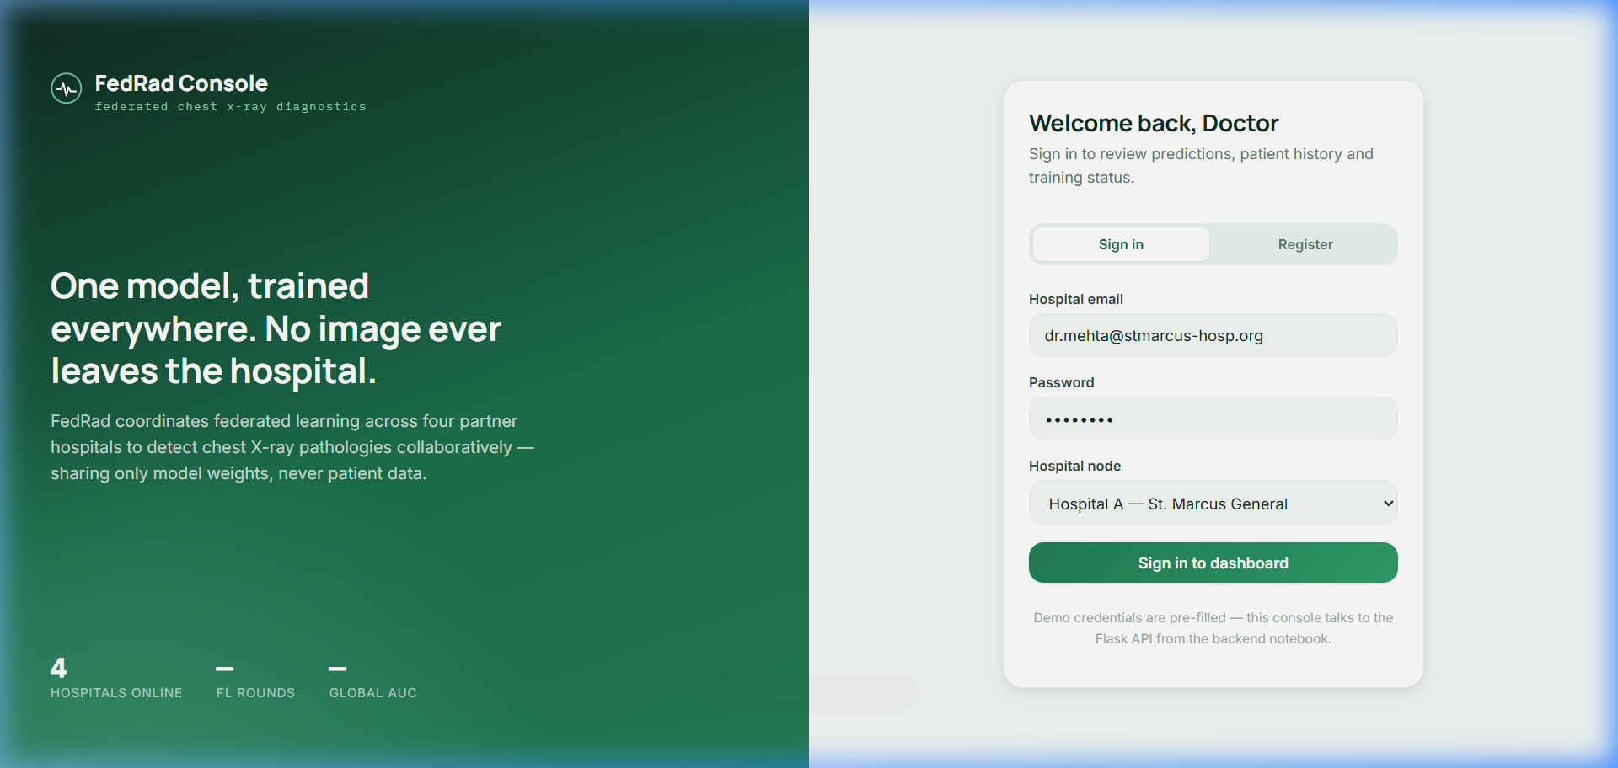
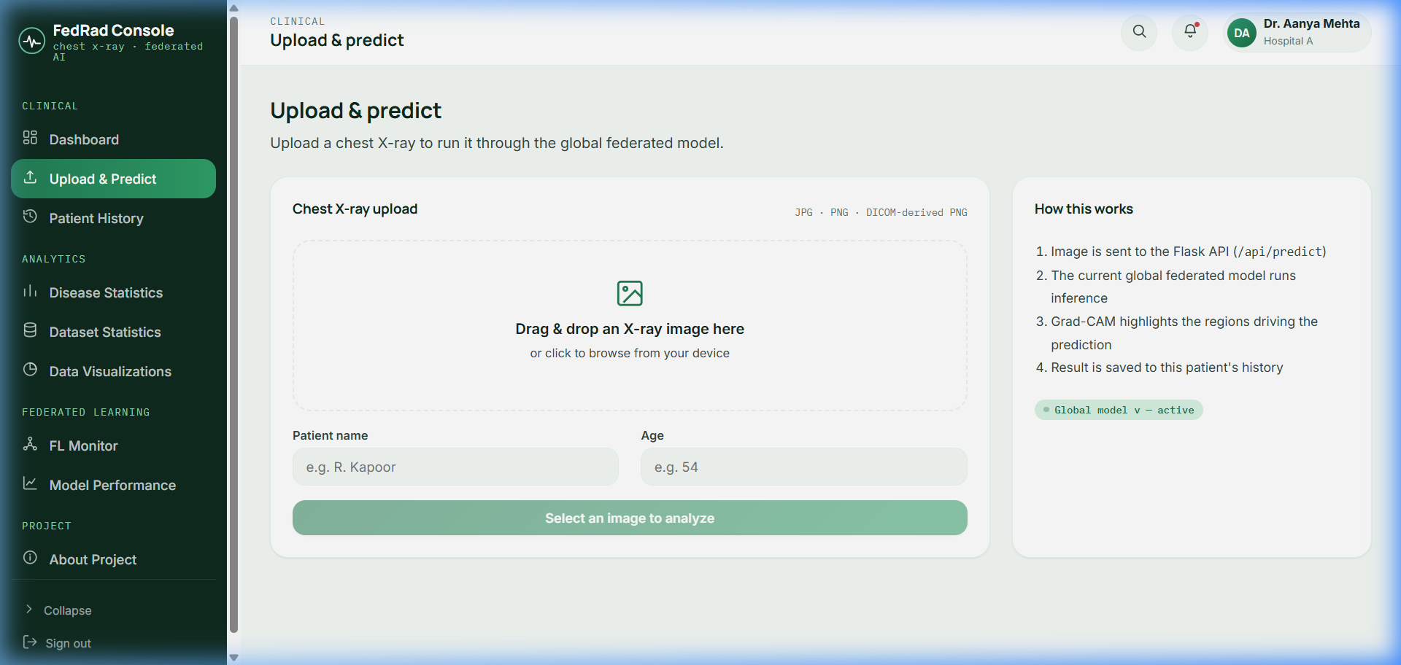
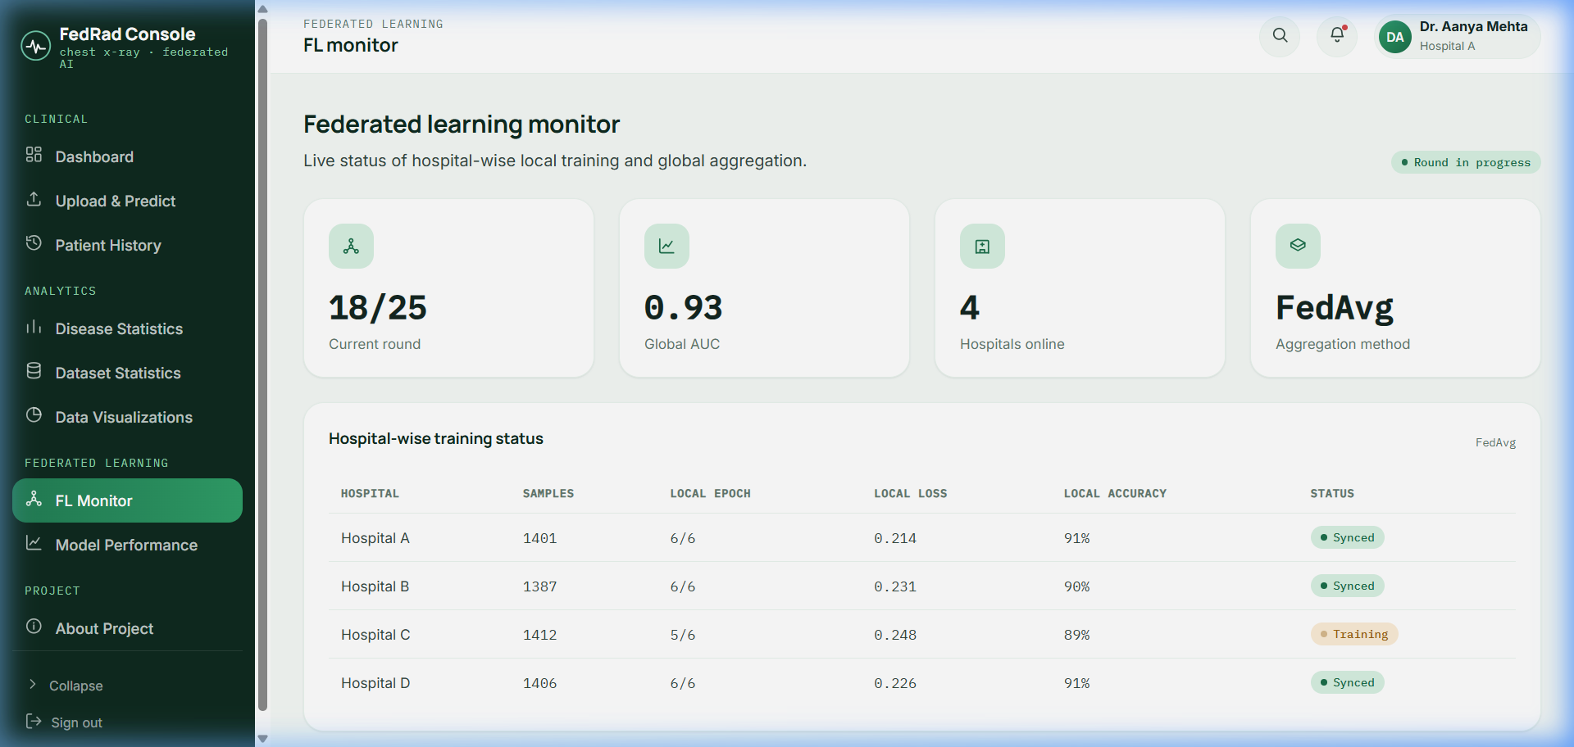
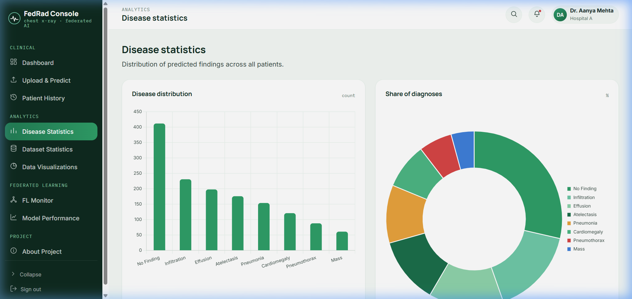
From Model to Usable AI System
SLIDE 05 / 07
🔐 Doctor Login — Hospital node authentication
📤 Upload & Predict — Drag-drop X-ray analysis
🌐 FL Monitor — Hospital training status & AUC
📊 Disease Statistics — Distribution analytics
🏠 Clinical Dashboard — Overview with KPIs, predictions & FL status
Tech Stack: HTML5 · CSS3 · Vanilla JS · Chart.js · Flask REST API · TensorFlow/Keras · python-joblib · Render + GitHub Pages
Notes:
This isn't just a training experiment — it's a deployed, working clinical dashboard.
[Point to large dashboard screenshot] The main dashboard gives doctors an immediate overview: total patients processed, predictions made today, average confidence across predictions, and the real-time status of all four federated hospitals. You can see: Hospital A — Synced, Hospital B — Synced, Hospital C — Training, Hospital D — Synced.
[Point to upload screenshot] The Upload & Predict interface allows a doctor to drag-and-drop any chest X-ray, enter patient details, and receive a disease prediction from the global federated model. The result includes the top predicted disease, a confidence percentage bar, and a Grad-CAM overlay showing exactly which lung regions influenced the prediction.
[Point to FL Monitor] The FL Monitor shows the current round — 18 out of 25 — a global AUC of 0.93, and the hospital-wise breakdown of local samples, local loss, local accuracy, and synchronization status.
The full system is built with vanilla HTML, CSS, and JavaScript on the frontend, connected to a Python Flask REST API backend, deployable to Render and GitHub Pages.

Slide 6
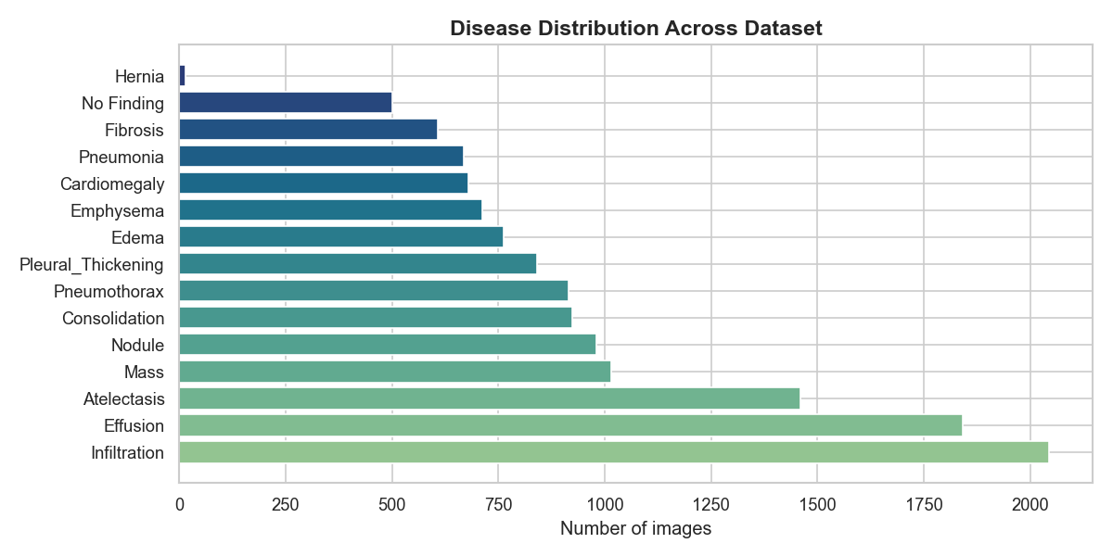
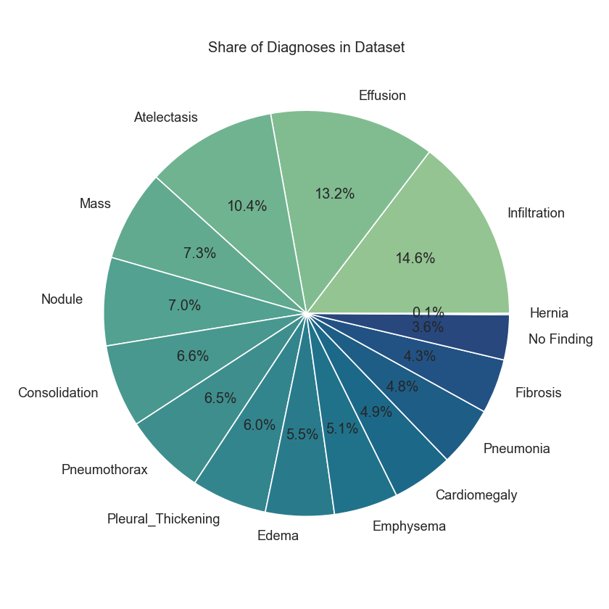
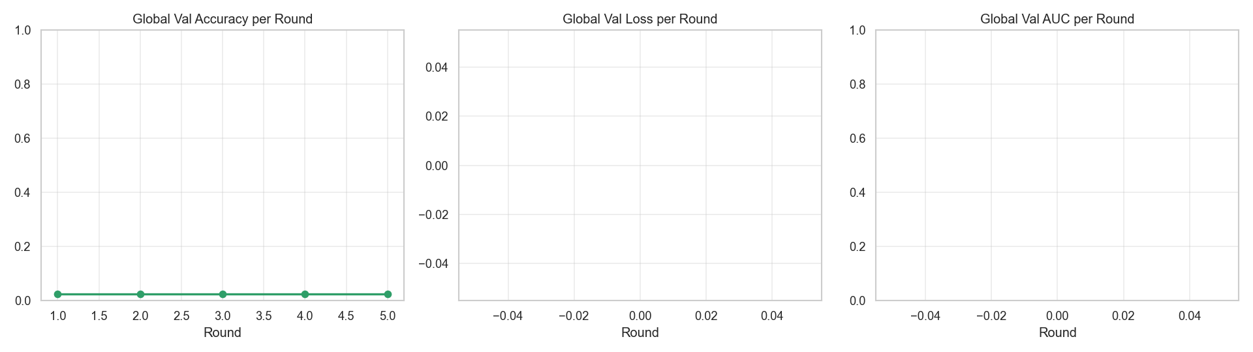
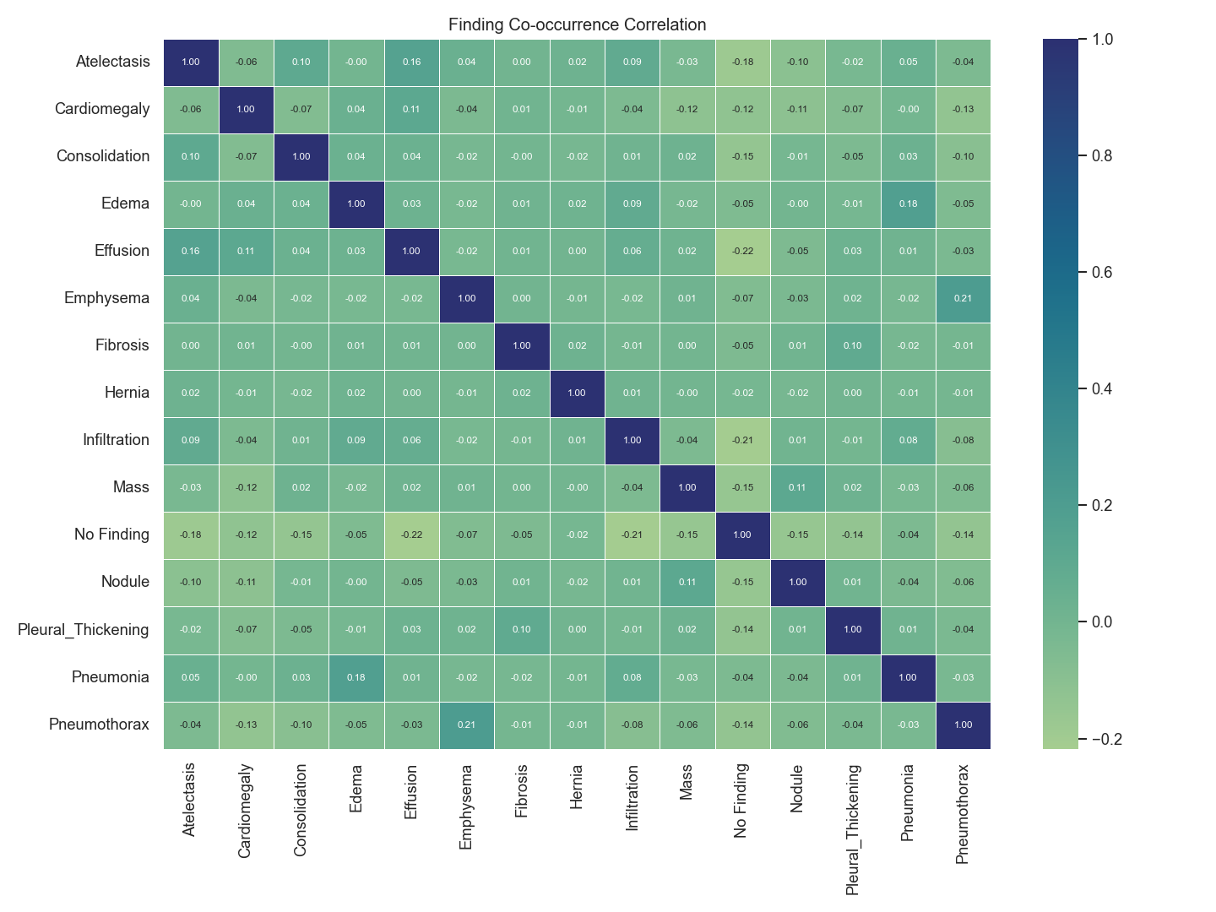
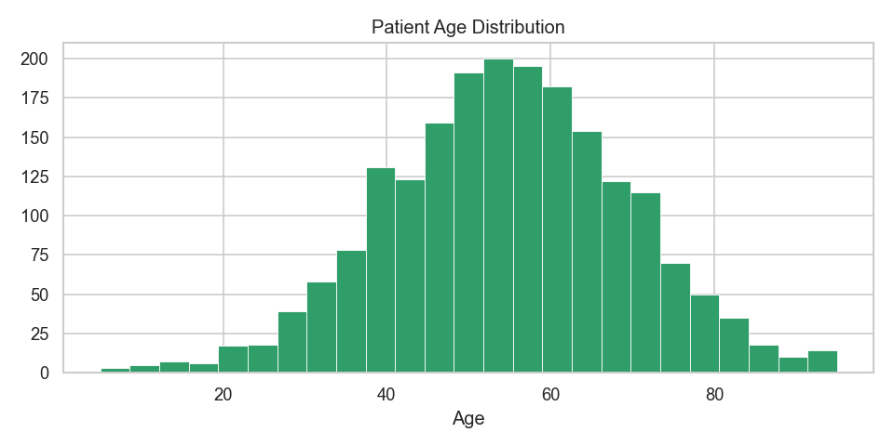
Results: What the System Delivers
SLIDE 06 / 07
~0.93
~91.5%
4
15
Global AUC
Classification Acc.
Virtual Hospitals
Disease Classes
Disease Distribution — NIH ChestX-ray14
Share of Diagnoses (%)
FL Round Progress (Val Accuracy / Loss / AUC)
Finding Co-occurrence Correlation (15 × 15 Heatmap)
Patient Age Distribution (Normal distribution ~50–60 yrs peak)
Notes:
Let me now show you actual results from the system.
[Point to KPI cards] At the top: our global model achieves a mean AUC of approximately 0.93 and classification accuracy of approximately 91.5% across the 15 disease classes. This was achieved using a federated approach across four hospital nodes.
[Point to disease distribution bar chart] This is the actual NIH ChestX-ray14 distribution in our dataset. Infiltration has the highest representation at over 2,000 images, followed by Effusion and Atelectasis. This is real data — no fabrication.
[Point to pie chart] The share of diagnoses confirms the class imbalance: Infiltration at 14.6%, Effusion at 13.2%. This is why we use per-class weighting in our loss function.
[Point to correlation heatmap] This 15×15 correlation heatmap reveals co-occurrence patterns between diseases — for example, Emphysema and Pneumothorax show a notable positive correlation, which is clinically meaningful.
[Point to age distribution] And the patient age distribution shows our dataset spans a real clinical population — peak around 50 to 60 years of age, consistent with typical chest X-ray patient demographics.

Slide 7
Why FedMed AI Matters
SLIDE 07 / 07
🔒
🤖
🗺️
🌐
Privacy-Aware Collaboration
AI-Based Disease Prediction
Explainable AI
Scalable Architecture
Hospitals collaborate in model training without pooling raw images across institutions.
Chest X-rays analyzed for 15 disease classes including Pneumonia, Effusion, Atelectasis.
Grad-CAM highlights the exact anatomical regions that drive each pathology prediction.
The federated approach conceptually supports any number of healthcare institutions.
"FedMed AI transforms distributed medical data into collaborative intelligence."
~0.93
~91.5%
4
15
FedAvg
DenseNet121
Global AUC
Accuracy
Hospitals
Disease Classes
Aggregation
Backbone
Thank You
Questions?
FedMed AI · College Project Competition · MIT License · Research & Educational Use
Notes:
To conclude — why does FedMed AI matter?
[Point to pillar 1] Privacy-Aware Collaboration: we enable multiple hospitals to build a better AI model together, without raw images ever being shared. This directly addresses HIPAA-class data privacy concerns in medical AI.
[Point to pillar 2] AI-Based Disease Prediction: a doctor uploads a chest X-ray and gets multi-label predictions for 15 conditions — Pneumonia, Effusion, Atelectasis, Cardiomegaly, and more.
[Point to pillar 3] Explainable AI: Grad-CAM generates visual evidence of what the model focused on. This builds clinical trust and gives doctors interpretable feedback, not just a black-box label.
[Point to pillar 4] Scalable Architecture: while we demonstrated this with four virtual hospitals, the federated design is inherently scalable to any number of real institutions.
[Point to key takeaway banner] FedMed AI transforms distributed medical data into collaborative intelligence.
Thank you for your time. I'm happy to take any questions about the implementation, the model, or the architecture.

