Slide 1
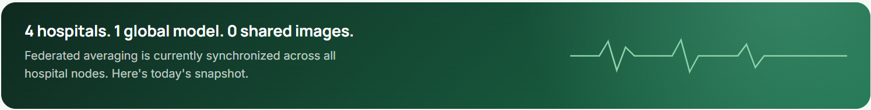
COLLEGE PROJECT COMPETITION
FedMed AI
Federated AI Medical Imaging Network for Disease Detection
CHEST X-RAY
→
AI
→
FEDERATED HOSPITALS
→
GLOBAL MODEL
→
DISEASE PREDICTION
Simran Singh
LIVE FROM THE FEDRAD CONSOLE
Presenter • College Project Competition
Notes:
WHAT TO SAY: Good [morning/afternoon] judges. I'm Simran Singh, and I built FedMed AI — a federated AI system for chest X-ray disease detection. In one line: hospitals train together on a shared AI model without ever moving their patients' raw X-ray images out of their own systems. Four hospital nodes, one global model, zero shared images. Let me walk you through why this matters and how it actually works. WHAT TO POINT AT: The title and the flow row (X-ray → AI → Federated Hospitals → Global Model → Disease Prediction). KEY MESSAGE: FedMed AI lets hospitals collaborate on medical AI without centralizing sensitive patient data.

Slide 2
The Challenge: Medical AI Needs Data.
Healthcare Data Needs Privacy.
Medical AI needs large, diverse datasets to learn robust patterns — but medical imaging data is sensitive and usually stays within the institution that collected it. Centralizing raw images means transferring sensitive patient data, and individual hospitals often have too little data to train strong models alone.
+
+
+
+
CORE QUESTION
Hospital A
Hospital B
Hospital C
Hospital D
“Can hospitals learn together without sharing raw medical images?”
Local chest X-ray
data stays on-site
Local chest X-ray
data stays on-site
Local chest X-ray
data stays on-site
Local chest X-ray
data stays on-site
Centralized raw-image
pooling is challenging
Notes:
WHAT TO SAY: Medical AI models get better with more data, but chest X-ray datasets are sensitive, and usually locked inside the hospital that collected them. If we wanted one strong shared model the traditional way, hospitals would need to pool their raw images into one place — that's a hard ask for any hospital, and any single hospital's own dataset is often too small to train a strong model alone. So the real question we had to answer was: can hospitals learn together, without sharing raw medical images? WHAT TO POINT AT: The four hospital cards, the dashed lines converging on "Centralized raw-image pooling is challenging," and the core question panel. KEY MESSAGE: Centralizing raw medical images isn't a practical starting point — we needed a different approach.

Slide 3
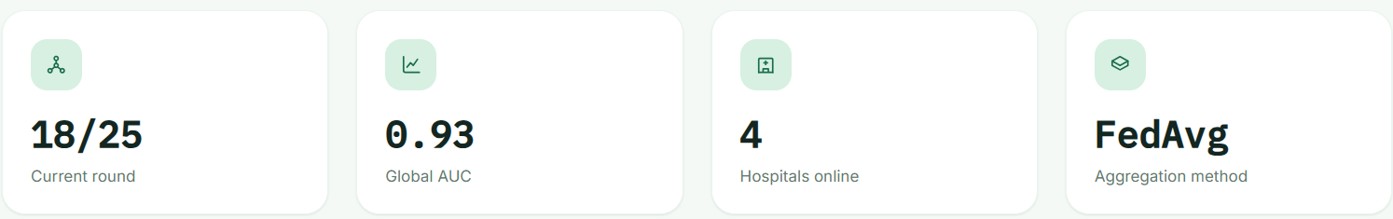
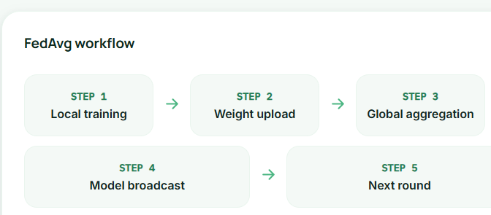
FedMed AI: Collaborative Intelligence Without Centralizing Raw Images
Hospital A — Local Training
LIVE EVIDENCE — FL MONITOR
Hospital B — Local Training
Hospital C — Local Training
Hospital D — Local Training
FedAvg Aggregation
Global Model
Updated global model returns to hospital nodes for the next round.
Raw chest X-ray images stay at the local hospital node — only model updates are exchanged.
“Train locally. Aggregate model updates. Build one shared model.”
Notes:
WHAT TO SAY: That's exactly what federated learning gives us. Instead of moving the data to the model, we move the model to the data. Each hospital — A, B, C, D — trains the same model architecture locally, on its own X-rays. Only the learned model weights are sent to a central aggregator, which combines them using an algorithm called FedAvg, Federated Averaging, into one improved global model. That global model is then sent back to every hospital for the next round. This is live from our actual FL Monitor — you can see round 18 of 25, a global AUC of 0.93, and all four hospitals synced. WHAT TO POINT AT: The FedAvg workflow diagram and the live FL Monitor KPI cards (18/25, 0.93, 4, FedAvg). KEY MESSAGE: Train locally, aggregate model updates, build one shared model — raw images never have to leave the hospital node.

Slide 4
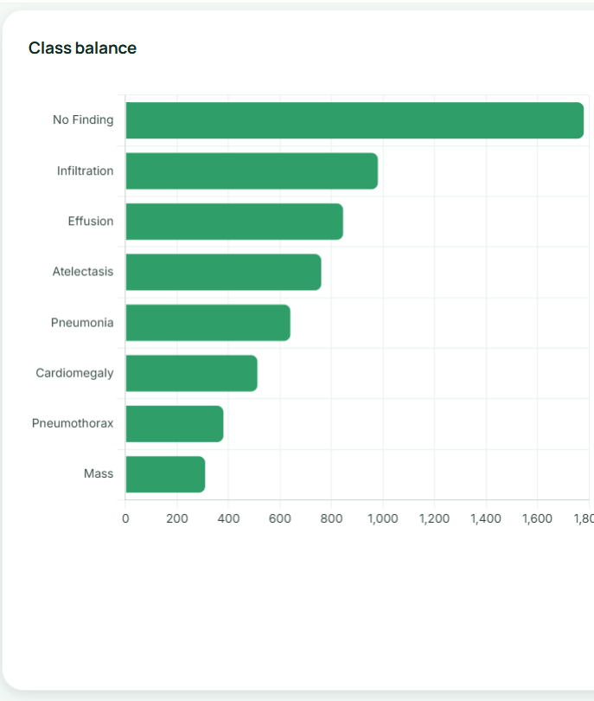
From Chest X-ray to Explainable Prediction
Chest
X-ray
→
Pre-
processing
→
CNN / Transfer
Learning
→
Local Model
Training
→
FedAvg
Aggregation
→
Global
Model
→
Disease
Prediction
→
Grad-CAM
Explainability
Every hospital node trains locally on its own chest X-ray images; only model weights travel to the aggregator.
DATASET USED FOR FEDERATED TRAINING
CLASS BALANCE — 8 FINDINGS
5,606
4,030
806
8
Total images
Training images
Validation images
Disease classes
Notes:
WHAT TO SAY: Here's what happens end to end. A chest X-ray comes in, gets preprocessed, and passed through a CNN built on transfer learning. Each hospital trains this locally; FedAvg aggregates it into the global model, which then makes disease predictions and — importantly — uses Grad-CAM to visually highlight which regions of the X-ray influenced that prediction, so it's not a black box. This entire pipeline is trained on a real dataset: 5,606 total images, 4,030 for training, 806 for validation, across 8 disease classes like Infiltration, Effusion, and Pneumonia. WHAT TO POINT AT: The 8-step pipeline row, then the four dataset KPI cards, then the class balance chart. KEY MESSAGE: This is a complete, explainable pipeline from raw X-ray to a disease prediction — not just a trained model file.

Slide 5
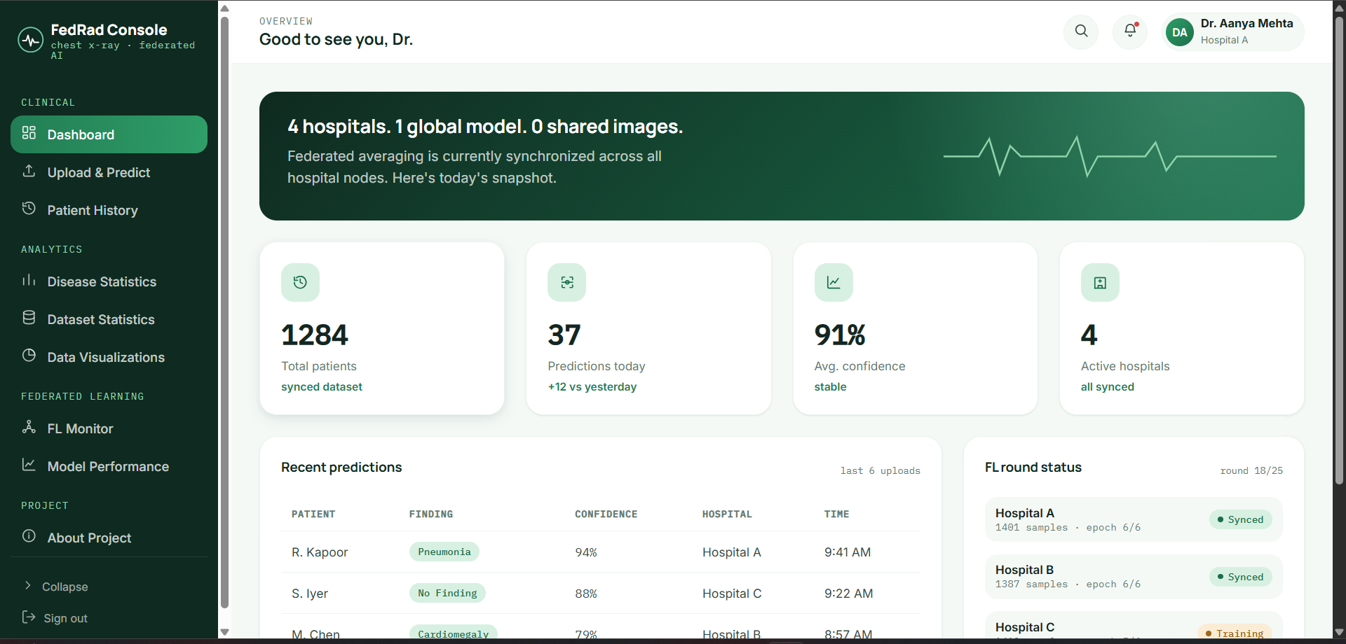
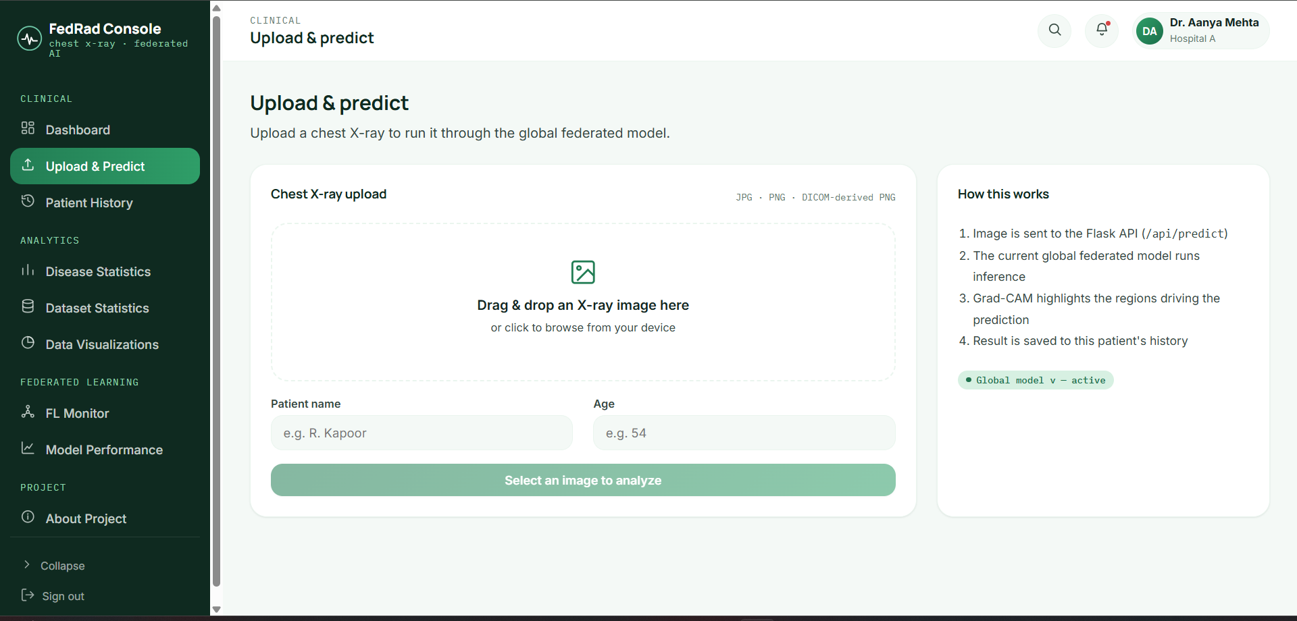
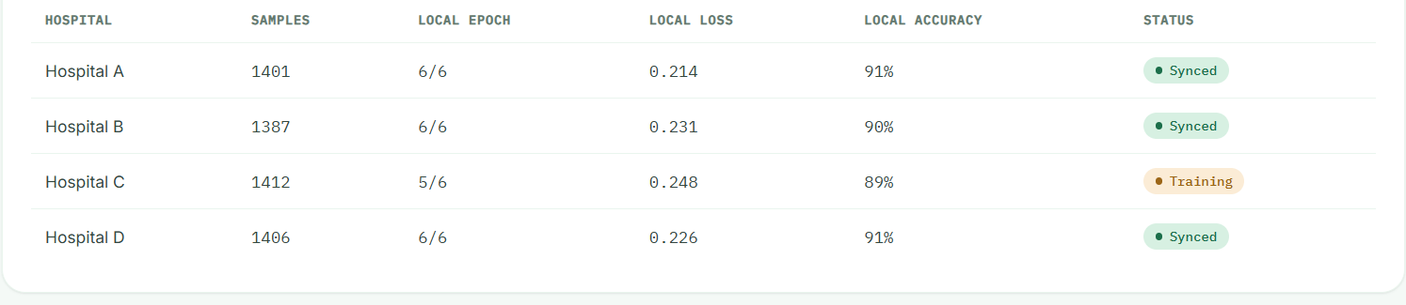
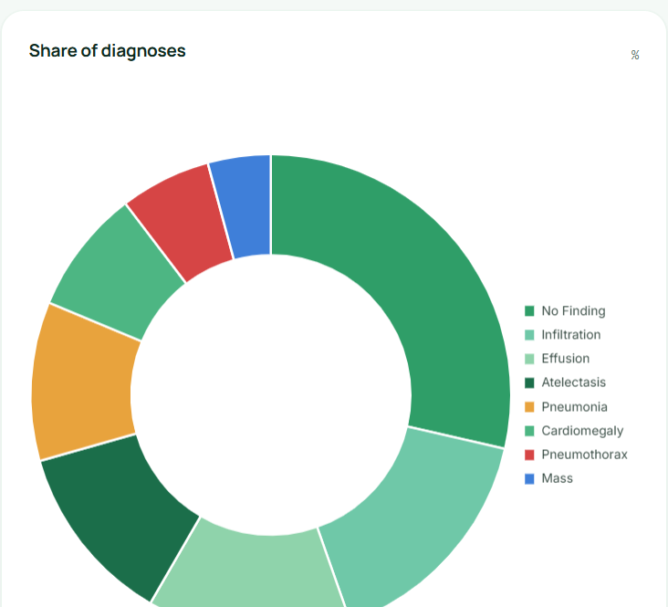
More Than a Model: A Complete AI Workflow
PREDICT
Upload & Predict
Upload a chest X-ray and run inference through the global federated model.
MONITOR
Federated Learning Monitor
Track federated rounds, hospital sync status, and aggregation live.
DASHBOARD — CLINICAL OVERVIEW
ANALYZE
Disease & Model Analytics
Explore disease distributions and model performance in depth.
This is an implemented end-to-end system — not just a machine-learning notebook.
Notes:
WHAT TO SAY: This isn't just a notebook — it's a working product. This is our actual dashboard: total patients, predictions made today, average confidence, and live federated round status. On the right, a doctor can upload an X-ray and get a prediction from the global model, monitor the federated learning process across hospitals in real time, and analyze disease distributions and model performance — all from one interface. WHAT TO POINT AT: The dashboard hero screenshot, then each of the PREDICT, MONITOR, ANALYZE cards. KEY MESSAGE: FedMed AI is an implemented, end-to-end system — prediction, monitoring, and analytics in one product.

Slide 6
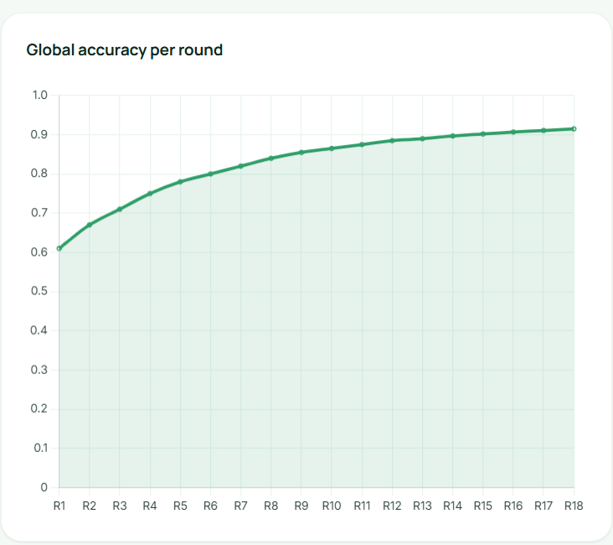
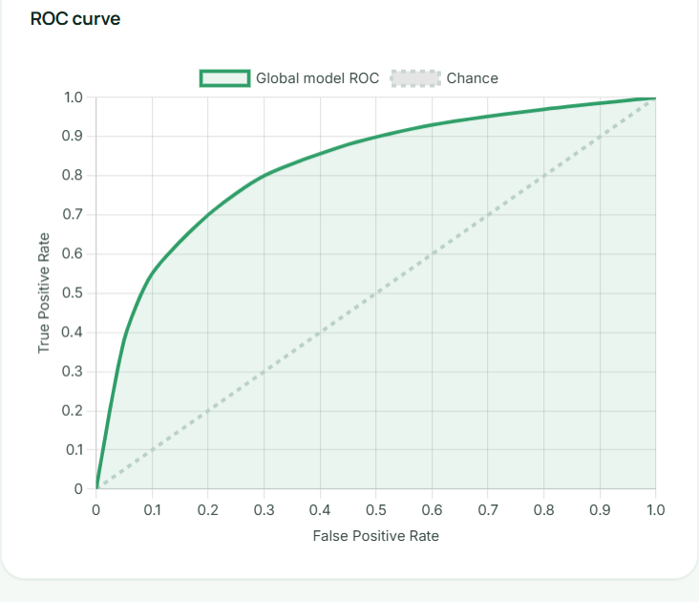
Results: Model Performance & Federated Learning Progress
92%
90%
88%
0.93
ACCURACY
PRECISION
RECALL
AUC
GLOBAL ACCURACY PER FEDERATED ROUND
ROC CURVE — GLOBAL MODEL
The federated model shows improving global performance across communication rounds.
Notes:
WHAT TO SAY: Now for the numbers. After federated training, our global model reaches 92% accuracy, 90% precision, 88% recall, and a 0.93 AUC on evaluation. This chart on the left shows global accuracy climbing steadily across 18 federated rounds — proof that the hospitals are genuinely learning together and improving as a group. On the right, the ROC curve sits well above the diagonal chance line, which tells us the model is meaningfully separating disease from no-disease cases. WHAT TO POINT AT: The four KPI stat cards, then the global accuracy per round chart, then the ROC curve. KEY MESSAGE: The federated model shows strong and steadily improving performance across communication rounds.

Slide 7
Why FedMed AI Matters
01
Collaborative Learning
02
Local Data Processing
Multiple hospital nodes contribute to a shared model.
Raw chest X-ray data can remain within its local node in the federated workflow.
03
Explainable AI
04
Usable AI Platform
Grad-CAM provides visual insight into regions influencing predictions.
Prediction, history, analytics, and federated monitoring are integrated into one interface.
“FedMed AI turns distributed medical data into collaborative intelligence.”
Simran Singh
Thank You
College Project Competition
Notes:
WHAT TO SAY: So why does FedMed AI matter? Four things. One, collaborative learning — multiple hospitals contribute to one shared model instead of working in isolation. Two, local data processing — raw X-rays can stay within their own hospital node in this workflow. Three, explainable AI — Grad-CAM means predictions come with visual reasoning, not just a label. And four, it's a usable platform — prediction, history, analytics, and monitoring, all integrated. FedMed AI turns distributed medical data into collaborative intelligence. Thank you. WHAT TO POINT AT: Each of the four numbered pillars, then the closing statement. KEY MESSAGE: FedMed AI shows that hospitals can build stronger shared medical AI without centralizing sensitive patient data.

